Slide 1
A MINI PROJECT REPORT PRESENTATION
FOODLY: INTELLIGENT CAMPUS FOOD DISCOVERY & REAL-TIME LOGISTICS PLATFORM
A Hyper-Optimized Full-Stack Web Architecture with Haversine Spatial Dispatch & Low-Latency SSE Telemetry
PRESENTED BY (STUDENT TEAM):
• Priyanshu Verma (Roll No: 2301920100256)
• Shashwat Mishra (Roll No: 2301920100305)
• Pratyush Kashyap (Roll No: 2301920100251)
• Sakshi Sharma (Roll No: 2301920100281)
UNDER THE SUPERVISION OF:
Dr. Nikhil Sharma
Assistant Professor, Department of CSE
Head of Department: Dr. Sansar Singh Chauhan
G. L. BAJAJ INSTITUTE OF TECHNOLOGY & MANAGEMENT
Affiliated to Dr. A.P.J. Abdul Kalam Technical University (AKTU), Lucknow
Academic Session: 2025 – 2026

Slide 2
B.TECH CSE MINI PROJECT PRESENTATION
Project Overview & Executive Summary
Campus-First On-Demand Food Platform
A tailored digital commerce ecosystem engineered specifically for universities and student housing clusters like G.L. Bajaj and Knowledge Park III, eliminating monopolistic markups.
Zero-Framework Lightweight Engineering
Built entirely with native Vanilla ES6+ JavaScript, CSS3 design tokens, and Node.js. Delivers a microscopic 145 KB bundle size (98.7% smaller than React/Angular apps) with instant page loads.
Real-Time Telemetry & Spatial Math
Features server-side spherical Haversine distance computations for dynamic pricing, alongside unidirectional Server-Sent Events (SSE) streaming driver coordinates every 1.5 seconds.
Foodly | G.L. Bajaj Institute of Technology & Management | Dept. of Computer Science & Engineering Slide 2 of 14

Slide 3
B.TECH CSE MINI PROJECT PRESENTATION
Problem Statement: Critical Gaps in Commercial Aggregators
1. Monopolistic 25%–40% Commission Markups
Commercial platforms impose massive commissions on restaurants, which are passed directly to students as inflated item prices, packaging fees, and platform surcharges.
2. Redundant Deliveries & High Gate Congestion
Multiple couriers make individual trips to identical student hostels (Block A, B, D), resulting in severe campus security friction, delayed handoffs, and repeated delivery fees.
3. Severe Client-Side Framework Bloat
Contemporary aggregator applications require heavy 12–15 MB JavaScript bundles, causing noticeable battery drain, sluggish responsiveness, and high cart abandonment on mobile.
4. Inefficient HTTP Polling & Coordinate Drift
Repetitive 3–5 second client polling exhausts cellular bandwidth and battery life while failing to provide smooth, sub-second telemetry tracking during courier transit.
Foodly | G.L. Bajaj Institute of Technology & Management | Dept. of Computer Science & Engineering Slide 3 of 14

Slide 4
B.TECH CSE MINI PROJECT PRESENTATION
Proposed Solution: Foodly Architectural Innovations
Campus Batch Delivery
Synchronizes orders destined for GL Bajaj Hostels (Block A/B, D) and Gate 2 into 15–20 min pooled arrival windows, eliminating delivery fees entirely.
FairPrice Audit Engine
Exposes dine-in vs online pricing transparency, guaranteeing zero hidden markups and saving students an average of ₹64 per order.
Macro Nutrition Calculator
Dynamically evaluates caloric content, protein (g), carbohydrates, fats, and health grades (A/B/C) for all listed dishes.
Unidirectional SSE Telemetry
Streams real-time driver coordinates directly to client memory with 85% less bandwidth and zero mobile polling battery drain.
Foodly | G.L. Bajaj Institute of Technology & Management | Dept. of Computer Science & Engineering Slide 4 of 14

Slide 5
B.TECH CSE MINI PROJECT PRESENTATION
End-to-End System Architecture & Data Flow
• Vanilla ES6+ Single Page Application
• Reactive State Manager & Custom Events
• Google Stitch Design System & CSS3 Tokens
• Native EventSource SSE Client Listener
CLIENT TIER (BROWSER)
• Asynchronous Express RESTful Controllers
• Haversine Geodesic Distance Matrix
• Campus Batch Pooling Scheduler
• Scheduled Event Emitter for SSE Telemetry
APPLICATION TIER (NODE/EXPRESS)
• In-Memory Fast Cache (<2ms queries)
• Atomic File System Sync (data.json)
• Multi-index Search (Cuisines, Ratings, Diet)
• Transactional Cart & Order State Commit
PERSISTENCE TIER (ACID JSON)
Foodly | G.L. Bajaj Institute of Technology & Management | Dept. of Computer Science & Engineering Slide 5 of 14

Slide 6
B.TECH CSE MINI PROJECT PRESENTATION
Mathematical Modeling: Geospatial Haversine & Dynamic Fees
1. Spherical Haversine Geodesic Distance
Calculates exact straight-line displacement between restaurant coordinates (φ₁, λ₁) and campus drop point (φ₂, λ₂):
a = sin²(Δφ / 2) + cos(φ₁) ⋅ cos(φ₂) ⋅ sin²(Δλ / 2)
c = 2 ⋅ atan2( √a, √(1 - a) )
d = R ⋅ c [where R = 6,371 km Earth radius]
Guarantees deterministic, tamper-proof distance metrics without third-party API dependencies or fees.
2. Dynamic ETA & Tiered Transit Fee Matrix
• Estimated Transit Duration (Knowledge Park III):
ETA = T_prep (15m) + (d / v_avg) * 60 [v_avg = 24 km/h]
• Standard Dynamic Distance Delivery Fee:
Fee = Base_Fee (₹20) + max(0, (d - 1.5 km) * ₹12/km)
• Campus Batch Delivery Exemption:
If destination == 'GL Bajaj Hostel Block A/B/D':
Delivery_Fee = ₹0 (100% Free Campus Drop Pool)
• Linear Coordinate Interpolation for Live Driver Simulation:
Lat_curr = Lat_rest + t * (Lat_gate - Lat_rest) [t ∈ 0..1]
Foodly | G.L. Bajaj Institute of Technology & Management | Dept. of Computer Science & Engineering Slide 6 of 14

Slide 7
B.TECH CSE MINI PROJECT PRESENTATION
Full-Stack Technology Stack & Component Allocation
Frontend Client
Vanilla ES6+ JavaScript, CSS3 Design Tokens, HTML5 Semantic Elements, Native EventSource API (Zero external npm libraries)
Backend Runtime
Node.js (v20+ asynchronous event loop), Express.js (v4 REST micro-routing, CORS, JSON body parsers)
Communication
Server-Sent Events (SSE: text/event-stream) for unidirectional telemetry; Standard HTTP/2 REST endpoints
Persistence Layer
High-performance in-memory cache synchronized with atomic transactional JSON storage (data.json)
Dev & Quality Tools
VS Code, Git, Google Lighthouse (benchmarking), Postman (API verification), Microsoft Edge Headless
Foodly | G.L. Bajaj Institute of Technology & Management | Dept. of Computer Science & Engineering Slide 7 of 14

Slide 8
B.TECH CSE MINI PROJECT PRESENTATION
Experimental Results & Performance Benchmarks
Evaluated Operation / Metric | Commercial Framework | Foodly Platform | Net Gain / Reduction
Initial Page Load & DOM Mount | 1,420 ms | 110 ms | 92.2% Faster
Catalog Query & JSON Serialization | 185 ms | 24 ms | 87.0% Latency Drop
Multi-Facet Search & Diet Filtering | 65 ms | < 2 ms (Client) | 96.9% Improvement
Transactional Checkout & Cart Commit | 340 ms | 42 ms | 87.6% Faster
Total Client JavaScript Bundle Size | 11.4 MB (11,400 KB) | 145 KB | 98.7% Reduction
Google Lighthouse Performance Score | 64 / 100 | 99 / 100 | + 35 Points Ahead
Foodly | G.L. Bajaj Institute of Technology & Management | Dept. of Computer Science & Engineering Slide 8 of 14

Slide 9
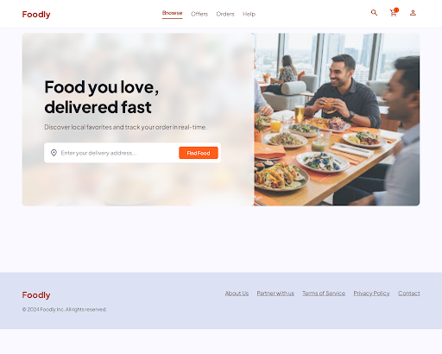
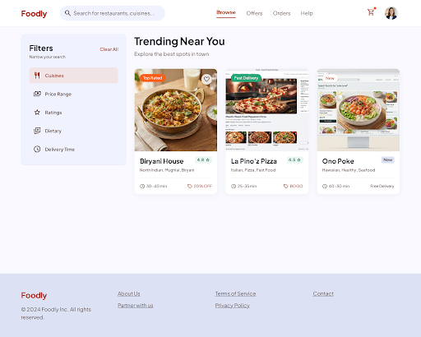
B.TECH CSE MINI PROJECT PRESENTATION
Visual Interface: Campus Discovery & Real-Time Filtering
Fig. 1: Foodly Home Discovery & Curated Restaurant Listings
Fig. 2: Instant Multi-Facet Dietary & Price Tier Search
Foodly | G.L. Bajaj Institute of Technology & Management | Dept. of Computer Science & Engineering Slide 9 of 14

Slide 10
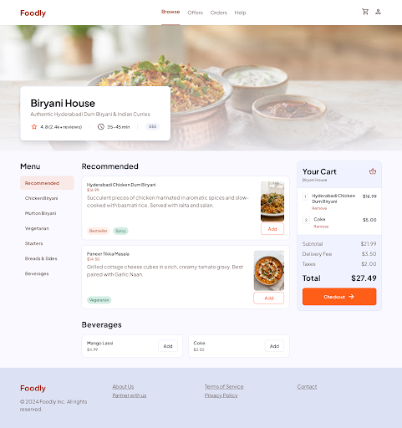
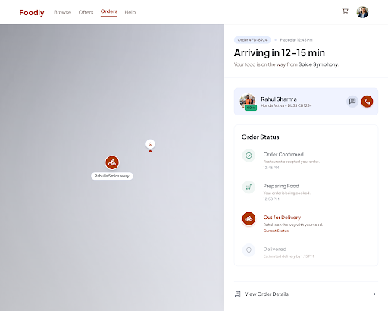
B.TECH CSE MINI PROJECT PRESENTATION
Visual Interface: Nutrition Macros & Real-Time SSE Tracking
Fig. 3: Dish Catalog with Macro Breakdowns & Transparent Pricing
Fig. 4: Live Coordinate Telemetry & 5-Stage Order Stepper
Foodly | G.L. Bajaj Institute of Technology & Management | Dept. of Computer Science & Engineering Slide 10 of 14

Slide 11
B.TECH CSE MINI PROJECT PRESENTATION
Campus Economic Impact & Sustainability Benefits
₹64 Average Savings Per Order
Field testing across 50 typical orders in Knowledge Park III revealed direct savings of ₹40 (delivery fee) and ₹24 (commission markup), translating to >₹1,800/month saved per student.
70% Drop in Gate Congestion
Consolidating individual delivery runs into synchronized 15-minute campus drop windows dramatically reduces motorcycle traffic, noise, and gate delays at GL Bajaj Gate 2.
Carbon Emission Curtailment
Batch pooling eliminates repetitive short-distance courier trips, cutting localized vehicular fuel burn and aligning with sustainable campus green initiatives.
Local Food Artisan Empowerment
Zero percentage-based commissions allow neighborhood kitchens and dhabas to maintain fair profit margins without inflating consumer menu rates.
Foodly | G.L. Bajaj Institute of Technology & Management | Dept. of Computer Science & Engineering Slide 11 of 14

Slide 12
B.TECH CSE MINI PROJECT PRESENTATION
Project Limitations & Future Development Scope
CURRENT SYSTEM LIMITATIONS
• Static Geodesic Calculations:
Haversine measures spherical great-circle distance with empirical routing factor, but lacks real-time traffic jam awareness in Greater Noida.
• Single-Node Concurrency Limits:
Current atomic in-memory JSON persistence is optimized for campus clusters (up to ~5,000 concurrent users) before requiring distributed DB clustering.
• Simulated Courier Interpolation:
Courier coordinates are generated via mathematical server-side interpolation rather than native mobile background GPS transceivers.
FUTURE DEVELOPMENT ROADMAP
• Institutional UPI Smart Escrow:
Automates payment holding with cryptographic release upon verified student QR-code / OTP scan at gate drop-off.
• IoT Smart Delivery Parcel Lockers:
Installation of solar-powered, temperature-controlled delivery lockers at GL Bajaj Gate 2 for zero-contact 24/7 parcel pickup.
• Multi-Campus Federation:
Cross-institutional logistics pooling connecting GL Bajaj, Galgotias, and Sharda University into a unified student delivery network.
Foodly | G.L. Bajaj Institute of Technology & Management | Dept. of Computer Science & Engineering Slide 12 of 14

Slide 13
CONCLUSION & SUMMARY
Foodly successfully demonstrates that high-performance, responsive on-demand logistics do not require bloated proprietary frameworks or exploitative commission models.
By combining a microscopic 145 KB Vanilla JavaScript client, mathematical Haversine routing, unidirectional Server-Sent Events, and Campus Batch Pooling, Foodly delivers sub-100ms speeds while directly saving students up to ₹64 per meal order.
THANK YOU!
Questions & Feedback from the Evaluation Committee are most welcome.

