Slide 1

GLASS IDENTIFICATION
Himanshu Soni – CB.EN.U4ELC19018
Pranjal Shrivastava – CB.EN.U4ELC19037

Slide 2
References
Dataset : https://archive-beta.ics.uci.edu/ml/datasets/Glass%20Identification
Website Links :
https://www.geeksforgeeks.org/introduction-to-support-vector-machines-svm/
https://www.analyticsvidhya.com/blog/2017/09/understaing-support-vector-machine-example-code/
https://towardsdatascience.com/support-vector-machine-introduction-to-machine-learning-algorithms-934a444fca47
https://medium.com/@james_52456/why-kernelized-support-vector-machine-svm-is-mls-most-beautiful-algorithm-183887accdd2
Code Link :
https://drive.google.com/file/d/1ooUdfZoEm00IN5UDSXXP9zVUmN1lzXb9/view?usp=sharing

Slide 3
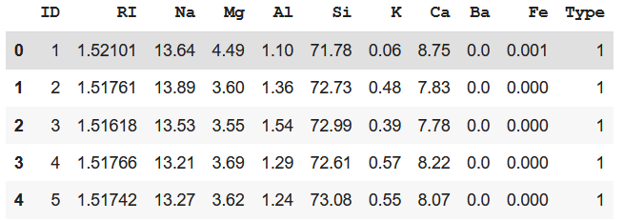
Problem Formulation
Objective: To classify different samples of glasses based on their physical and chemical properties.
Dataset details:
Number of Columns – 11
Number of Rows – 214
Number of Classes - 7
Dataset is published by B.German, Central Research Establishment,Home Office Forensic Science Service, Aldermaston, Reading, Berkshire RG7 4PN
Donor of dataset is Vina Spiehler, Ph.D., DABFT, Diagnostic Products Corporation, (213) 776-0180 (ext 3014)
ID : ID number(ignored)
RI: Refractive Index
Na: Sodium
Mg: Magnesium
Al: Aluminum
Si: Silica
K: Potassium
Ca: Calcium
Ba: Barium
Fe: Iron
Type of glass (Target label)

Slide 4
Feature Description
Dataset contains 214 samples of glasses which can be categorized into different types based on their usage.
In dataset, RI is an index variable(after modification) and has no units.
Na, Mg, Al, Si, K, Ca, Ba and Fe are measured as weight percent in corresponding oxide.
The Target label, Types of Glasses has 7 classes:
Windows Glasses
1: Building_windows_float_processed
2: Building_windows_non_float_processed
3: Vehicle_windows_float_processed
4: Vehicle_windows_non_float_processed
Non – Window Glasses
5: Containers
6: Tableware
7: Headlamps
Assumptions -
Our Dataset does not contain any null value and all data types are correct. Thus, no assumptions are required.

Slide 5
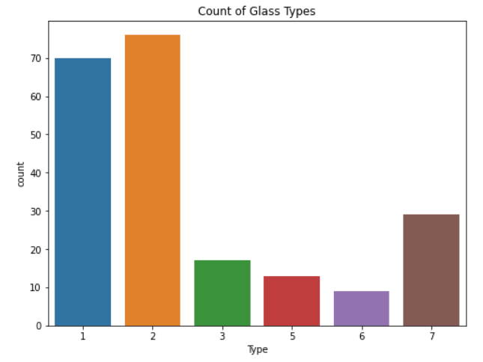
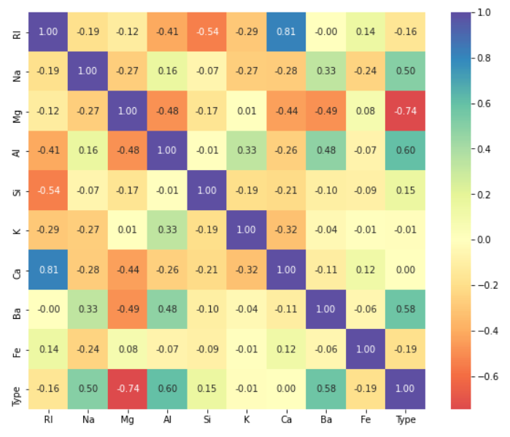
Counts of Types Glasses
Correlation Matrix
Initial Inference -
Type 2 and 1 have the highest occurrences in the dataset. The dataset source is forensic sciences department and the probable reason of the high count of type 1 & 2 is that many criminals break through building window glasses at the scene rather than breaking containers or tableware.
From Correlation Matrix we can see, RI and Ca have a high positive correlation, and Si and RI, have negative I.e., inverse relationship.
After seeing the relationship between RI and Ca, we can see that PCA method should be applied, to reduce the factor of overfitting.

Slide 6
SVM
Kernel | Accuracy Score(%)
Linear Kernel | 55.81
Gaussian Kernel(default Gamma & C) | 62.79
Gaussian Kernel(with user input Gamma & C) | 34.88
LINEAR KERNEL –
Linear Kernel is used when the data is Linearly separable, that is, it can be separated using a single Line.
It is mostly used when there are a Large number of Features in a particular Data Set
Training a SVM with a Linear Kernel is Faster than with any other Kernel.
GAUSSIAN KERNEL –
It is a commonly used kernel. It is used when there is no prior knowledge of a given dataset. Gaussian kernels are universal kernels i.e. their use with appropriate regularization guarantees a globally optimal predictor which minimizes both the estimation and approximation errors of a classifier
Parameters C: Inverse of the strength of regularization.
γ : Gamma (used only for RBF kernel)

Slide 7
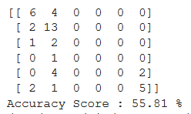
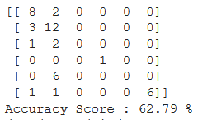
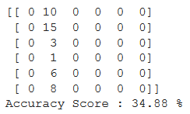
Accuracy Score & Confusion Matrix –
Linear Kernel Output Gaussian Kernel (Default values Gaussian Kernel (Custom values
of C and gamma) of C and gamma)
Some More Remarks –
The SVM classifier works by drawing a straight line between two classes. All the data points that fall on one side of the line will be labeled as one class and all the points that fall on the other side will be labeled as the second.
In RBF kernel, as the value of ‘c’ increases the model gets overfits and vice versa.
In RBF kernel, as the value of ‘ γ’ increases the model gets overfits and vice versa.

