Slide 1

Glass Classification
CB.EN.U4ELC19018 – Himanshu Soni
CB.EN.U4ELC19037 – Pranjal Shrivastava

Slide 2
References
Dataset : https://archive-beta.ics.uci.edu/ml/datasets/Glass%20Identification
Website Links :
https://www.tensorflow.org/api_docs/python/tf?version=nightly
https://keras.io/api/
Code Link :
https://colab.research.google.com/drive/1wEn6G9S_KOIt4BPKSwOjnw-yU1VwtyhV?usp=sharing

Slide 3
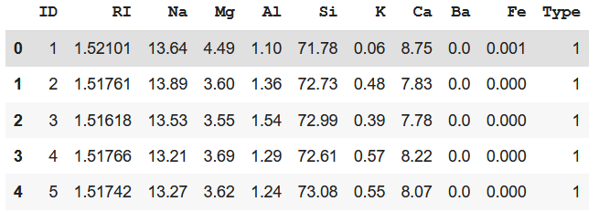
Problem Formulation
Objective: To classify different samples of glasses based on their physical and chemical properties.
Dataset details:
Number of Columns – 11
Number of Rows – 214
Number of Classes - 7
Dataset is published by B.German, Central Research Establishment,Home Office Forensic Science Service, Aldermaston, Reading, Berkshire RG7 4PN
Donor of dataset is Vina Spiehler, Ph.D., DABFT, Diagnostic Products Corporation, (213) 776-0180 (ext 3014)
ID : ID number(ignored)
RI: Refractive Index
Na: Sodium
Mg: Magnesium
Al: Aluminum
Si: Silica
K: Potassium
Ca: Calcium
Ba: Barium
Fe: Iron
Type of glass (Target label)

Slide 4
Feature Description
Dataset contains 214 samples of glasses which can be categorized into different types based on their usage.
In dataset, RI is an index variable(after modification) and has no units.
Na, Mg, Al, Si, K, Ca, Ba and Fe are measured as weight percent in corresponding oxide.
The Target label, Types of Glasses has 7 classes:
Windows Glasses
1: Building_windows_float_processed
2: Building_windows_non_float_processed
3: Vehicle_windows_float_processed
4: Vehicle_windows_non_float_processed
Non – Window Glasses
5: Containers
6: Tableware
7: Headlamps
Assumptions -
Our Dataset does not contain any null value and all data types are correct. Thus, no assumptions are required.

Slide 5
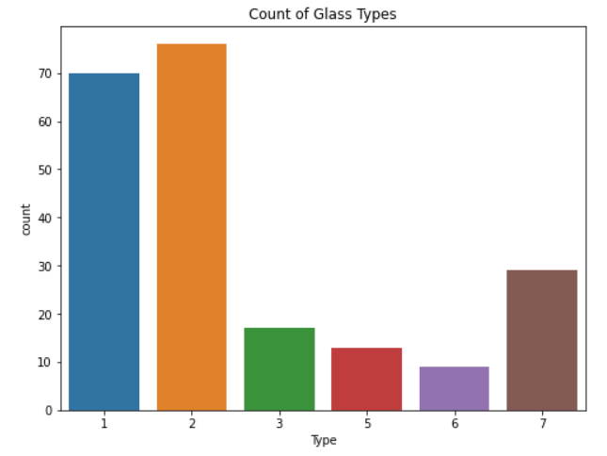
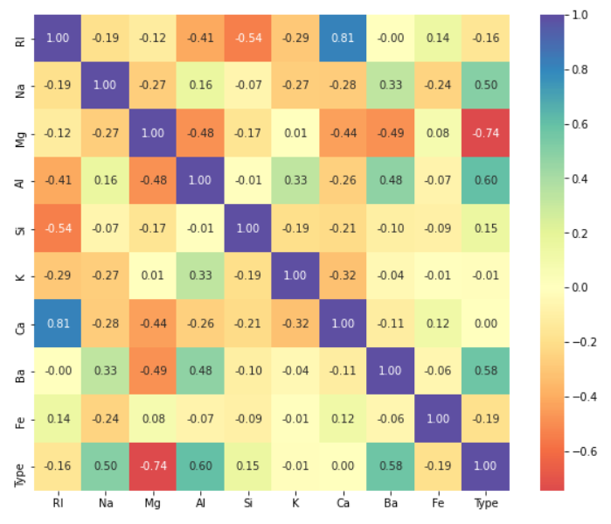
Counts of Types Glasses
Correlation Matrix
Initial Inference -
Type 2 and 1 have the highest occurrences in the dataset. The dataset source is forensic sciences department and the probable reason of the high count of type 1 & 2 is that many criminals break through building window glasses at the scene rather than breaking containers or tableware.
From Correlation Matrix we can see, RI and Ca have a high positive correlation, and Si and RI, have negative I.e., inverse relationship.
After seeing the relationship between RI and Ca, we can see that PCA method should be applied, to reduce the factor of overfitting.

Slide 6
Neural Network
Activation Function | Accuracy Score(%)
Sigmoid Layer | 65.12
Radial Basis Function Layer | 37.21
In the above assignment we have tensorflow library to perform neural networks and one hidden layer.
Activations.Sigmoid –
Sigmoid(x) = 1/(1+ exp(-x))
Sigmoid is equivalent to a 2-element SoftMax, where the second element is assumed to be zero.
The sigmoid function always returns a value between 0 and 1.
Experimental.RandomFourierFeatures –
Radial Basis Kernel is a kernel function that is used in machine learning to find a non-linear classifier or regression line.
Gaussian(x,y) = exp(- square(x-y)/(2*square(sqrt(input_dim/2)))
This layer is used to "kernelize" linear models by applying a non-linear transformation (this layer) to the input features and then training a linear model on top of the transformed features.

Slide 7
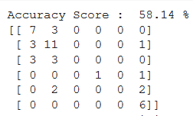
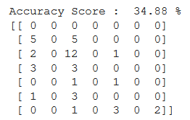
Accuracy Score & Confusion Matrix –
Sigmoid Activation Layer Output
RBF Activation Layer Output
Some More Remarks –
Sigmoid function is monotonic, continuous and differentiable everywhere, coupled with the property that its derivative can be expressed in terms of itself, makes it easy to derive the update equations for learning the weights in a neural network when using back propagation algorithm.

