Slide 1

GLASS IDENTIFICATION
HIMANSHU SONI – CB.EN.U4ELC19018
PRANJAL SHRIVASTAVA – CB.EN.U4ELC19037

Slide 2
References
Dataset : https://archive-beta.ics.uci.edu/ml/datasets/Glass%20Identification
Video Links :
https://www.youtube.com/watch?v=83x5X66uWK0
https://www.youtube.com/watch?v=o0NNUeWNnL4
https://www.youtube.com/watch?v=_ZkFfrCfIws
https://www.youtube.com/watch?v=Lsue2gEM9D0
https://www.youtube.com/watch?v=HVXime0nQeI
https://www.youtube.com/watch?v=6kZ-OPLNcgE
https://www.youtube.com/watch?v=vvTMFFZs6Dk
https://www.youtube.com/watch?v=n7npKX5zIWI
https://www.youtube.com/watch?v=OFyyWcw2cyM
https://www.youtube.com/watch?v=QdBy02ExhGI

Slide 3
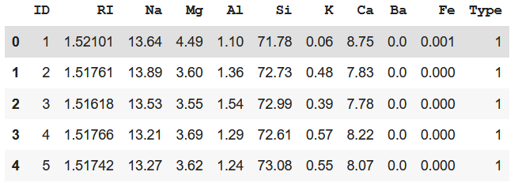
Problem Formulation
Objective: To classify different samples of glasses based on their physical and chemical properties.
Dataset details:
Number of Columns – 11
Number of Rows – 214
Number of Classes - 7
Dataset is published by B.German, Central Research Establishment,Home Office Forensic Science Service, Aldermaston, Reading, Berkshire RG7 4PN
Donor of dataset is Vina Spiehler, Ph.D., DABFT, Diagnostic Products Corporation, (213) 776-0180 (ext 3014)
ID : ID number(ignored)
RI: Refractive Index
Na: Sodium
Mg: Magnesium
Al: Aluminum
Si: Silica
K: Potassium
Ca: Calcium
Ba: Barium
Fe: Iron
Type of glass (Target label)

Slide 4
Feature Description
Dataset contains 214 samples of glasses which can be categorized into different types based on their usage.
In dataset, RI is an index variable(after modification) and has no units.
Na, Mg, Al, Si, K, Ca, Ba and Fe are measured as weight percent in corresponding oxide.
The Target label, Types of Glasses has 7 classes:
Windows Glasses
1: Building_windows_float_processed
2: Building_windows_non_float_processed
3: Vehicle_windows_float_processed
4: Vehicle_windows_non_float_processed
Non – Window Glasses
5: Containers
6: Tableware
7: Headlamps
Assumptions -
Our Dataset does not contain any null value and all data types are correct. Thus, no assumptions are required.

Slide 5
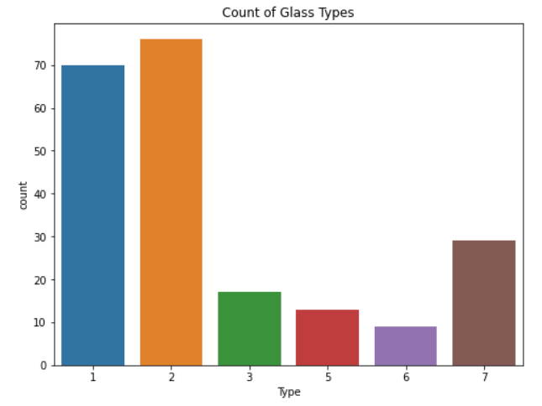
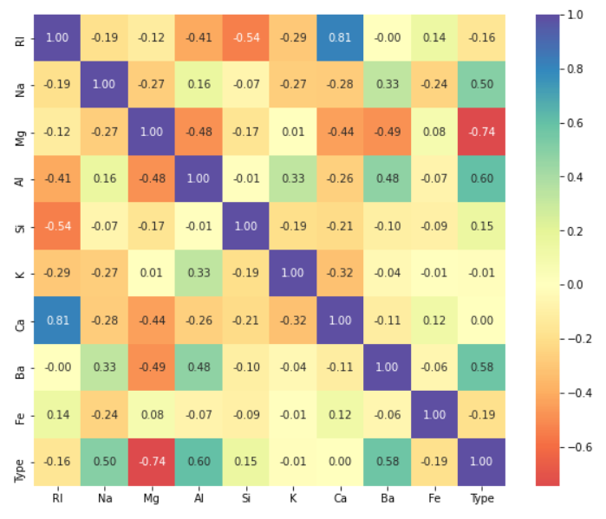
Counts of Types Glasses
Correlation Matrix
Initial Inference -
Type 2 and 1 have the highest occurrences in the dataset. The dataset source is forensic sciences department and the probable reason of the high count of type 1 & 2 is that many criminals break through building window glasses at the scene rather than breaking containers or tableware.
From Correlation Matrix we can see, RI and Ca have a high positive correlation, and Si and RI, have negative I.e., inverse relationship.
After seeing the relationship between RI and Ca, we can see that PCA method should be applied, to reduce the factor of overfitting.

Slide 6
KNN Classifier
#Authors: Himanshu Soni(ELC19018) & Pranjal Shrivastava(ELC19037)
#Objective: To classify different samples of glasses
#Input: Inside the program
#Output: To display the Accuracy Score vs K value
X = df[['RI', 'Na', 'Mg', 'Al', 'Si', 'K', 'Ca', 'Ba', 'Fe']].values
Y = df[['Type']].values
X_train, X_test, y_train, y_test = train_test_split(X,Y,test_size=0.2)
print ('Train set:', X_train.shape, y_train.shape)
print ('Test set:', X_test.shape, y_test.shape)
k_value = 26
acc_score = []
for i in range(1,k_value):
neighbour = KNeighborsClassifier(n_neighbors = i)
neighbour.fit(X_train,y_train)
y_hat = neighbour.predict(X_test)
acc_score.append(metrics.accuracy_score(y_test,y_hat)*100)
fig = px.line(x=range(1,k_value),y=acc_score,labels={'x':'K Values','y':'Accuracy Score(%)'})
fig.show()
knn = KNeighborsClassifier(n_neighbors=4,metric='minkowski')
knn.fit(X_train,y_train)
y_hat_pred = knn.predict(X_test)

Slide 7
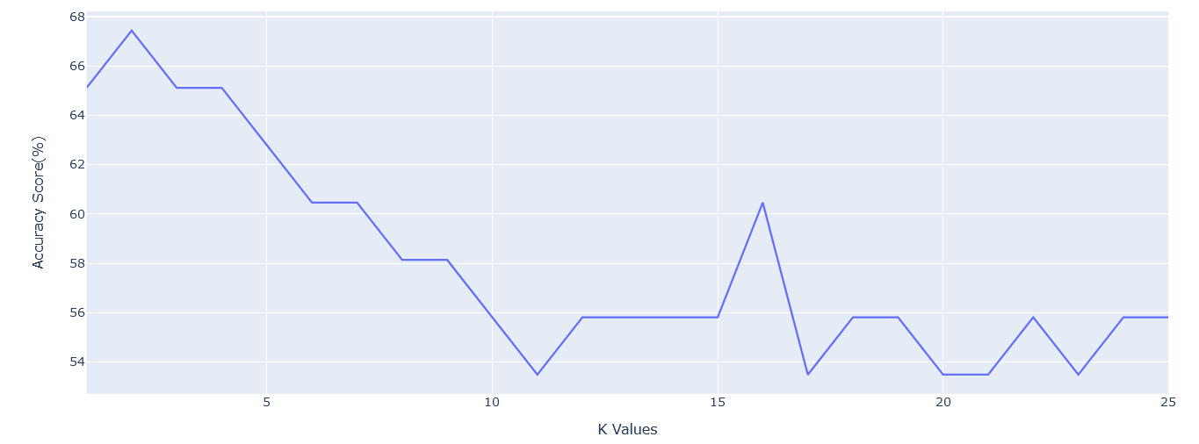
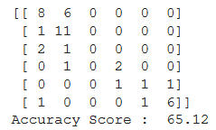
print(confusion_matrix(y_test,y_hat_pred))
print("Accuracy Score : ",metrics.accuracy_score(y_test,y_hat_pred)*100)

Slide 8
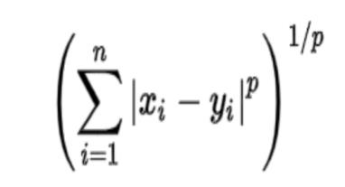
Inference
KNN stands for “K-Nearest Neighbour”. It is a supervised machine learning algorithm. The algorithm can be used to solve both classification and regression problem statements, but mostly it is used for the Classification problems.
For the given data maximum accuracy using K-Nearest Neighbours method was found to be 65.12%
Minkowski Distance uses both Manhattan and Euclidean distance in a generalized form for calculation.
For various values of 'K' the accuracy rates changes and through plotting all values of K, the best case has been found.
The accuracy rates for other K values can be inferred from graph.
The corresponding confusion matrix has been printed, which is summarizing the performance of a classification algorithm.

Slide 9


Normalization & Standardization
Feature scaling is one of the most important data preprocessing step in machine learning. Algorithms that compute the distance between the features are biased towards numerically larger values if the data is not scaled.
Normalization is used to transform features to be on a similar scale.
Standardization is the transformation of features by subtracting from mean and dividing by standard deviation.

Slide 10
Normalization
#Authors: Himanshu Soni(ELC19018) & Pranjal Shrivastava(ELC19037)
#Objective: To classify different samples of glasses
#Input: Inside the program
#Output: To display the Accuracy Score vs K value
X = preprocessing.MinMaxScaler().fit(X).transform(X.astype(float))
print(X[0:5])
print(Y[0:5])
X_train, X_test, y_train, y_test = train_test_split(X,Y,test_size=0.2)
print ('Train set:', X_train.shape, y_train.shape)
print ('Test set:', X_test.shape, y_test.shape)
k_value = 26
acc_score = []
for i in range(1,k_value):
neighbour = KNeighborsClassifier(n_neighbors = i)
neighbour.fit(X_train,y_train)
y_hat = neighbour.predict(X_test)
acc_score.append(metrics.accuracy_score(y_test,y_hat)*100)
fig = px.line(x=range(1,k_value),y=acc_score,labels={'x':'K Values','y':'Accuracy Score(%)'})
fig.show()
knn = KNeighborsClassifier(n_neighbors=5,metric='minkowski')
knn.fit(X_train,y_train)
y_hat_pred = knn.predict(X_test)
print(confusion_matrix(y_test,y_hat_pred))
print("Accuracy Score : ",np.round(metrics.accuracy_score(y_test,y_hat_pred)*100,2))

Slide 11
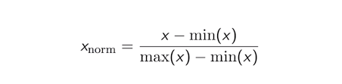
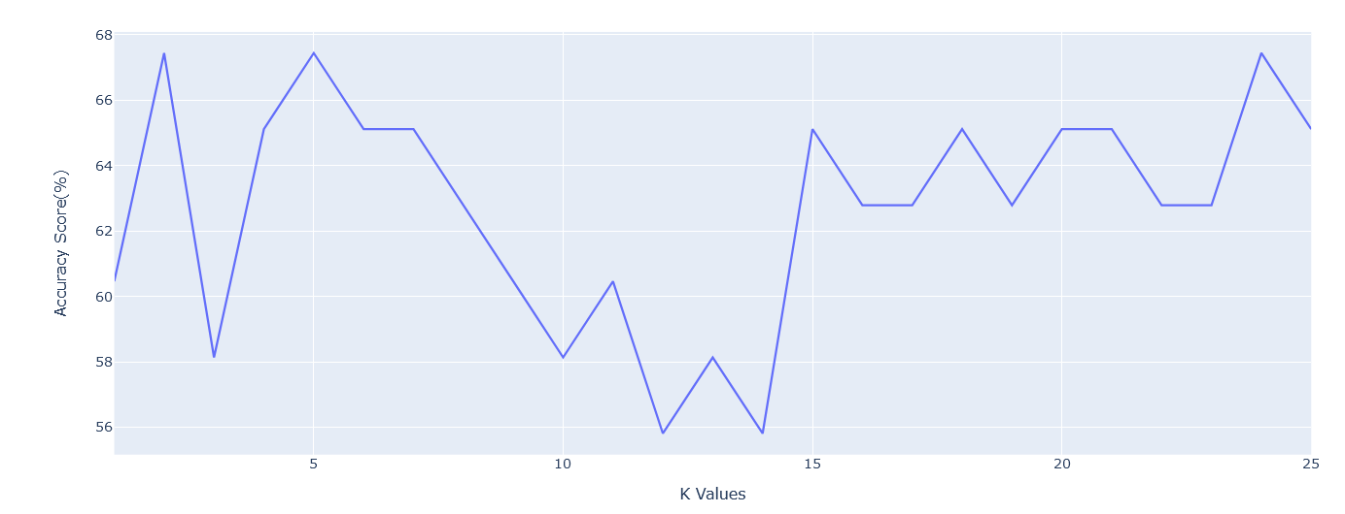
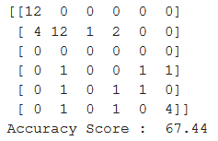
Inference
Normalization is a scaling technique in which all values in dataset is computed and rescaled between 0 and 1 or from -1 to 1. It is also known as Min-Max scaling.
For the given dataset accuracy rate using Normalization method was found to be 67.44%.
The sensitivity/specificity of confusion matrix has been improved compared to KNN without normalization. Hence, resulting an increase in accuracy rate

Slide 12
Standardization
#Authors: Himanshu Soni(ELC19018) & Pranjal Shrivastava(ELC19037)
#Objective: To classify different samples of glasses
#Input: Inside the program
#Output: To display the Accuracy Score vs K value
X = preprocessing.MinMaxScaler().fit(X).transform(X.astype(float))
print(X[0:5])
print(Y[0:5])
X_train, X_test, y_train, y_test = train_test_split(X,Y,test_size=0.2)
print ('Train set:', X_train.shape, y_train.shape)
print ('Test set:', X_test.shape, y_test.shape)
k_value = 26
acc_score = []
for i in range(1,k_value):
neighbour = KNeighborsClassifier(n_neighbors = i)
neighbour.fit(X_train,y_train)
y_hat = neighbour.predict(X_test)
acc_score.append(metrics.accuracy_score(y_test,y_hat)*100)
fig = px.line(x=range(1,k_value),y=acc_score,labels={'x':'K Values','y':'Accuracy Score(%)'})
fig.show()
knn = KNeighborsClassifier(n_neighbors=5,metric='minkowski')
knn.fit(X_train,y_train)
y_hat_pred = knn.predict(X_test)
print(confusion_matrix(y_test,y_hat_pred))
print("Accuracy Score : ",np.round(metrics.accuracy_score(y_test,y_hat_pred)*100,2))

Slide 13

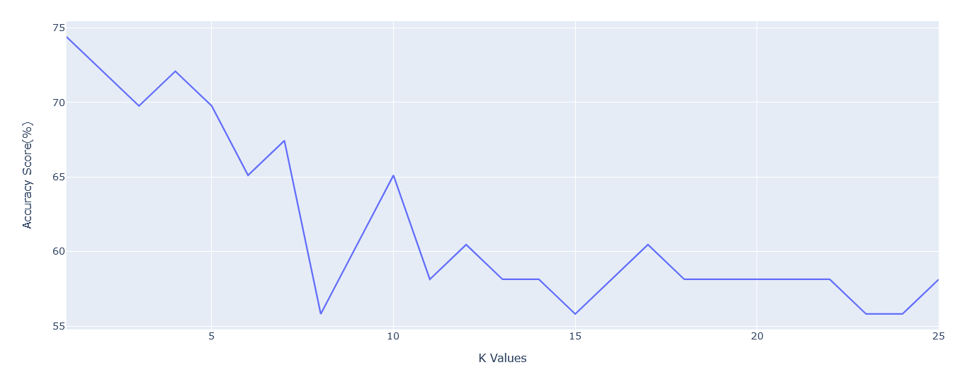
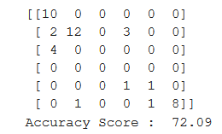
Inference
Standardization is a scaling technique where the values are centered around the mean with a unit standard deviation.
For the given dataset accuracy rate using Standardization method was found to be 72.09%.
The sensitivity/specificity of confusion matrix has been improved compared to KNN with normalization. Hence, resulting is an increase in accuracy rate.
It is also used when we want to ensure zero mean and unit standard deviation.

Slide 14
PCA Application
#Authors: Himanshu Soni(ELC19018) & Pranjal Shrivastava(ELC19037)
#Objective: To classify different samples of glasses
#Input: Inside the program
#Output: To display the Accuracy Score vs K value
X_var = df[['RI','Na','Mg','Al','Si','K','Ca','Ba','Fe']]
pca = PCA(random_state = 2)
pca.fit(X_var)
var_exp = pca.explained_variance_ratio_
cum_var_exp = np.cumsum(var_exp)
var_df = pd.DataFrame(pca.explained_variance_.round(2), index=["P" + str(i) for i in range(1,10)],
columns=["Explained_Variance"])
plt.figure(figsize=(10,10))
plt.bar(range(1,len(cum_var_exp)+1), var_exp, align= 'center', label= 'individual variance', color='teal', alpha = 0.8)
plt.step(range(1,len(cum_var_exp)+1), cum_var_exp, where = 'mid' , label= 'cumulative variance', color='red')
plt.ylabel('Explained variance ratio')
plt.xlabel('Principal components')
plt.xticks(np.arange(1,len(var_exp)+1,1))
plt.legend(loc='center right')
plt.show()

Slide 15
df_scaled = StandardScaler().fit(df).transform(df)
pca = PCA(n_components=4)
pca.fit(X)
X_pca = pca.transform(X)
print(X.shape)
print(X_pca.shape)
X_train, X_test, y_train, y_test = train_test_split(X_pca,Y,test_size=0.2)
print ('Train set:', X_train.shape, y_train.shape)
print ('Test set:', X_test.shape, y_test.shape)
k_value = 26
acc_score = []
for i in range(1,k_value):
neighbour = KNeighborsClassifier(n_neighbors = i)
neighbour.fit(X_train,y_train)
y_hat = neighbour.predict(X_test)
acc_score.append(metrics.accuracy_score(y_test,y_hat)*100)
fig = px.line(x=range(1,k_value),y=acc_score,labels={'x':'K Values','y':'Accuracy Score(%)'})
fig.show()
knn = KNeighborsClassifier(n_neighbors=16,metric='minkowski')
knn.fit(X_train,y_train)
y_hat_pred = knn.predict(X_test)
print(confusion_matrix(y_test,y_hat_pred))
print("Accuracy Score : ",np.round(metrics.accuracy_score(y_test,y_hat_pred)*100,2))

Slide 16
dataset = pd.read_csv('glass_identification.csv')
dataset.head()
from sklearn.preprocessing import StandardScaler
scaler=StandardScaler()
scaler.fit(dataset)
scaled_data=scaler.transform(dataset)
from sklearn.decomposition import PCA
pca=PCA(n_components=4)
pca.fit(scaled_data)
x_pca=pca.transform(scaled_data)
dataset.drop(['ID'],axis = 1,inplace = True)
x_std = StandardScaler().fit_transform(dataset)
mean_vec = np.mean(x_std, axis = 0)
cov_mat = (x_std - mean_vec).T.dot((x_std - mean_vec))/(x_std.shape[0]-1)
cov_1 = pd.DataFrame(np.round(cov_mat,2))
print('Covariance Matrix \n', cov_1)
cov_mat = np.cov(x_std.T)
eig_vals, eig_vecs = np.linalg.eig(cov_mat)
#print('Eigen Vectors \n',eig_vecs)
print('Eigen Values \n',np.round(eig_vals,3))
sup = 0
for i in range(0,10):
for j in range(0,10):
if i>j:
sup = sup + cov_mat[i][j]
print('Sum of Upper Triangle of Co-Variance Matrix :\n',np.round(sup,2))

Slide 17
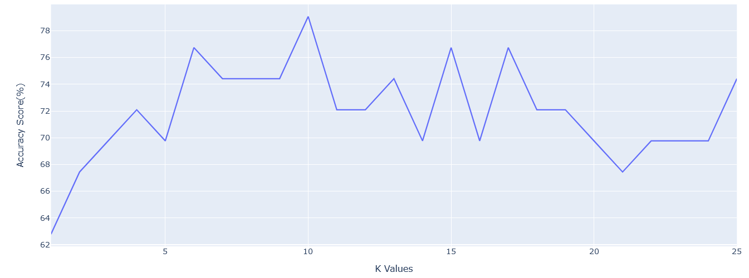
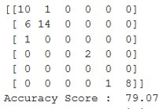
x_pca = StandardScaler().fit_transform(x_pca)
mean_vec = np.mean(x_pca, axis = 0)
cov_mat = (x_pca - mean_vec).T.dot((x_pca - mean_vec))/(x_pca.shape[0]-1)
cov_1 = pd.DataFrame(cov_mat)
print('Covariance Matrix \n', cov_1)
cov_mat = np.cov(x_pca.T)
eig_vals, eig_vecs = np.linalg.eig(cov_mat)
#print('Eigen Vectors \n',eig_vecs)
print('Eigen Values \n',eig_vals)
sup = 0
for i in range(0,2):
for j in range(0,2):
if i>j:
sup = sup + cov_mat[i][j]
print('Sum of Upper Triangle of Co-Variance Matrix :\n',sup)

Slide 18
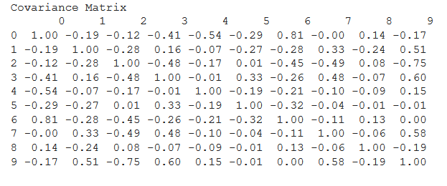
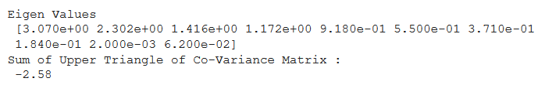
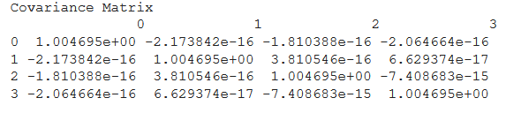

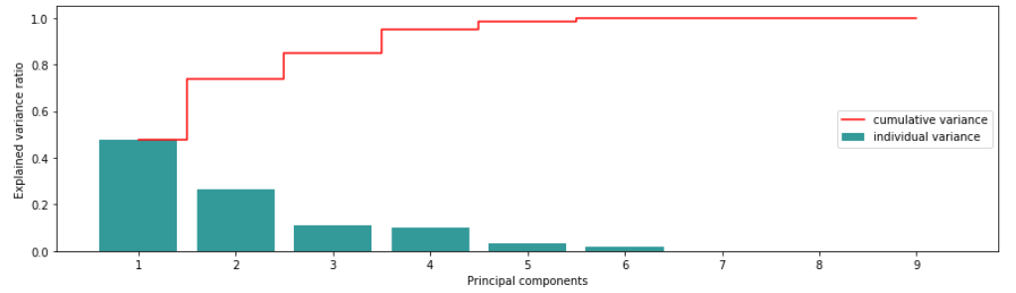
Before PCA -
After PCA -
5 Components takes about 99% of Explained Variance Ratio

Slide 19
Inference
PCA stands for Principal Component Analysis is a statistical algorithm that is used for the dimensionality reduction in machine learning.
It is a statistical process that converts the observations of correlated features into a set of linearly uncorrelated features by computing the relation between one feature and another .
Eigen values and eigen vectors are used which helps in transforming the dataset into a set of only most important dimensions.
Eigen value represents magnitude and variance of data.
Eigen vector represents the direction of data.
The eigen value with least percent of variance was found and the corresponding eigen vector was removed.
Before applying PCA, the sum of upper triangular matrix was found to be –2.58 and after PCA, it is found as –2.17e-16 (In output part of 'After PCA', rounded up sum value is coming out to be 0.00, Hence we did not round the whole long value)
For the given dataset, the accuracy score obtained after PCA+ Standardization is 79.07%.
We can see from the graph between, Explained Variance Ratio and Principal Components that Components 1,2,3,4 take up to maximum part of variance, thus 4 Components are good to predict the type of glass.

Slide 20
Final Inference
 | KNN | KNN+Normalization | KNN+Standardization | KNN+Standardization+PCA
Optimal K Value | 4 | 5 | 5 | 16
Maximum Accuracy Score | 65.12 | 67.44 | 72.09 | 79.07
The best accuracy obtained can be inferred from the above table.
Various concepts, libraries associated with KNN,PCA, Metrics has been learnt and understood.
We can see that overall model identifies most of the glass types correctly – for example type 1,2, 5 and 7 has been identified and classified successfully.
The intention of using Principal Component Analysis was mainly to learn the technique and performing PCA makes sense when we generally have big data problems for dimensionality reduction.

