Slide 1
Python
Python is interpreted
Python is clear, expressive and readable
It allows reusability and also includes sharable code
Comprises of BIFs which makes programming easier
Handles complex data
Exception handling

Slide 2
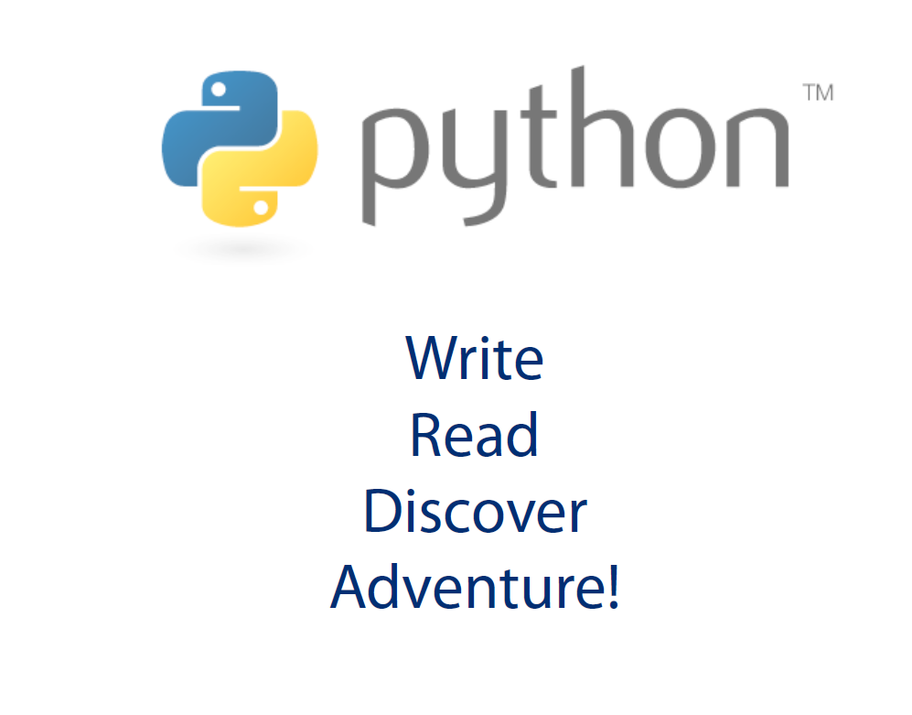

Slide 3
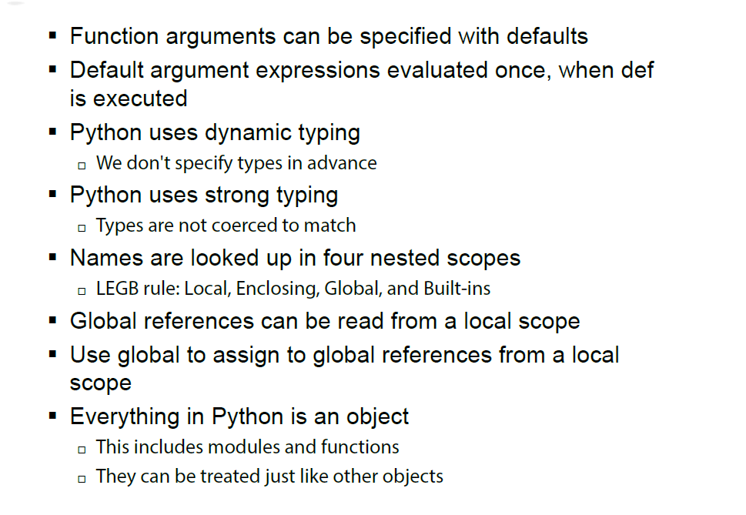

Slide 4
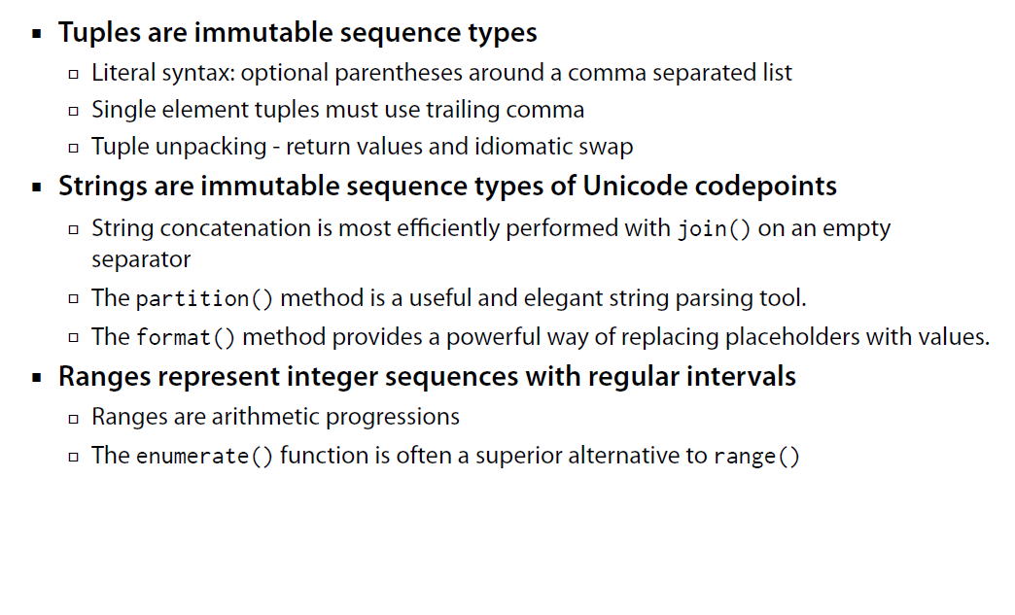

Slide 5
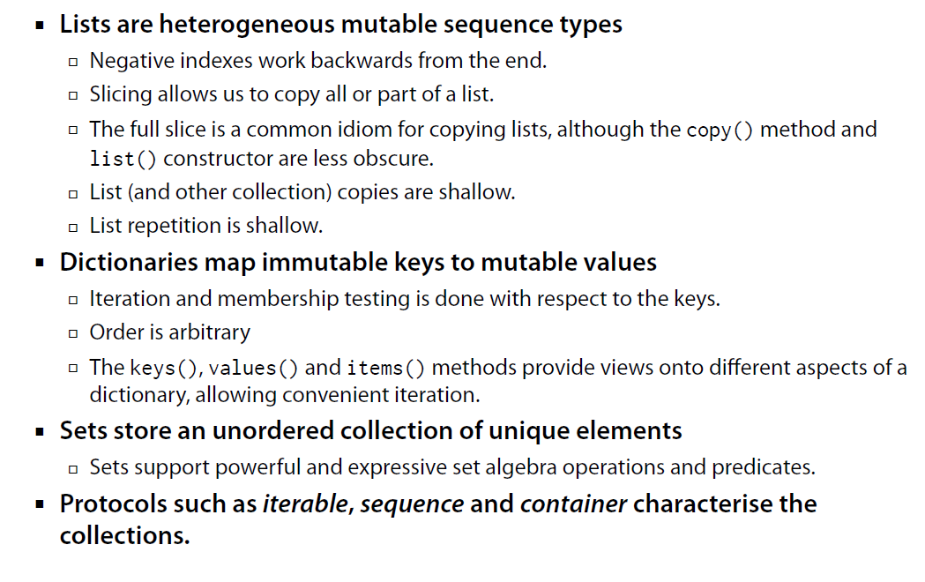

Slide 6
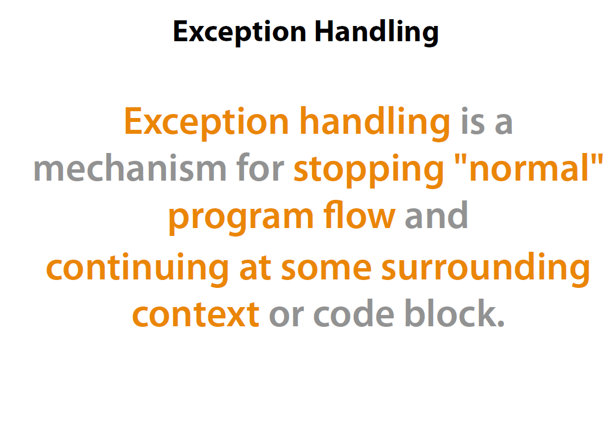

Slide 7
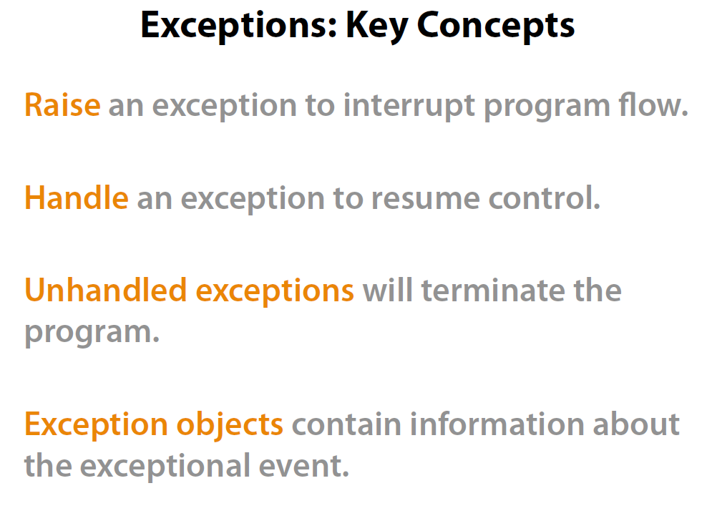

Slide 8
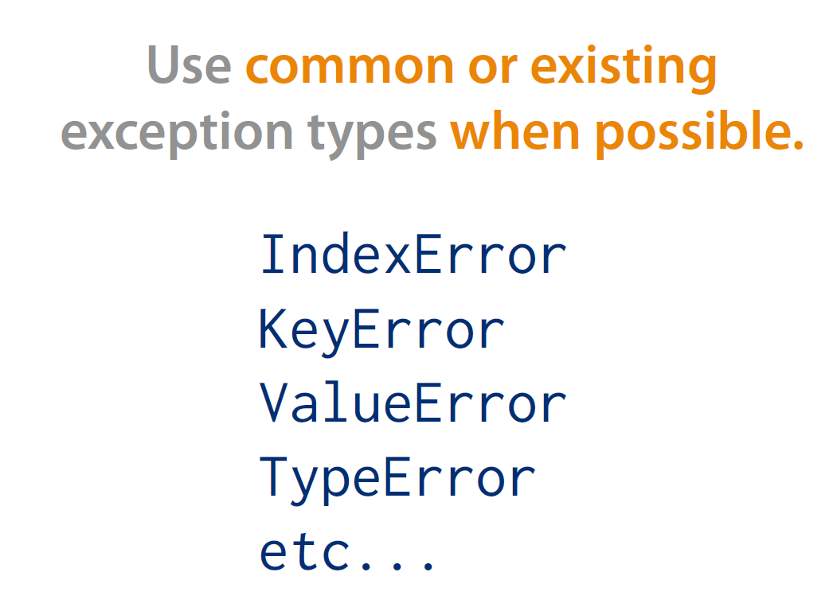

Slide 9
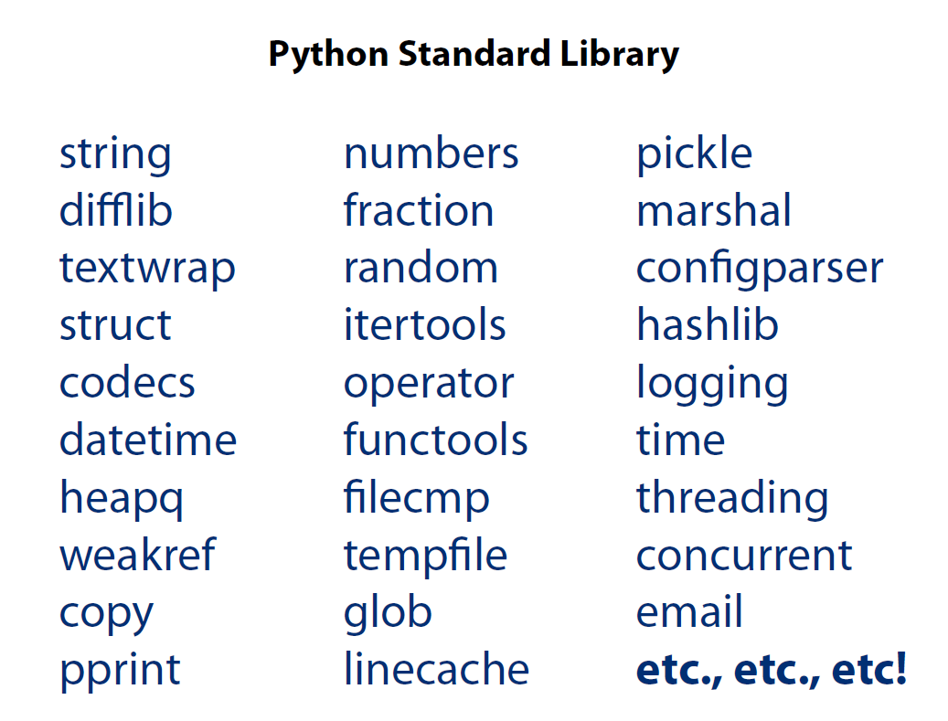

Slide 10
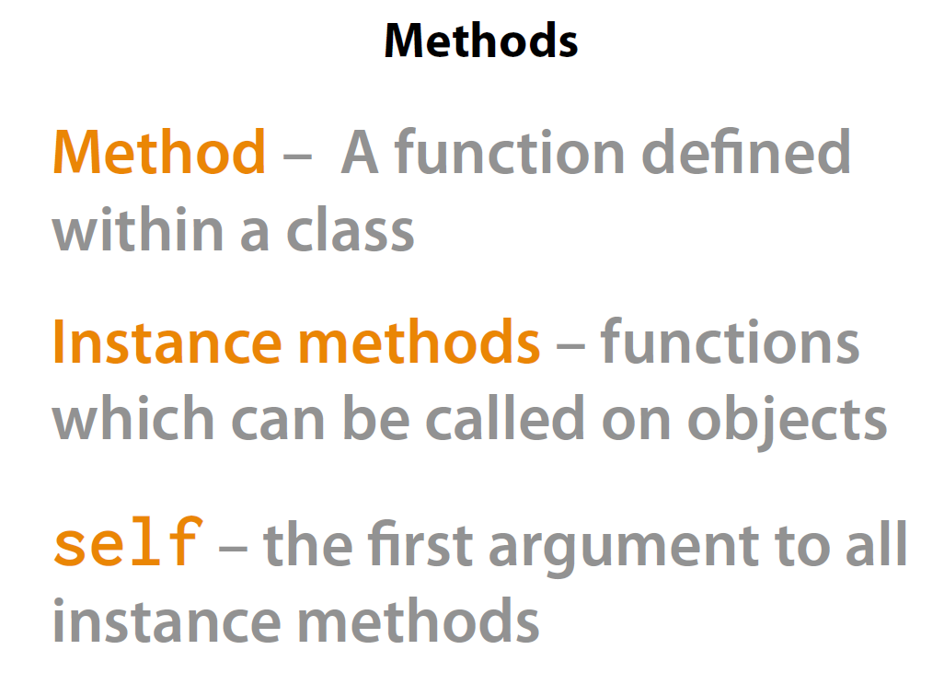

Slide 11


Slide 12
