Slide 1








HTML + CSS
STATIC
MODEL
Response Object from Backend
/ URL
Two-way
DATA BINDING
DYNAMIC
CONTROLLER
BROWSER
DEVELOPMENT APPROACH
Request to Backend
(SPRINGBOOT)
Communicates request
DAO
DATA ACCESS OBJECT
JAVA SERVICE LOGIC
Associated Service Logic
JAVA CONTROLLER
Calls Function
Response
Response
Response
DATABASE
DTO
Mapping of Data Set

Slide 2
HTML + CSS
STATIC
Response Object from Backend
/ URL
Two-way
DATA BINDING
MODEL
DYNAMIC
CONTROLLER
BROWSER
Request to Backend
(SPRINGBOOT)
Communicates request
DAO
DATA ACCESS OBJECT
JAVA SERVICE LOGIC
Associated Service Logic
JAVA CONTROLLER
Calls Function
Response
Response
Response
DATABASE
DTO
Mapping of Data Set

Slide 3

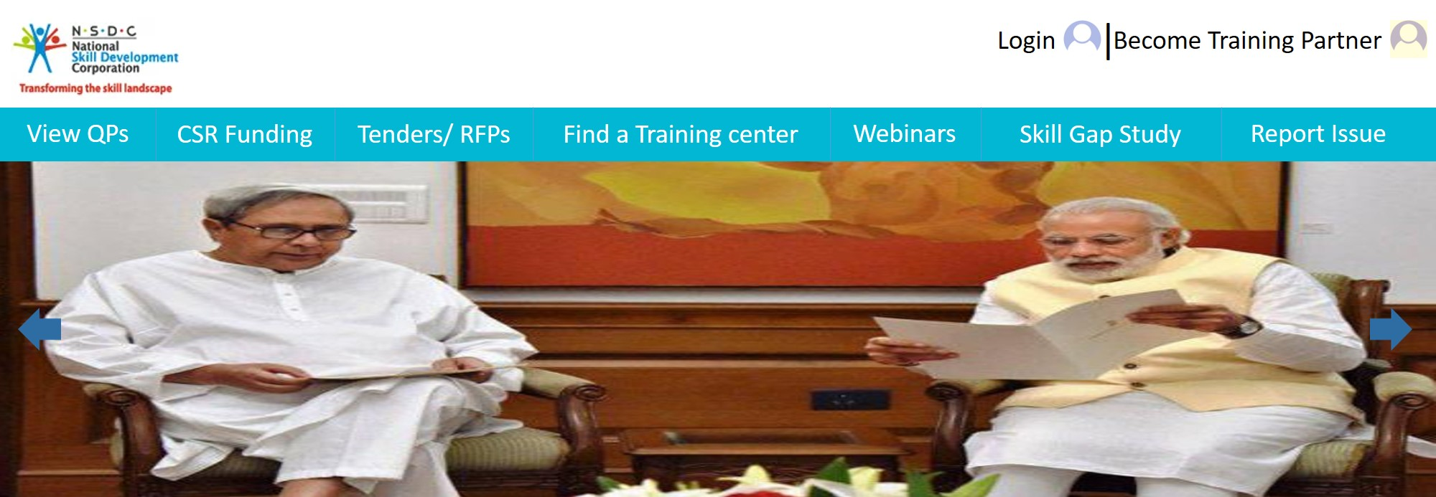
Existing training partner can REGISTER ONLINE FOR NEW QUALIFICATION PACKS by existing training partner
ONLINE TRAINING SESSIONS can be integrated with National Informatics Center(NIC)
Local user can have better readability by
MULTILINGUAL Feature
Training Partner can have PERSONALIZED HOMEPAGE for Monitoring their application status
CSR Funds can be closely monitored.
Source
Amount
Used at
INTEGRATING THE DESKTOP ASSESSMENT OF TP in the application.
SEGREGATION of students FOR WORLD’s COMPETITION
on different levels
ONLINE ACCREDIATION & RENEWAL
PROCESS
of training centers
MONITORING Sector Skill Councils
MOBILE APPLICATION
For notifying users for latest news and events update
SKILL INDIA APP | FUTURE SCOPE

