Slide 1
ESTIMATION OF OBESITY LEVELS
Subject : Predictive Analysis
Presented by: Pranjal Prabhu
S039

Slide 2
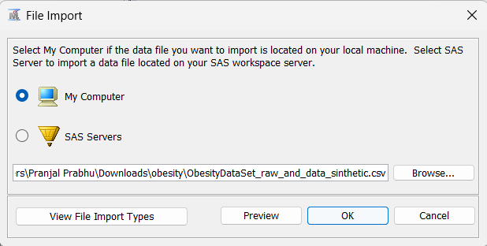
File Import
Importing the data externally
With the help of Import Data node
The data type is .csv

Slide 3
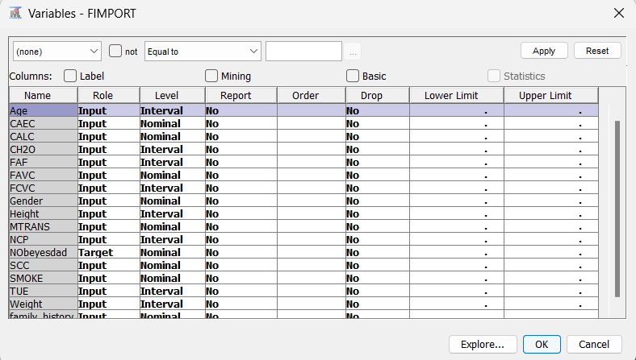
Exploring the data

Slide 4
Description of Data
Has a family member suffered or suffers from overweight? - family_history_with_overweight
Do you eat high caloric food frequently? – FAVC
Do you usually eat vegetables in your meals? – FCVC
Do you smoke? – SMOKE
How much water do you drink daily? - CH2O
Which transportation do you usually use? – MTRANS
Obesity level – NObeyesdad

Slide 5
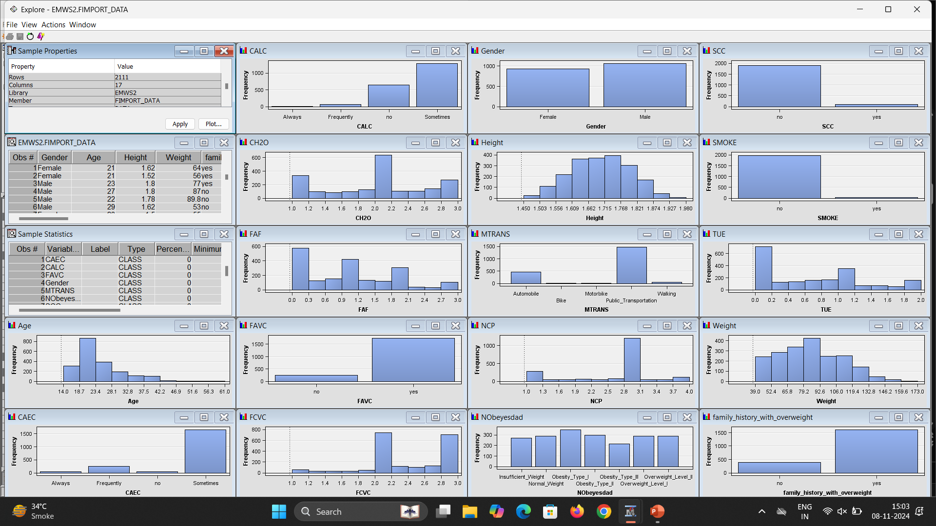
Exploration of all the data

Slide 6
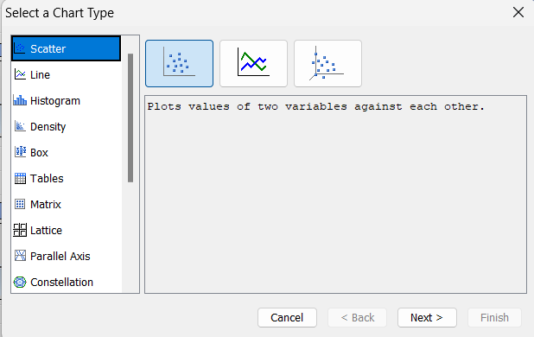
Plotting various other graphs
Sas EMINER provides us with wide range of plots
Here we will plot pie chart

Slide 7
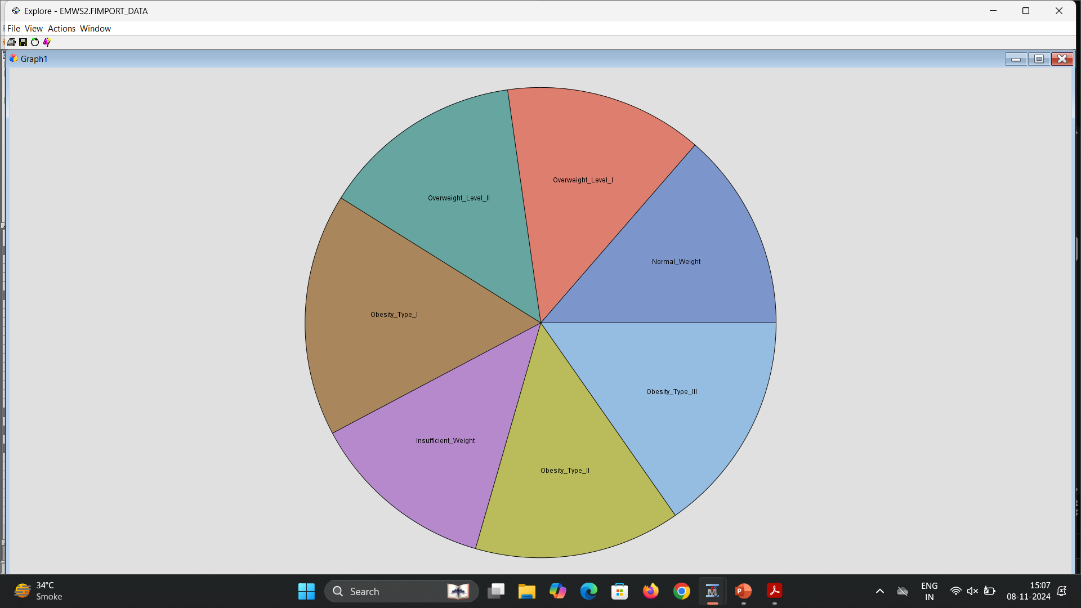
Pie Chart
Pie chart of the target variable
Each Category has there own segment in the pie chart

Slide 8
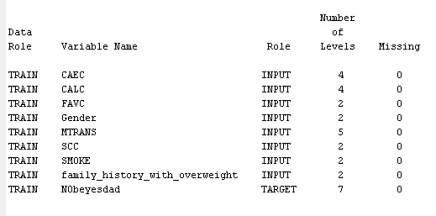
No missing values in the data
To check if the data has any of the missing value4s we use the StatExplore node
This node results gave the analysis that there are no missing values in the data

Slide 9

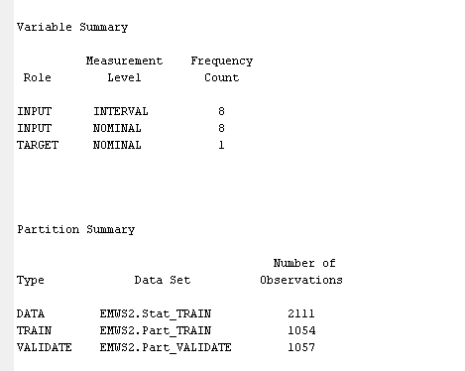
Setting the data in partition node
Here we partition the data into train and validate
The proportion of train is 50 and validation is 50
The output gives us the outputs that are being divided into train and validation

Slide 10
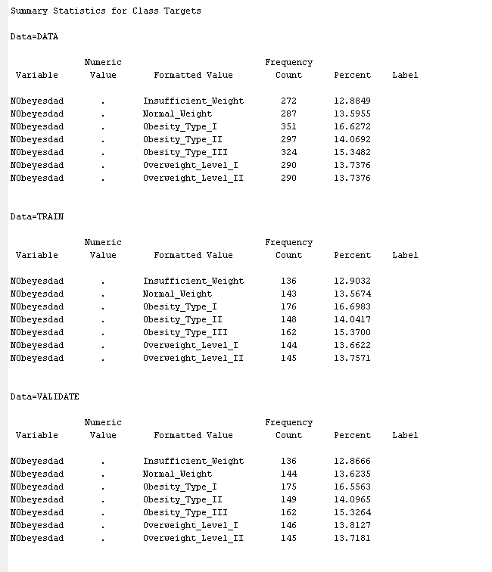
Target Variable summary
Here since the target data is categorical type i.e. it has categories like Normal weight, Obeseity types
Each category data is divided in train and validation

Slide 11
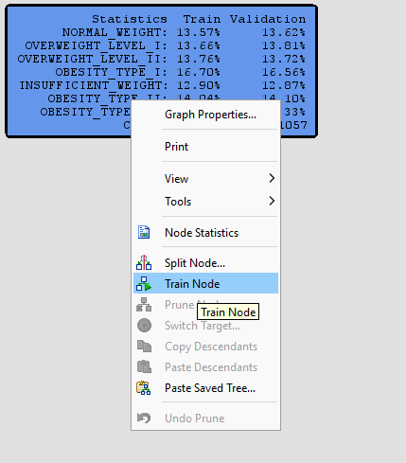
Training the data to get tree
To get the decision tree we will add the decision tree node to the diagram and attach it to data partition node
In the interactive decision tree application we will train the root node
The tree is grown until stopping rules prohibit further growth.

Slide 12
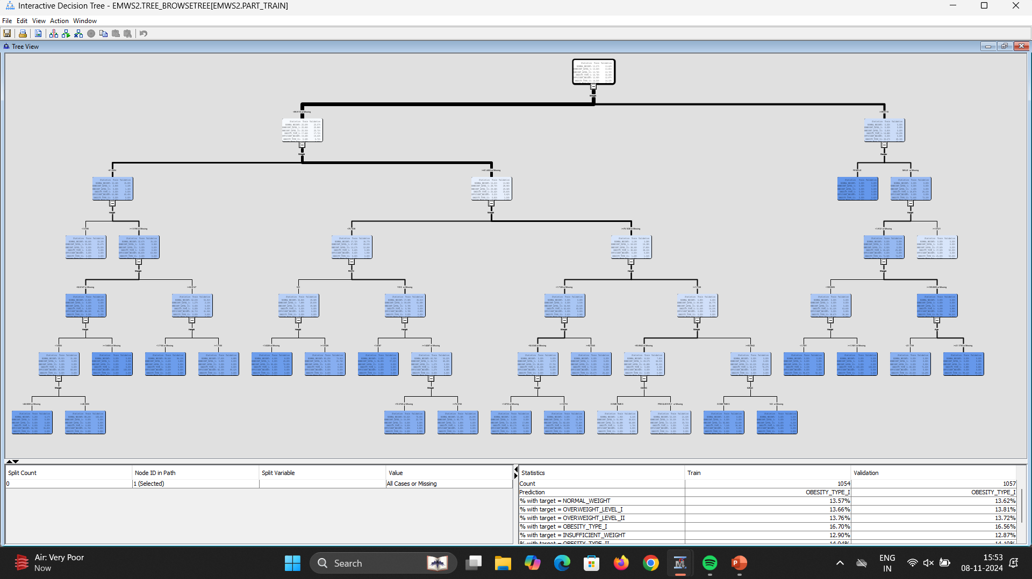
Maximal Tree

Slide 13
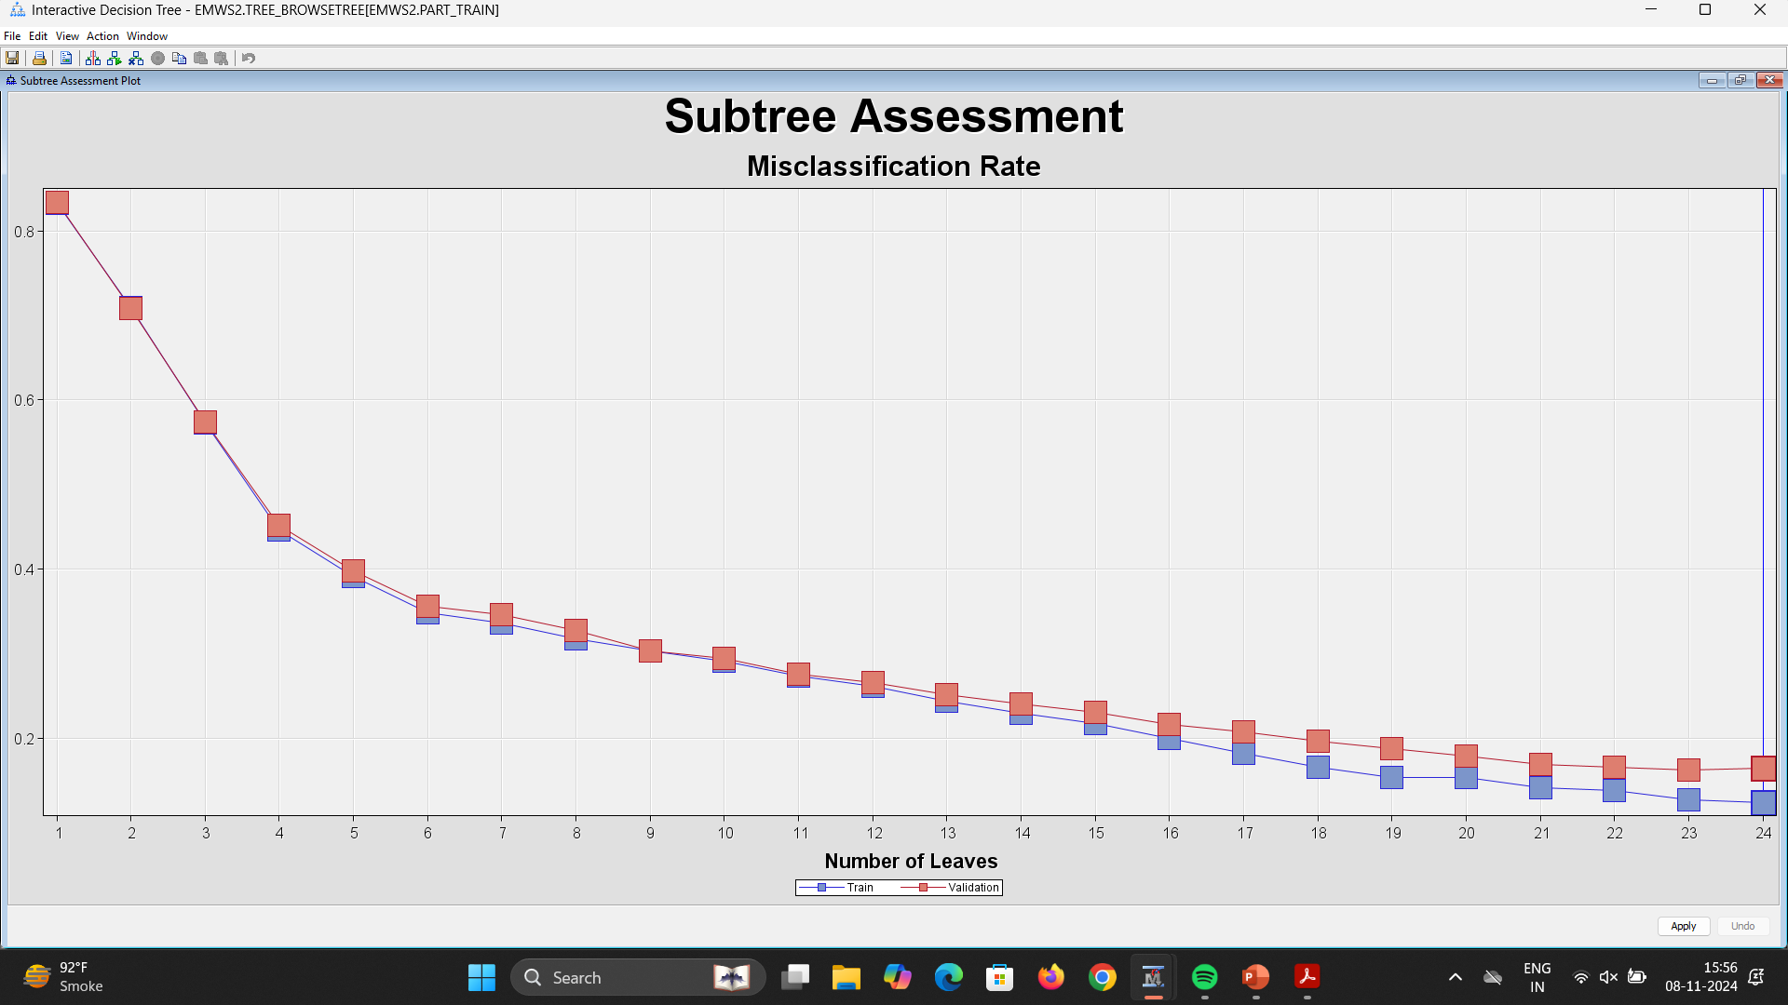
Subtree Assessment Plot
A predictive model that assigns one of 24 predicted target values to each case.

Slide 14
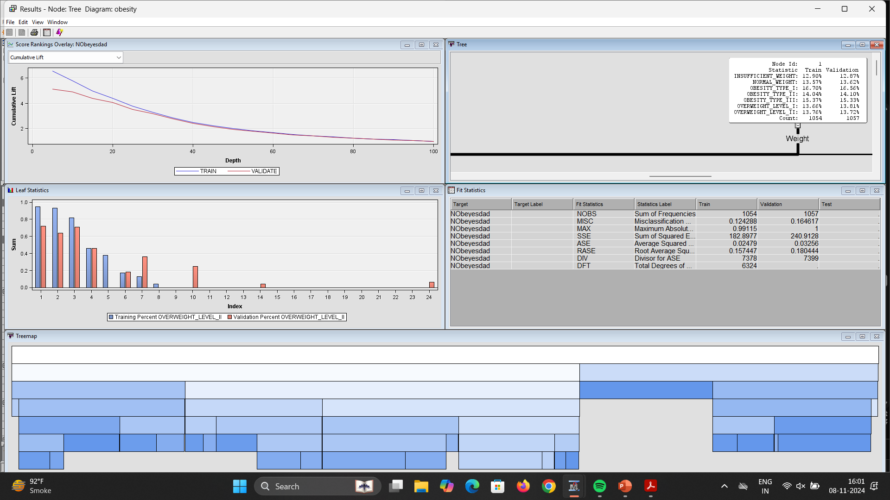
Results of Decision tree node

Slide 15
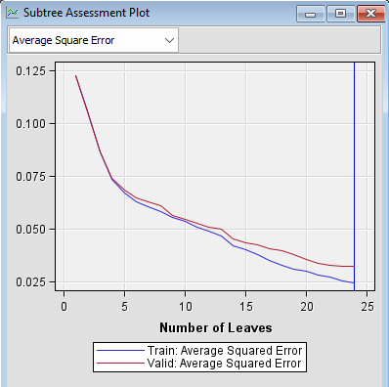
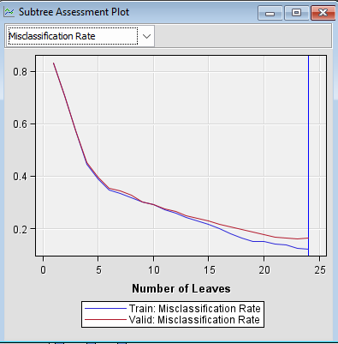
Subtree assessment plots

Slide 16
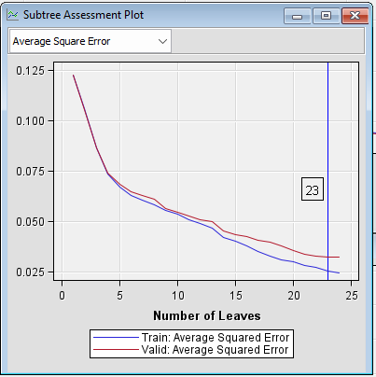
Pruning of decision tree

Slide 17
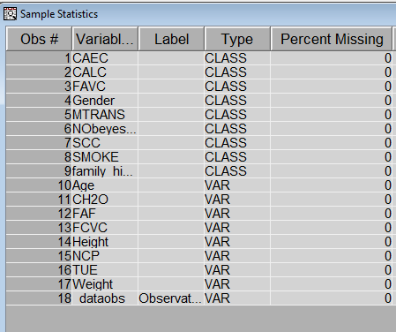
Data assessment for regression with replacement node

Slide 18
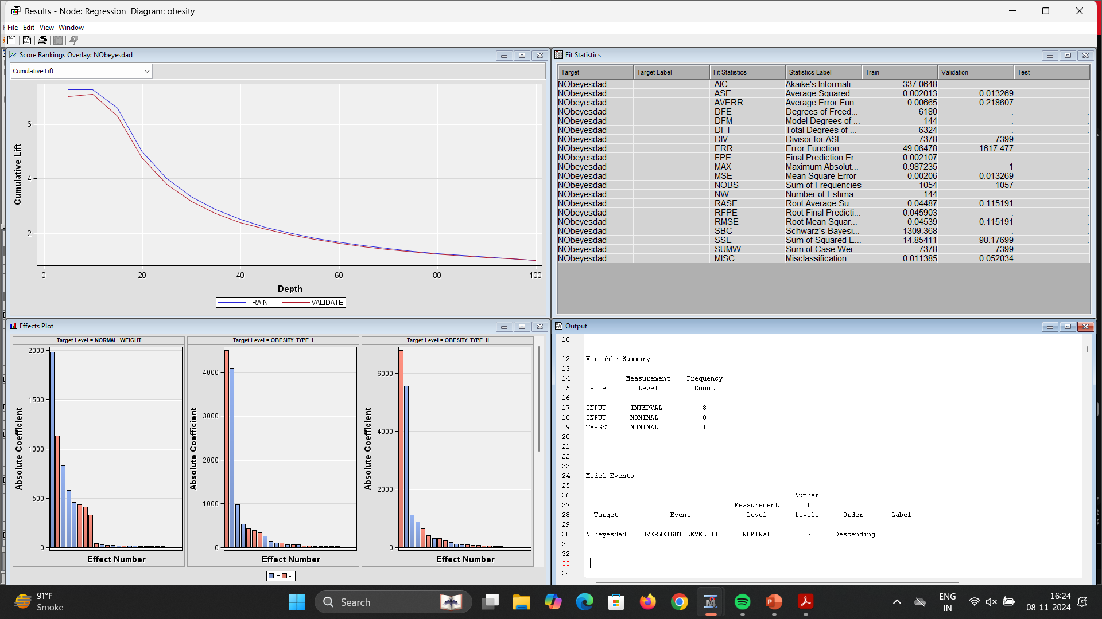
Result of regression node

Slide 19
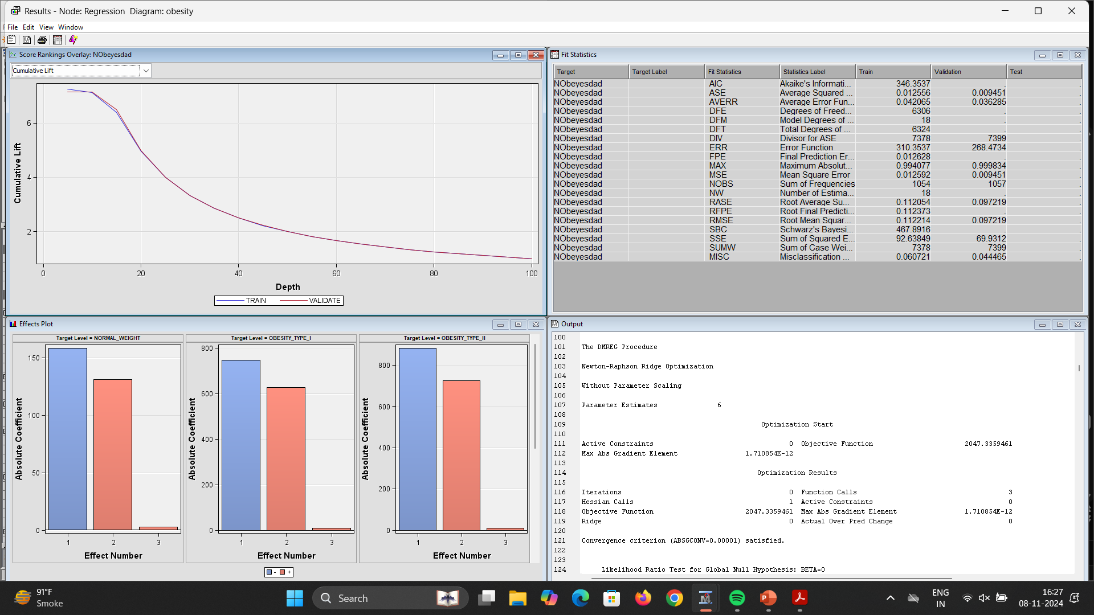
Result of regression node when Stepwise model selected

Slide 20
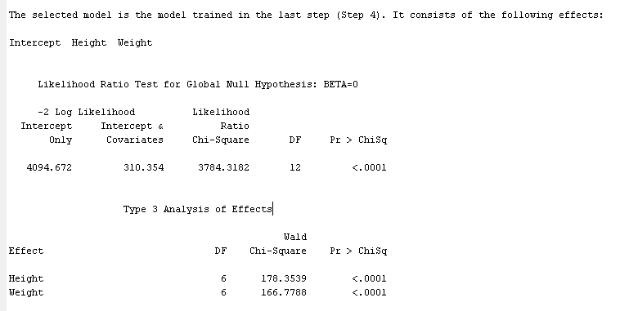
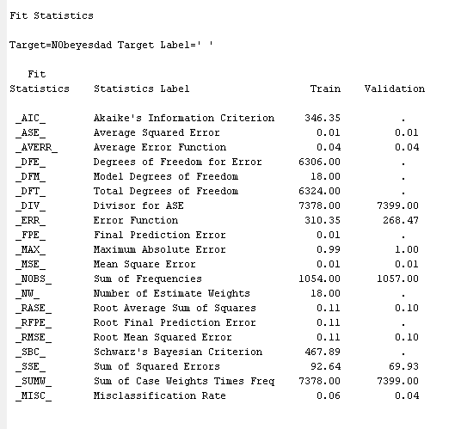
Fit Statistics after Regression

Slide 21
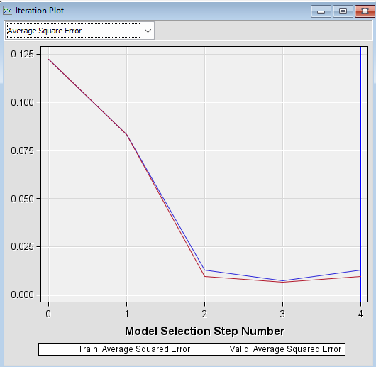
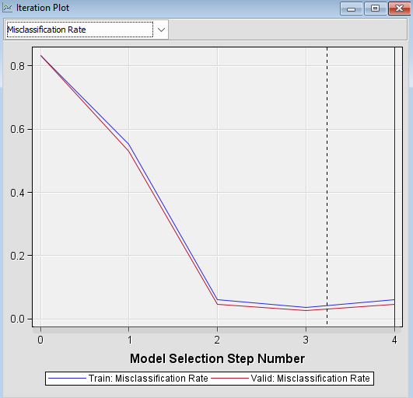
Iteration plots of regression node

Slide 22
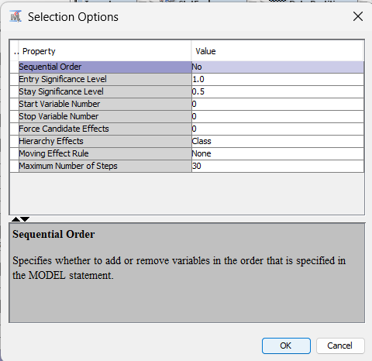

Full model selection
1.0 as the Entry Significance Level value.
0.5 as the Stay Significance Level value
Maximum number of steps - 30

Slide 23
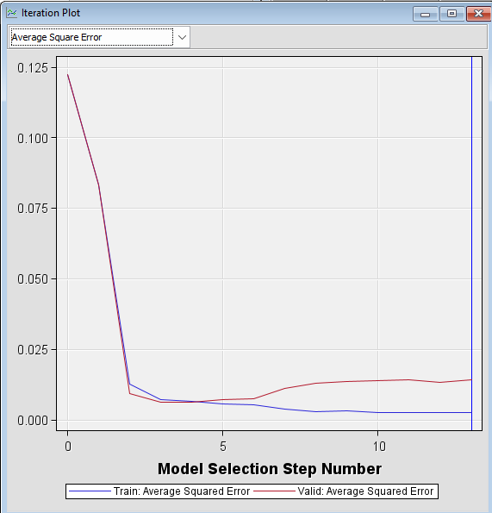
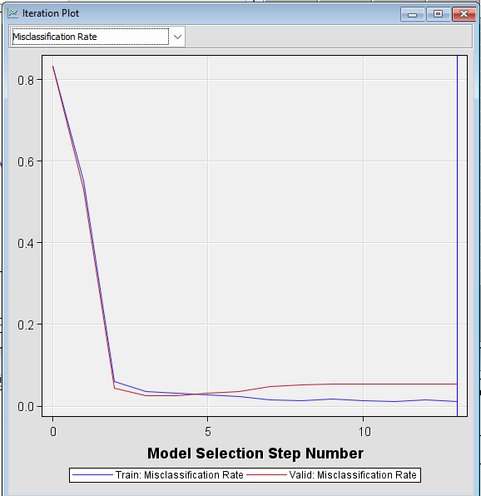
Iteration plots

Slide 24

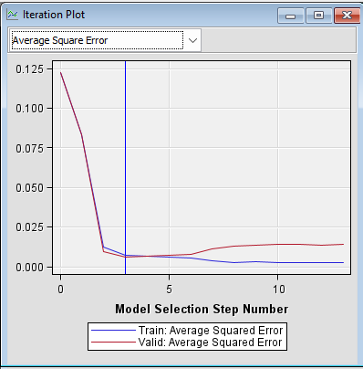
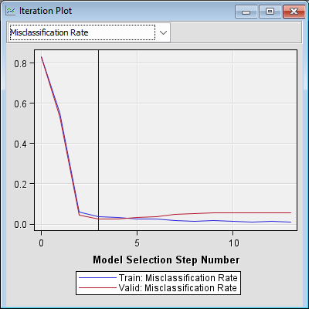
Best Sequence Model
Selection Criterion - Validation Error.
The model with minimum Average Squared Error occurs at iteration 2.
The vertical blue line shows the model with minimum Validation Error or Error Function

Slide 25
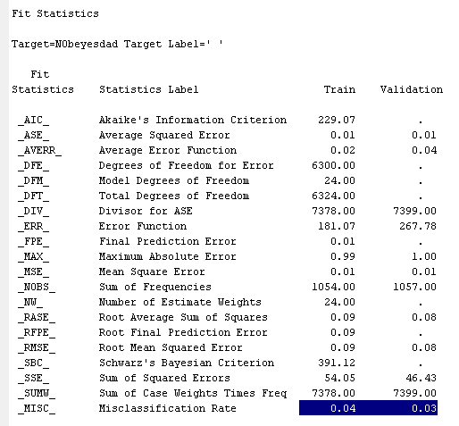
Fit Statistics

Slide 26
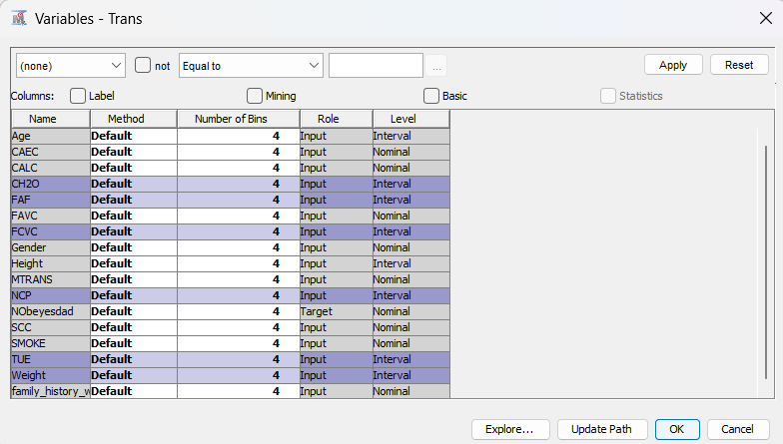
Transforming inputs
Firstly exploring the data and then deciding which inputs to be transformed

Slide 27
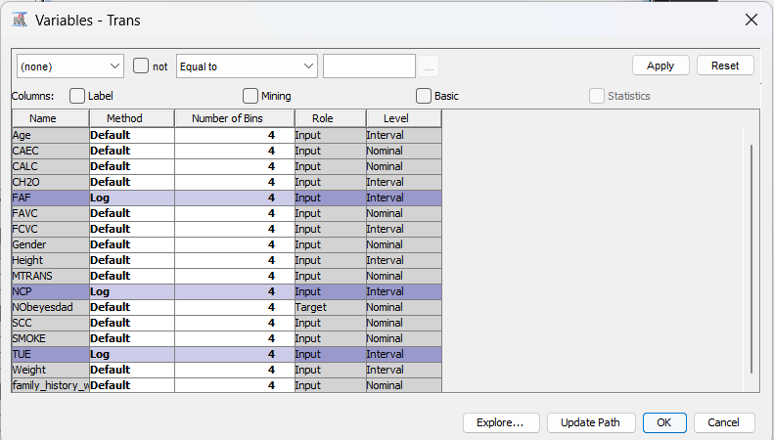
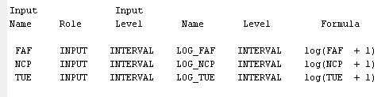
Transformed variables
Action of the Transform Variables tool avoids problems with 0-values of the underlying inputs.

Slide 28
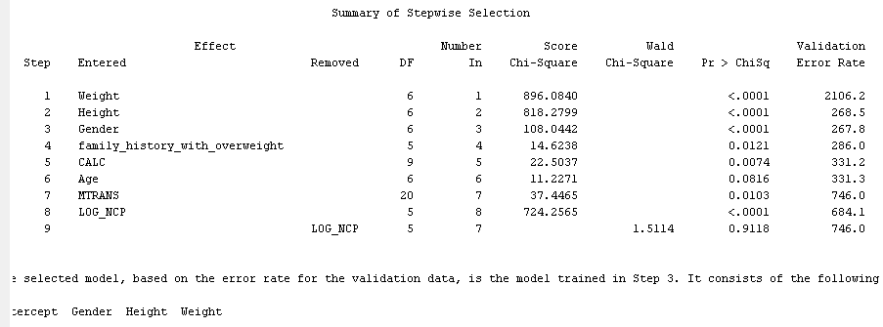
Summary of Stepwise Selection

Slide 29
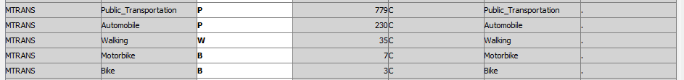
Transforming the categorical inputs

Slide 30
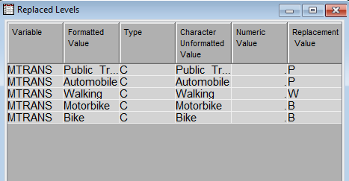
Replaced Values
This result shows us the replaced values

Slide 31
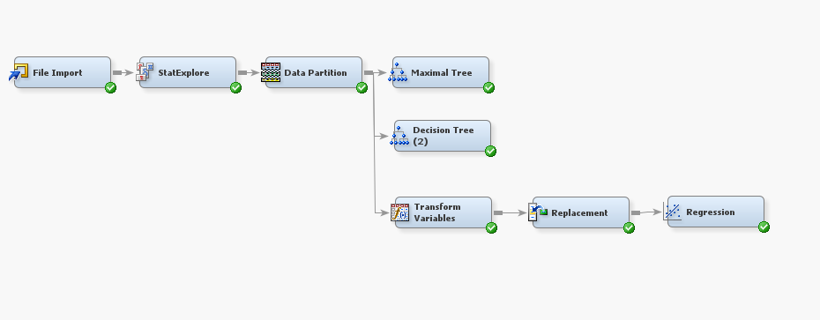
Diagram till now…

Slide 32
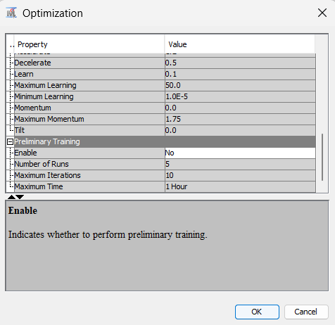
Training a neural network
We connect the neural network with replacement node for training
Also known as preliminary training

Slide 33
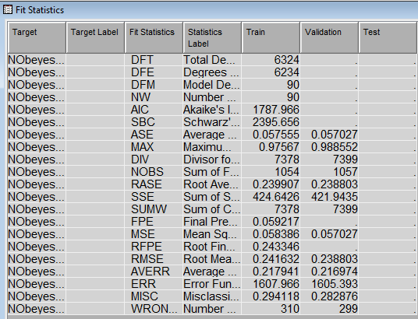
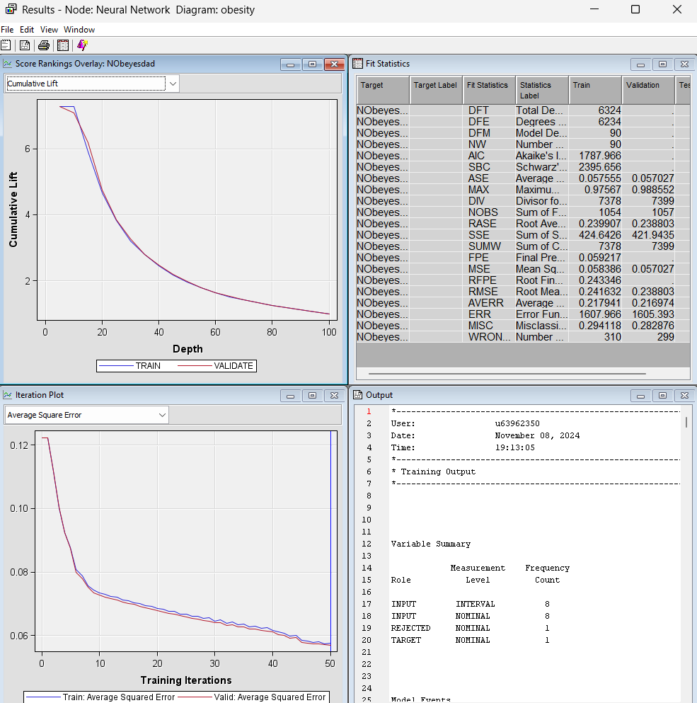
Fit Statistics after

Slide 34
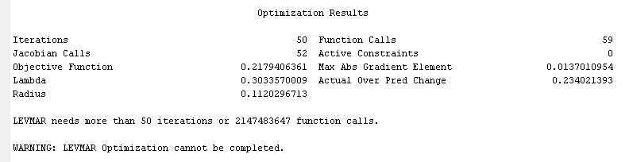
Optimization results

Slide 35
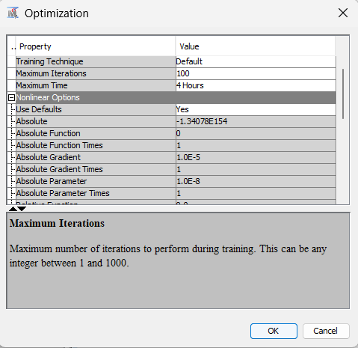
Increasing the iterations
Increasing the iterations to 100

Slide 36
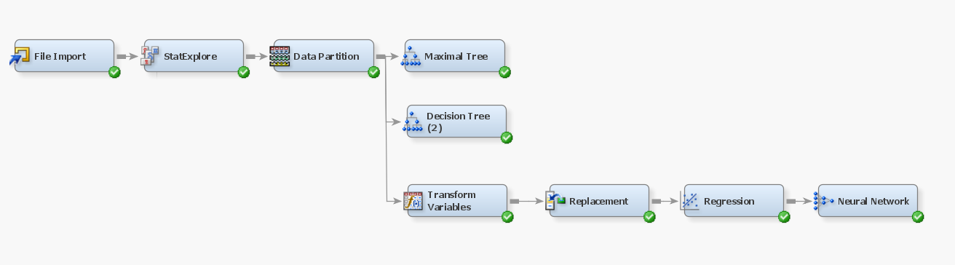
Input selection

Slide 37
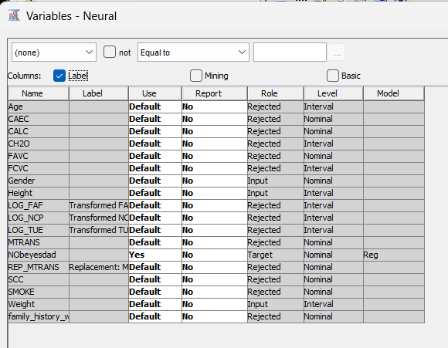
Variables for neural network

Slide 38
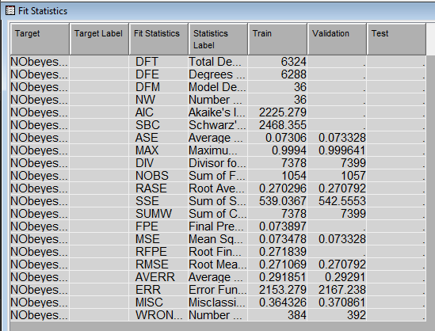
Fit statistics

Slide 39
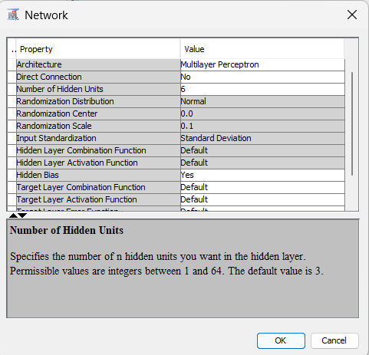
Increasing the network flexibility
Increased the number of hidden units to 6

Slide 40
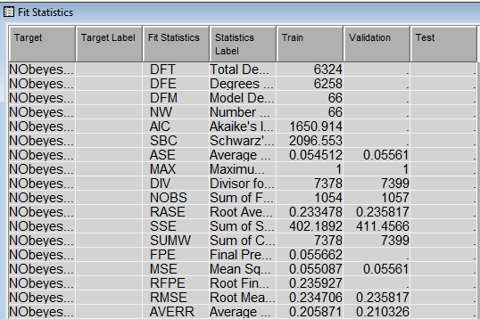
Fit statistics

Slide 41
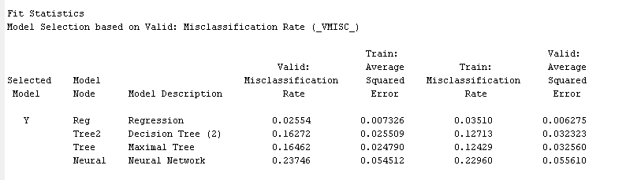
Model Comparison

Slide 42
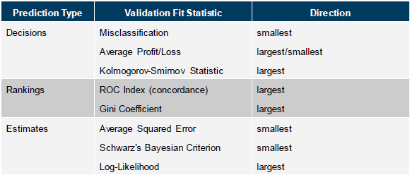
Model assessment

Slide 43
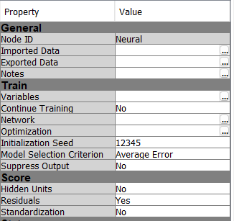
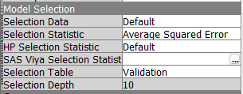
Decision Processing and the Neural Network Node

Slide 44
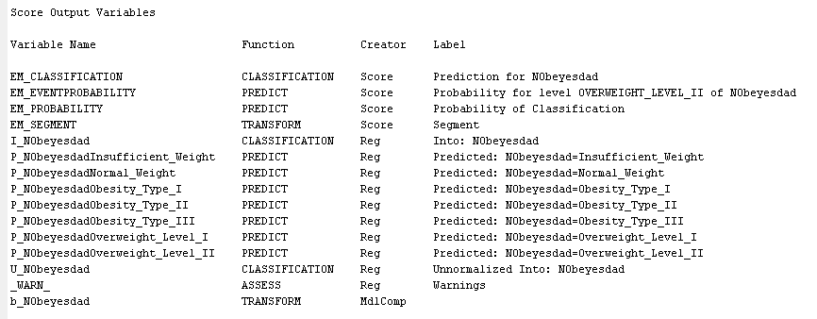
Score data

Slide 45

Supervised Learning (Final Diagram)

Slide 46



K-means clustering

Slide 47

Selecting inputs for clustering

Slide 48

results

Slide 49

CCC plot

Slide 50

Increasing the segments

Slide 51

Scatter plot

Slide 52

Association of data

Slide 53

Selecting variables of segmentation

Slide 54

results

Slide 55

Creating ensemble models

Slide 56
THANK YOU

