Slide 1

MIC
INSURANCE PRICE PREDICTION
PRESENTATION
PRESENTED BY:
ABHISHEK PRASHAD, PRANJAL Upadhyay,
SATYAM SINGH

Slide 2

INTRODUCTION
Predicting insurance charges based on various factors like age, BMI, region, etc.
This is a regression problem because the target variable (charges) is continuous.

Slide 3
PROJECT OBJECTIVES
Develop a machine learning model to accurately predict insurance charges.
Perform exploratory data analysis (EDA) to understand the key factors affecting charges.
Compare different regression models and evaluate their performance.
Implement and optimize a neural network for improved predictions.
Provide insights and scope for future improvements.

Slide 4
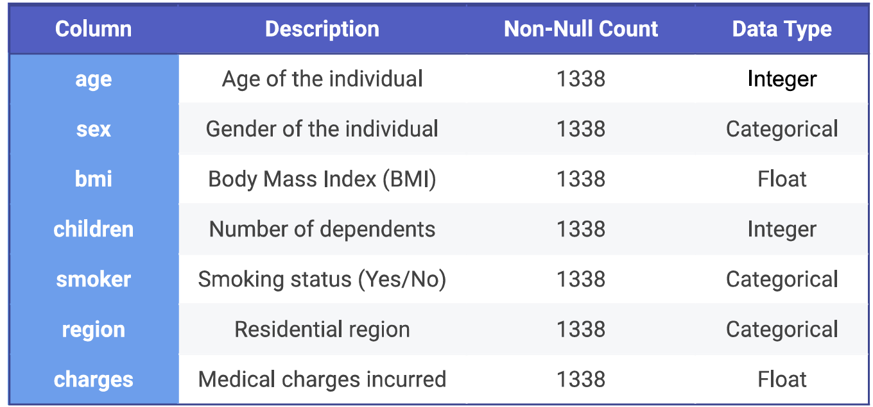
DATASET DETAILS
The dataset contains 1338 entries with 7 columns and no missing values.

Slide 5
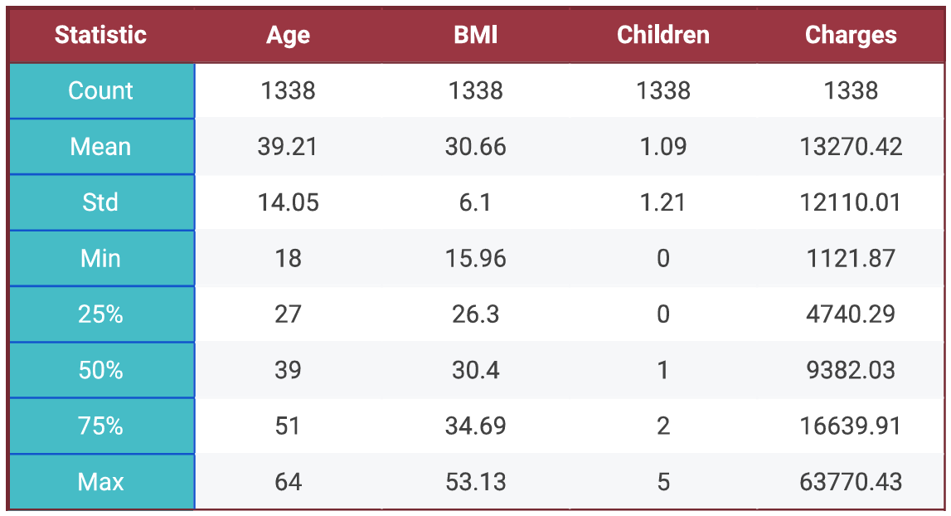
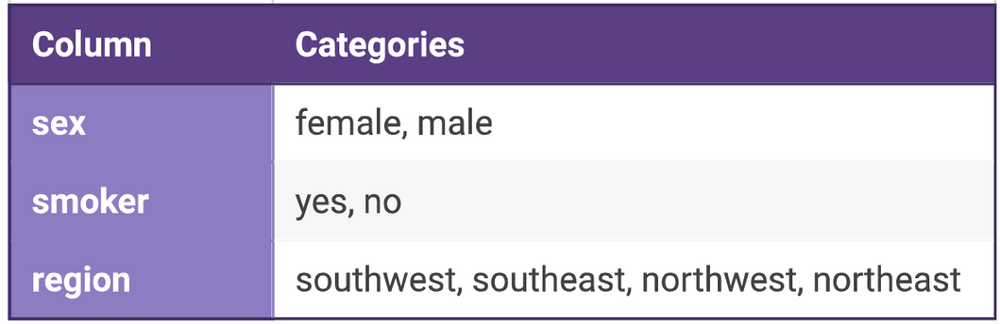
The statistical analysis of the numerical data are shown in the table.
Our data has 3 categorical variables with categories shown in table.

Slide 6
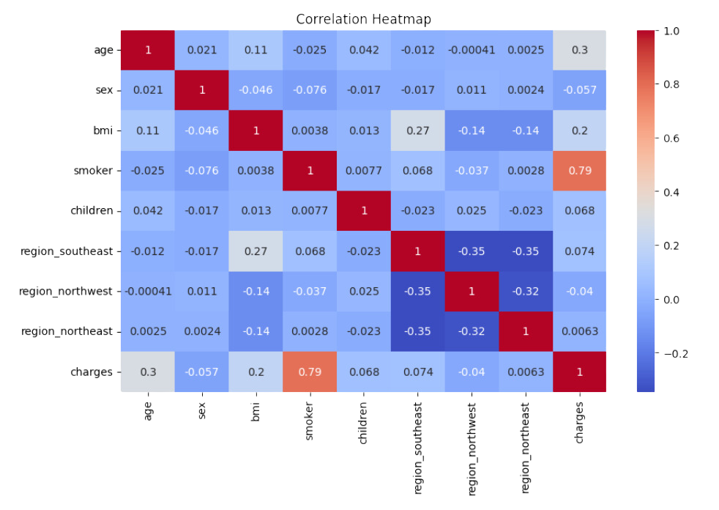
EXPLORATORY DATA ANALYSIS (EDA)
From this, we infer that the most prominent features are:
Smoker
age
bmi

Slide 7
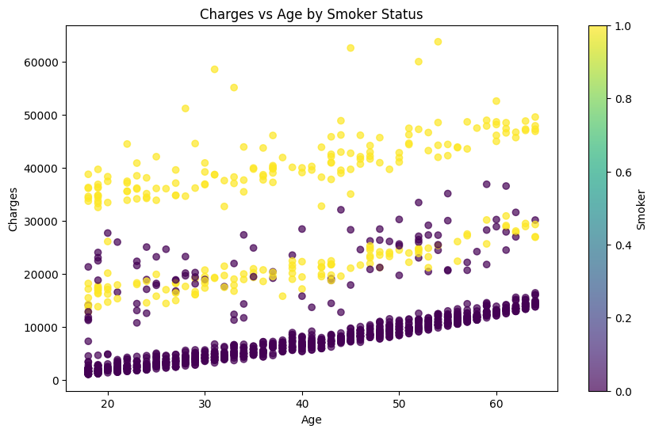
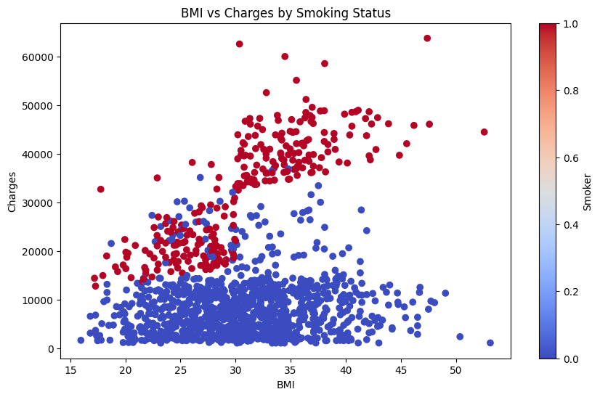
PLOTS
In this plot we can see that the most prominent features show high colinearity with charge

Slide 8
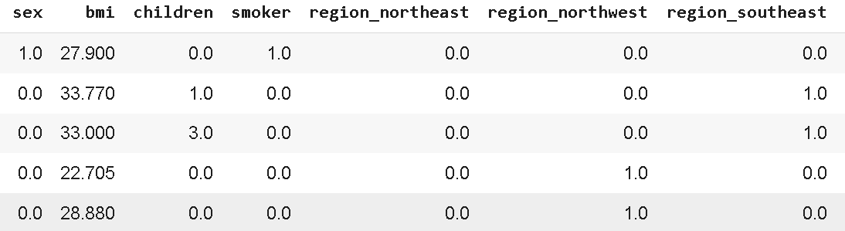
CATEGORICAL DATA:
We have sex, smoker and region as categorical data
We used one hot encoding to convert categorical variables into a numerical format that machine learning algorithms can understand
SCALING DATA:
We used standard scaling for normalizing the range of features in a dataset

Slide 9
REGRESSION MODELS WE HAVE USED
Linear Regression
Random Forest Regressor
Gradient Boosting Regressor
Decision Tree Regressor
XGBoost Regressor
Lasso Regression
Ridge Regression
Polynomial Regression
Adaboost
Fully connected neural network

Slide 10
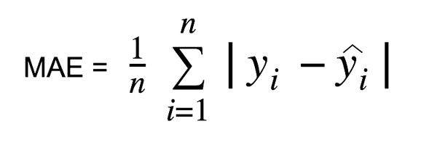

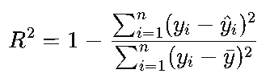
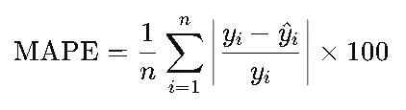
METRICS WE ARE USING TO EVALUATE MODELS ARE
Mean absolute error
Mean square error
R2 squared
Mean absolute percentage error

Slide 11
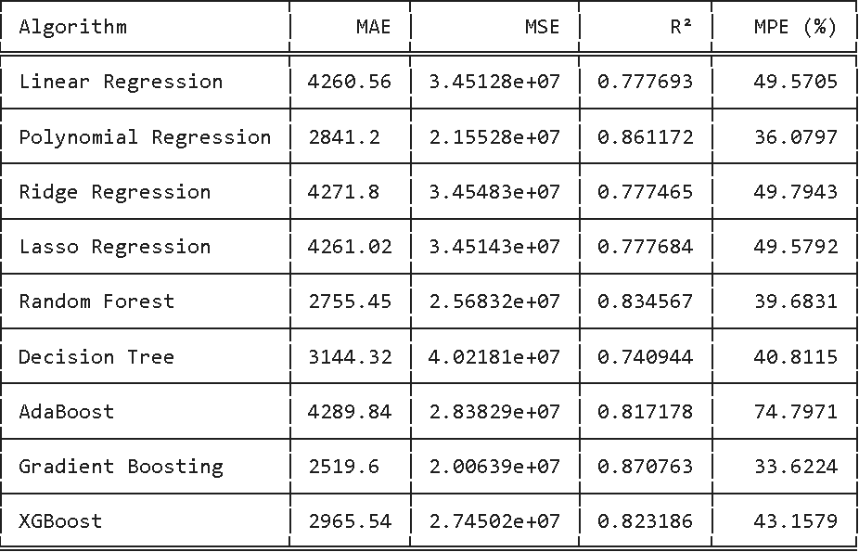
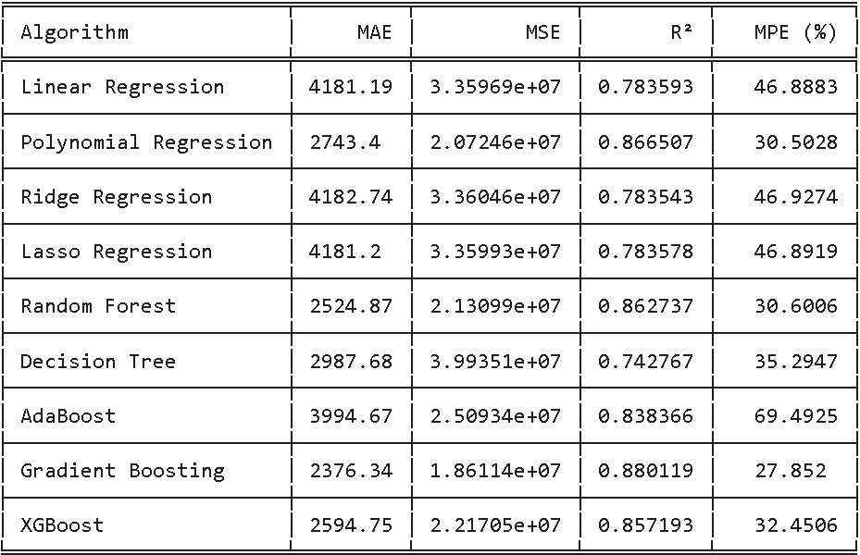
RESULTS
Here we used only 3 variables age, bmi, smoker
Here we used all the variables

Slide 12
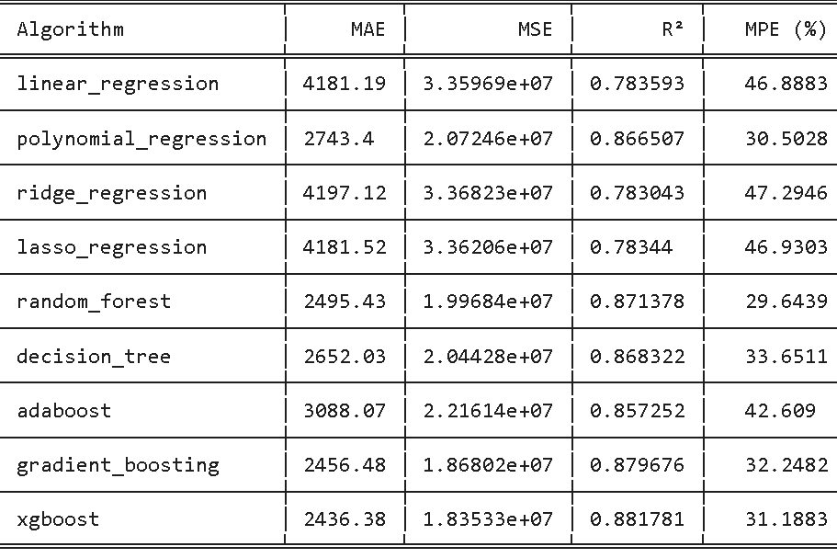
AFTER GRID SEARCH CV
After optimisation
Before optimisation

Slide 13
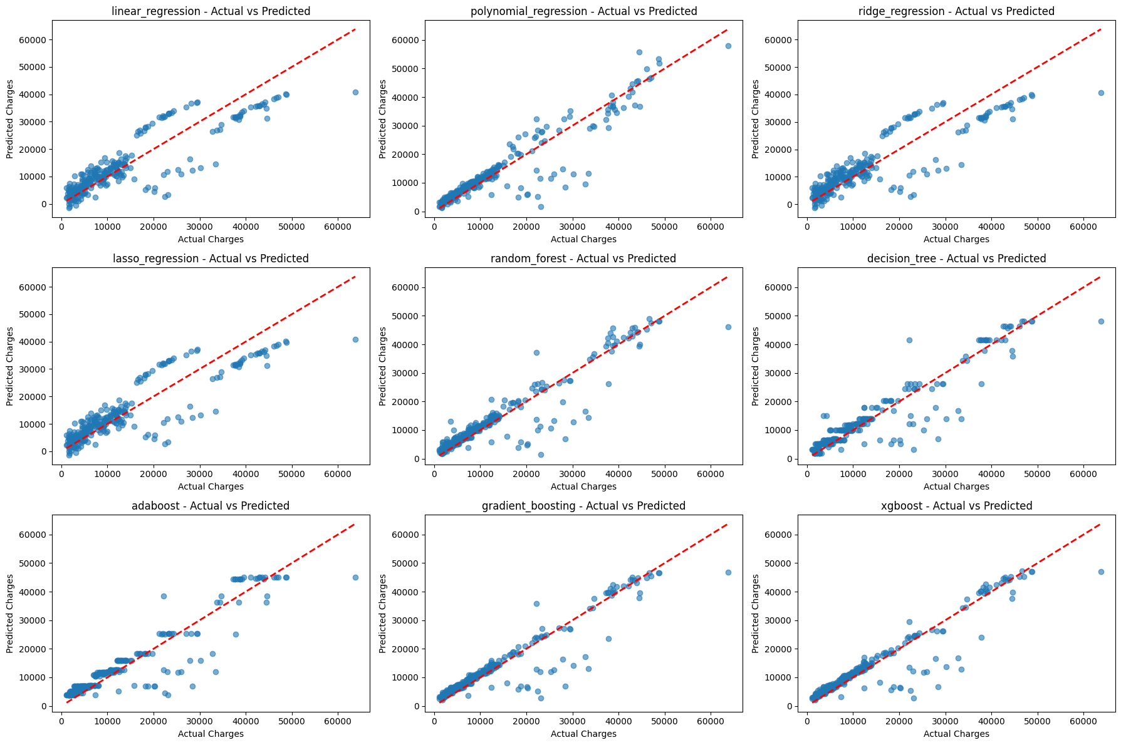

Slide 14
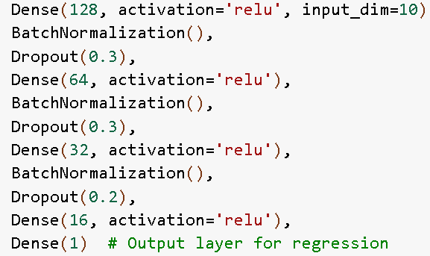
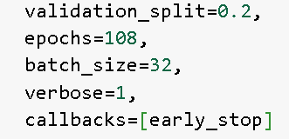
DEEP LEARNING

Slide 15
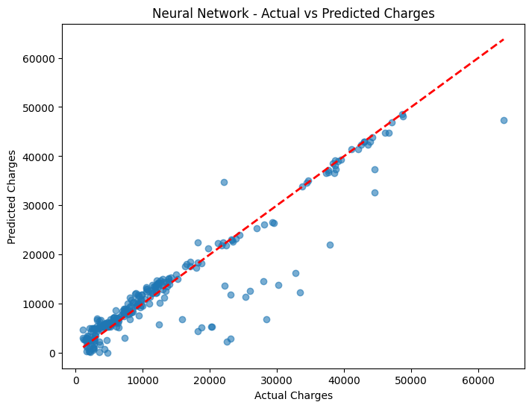
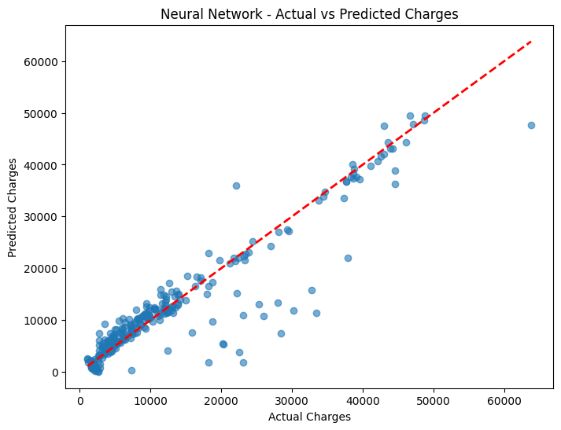
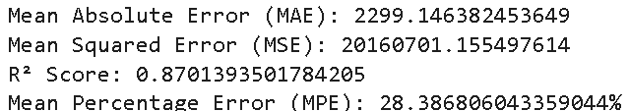
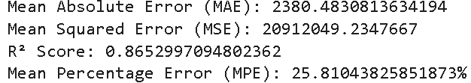
DEEP LEARNING
with only age,bmi,smoker variable
With all variables

Slide 16
CONCLUSION
Ensemble algorithms performed better than traditional regression methods.
After evaluating machine learning regression models, we found that Random Forest gave the best result, with the mean percentage error being 29.6%.
But deep learning model outperformed all the machine learning algorithms as it gave 25.8% MPE.
We choose MPE evaluation metric so that whenever our model predicts Insurance price we can tell the range of insurance price as:
predicted values ± MPE

