Slide 1

A
PROJECT
PRESENTATION ON
“Flood Detection and Alert System Using Machine Learning”
Presented by
Pranjali Patil(41206)
Isha Solao(41247)
Dipti Pimparkar(41210)
Under the Guidance of
Prof. M.S.Kasar
DEPARTMENT OF ELECTRONICS AND TELECOMMUNICATION ENGINEERING
BHARATI VIDYAPEETH’S COLLEGE OF ENGINEERING FOR WOMEN,PUNE
( 2021-2022)

Slide 2
Outline
Introduction
Literature Survey
Problem statement
Objectives
Methodology
Block diagram
Result
References

Slide 3
Introduction
Among the natural disasters, floods are the most destructive.
We have experimented with different ML algorithms like SVM, KNN, Logistic Regression etc., for the available rainfall dataset.
Alert System consisting of a Webpage and E-mail for alerting.

Slide 4
Literature Survey
Name of Author | Paper Title | Publications and Source | Finding | Method | Results and comments
Pooja Mane , Meghana Katti , Preeti Nidgunde , Anil Surve | Early Flood Detection and Alarming System Using Machine Learning Techniques | International Journal of Research in Engineering, Science and Management Volume-3, Issue-10, October-2020 | An early flood prediction system composed of a monitoring centre , and a notification system and equipped with the water level sensor and the precipitation sensor is presented. | As per the results Logistic Regression and the SVM (Support Vector Machine) come out as with accuracy of 79%. | flood prediction and early warning system that utilizes ML to predict flood situations function perfectly according to the specification provided.
MOHAMMED KHALAF , HAYA ALASKAR , ABIR JAAFAR HUSSAIN , (Member, IEEE), | Flood Severity Prediction via Ensemble Machine Learning Models | SPECIAL SECTION ON SCALABLE DEEP LEARNING FOR BIG DATA Received March 28, 2020, accepted April 2, 2020, date of publication April 6, 2020, date of current version April 27, 2020 | River flooding is a natural phenomenon that can have a devastating effect on human life and economic losses. There have been various approaches in studying river flooding; however, insufficient understanding and limited knowledge about flooding conditions hinder the development of prevention and control measures for this natural phenomenon | LSTM and RF showed an average sensitivity of 0.714, followed by the ensemble of the LSTM and SVM with an average sensitivity of 0.69, then the ensemble of ANN and RF with an average sensitivity of 0.664 for the testing data. | The results indicate that early warning of flood severity can be obtained using appropriate ensemble machine learning based data science techniques

Slide 5
Name Of Author | Paper Title | Publications and Source | Finding | Method | Results and comments
Amir Mosavi , Pinar Ozturk and Kwok-wing Chau | Flood Prediction Using Machine Learning, Literature Review | Department of Computer Science, Norwegian University of Science and Technology | Researchers through introducing the novel ML methods and hybridization of the existing ones have been aiming at discovering more accurate and efficient prediction models | To present a fare evaluation of RMSE we made sure that unit of RMSE is same and for the multiple RMSE the average is Calculated | This paper presents an overview of machine learning models used in flood prediction, and develops a classification scheme to analyze the existing literature.
Lamovec Peter | Detection of Flooded Areas using Machine Learning Techniques | Case Study of the Ljubljana Moor Floods in 2010 | Floods are one of the most frequent and severe natural disasters. In addition to causing a huge economic damage (to the human property) they cause a substantial loss of human lives. | Methods Percentage of correctly classified examples Training Testing 48 95% 85% SVM / 83% NN / 82% | In the study we have defined the most accurate method and the most important attributes for detection of floods in the flat area of Ljubljana Moor.
Nadia Zehra | Prediction Analysis of Floods Using Machine Learning Algorithms (NARX & SVM) | International Journal of Sciences: Basic and Applied Research | how prediction strength of ML algorithms Nonlinear Autoregressive Exogenous Model (NARX) and Support Vector Machine (SVM) help in providing early forecasts. | NARX worked efficiently in rainfall based flow prediction in advance of 24 hours on the basis of current rainfall rates with almost 99% accuracy. | This report was aimed at the meta-analysis of previously reported articles in the context of flood forecasting and the techniques targeted were the SVM and NARX.
Kazi Aminul Islam ¹ , Mohammad Shahab Uddin ¹, Chiman Kwan ² and Jiang Li | Flood Detection Using Multi-Modal and Multi-Temporal Images: A Comparative Study | Department of Electrical & Computer Engineering, Old Dominion University, Norfolk, VA 23529, USA; 2020 | domain adaptation-based methods can achieve competitive performance for flood detection and require much less labeled samples in the post-event images for model fine-tuning. | To prepare our flood map, we chose 201 flood points and 201 nonflood points, of which we used 70% for training | comparative study of various methods for flood detection including SVM, MLP, deep CNN models and domain adaptation method combined with those models.

Slide 6
Name Of Author | Paper Title | Publications and Source | Finding | Method | Results and comments
Mr. Prasad D. Kadam1, Mr. ALOK Singh2, Ms. OSHEEN Bhau 3 | FLOOD EARLY DETECTION AND AVOIDANCE BY IOT | International Research Journal of Engineering and Technology (IRJET) e-ISSN: 2395-0056 Volume: 07 Issue: 07 | July 2020 www.irjet.net p-ISSN: 2395-0072 | All the values can be collected and sent to the Ardiuno Uno to process these values and then shown on the screen with the help of WIFI module and with the use of IOT gecko. | Calculated as output as a pulse signal by the hall effect sensor. Thus, the rate of flow of water can be measured.. | The system has WIFI feature, which is useful to access the system and its data over IOT.
Abdirahman Osman Hashi, Abdullahi Ahmed Abdirahman, Mohamed Abdirahman Elmi, Siti Zaiton Mohd Hashi, Octavio Ernesto Romo Rodriguez | A Real-Time Flood Detection System Based on Machine Learning Algorithms with Emphasis on Deep Learning | Department of Artificial intelligence and Big Data, Faculty of Computing, University Malaysia Kelantan Kelantan, Malaysia | Using a Deep Learning approach achieved 87% of accuracy, showing overall good results on precision and recall. The proposed method has contributed to the field of study by introducing a new way of preventing floods in the field of Artificial Intelligence, data mining, and Deep Learning. | Random Forest algorithm had the best performance regarding accuracy compared to the alternative classification methods with 98.7 % of accuracy, compared to 88.4% | Proposed method can be further improved or enhanced to achieve to do more advanced technology and well applications that are capable of data mining in the next phase of the research
Mohamed khalif | Flood Detection using Sensor Network and Notification via SMS and Public Network | Student Conference On Research And Development (SCOReD 2011) 2nd November 2011, Administration Gallery, UNITEN | This paper presents a description of an alert generating system for flood detection. This paper focused on the development of the system which will determine the current water level by means of sensors and by using wireless sensor network will then provide notification via GSM modem. | Water level sensor is consider one of the important devices which has been used in the project because from this device can be recognized the current level of water. | The flood detection system is described in this paper. The system will determine the current water level by using wireless sensor network, which will also provide notification of SMS via GSM modem.

Slide 7
Problem Statement
To Design and Develop Flood detection and Alert system Using Machine Learning.

Slide 8
Objectives
To Observe various natural factors to detect the flood system.
To intimate about the flood.
To give alert for precautionary measurement about the flood.

Slide 9
Block diagram
Arrange dataset for training
SVM algorithm for training
Dataset about rainfall and flood
Take input query
from user
SVM trained Module
Predicted result
Display

Slide 10
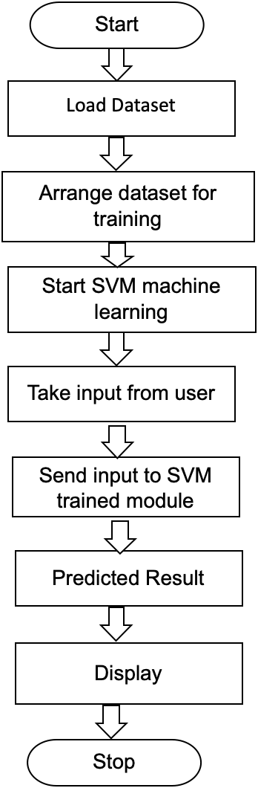
Work Flow

Slide 11
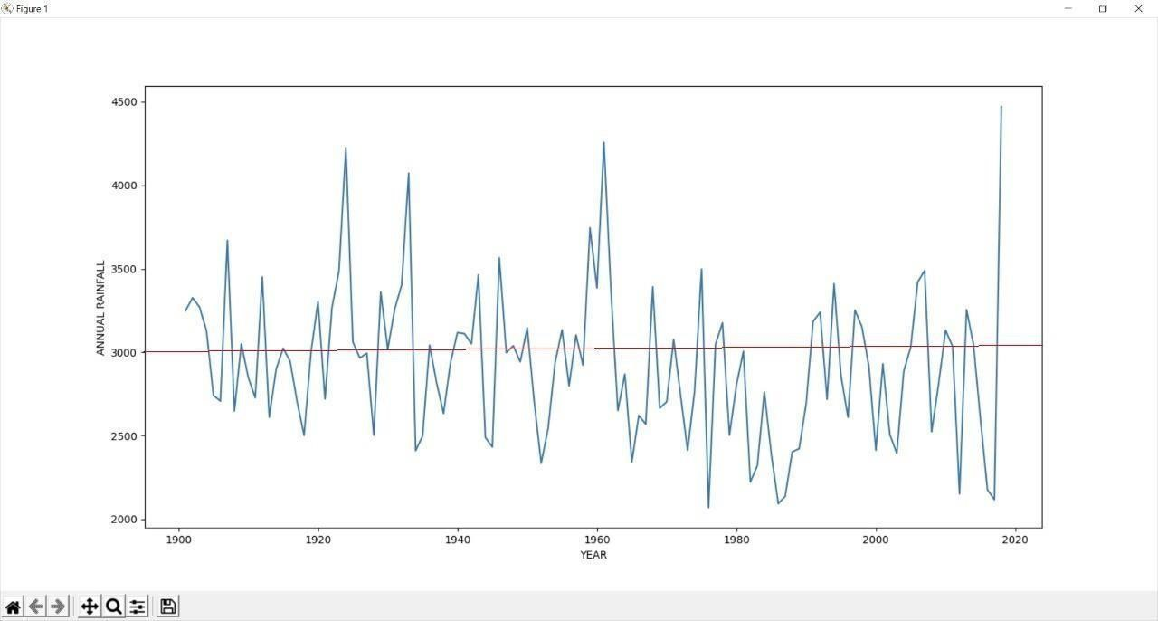
Training Module Output
X-axis - Year
Y-axis - Annual rainfall
- Threshold Line
Threshold Line- Threshold annual rainfall is 3000 mm and if the rainfall is above that,
the flood will occur.

Slide 12

Output

Slide 13


Slide 14
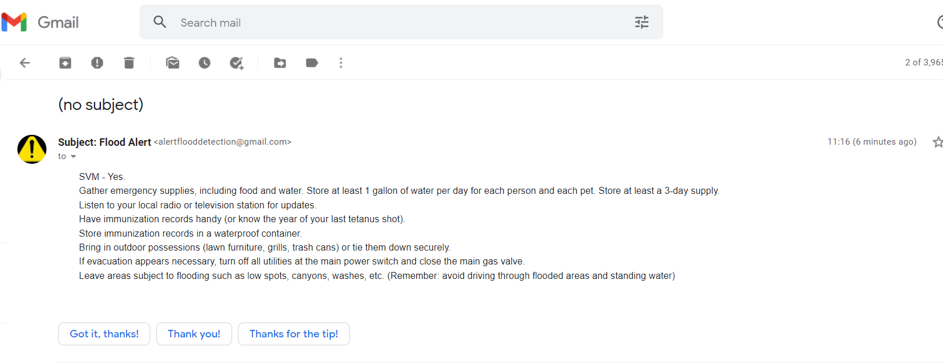
Alert System

Slide 15
Conclusion
The research contributes towards the economy and the citizens. The system also promotes the use of real-time monitoring through the developed application, and notification system as an easy medium in disseminating information, particularly in remote areas. Finally, the developed flood detection and alert system that utilizes ML to predict flood situations function perfectly according to the Specifications provided.

Slide 16
References
Pooja Mane , Meghana Katti , Preeti Nidgunde , Anil Surve “Early Flood Detection and Alarming System Using Machine Learning Techniques”, International Journal of Research in Engineering, Science and Management, Volume 3, Issue 10, pp.29-32, October 2020.
Mohammad Khalif Haya Alaskar, Abir Jafar Hussan, (Member, IEEE), “Flood Severity Prediction via Ensemble Machine Learning Models Special Section on Scalable Deep Learning For Big Data”Received March 28, 2020, accepted April 2, 2020, date of publication April 6, 2020, date of current version April 27, 2020
Amir Mosavi , Pinar Ozturk and Kwok-wing Chau “Flood Prediction Using Machine Learning” Literature Review Department of Computer Science, Norwegian University of Science and Technology, Trondheim, Norway; amir.mosavi@ntnu.no, pinar@ntnu.no
Lamovec Peter “Detection of Flooded Areas using Machine Learning Techniques Case Study of the Ljubljana Moor Floods in 2010”

Slide 17
Danso-Amoako, E.; Scholz, M.; Kalimeris, N.; Yang, Q.; Shao, J. “Predicting dam failure risk for sustainable flood retention basins: A generic case study for the wider greater manchester area” Computers, Environment and Urban Systems 2012, 36, 423-433.
Xie, K.; Ozbay, K.; Zhu, Y.; Yang, H. “Evacuation zone modeling under climate change: A data-driven method” Journal of Infrastructure Systems 2017, 23, 1-9.
Pitt,” Machine Learning lessons from the 2007 floods” Cabinet Office London: 2008.
Lohani, A.K.; Goel, N.; Bhatia, K. “Improving real time flood forecasting using fuzzy inference systems” Journal of hydrology 2014, 509, 25-41
Patro, S.; Chatterjee, C.; Mohanty, S.; Singh, R.; Raghuwanshi, N. “Flood inundation modeling using mike flood and remote sensing data”. Journal of the Indian Society of Remote Sensing 2009, 37, 107-118.
Zhao, M.; Hendon, H.H. “Representation and prediction of the indian ocean dipole in the poama seasonal forecast model”Quarterly Journal of the Royal Meteorological Society 2009, 135, 337-352

Slide 18
Liang, X.; Lettenmaier, D.P.; Wood, E.F.; Burges, S.J. “A simple hydrologically based model of land surface water and energy fluxes for general circulation models”. Journal of Geophysical Research: Atmospheres 1994, 99, 14415-14428
Nayak, P.; Sudheer, K.; Rangan, D.; Ramasastri, K. “Short-term flood forecasting with a neurofuzzy model” Water Resources Research 2005, 41
Kim, B.; Sanders, B.F.; Famiglietti, J.S.; Guinot, V. Urban “flood modeling with porous shallow-water equations” A case study of model errors in the presence of anisotropic porosity. Journal of Hydrology 2015, 523, 680-692
van den Honert, R.C.; McAneney, J. The 2011 “Brisbane floods: Causes, impacts and implications” Water 2011, 3, 1149-1173. Preprints (www.preprints.org) Posted: 5 October 2018 doi:10.20944/preprints201810.0098.v1
Lee, T.H.; Georgakakos, K.P. “Operational rainfall prediction on meso-γ scales for hydrologic applications” Water Resources Research 1996, 32, 987-1003.

Slide 19
THANK YOU

