Slide 1



MLSA Data Analysis
Internship
Project Work Report By: Pranjali Sec. : 3-C Branch : CSE Roll No.: 2300290100179

Slide 2
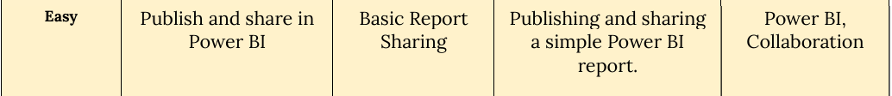
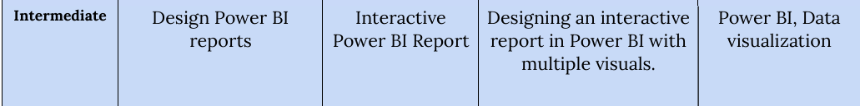
Project Objective:
The main objective of this project is to analyze the provided sales data using Power BI to uncover actionable insights that support strategic decision-making for customer engagement, sales optimization, and store performance.
Tasks Completed:

Slide 3
Easy Level Task:
Publishing and sharing a simple Power BI report.
Power BI allows various sharing methods for collaboration:
Share via Link: Users can generate a shareable link with viewing permissions.
Publish to Web: This feature allows the report to be embedded in websites, making it publicly accessible if desired.
Email Sharing: The report can be directly shared with users via email.
Published Link: https://app.powerbi.com/groups/me/reports/09edfacc-ae70-41b4-8f92-613fcabfd548/6878804ab4032d2a9681?experience=power-bi:

Slide 4
Intermediate Level Task:
Designing an interactive report in Power BI with multiple visuals.
Objective: Develop an interactive, detailed Power BI report that goes beyond basic metrics to provide a deeper analysis of sales, customer demographics, and store performance.
Process:
Data Modeling: Structuring and filtering data to focus on key metrics and enable interactive visuals.
Visualization Techniques: Implementing a variety of visuals, including pie charts, bar graphs, line charts, & maps.
User Interaction: Adding slicers and filters to allow dynamic exploration of different regions, age groups, and categories.
Publishing: Sharing the report with a focus on actionable insights for stakeholders.
Skills Developed: Advanced Power BI features like interactive filters, custom visualizations, and data-driven storytelling.

Slide 5
Dashboard 1 - Sales Overview
Overview: Aggregated view of overall sales performance across categories and regions.
Key Visuals:
Profit by Category: Highlights top categories such as Home Appliances and Computers.
Regional Sales and Profit Comparison: Displays leading regions (United States, China, Germany).
Monthly Sales by Top Categories: An area chart showing trends in top-selling categories throughout the year.
Insights:
Highest profitability from Home Appliances, followed by Computers and Cameras.
Seasonal trends in sales volumes, with certain categories performing better in specific months.

Slide 6
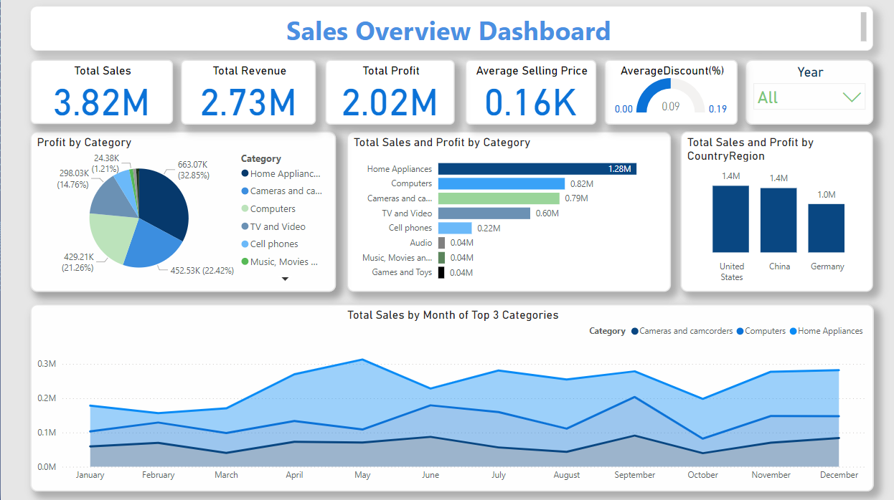

Slide 7

Dashboard 2 – Customer Insights
Overview: Detailed insights into customer demographics and purchasing patterns.
Key Visuals:
Customer Segments: High-value, medium-value, low-value customers.
Demographic Breakdown: Gender, marital status, and education levels.
Customer Retention Rate and Average Order Value: Important indicators of customer loyalty and spending habits.
Insights: High-value customers constitute the largest segment.
Balanced gender distribution, with a majority of customers having a college degree.

Slide 8
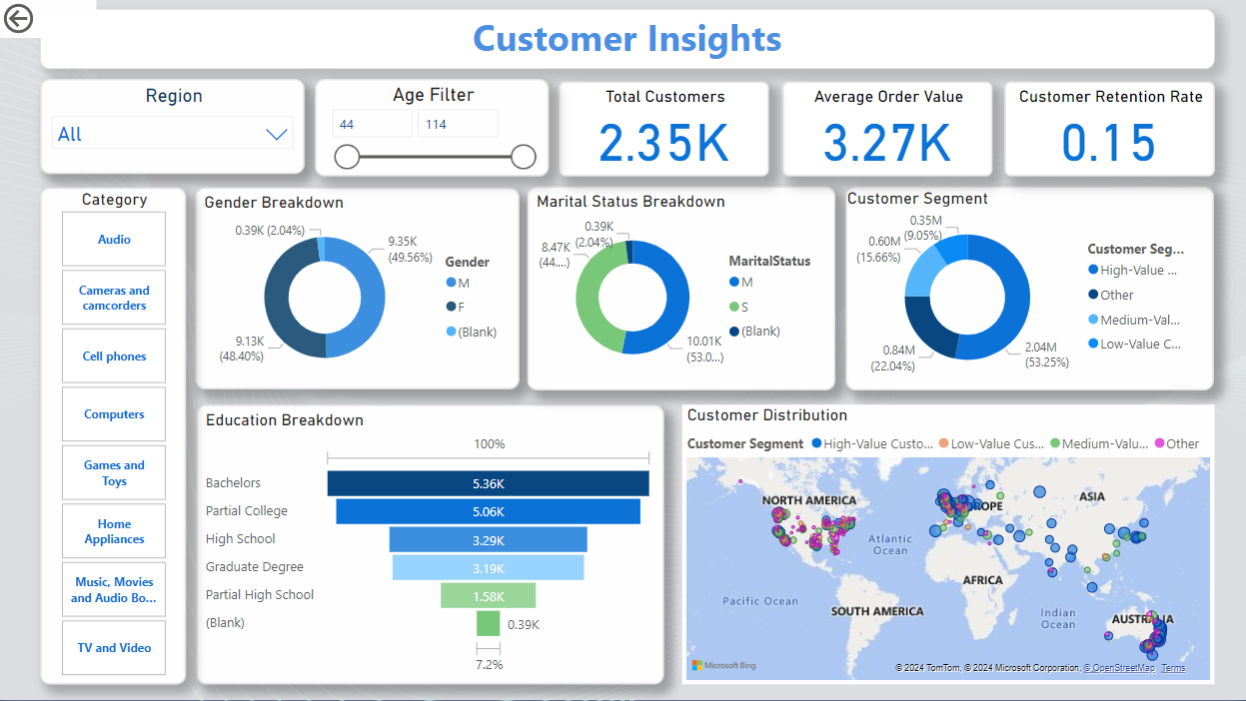

Slide 9
Dashboard 3 – Store Performance Analysis
Overview: A closer look at profit, sales, and revenue across different store locations and categories.
Key Visuals:
Store Profit and Discount Distribution: Shows how profit varies across store locations.
Sales by Category and Store: Highlights which categories perform best in specific stores.
Monthly Sales Trends of Top Stores: A line chart showing monthly sales changes for the top-performing stores.
Insights:
Contoso Asia Online Store shows the highest profit contribution.
Categories like Cell Phones perform well in some regions while others, like Audio, vary by location.

Slide 10
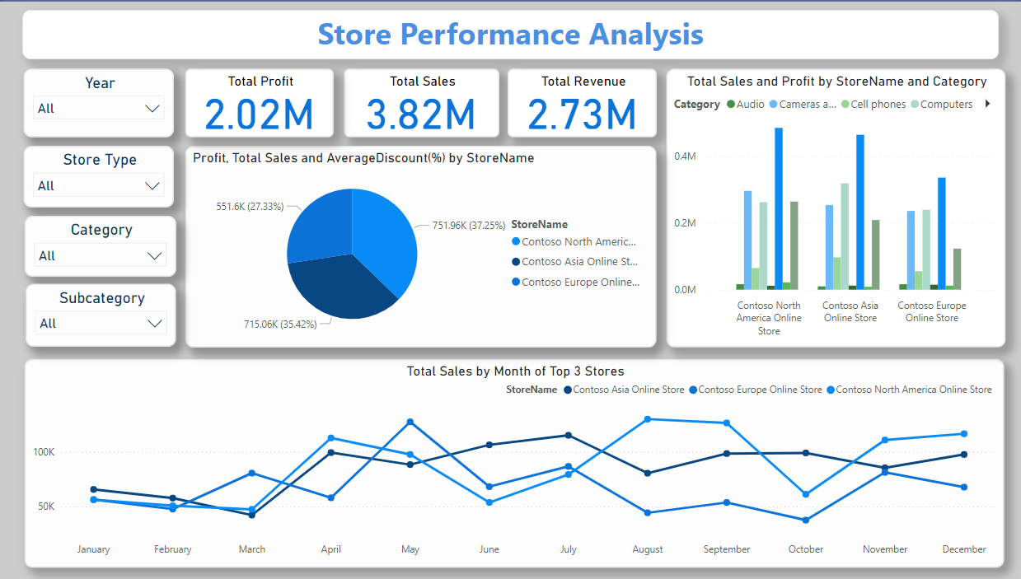

Slide 11
Learning
Skills Developed in Power BI:
Data visualization techniques, interactive filters, and creating advanced dashboards.
Analytical Skills Enhanced:
Ability to interpret complex data, identify key insights, and recommend business actions.
Overall Internship Impact:
Improved data-driven decision-making skills and experience with real-world business analytics.

