Slide 1



Super Store US Report
By Pranjali Shukla

Slide 2

Learning Objectives
Analyze Sales Performance Across Different Product Categories
Identify which product categories contribute the most to overall sales.
Determine seasonal trends affecting sales.
Understand Regional Sales Trends and Their Impact on Revenue
Compare sales data across different states or cities.
Identify underperforming regions and determine the reasons.
Identify Key Customer Segments and Their Purchasing Behavior
Segment customers based on demographics, purchasing power, and buying frequency.
Analyze which products are popular among different customer segments.
Optimize Inventory Management to Reduce Stockouts and Overstocking
Predict demand using past sales trends.
Identify slow-moving inventory to prevent overstock.
Use Data-Driven Insights to Improve Business Decision-Making
Provide executives with real-time reports and dashboards.
Improve forecasting accuracy using historical data.
GOAL

Slide 3
Tools and Technology used
Power BI – Creates interactive dashboards, visual reports, and enables real-time analytics for business decision-making and performance tracking.
DAX (Data Analysis Expressions) – Performs complex calculations, custom aggregations, and time-based analysis to enhance report accuracy and data insights.
SQL – Extracts, filters, and processes structured data efficiently for improved report generation, database management, and analytical performance.
Power Query – Cleans, transforms, and merges raw data while automating repetitive tasks for better consistency, efficiency, and structured reporting.
Data Modeling – Establishes table relationships, eliminates redundancy, and ensures seamless cross-table reporting for improved data accuracy and consistency.
Power BI Service – Publishes, shares, and collaborates reports with real-time updates, cloud accessibility, and secure data management.

Slide 4
Methodology
Data Collection
Sales data extracted from the Super Store US dataset.
Included transactional records, customer details, product categories, and location-based sales.
Data Cleaning & Transformation
Removed missing values, duplicate entries, and inconsistent data.
Standardized date formats and categorized products based on revenue contribution.
Data Analysis & Visualization
Created dashboards in Power BI to track real-time sales performance.
Used different types of charts, such as bar charts, pie charts, and maps, to enhance data representation.
Key Metrics & KPIs Analyzed
Total Sales, Profit Margins, Customer Retention, and Regional Performance.
Compared sales trends over different time periods.
Insights Generation
Identified patterns in customer purchases.
Provided recommendations to improve revenue and operational efficiency.

Slide 5
Problem Statement:
Declining Sales in Certain Regions – Some regions consistently show lower sales performance, impacting overall revenue and profitability.
Uneven Product Demand – Certain products are overstocked while others frequently run out, leading to inefficient inventory management.
High Customer Churn Rate – Many customers do not return after their first purchase, reducing long-term profitability and retention.
Unclear Profit Margins – Some high-selling products have low-profit margins, making it difficult to focus on the most profitable items.
Inefficient Marketing Strategies – Marketing campaigns are not yielding expected returns due to a lack of targeted customer segmentation.
Delayed Order Deliveries – Logistics and supply chain inefficiencies result in longer delivery times, leading to customer dissatisfaction.
Lack of Real-Time Sales Tracking – Decision-makers struggle to access up-to-date sales data, delaying crucial business strategies.
Underperforming Sales Representatives – Sales teams are not meeting targets, and there is no clear insight into their performance metrics.
Poor Regional Performance Insights – The business lacks detailed analysis of why certain regions are underperforming compared to others.
Limited Predictive Analytics – No forecasting models exist to predict future sales trends, leading to missed opportunities for growth.

Slide 6
Solution:
1. Sales Performance Dashboard
Created an interactive dashboard to track sales across different regions.
Allowed managers to filter data based on time periods, product types, and locations.
2. Customer Segmentation
Grouped customers based on their purchasing frequency and preferences.
Designed targeted marketing strategies for different customer segments.
3. Inventory Optimization
Used past sales data to forecast demand and balance stock levels.
Prevented stockouts and reduced overstocking losses.
4. Profitability Analysis
Identified high-margin products and focused on increasing their sales.
Recommended pricing strategies to improve profitability.
5. Regional Sales Analysis
Compared different regions and identified why some were underperforming.
Recommended region-specific promotions and marketing efforts.

Slide 7
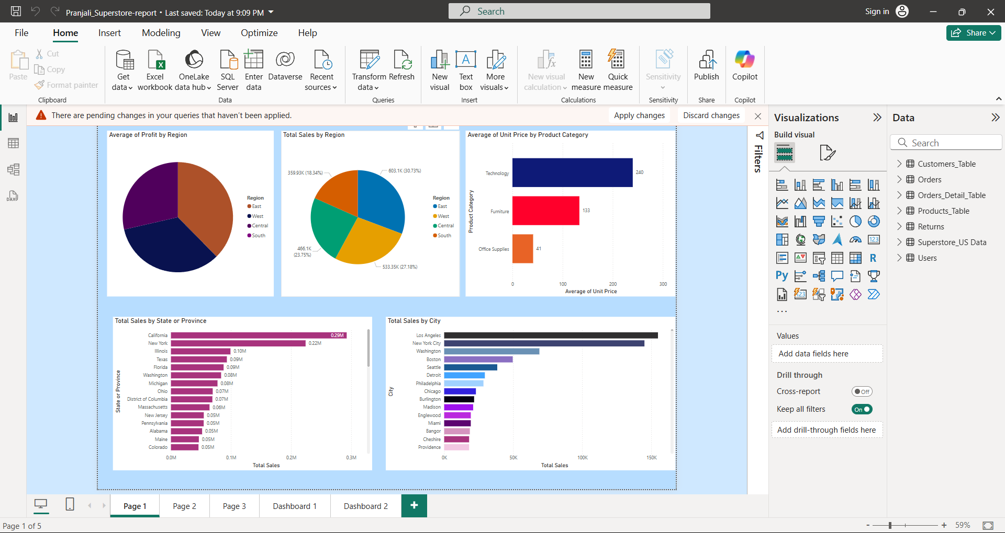
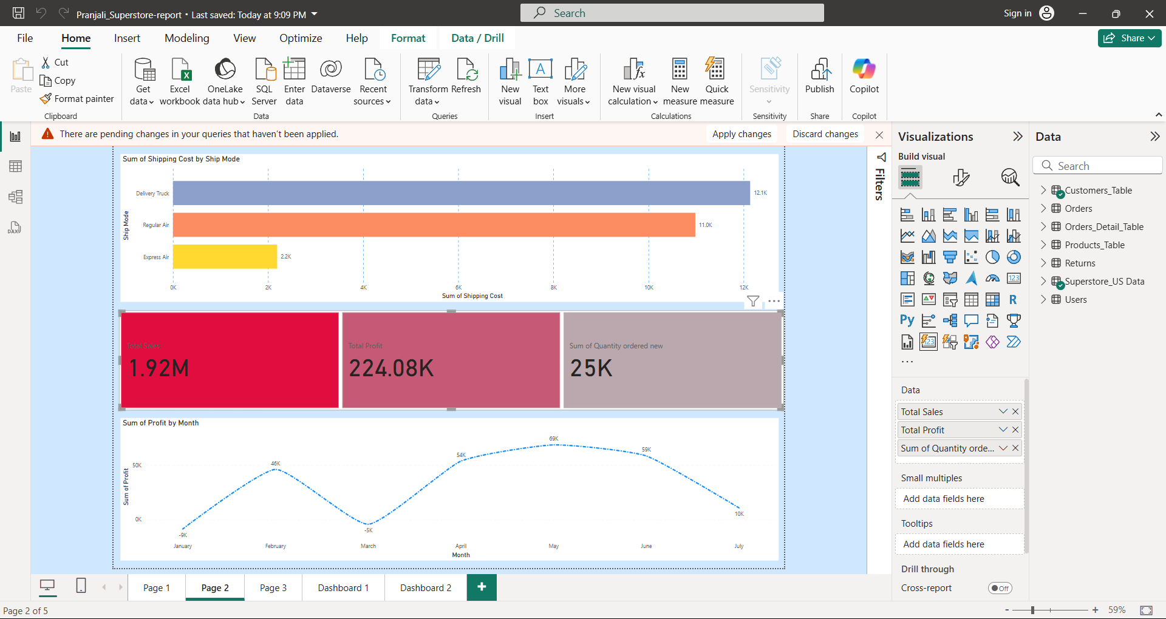
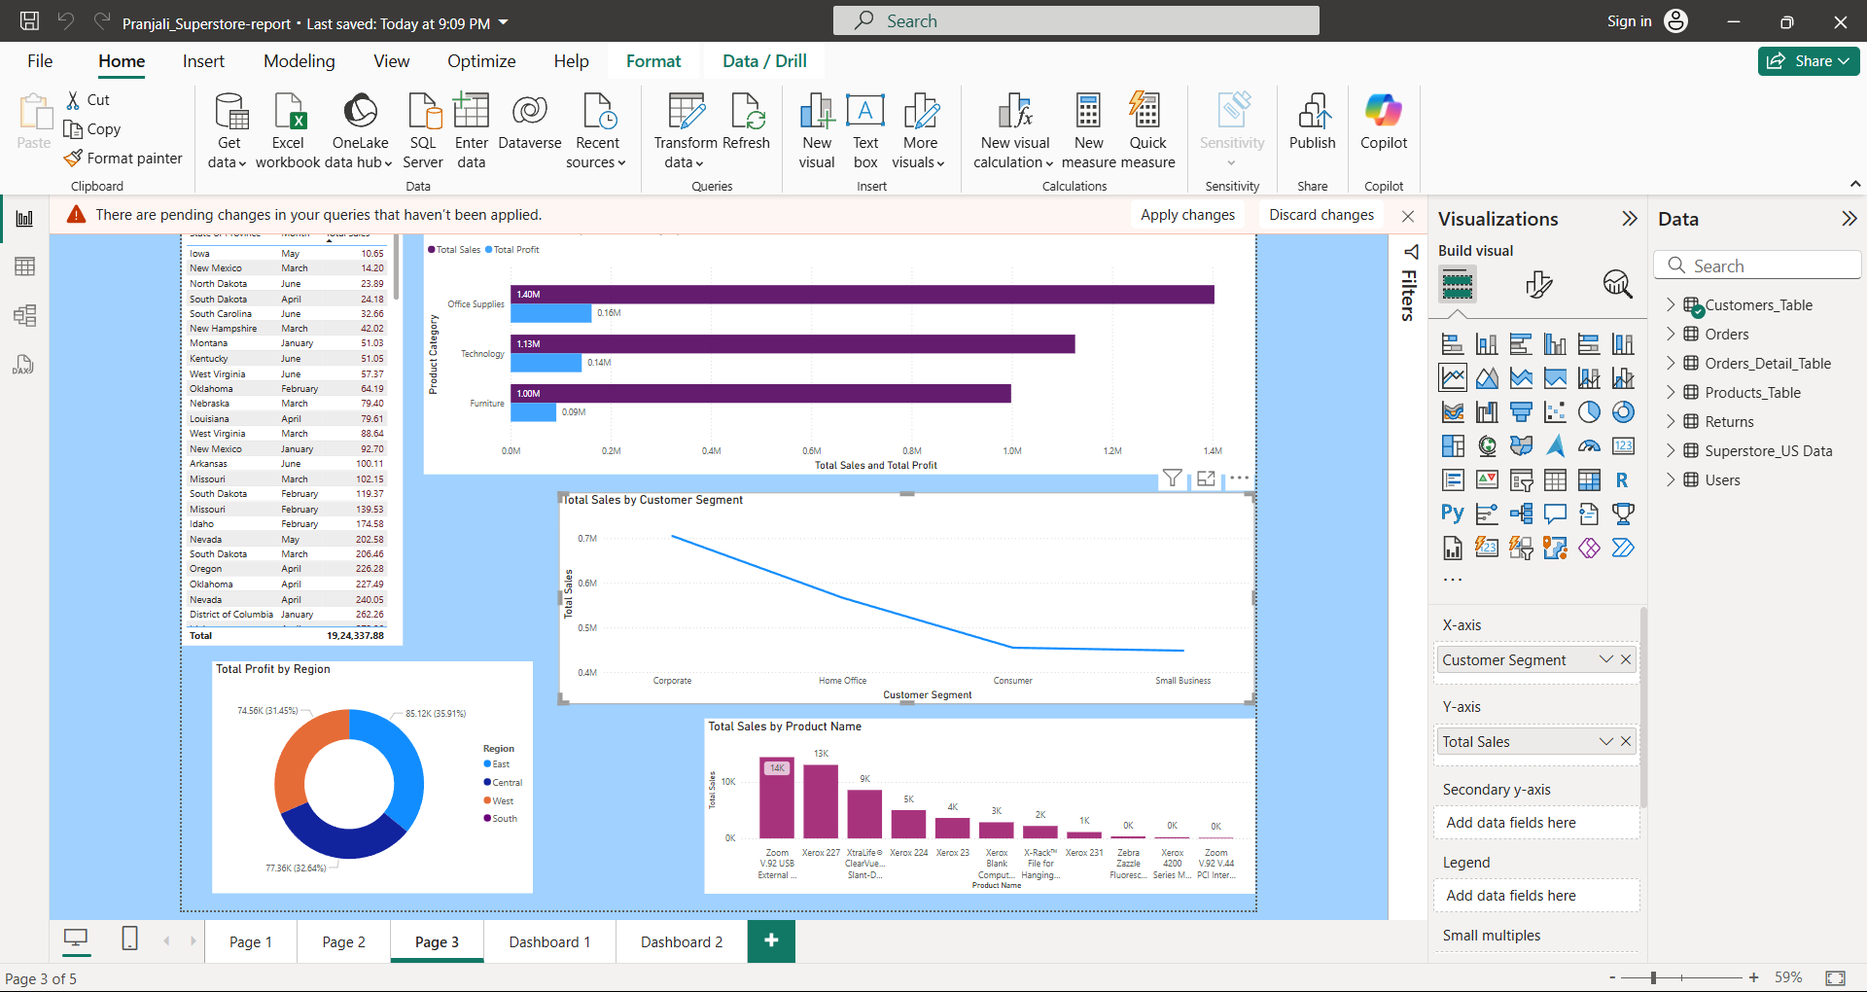
Screenshot of Output:

Slide 8
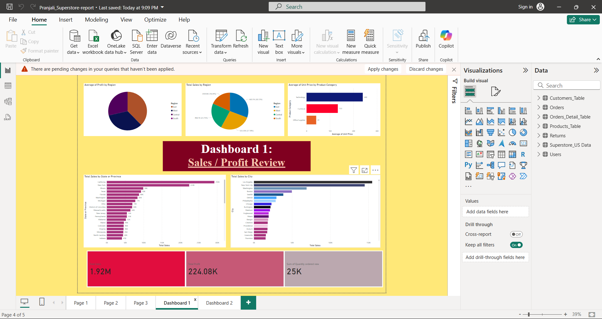
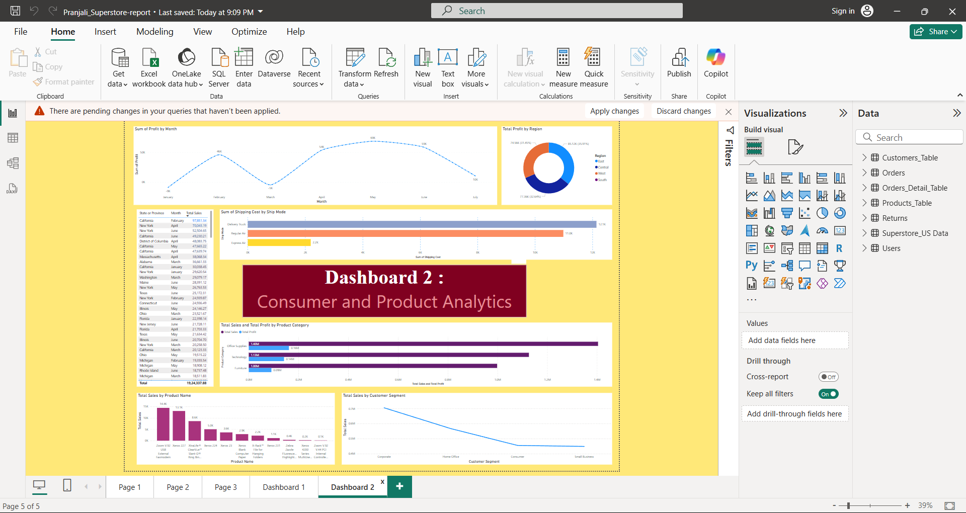

Slide 9
Conclusion:
Data-Driven Decision Making
Power BI dashboards provided real-time insights for executives.
Helped the company make informed decisions quickly.
Sales & Inventory Optimization
Demand forecasting improved stock levels and prevented losses.
Reduced stockouts and ensured high-selling products were always available.
Improved Customer Retention
Recognized loyal customers and personalized marketing campaigns.
Increased repeat purchases by offering targeted promotions.
Future Scope
Implement AI-driven analytics to predict future sales trends.
Enhance customer segmentation with machine learning models.
Improve automation in data processing for real-time insights.

