Slide 1

Title: To analyze suitable place for opening New Shopping Mall
Coursera capstone project

Slide 2
Business Problem:- 1. The objective of this capstone project is to analyze and select the best locations in the city of Pune, India to open a new shopping mall. 2. Using data science methodology and machine learning techniques like clustering, this project aims to provide solutions to answer the business question: In the city , if a property developer is looking to open a new shopping mall, where would you recommend that they open it?

Slide 3
Data :-
To solve the problem, we will need the following data:
List of neighborhood’s in Pune city.
Latitude and longitude coordinates of those neighborhoods. This is required in order to plot the map and to get the venue data.
Venue data, particularly data related to shopping malls. We will use this data to perform clustering on the neighborhoods.

Slide 4
Results:-
1.The results from the k-means clustering show that we can categorize the neighborhoods into 3 clusters based on the frequency of occurrence for “Shopping Mall”:
• Cluster 0: Neighborhoods with moderate number of shopping malls
• Cluster 1: Neighborhoods with no existence of shopping malls
• Cluster 2: Neighborhoods with high concentration of shopping malls
2. The results of the clustering are visualized in the map below with cluster 0 in red color, cluster 1 in purple color, and cluster 2 in mint green color.

Slide 5
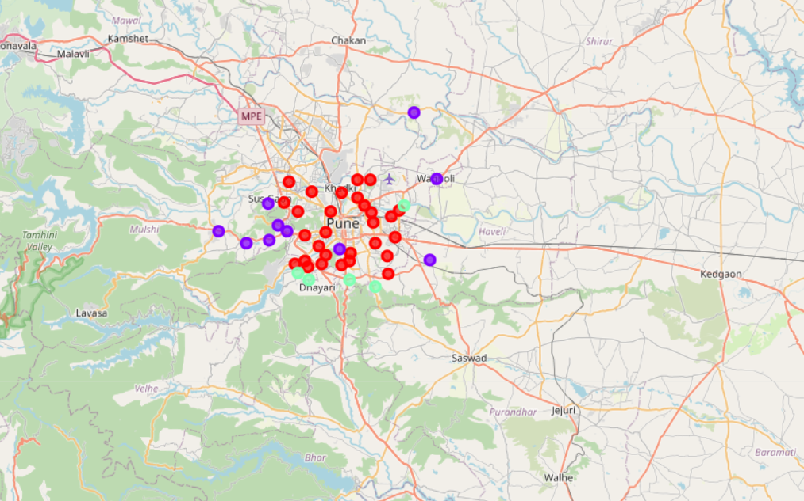
Clustering on Map in Pune city

Slide 6
Conclusion:-
In this project analysis we just considered the areas which are under Municipal corporation. There are other factors which need to be considered.
Factors like quality of housing area , any industries or IT parks in vicinity these are also the factors that would add quality to result. As in where the mall could be in more good business.
Other API’s like Zomato should also be considered in order to get all venues present in the areas of cluster.

Slide 7
THANK YOU

