Slide 1

DYNAMIC FOOD DELIVERY RESPONSE TIME CALCULATOR
M
A
C
H
I
N
E
L
E
A
R
N
I
N
G
GAUTAM : 102203498
PRANJAL : 102203972 DATE : 25 NOVEMBER 2024

Slide 2
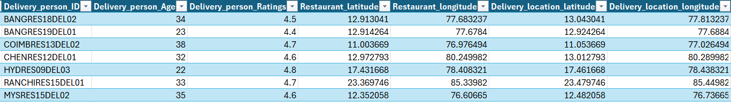
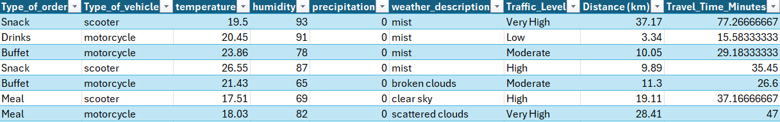
INTRODUCTION
PURPOSE
OBJECTIVE
The project aims to develop a machine learning model that accurately predicts food delivery times, addressing one of the most crucial aspects of customer satisfaction in the food delivery industry. By predicting delivery time more precisely, businesses can improve operational efficiency, reduce customer wait times, and provide more accurate delivery estimates.
To enhance the accuracy of delivery time estimates and to examine the influence of factors that impact delivery speed, such as traffic, weather, and delivery personnel characteristics. This model could eventually be deployed to provide real-time estimates to customers, factoring in dynamic data from weather and traffic conditions. It can also predicted delays, helping owners make data-driven decisions.

Slide 3
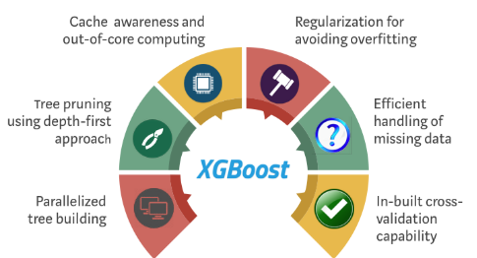
LITERATURE REVIEW
Existing Research in Food Delivery Optimization: Food delivery optimization has been a focus of numerous studies, primarily targeting route planning, traffic prediction, and ensuring customer satisfaction. For instance, predictive analytics and real-time traffic updates are commonly employed to streamline operations in popular applications like Blinkit, Zomato, and Swiggy. However, these approaches often fall short of leveraging an integrated framework that accounts for diverse delivery dynamics beyond traffic, such as weather conditions or individual delivery personnel characteristics.
Gaps in Current Models:
Traffic Prediction Focus: Current models heavily emphasize traffic patterns and route efficiency. While this reduces travel time, it disregards other critical variables such as delivery personnel’s experience, physical attributes, or ratings, which could influence delivery efficiency.
Neglect of Weather Conditions: Weather conditions, such as heavy rain or snow, are rarely incorporated into predictive models despite their significant impact on travel times and safety.
Vehicle Type: The type of vehicle (e.g., bike, car, scooter) affects both the speed and accessibility of delivery in different urban terrains, yet this is not commonly factored in existing platforms.

Slide 4
METHODOLOGY
METHODS
KAGGLE DATASET
TOMTOM API
WEATHER API
MySQL
Y PROFILING
STATISTICS
ONE HOT ENCODING
PCA
XGBoost
PERFORMANCE MEASURES
STEP 1 : Data Collection: Gathered dataset from Kaggle with features like ratings, age, location, coordinates, food type, and vehicle type. STEP 2 : Feature Enrichment: Added weather (Weather API), traffic level, and distance (TomTom API). STEP 3 : Target Calculation: Calculated delivery time target with TomTom API and processed it further in Microsoft Excel. STEP 4 : Data Import: Imported data into MySQL for querying capability STEP 5 : EDA: Performed Exploratory Data Analysis with Y profiling. STEP 6 : Data Preparation: Addressed missing values, one-hot encoded categorical features, and applied PCA for correlated features. STEP 7 : Modeling: Split data, tuned hyperparameters, and trained the XGBoost model. STEP 8 : Evaluation: Assessed model using metrics like RMSE and feature importance.

Slide 5
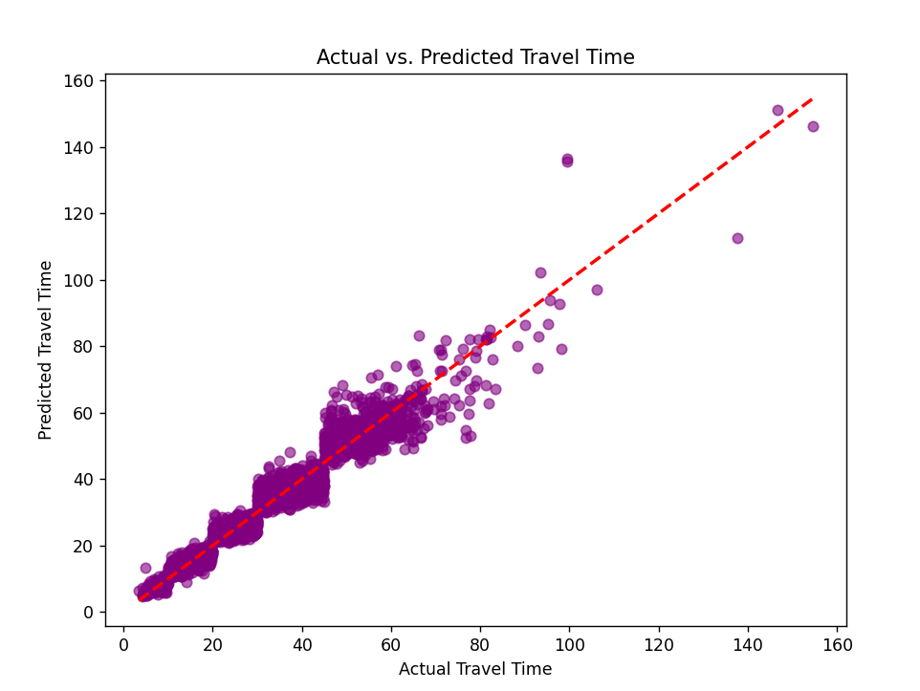
RESULTS

Slide 6
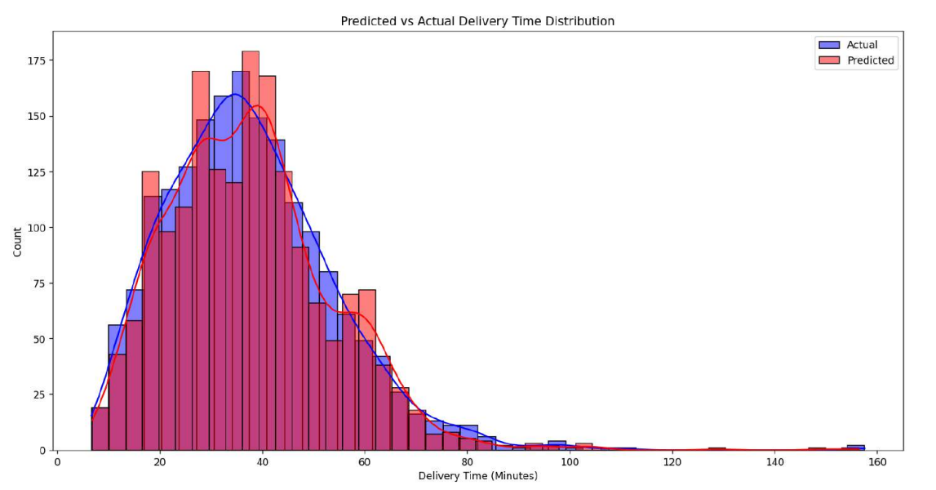
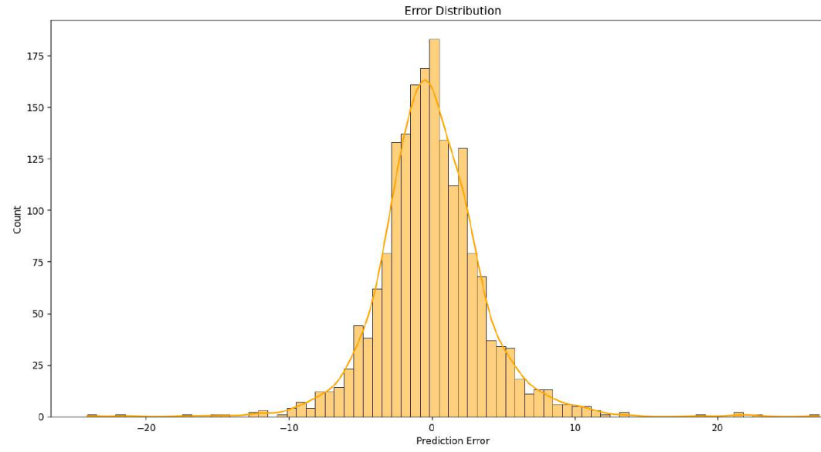
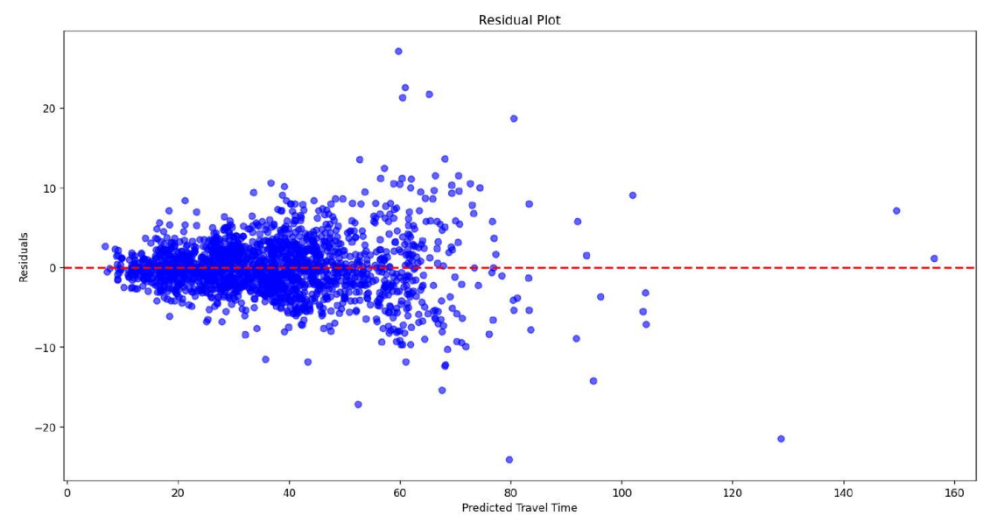
Predicted vs. Actual Delivery Time Distribution (Top Left): This histogram shows how well the model’s predicted delivery times align with the actual times, indicating overall accuracy and highlighting any discrepancies in prediction.
Error Distribution (Top Right): The error distribution plot shows the spread of prediction errors. A bell-shaped distribution centered around zero suggests that the model has balanced errors, with minimal over- or under-predictions.
Residual Plot (Bottom Left): The residual plot compares residuals (errors) against predicted travel time. A random scatter around zero indicates that errors are uniformly distributed and that the model captures patterns in the data effectively without significant bias.
Predicted vs. Actual Delivery Time Distribution : The model’s predicted delivery times align with the actual times, indicating overall accuracy and highlighting any discrepancies in prediction.
Error Distribution : The error distribution plot shows the spread of prediction errors. A bell-shaped distribution centered around zero suggests that the model has balanced errors, with minimal over- or under-predictions. Residual Plot (Bottom Left): The residual plot compares residuals (errors) against predicted travel time. A random scatter around zero indicates that errors are uniformly distributed and that the model captures patterns in the data effectively without significant bias.

Slide 7
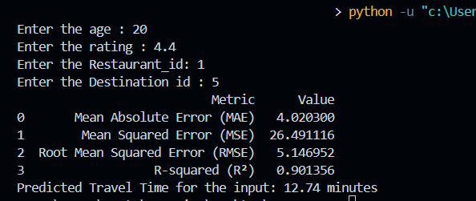
CONCLUSION
RECOMMENDATIONS :
We can further improve customer satisfaction by including Route optimizations, Time of Day (Peak hours can influence delivery time due to increased demand), Geographic data (condition of roads), Day of the Week (Weekends and holidays might have different traffic patterns, Experience level and Restaurant opening hours.
Our XGBoost model effectively predicts food delivery time by leveraging data on delivery personnel, restaurant and customer locations, food type, vehicle type, weather, traffic, and distance. Key preprocessing steps included feature engineering, data encoding, and dimensionality reduction to optimize performance.
The model demonstrated high accuracy with low error rates (measured by RMSE and MAE), providing reliable delivery time estimates.
The model enables more accurate delivery time predictions, helping improve customer satisfaction and operational efficiency
ACCURACY : 92.7%

Slide 8
REFERENCES
https://www.nvidia.com/en-in/glossary/xgboost
https://www.geeksforgeeks.org/xgboost/
https://www.researchgate.net/publication/349514304_Effect_of_weather_on_online_food_ordering
https://ieeexplore.ieee.org/document/8955108
https://www.foodstorm.com/blog/feature-spotlight-dynamic-delivery-times
https://triplogmileage.com/rideshare/best-time-to-do-uber-eats/

