Slide 1
Mega Mart Strategic Data Insights
Data-Driven Recommendations for Growth

Slide 2
Agenda
Sales Performance Insights
Inventory Management
Customer Behavior Analysis
Promotional Effectiveness
Channel Performance
Supply Chain and Logistics
Recommendations

Slide 3
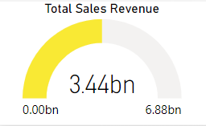
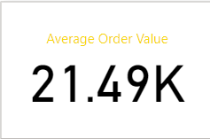
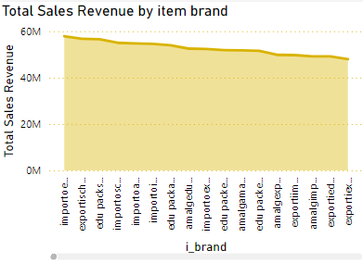
Sales Performance Insights
Key Findings:
Top Categories: Electronics and groceries generated the highest revenue.
Sales Trends: Significant peaks in sales during the holiday season.
Regional Performance: High sales in urban regions but low performance in rural areas.
Recommendation:
Focus marketing on high-performing regions and increase promotions during sales peaks.

Slide 4
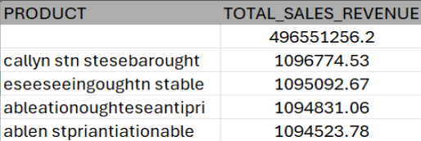
Top-Selling Products & Channels
Key Findings:
Top 5 best-selling products accounted for 35% of total sales.
Channels: Online sales grew by 20% compared to in-store sales.
Recommendation:
Stock top-selling products across all channels and integrate more omni-channel strategies.

Slide 5
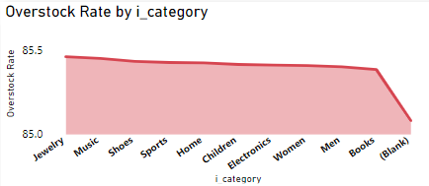
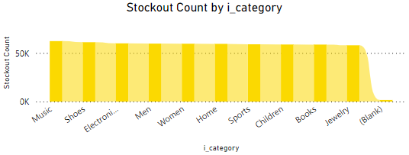
Inventory Management
Key Findings:
High stockout rates for fast-moving products.
Overstocking in slower categories like home decor.
Recommendation:
Automate replenishment for high-demand products.
Implement clearance sales to manage overstock.

Slide 6
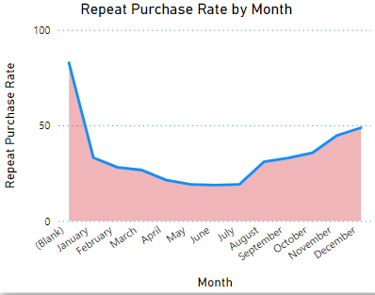
Customer Behavior Analysis
Key Findings:
Majority of customers are in the 26-35 age group.
Repeat Purchases: 40% of customers made repeat purchases.
Recommendation:
Target younger customers with personalized promotions and introduce loyalty programs for repeat buyers.

Slide 7
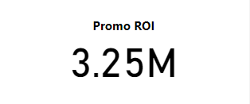
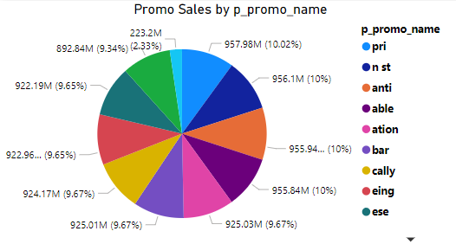
Promotional Effectiveness
Key Findings:
Discounts were more effective than coupons in driving sales (15% higher sales).
Certain promotions yielded higher ROI than others.
Recommendation:
Prioritize discount-based promotions and discontinue low-ROI campaigns.

Slide 8
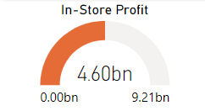
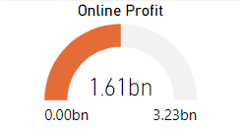
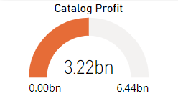
Channel Performance
Key Findings:
Web sales saw a significant increase, contributing 40% to overall revenue.
In-store sales growth has stagnated.
Recommendation:
Invest further in e-commerce and improve the in-store experience to attract more customers.

Slide 9
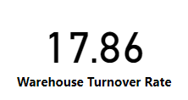
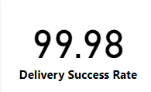
Supply Chain and Logistics
Key Findings:
Warehouses have inconsistent stock turnover rates.
Shipping delays in certain regions due to bottlenecks.
Recommendation:
Optimize warehouse operations and streamline shipping routes to reduce delivery times.

Slide 10
Recommendations Summary
Sales Strategy: Focus on top categories, regions, and channels
Inventory: Automate high-demand replenishment and manage overstock through promotions.
Customer Engagement: Expand loyalty programs and personalized offers.
Promotions: Run more discount-based campaigns and prioritize high-ROI efforts.
Supply Chain: Address bottlenecks and improve shipping efficiency.

Slide 11
Path to Sustainable Growth
Operational Efficiency: Optimize inventory and supply chain.
Customer Satisfaction: Enhance loyalty programs and improve the shopping experience.
Sales & Profitability: Leverage insights from data to drive revenue and increase profitability.

Slide 12
Conclusion
Data-driven strategies can help Mega Mart adapt to changing consumer behaviors and market conditions.
With these insights, Mega Mart can achieve both short-term operational improvements and long-term growth.

Slide 13

Thank you

