Slide 1
ROSManipal-RM

Slide 2
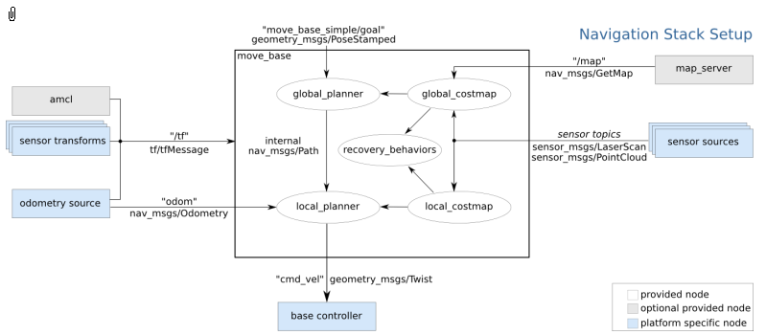
Navigation Stack

Slide 3
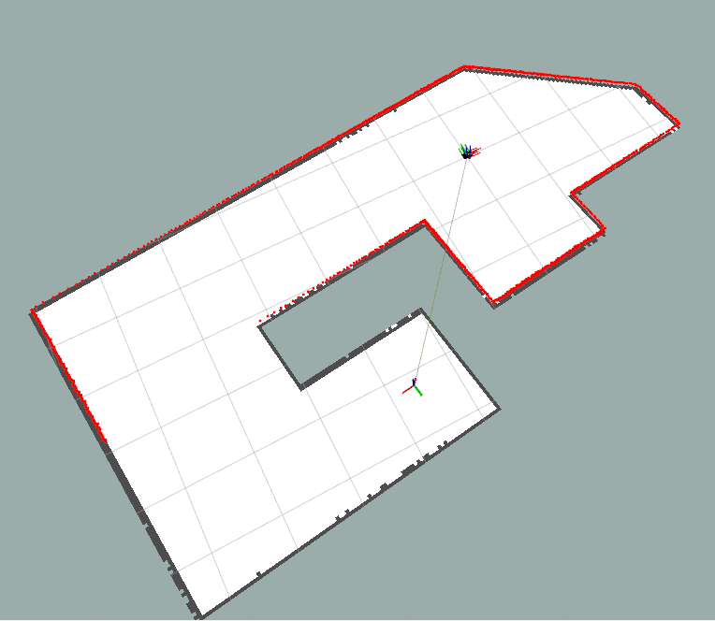
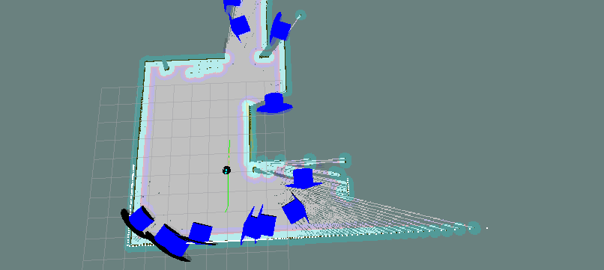
Mapping and exploration

Slide 4
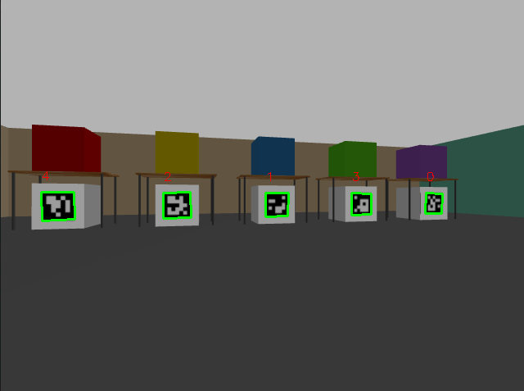
Aruco Detection
Aruco markers of 5x5 dictionary are detected
The cv2.aruco module is used to identify the markers
RGB values of the boxes are stored
These values are then published to a topic

Slide 5
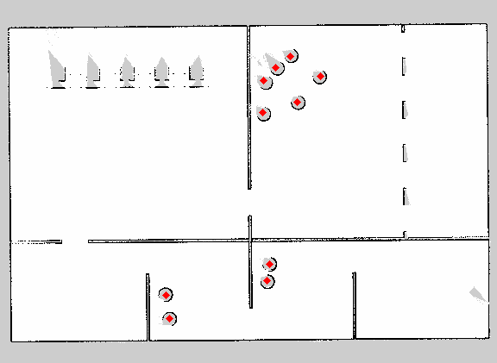
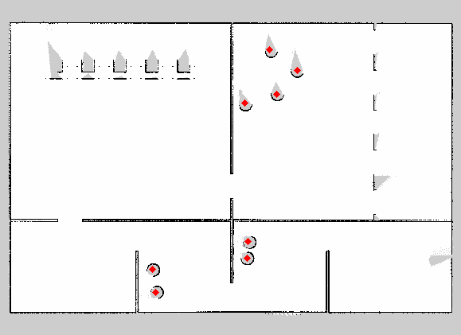
Ball detection
The arena map is saved using the map_server package.
The hough circle algorithm is used to detect and count all circular balls
10 balls detected
8 balls detected

Slide 6
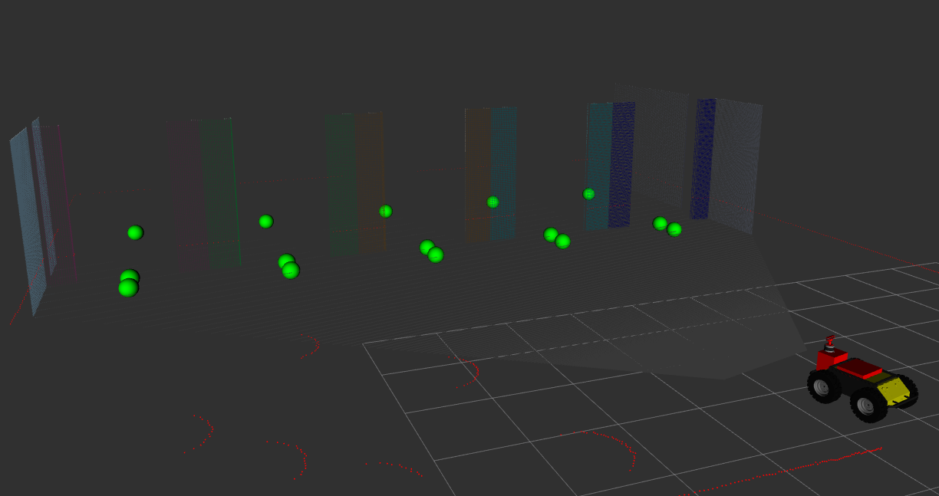
Gate Detection
Using the colour values published by aruco detection, the gates are located and their spatial positions are determined.
Additionally, navigation poses are calculated for each gate.

Slide 7
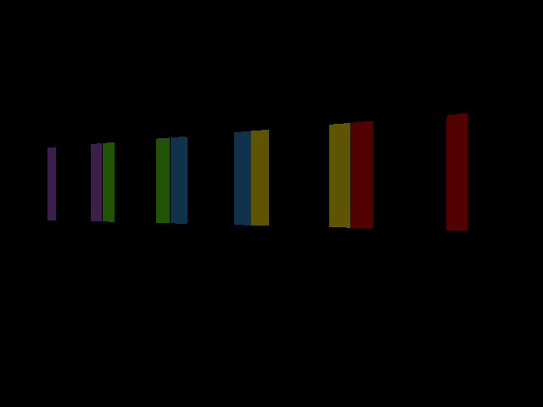
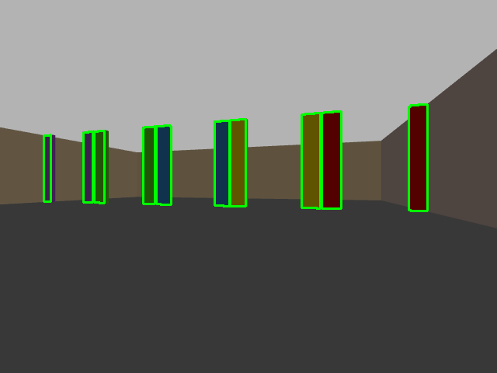
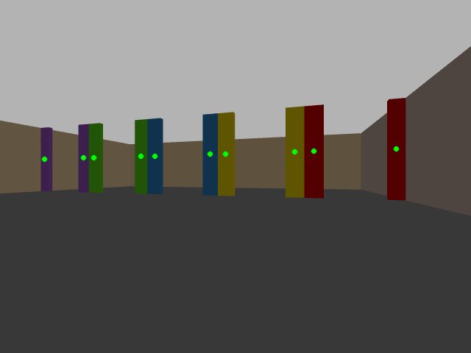
Steps for Gate Detection
Mask with BGR values
Contour the masks
Compute moment
of each contour
The spatial location of each moment centre is extracted from the depth camera point cloud. Midpoint of the two moment centres is the gate entrance.

Slide 8
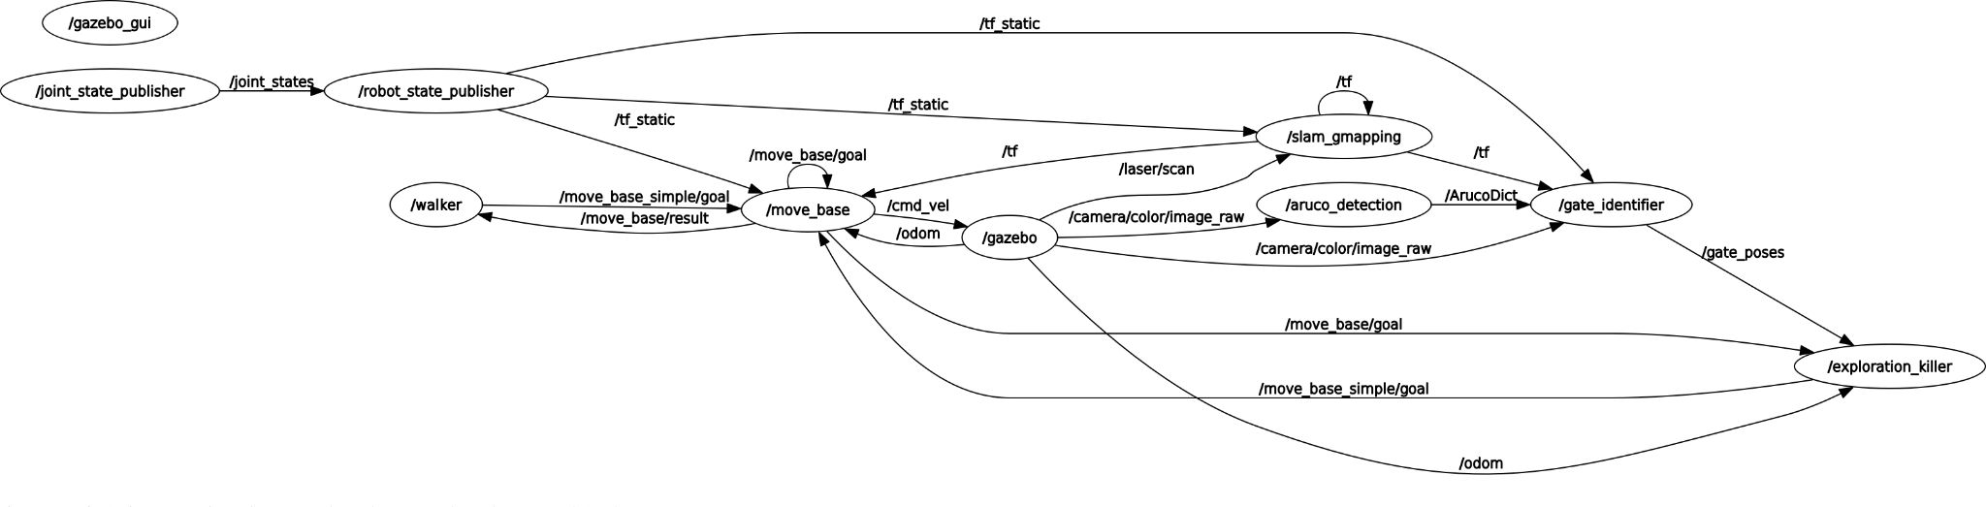
Rqt Graph

