Slide 1
Touch Detector Using Arduino and TTP223
Presented By: [Your Name]
Date: [Date]

Slide 2
Introduction
• A touch detector detects human touch.
• Uses TTP223 capacitive touch sensor.
• Interfaced with Arduino to trigger an LED.
• Implemented in Proteus 8 for simulation.

Slide 3
Components Used
• Arduino Uno (1)
• TTP223 Touch Sensor (1)
• LED (1)
• Resistor (220Ω) (1)
• Connecting Wires (As needed)

Slide 4
Circuit Diagram
Proteus-based schematic.
(Insert circuit diagram image here)

Slide 5
Working Principle
• TTP223 detects capacitive touch.
• When touched, OUT pin goes HIGH.
• Arduino reads HIGH signal and turns LED ON.
• Otherwise, LED remains OFF.

Slide 6
Connections Table
Component | Pin | Connected To
------------|------|----------------
TTP223 Sensor | VCC | 5V (Arduino)
TTP223 Sensor | GND | GND (Arduino)
TTP223 Sensor | OUT | Digital Pin 2 (Arduino)
LED | Anode (+) | Digital Pin 4 (Arduino)
LED | Cathode (-) | GND (Arduino)
Resistor (220Ω) | One end | LED Anode (+)
Resistor (220Ω) | Other end | Digital Pin 4 (Arduino)

Slide 7
Arduino Code
```cpp
#define TOUCH_SENSOR 2
#define LED 4
void setup() {
pinMode(TOUCH_SENSOR, INPUT);
pinMode(LED, OUTPUT);
}
void loop() {
int touchState = digitalRead(TOUCH_SENSOR);
if (touchState == HIGH) {
digitalWrite(LED, HIGH);
} else {
digitalWrite(LED, LOW);
}
}
```

Slide 8
Simulation in Proteus
• Open Proteus 8 and add Arduino Uno.
• Connect TTP223 sensor, LED, and resistor.
• Upload HEX file from Arduino IDE.
• Run simulation and observe LED behavior.
(Insert simulation screenshot here)

Slide 9
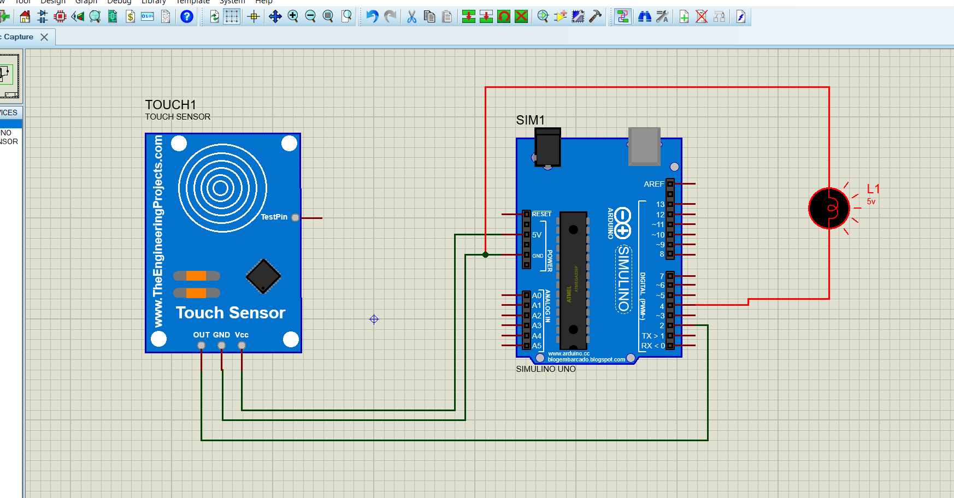

Slide 10
Results & Observations
• Before Touch: LED OFF
• On Touch: LED ON
• After Release: LED OFF
(Insert working GIF/image here)

Slide 11
Conclusion & Future Scope
• Successfully implemented touch detection.
• Verified circuit operation in Proteus.
• Future Scope:
- Used in touch-based switches, security systems.
- Can replace mechanical buttons.

Slide 12
Thank You!
Any Questions? 😊

