Slide 1

GitHub Copilot Hackathon
Team Name-MechaTech
Team Leader Name- Pranjil Jain
Team Leader Email Address-pranjiljain26@gmail.com
Theme 1: Weather Forecasting Tool (Python)

Slide 2

Brief Summary of Project:
Create a command-line tool that accepts a city's name and returns the current weather forecast.
We can simply enter a city’s name,Pincode,or even just the state name and the app will return the current Weather,Weather description,Temperature and the Pressure(in hg) of that place.

Slide 3
Business Challenge /Use Cases
(1) Clothing Recommendation-By Integrating this app with a physical gadget we can suggest a person what type of clothing should they wear on a particular day.
And recommend them for carrying other necessary accesories to carry with them.
(2)Accurate Weather Data: The app will utilize reliable weather APIs or data sources to gather accurate and up-to-date weather information. This ensures that event planners have access to the most precise forecasts, reducing the risk of unexpected weather-related disruptions.
(3)Customer Satisfaction: Delivering a seamless and enjoyable experience to attendees is crucial for event success. By leveraging the weather forecasting app, event organizers can adapt the event layout, provide appropriate amenities, and ensure the comfort of participants. This leads to increased customer satisfaction and positive event reviews, contributing to the event's reputation and future success.
(4)Weather Notifications: The app can send push notifications or emails to event organizers when significant weather changes occur, such as the possibility of rain or sudden temperature drops. This feature enables them to monitor weather conditions closely and make timely decisions regarding event adjustments or communication with attendees.
(5)Risk Assessment: The app evaluates the level of risk associated with specific weather conditions and provides recommendations accordingly. For instance, if the forecast predicts heavy rain, the app may suggest arranging additional tents or relocating certain activities to indoor areas. It can also provide guidance on emergency preparedness and evacuation plans.

Slide 4
Proposed Solution-
A weather app with Python Leveraging the OpenWeather Api for current weather status.
(It will require the computer to be connected to the internet)
Takes the data in the form of JSON from the website and we have taken some part from the JSON and used for diplaying the weather conditions.
We have other data also that can be used for showing very easily but for easier interface and better user experience we have shown only limited options.

Slide 5
Technology/Tool Stack Used:
Python- the basic tool for coding the solution.
tkinter library-> for GUI Application Development It provides a framework for creating windows, dialogs, and various GUI elements to build interactive and user-friendly applications.
Operweather API -> It provides current weather data including temperature, humidity, wind speed, and more for specific locations worldwide.
requests -> It was used to simplifying the HTTP request procedure,
for handling the responses, and working with APIs in the project.

Slide 6
Mention of usage of Github Copilot:
Github Copilot automatically completed some part of code that was to be same as above part just need to change the dimesnions.
Github Pilot was very handy in helping writing the codes easily and faster.
And if we try to implement some extra features or add some functions in the solution
copilot would be handy as it would reduce our redundant code writing and help completing the code faster and easy debugging.
We can add another feature of suggesting the type of clothing to wear and wheater to carry umbrella or not and so to the app.
And for this feature we can use copilot to integrate some machine learning algorithms and writing the complex codes for us.
Thereby making solution implementation easy and improving productivity.

Slide 7
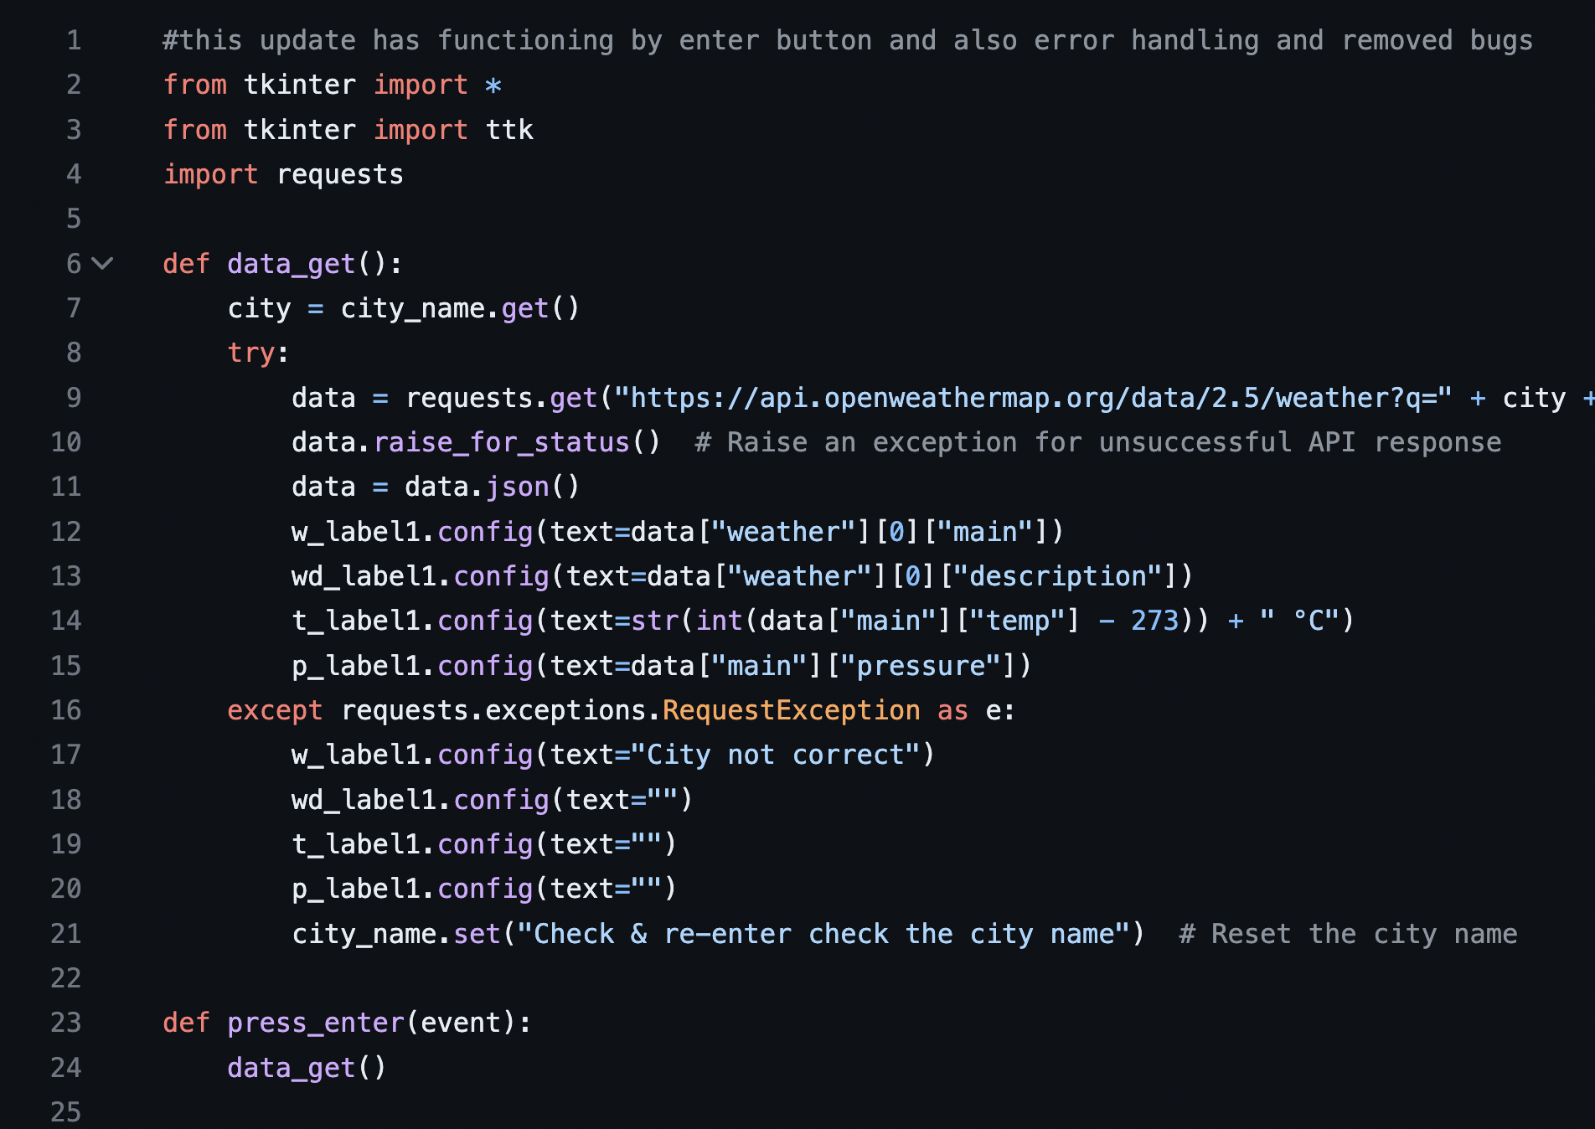
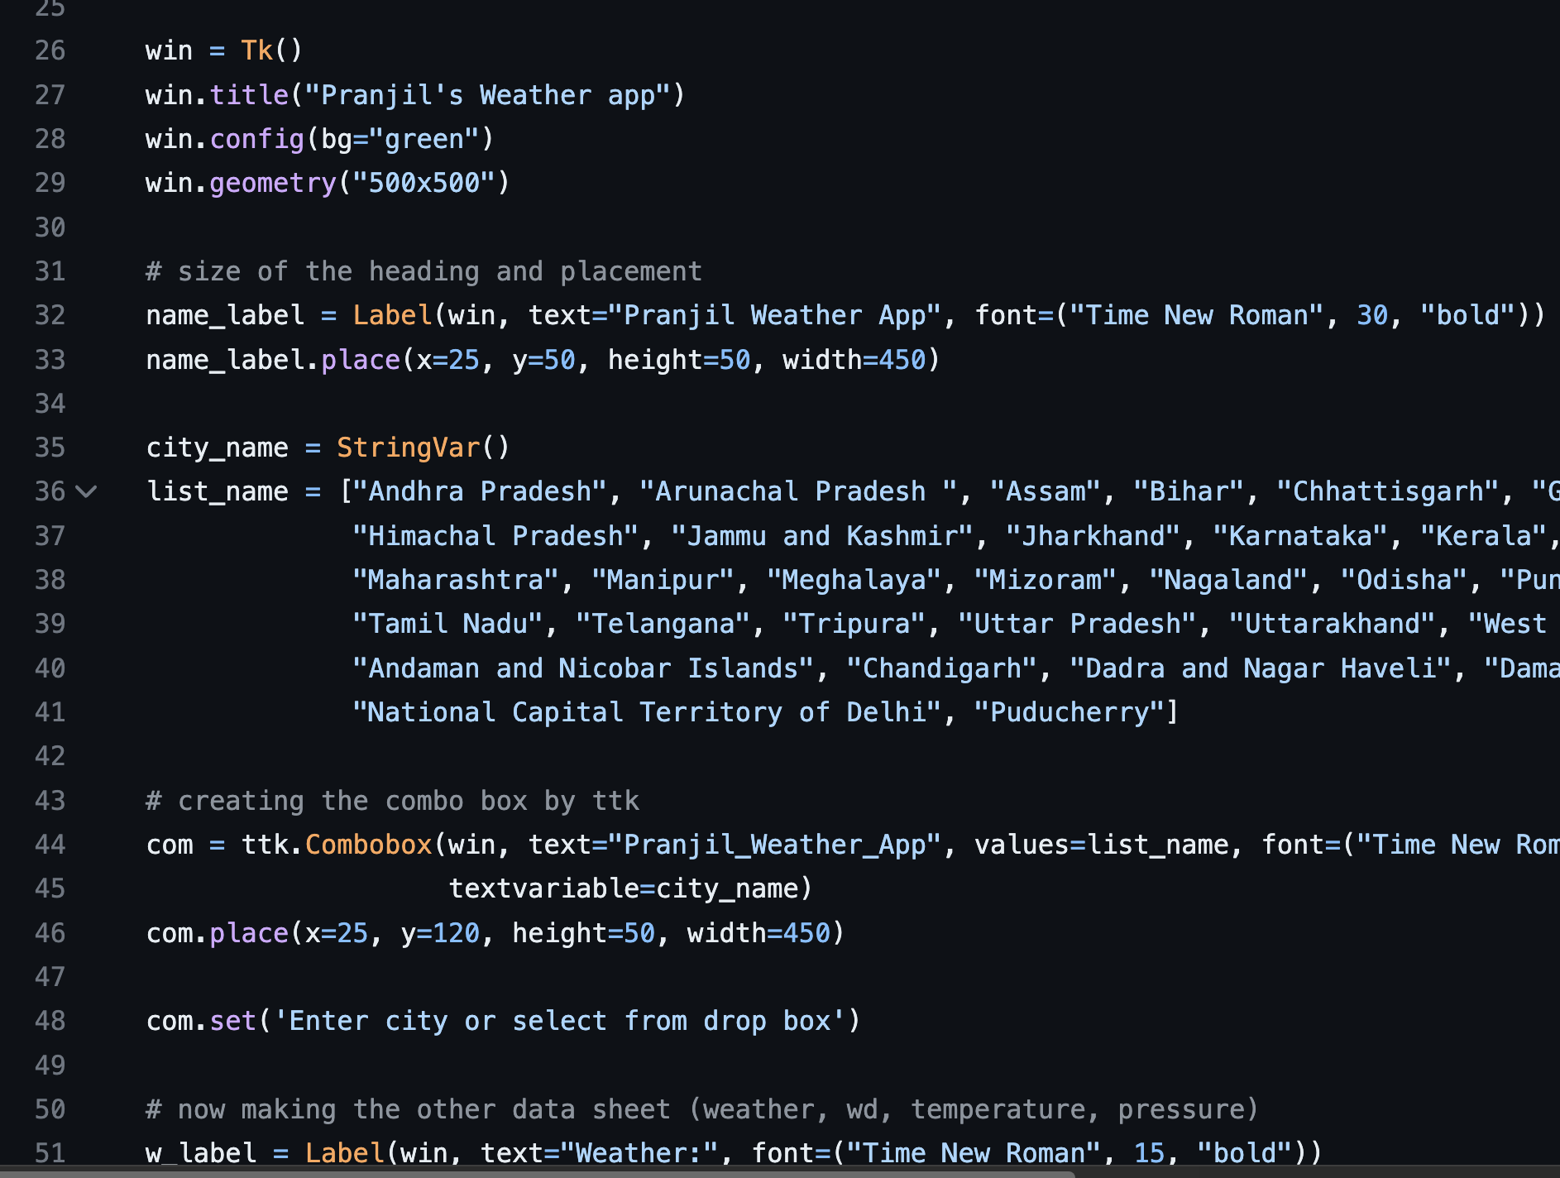
Source code in zip file / Github link :
https://github.com/Pranjiljain26/Weather-App

Slide 8
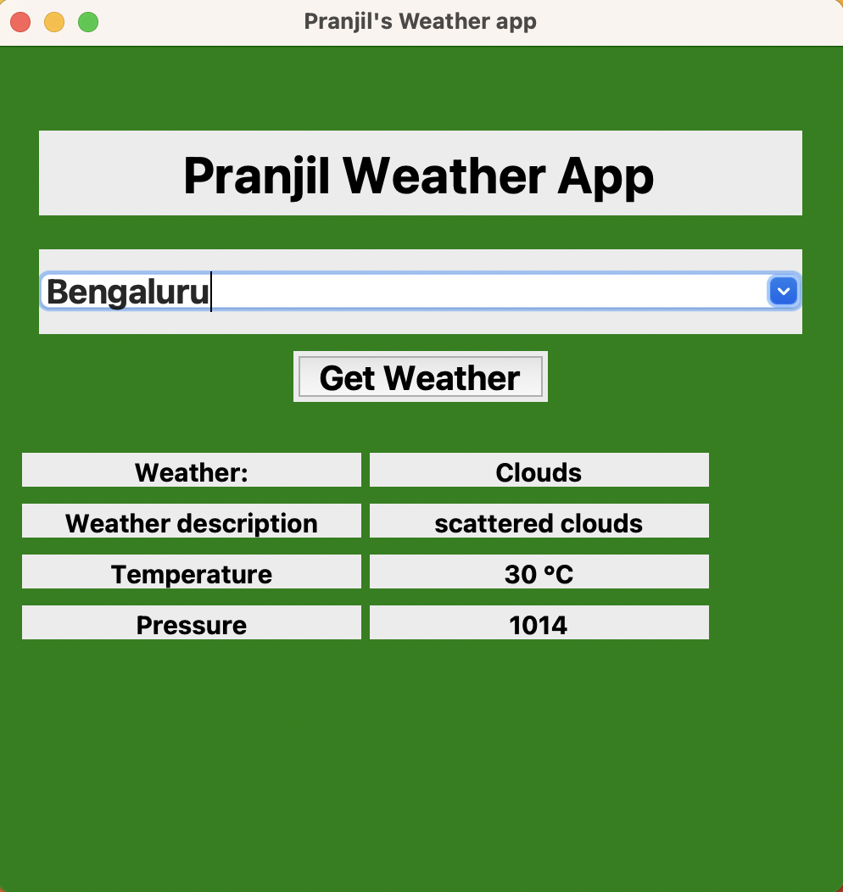
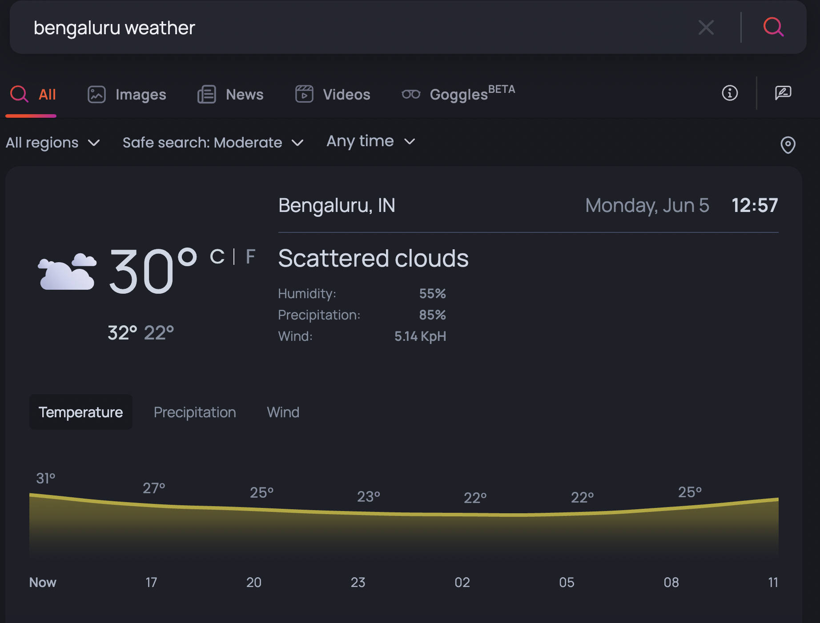
Weather status by the APP
Current weather on google

Slide 9
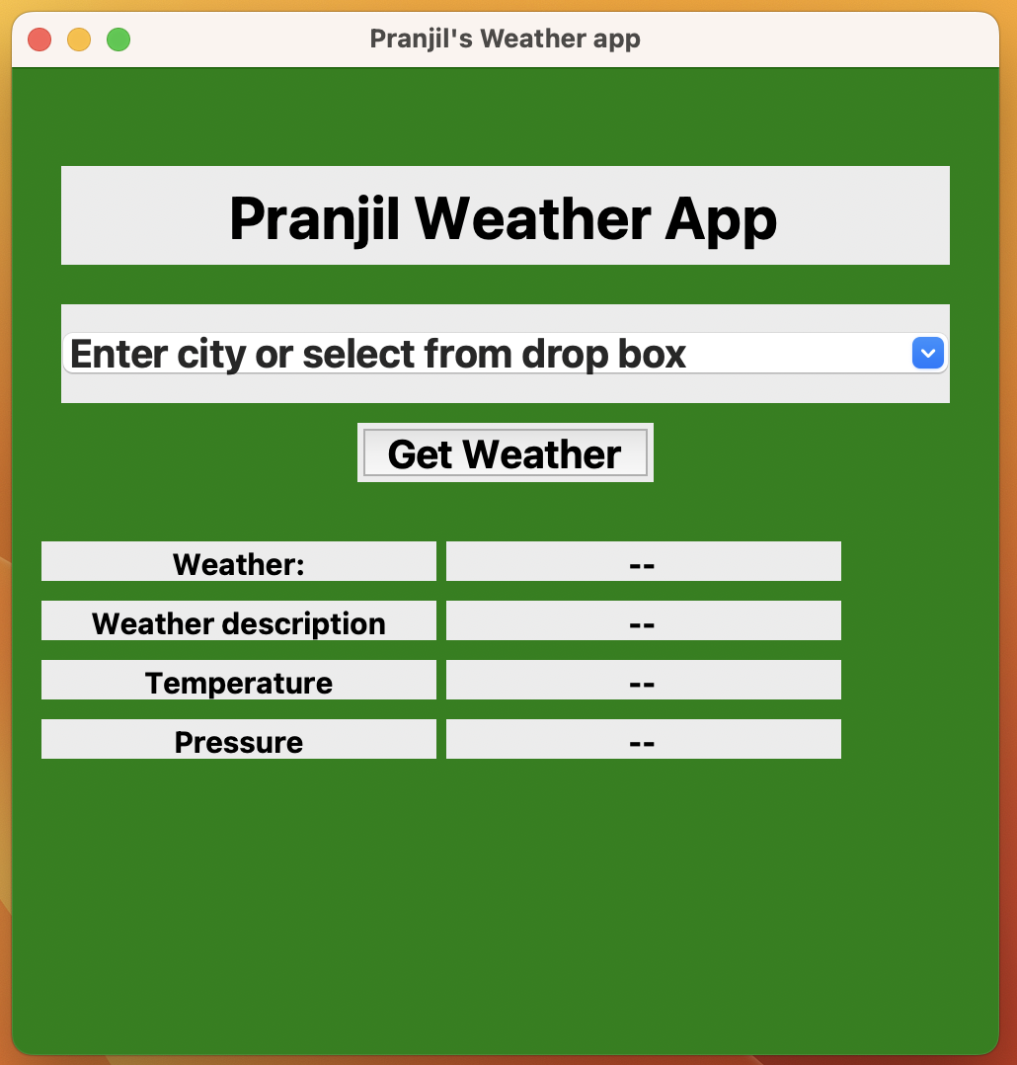
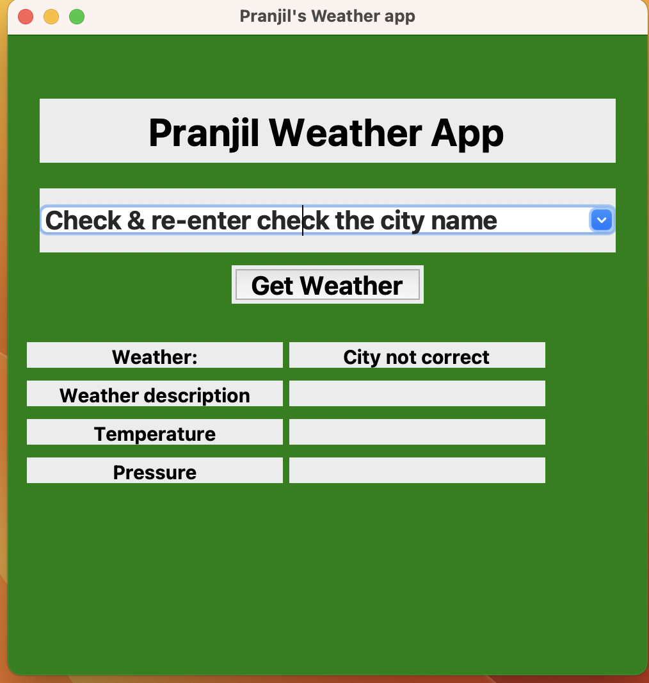
Error Handling:
If a unknown city is entered then it will reset name and ask to re-enter the city name
App Normal view

Slide 10
THANK YOU

