Slide 1


RESTAURANT MANAGEMENT WEBSITE
Submitted by
Abhishek devbone
Roll no. 71204
Pranjali zendekar
Roll no.71207

Slide 2
Introduction:
The Restaurant Management System Is A Website
We propose to build a website application Restaurant Management System that can efficiently handle restaurant and manage various branches under the supervision of the administrator. The business in restaurant is now growing constantly and branches increases day by day. Hence the website is developed proficiently to help administrator to manage branches as well as owner to manage their data. This application serves the best way to manages the branches and business data.

Slide 3
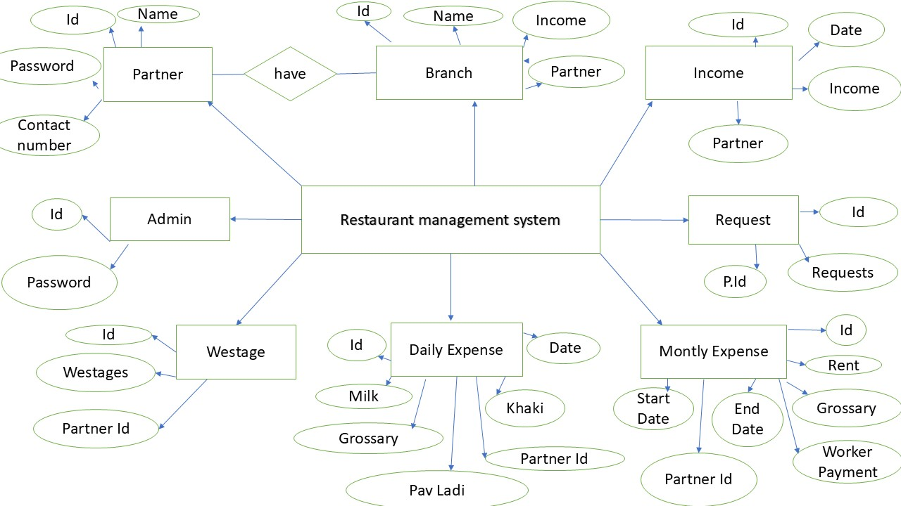
ER Diagram

Slide 4
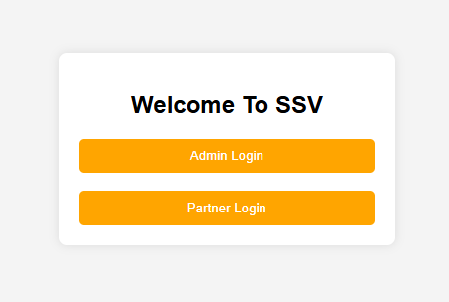
This is a login selection page for SSV (Shri Siddhivinayak Vadapav Centre),offering two options (Admin Login) and (Partner Login) Users can choose their respective login type to access the system

Slide 5
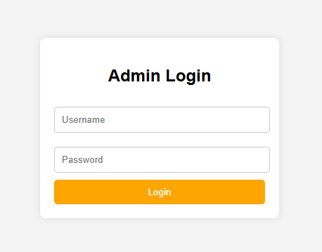
This is an (Admin Login) page with fields for entering a username and password, along with a login button. It appears to be part of a web-based system requiring authentication for access.

Slide 6
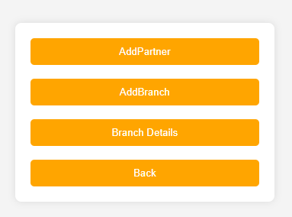
This page shows options for admin i.e
1. AddPartner – A page to add a new
partner to the system.
2.AddBranch – A page to register a ne
branch.
3.Branch Details – A page displaying details
of existing branches.
4.Back – Navigates to the previous screen.

Slide 7
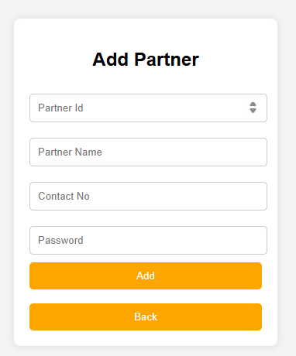
This page shows the Add Partner
page
1.Partner ID – A unique identifier
for the partner.
2.Partner Name – The name of the
Partner.
3.Contact No – The partners phone
number
4.Password – A password for the
partners account.

Slide 8
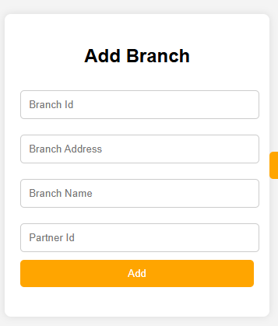
This page shows the Add Branch page
1.Branch ID – A unique identifier for
the branch.
2.Branch Address – The location of
the branch.
3.Branch Name – The name of the
branch.
4.Partner ID – The associated
partners ID.

Slide 9
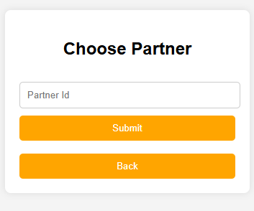
This page shows the Choose Partner
page
1.Partner ID –An input field to
enter a partners unique ID.
Buttons:
Submit – To confirm the selected
partner.
Back – To return to the previous
page.

Slide 10
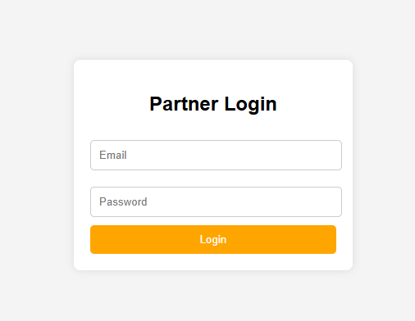
This is an (Partner Login) page with fields for entering a Email and password, along with a login button. It appears to be part of a web-based system requiring authentication for access.

Slide 11
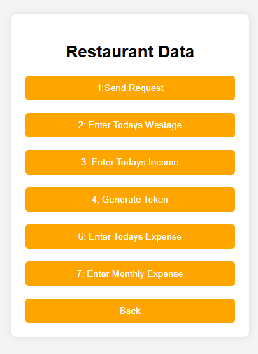
This page shows the "Restaurant Data" page, which includes several options:
1. Send Request – Likely used to
submit a request.
2. Enter Today's Wastage – To record
food wastage for the day.
3. Enter Today's Income – To log the
restauincome.
4. Generate Token – Possibly for order
or access rant's daily management.
5. Enter Today's Expense – To input
daily expenses.
6. Enter Monthly Expense – To record
expenses for the month.
7. Back – To return to the previous screen.

Slide 12
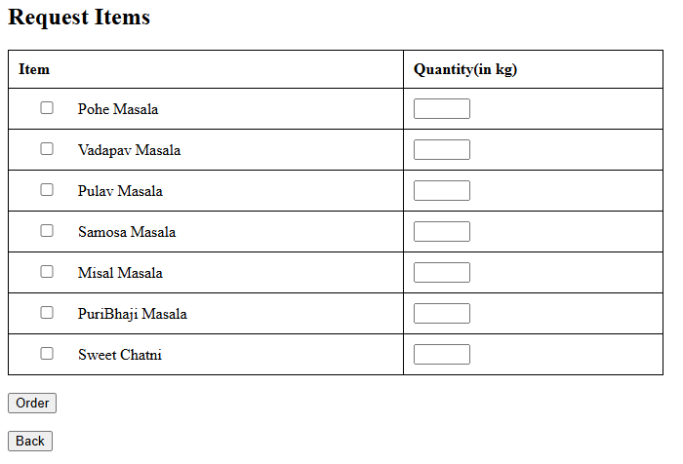
This page shows the "Request Items" page, which allows users to order ingredients.
Item List – Various food masalas and chutney options.
Quantity (in kg) – Input fields to specify the required quantity.
Order Button – To confirm and place the order.
Back Button – To return to the previous page.

Slide 13
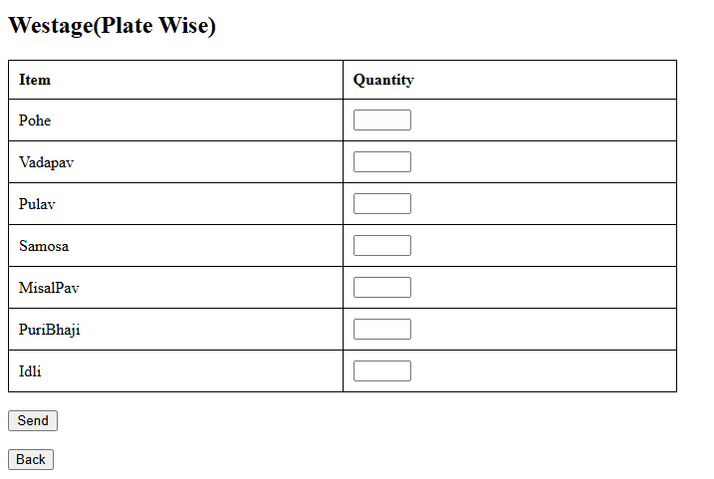
This page shows the "Westage (Plate Wise)" page, which is used to record food wastage.
Item List – Different food items such as Pohe, Vada Pav, Pulav, etc.
Quantity Input Fields – Users can enter the amount of wastage per plate.
Send Button – To submit the wastage data.
Back Button – To return to the previous page.

Slide 14
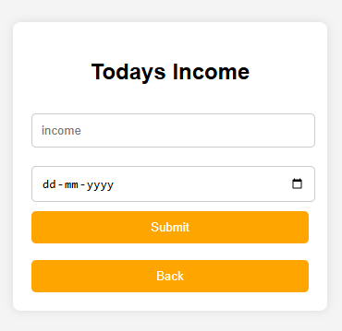
This page shows the "Today's Income" page, which is used to enter daily revenue.
Income Field – Input box to enter the amount earned.
Date Field – To specify the date (format: dd-mm - yyyy).
Submit Button – To save the entered income data.
Back Button – To return to the previous page.

Slide 15
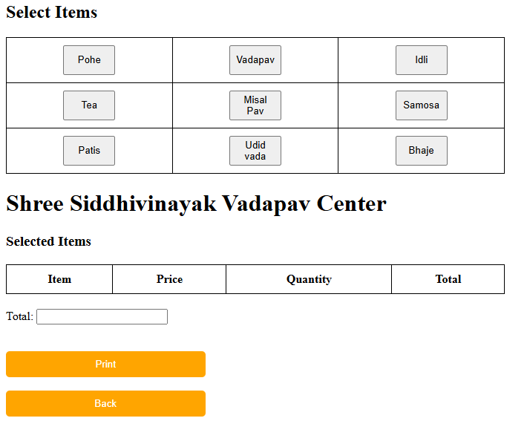
This page shows the "Select Items" page, which is used for choosing food items and processing orders.
Item Selection Grid – Various food items (e.g., Pohe, Vada Pav, Idli, Samosa) are listed in a table format for selection.
Selected Items Table – Displays the chosen items along with their price, quantity, and total cost.
Total Field – Calculates and displays the total amount.
Print Button – Likely used for generating a receipt.
Back Button – To return to the previous page.

Slide 16
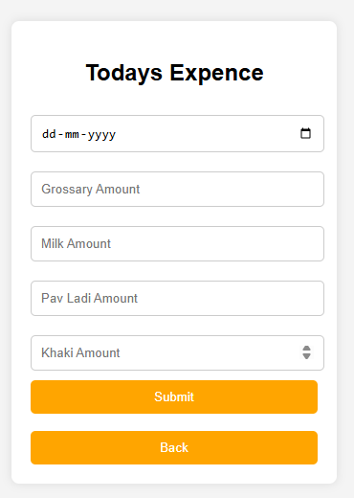
This is"Today's Expense" page, which is used for recording daily expenditures.
Date Field – Allows the user to select or enter the date of the expenses.
Expense Fields – Includes fields for different types of expenses such as: Grocery Amount,Milk Amount,Pav Ladi Amount,Khaki Amount etc.
Buttons:
Submit Button – Saves the entered expense details.
Back Button – Returns to the previous page.

Slide 17
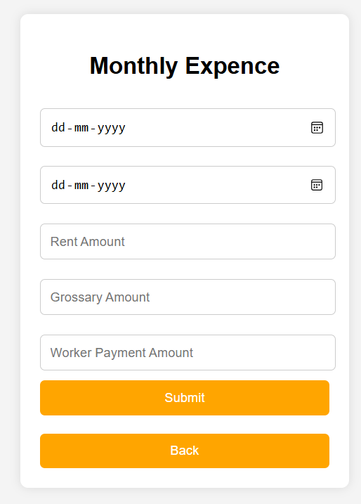
This is “Monthly Expense" page, which is used for recording monthly expenditures.
Date Field – Allows the user to select or enter the date of the expenses.
Expense Fields – Includes fields for different types of expenses such as: Grocery Amount,Rent Amount,Worker Payment Amount etc.
Buttons:
Submit Button – Saves the entered expense details.
Back Button – Returns to the previous page.

Slide 18
Thank You

