Slide 1



DEPARTMENT OF
Computer Science
Final Internship Project Presentation on
“Pizza Sales Dashboard”
Presented by
Pranjul Ojha
Under the guidance of
Faculty Internship guide:-
Ms. Sonal Saxena
Industrial guide:-
Mr. Sanket Patil
2024-2025

Slide 2
Contents
Company Profile
Internship Role
Project Introduction
Overall Learning
Roles and Responsibilities
Tools Used
Methodology
Outcomes
Conclusion

Slide 3
Company Profile
Name: Unified Mentor
Location : DLF Forum, Cybercity, Phase 3, Gurugram, Haryana 122002
Founded: 2022
Core Service: Unified Mentor is an IT Services and Consulting company.
Focus Areas: Specializes in areas such as Data Science, Web Development, and Machine Learning.
Industry-Simulation Projects: Project-based training in emerging technologies.
Skill Development: Aims to help learners build practical, hands-on skills. .
Portfolio Enhancement: Encourages creation of professional portfolios through project execution.

Slide 4
Internship Role
I am currently working as a Data Science Intern at Unified Mentor Pvt. Ltd., where I have the opportunity to apply
theoretical knowledge to real-world datasets and enhance my skills in data preprocessing, modeling, and
Visualization.
As a Data Science Intern, my key responsibilities include:
Strengthening core concepts of Python for data analysis and manipulation
Performing data cleaning, preprocessing, and handling missing values
Conducting Exploratory Data Analysis (EDA) using Pandas, Matplotlib, and Seaborn
Implementing machine learning models using scikit-learn for classification and regression tasks
Evaluating model performance using metrics like accuracy, precision, recall, F1-score
Visualizing key insights through interactive dashboards using Power BI/Tableau
Documenting project workflow and presenting results with clear insights and recommendations

Slide 5
Project Introduction
Objective: To analyze pizza sales revenue, identify trends, and provide insights to improve
sales.
The project focuses on analyzing pizza sales data to understand business performance
Used MySQL to calculate important sales metrics like revenue, orders, and average order value
Created a dashboard in Tableau to show trends and patterns in the sales data
Helps the business find out which pizzas are most popular and which are not selling well
The dashboard includes charts for time-based trends, category-wise sales, and top/bottom products
Makes it easy for managers to understand the data and make better decisions

Slide 6
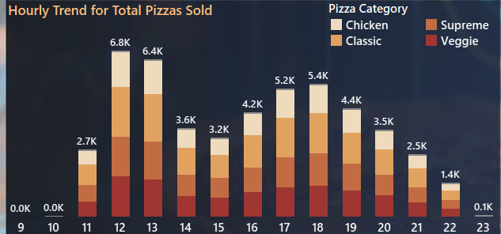
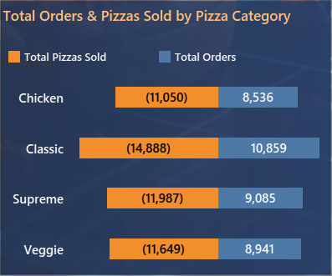
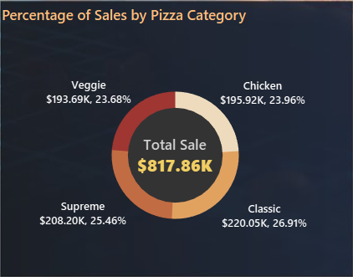
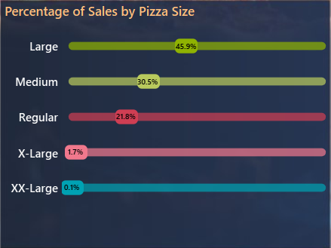
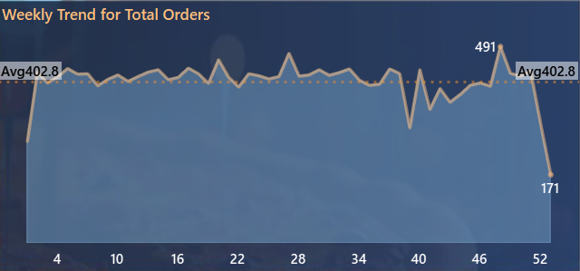
Some Graphs/Charts from the project:

Slide 7

Overall Learning
Technical Learnings:
Learned and applied SQL to extract and analyze sales data
Built interactive visualizations using Tableau dashboards
Gained hands-on experience in data cleaning and preprocessing
Learned how to visualize trends using charts like line, bar, pie, and funnel
Strengthened understanding of data-driven decision-making in a business context
Soft Skills Gained:
Improved analytical thinking and problem-solving using real business data
Developed attention to data accuracy, structure, and storytelling
Understood the value of clean documentation and organized reports
Strengthened time management and team collaboration

Slide 8
Roles and Responsibilities
Wrote complex SQL queries to extract and analyze sales data
Used MySQL to calculate business KPIs such as total revenue, average order value, and total pizzas sold
Cleaned and transformed raw data for effective visualization
Designed and structured visual layouts using Tableau dashboards
Created interactive charts including bar charts, pie charts, funnel charts, and line graphs
Developed filters and parameters in Tableau to make the dashboard dynamic and user-friendly
Built a fully functional dashboard to monitor sales trends and product performance
Maintained clean and organized data models for accurate and efficient reporting
Followed best practices in data storytelling and dashboard design

Slide 9
Tool Used
SQL Server Express: Used as the main database engine to store and manage pizza sales data locally. Ideal for lightweight analytics projects
SQL Server Management Studio (SSMS): Utilized as the interface to run SQL queries, manage tables, and perform database operations efficiently
Tableau: Developed an interactive dashboard to visualize sales trends, category distribution, and best/worst-selling pizzas using charts and filters
Microsoft Excel: Helped in initial data inspection, basic formatting, and early-stage cleaning before loading data into the SQL environment
Maven Analytics Dataset – Source of raw pizza sales data for the project

Slide 10
Methodology
Problem Understanding: Identified the need to analyze pizza sales data to gain insights into product performance, customer trends, and business growth opportunities
Tool & Technology Selection: selected SQL Server Express and SSMS for querying and analysis, and Tableau for building interactive dashboard and visualization
Data Collection & Preparation: Imported raw data form the Maven Analytics dataset, cleaned the dataset, and formatted columns such as date, time, category, and size using SQL
KPI Development: Wrote SQL queries to calculate key performance indicators like total revenue, total orders, average order value, and total pizzas sold
Visualization & Dashboard Design: Created bar charts, pie charts, line charts, line graphs, and funnel charts in Tableau to represents trends, category-wise performance, and best/worst sellers
Testing & Refinement: Checked dashboard filters, labels, and visuals for accuracy. Ensure that layout was clear, responsive, and easy to interpret
Finalization: Organized dashboard elements for maximum clarity, enabling easy understanding for stakeholders

Slide 11
Outcomes
Built a complete and interactive sales dashboard using SQL and Tableau
Strengthened hands-on skills in data extraction, analysis, and visualization
Improved ability to write clean, optimized SQL queries
Delivered a dashboard that clearly presents KPIs and sales insights
Gained deeper understanding of data storytelling and visual communication
Developed confidence in presenting analytical findings to stakeholders

Slide 12
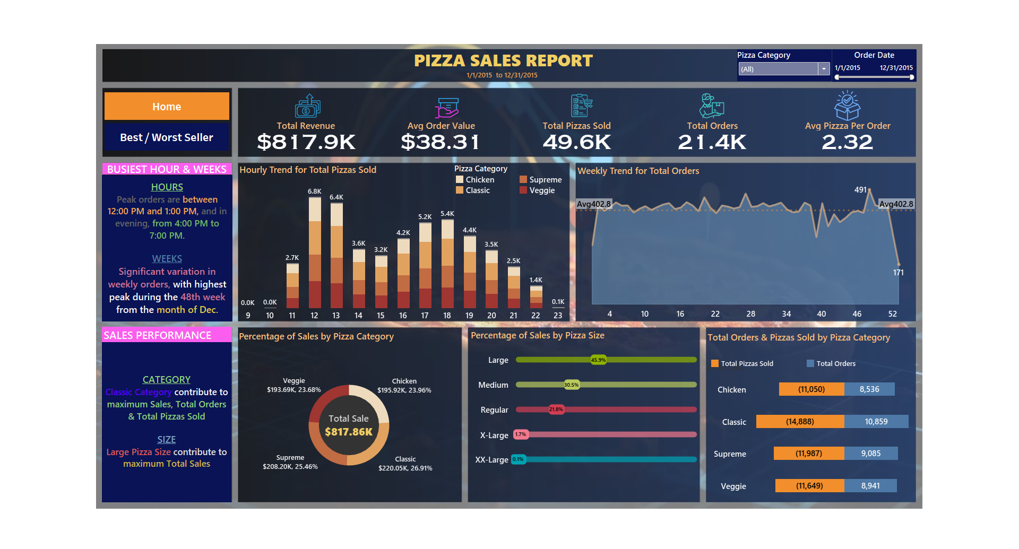
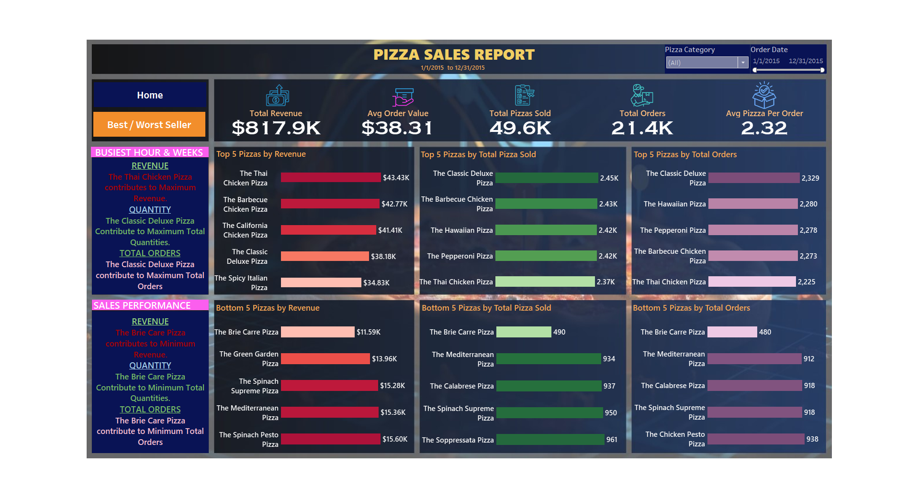
Outcomes

Slide 13
Conclusion
The development of the Pizza Sales Dashboard during my internship at Unified Mentor was a highly valuable experience. It allowed me to apply theoretical data analysis skills to real-world business problems and gain practical exposure to tools like SQL and Tableau
Through this project, I gained hands-on experience in writing optimized SQL queries, calculating KPIs, and visualizing insights using interactive dashboards. I also learned the importance of clean data, accurate reporting, and effective storytelling in analytics
Overall, this internship helped bridge the gap between academic learning and industry application. It strengthened my confidence in data analysis and visualization, and laid a strong foundation for future roles in data science and business intelligence

Slide 14
THANK YOU

