Slide 1
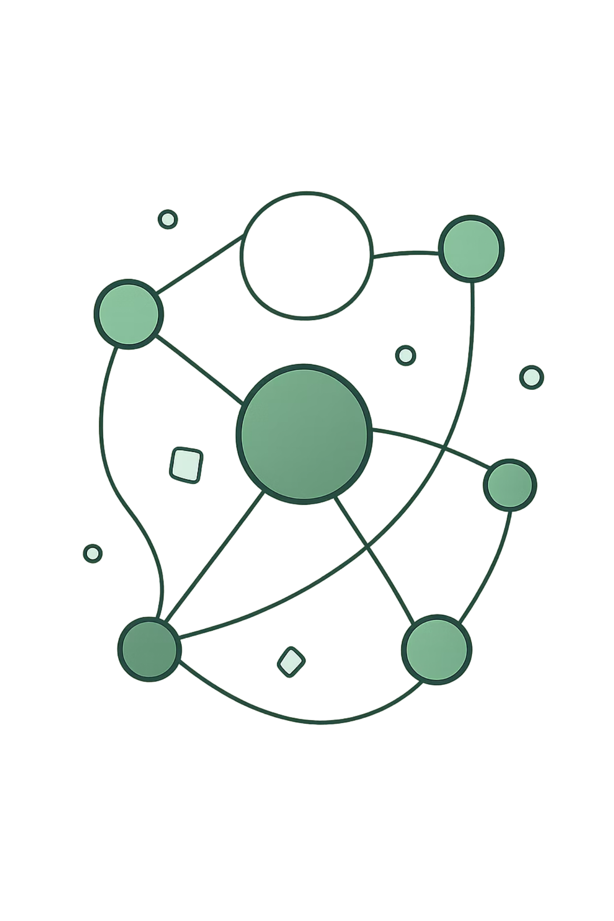
SecureLogin: Suspicious Login Detection Platform
Data Analytics Project using Risk-Based Authentication (RBA)

Slide 2


RBA Framework — concise definition: compute a contextual, time‑sensitive risk score per login by combining behavioral telemetry, device signals, network indicators, and historical user models. Scores drive automated policy responses: allow, step-up, deny.
The Landscape
Objective: embed risk-aware decisions into authentication flows with low false positives and measurable signal-to-noise improvement.
Key outputs: risk_score (0-100), risk_factors[], policy_action
Escalating Threats
Operational Blindspots
Data Complexity
Credential stuffing, automated bots, and account takeover campaigns are increasing velocity and sophistication.
Static MFA and password-only checks fail to capture contextual risk signals in real time.
High-cardinality telemetry (IP, device fingerprinting, geolocation) requires scalable analytics to surface anomalies.

Slide 3
Problem Statement — Why Traditional Auth Fails
Traditional Failure Points
Modern Threat Complexity
Core Detection Challenge
Passwords: reusable, phishable, high churn
Static MFA: bypassable via social engineering or push fatigue
Rule-based systems: brittle, high maintenance
Distributed botnets and credential stuffing at scale
VPN/proxy obfuscation and IP churn
Device spoofing and transient session hijacks
Distinguish legitimate behavioral variance from malicious deviation in real time without degrading user experience — requires automated, data-driven risk scoring and feedback loops to improve models.

Slide 4





Project Objectives — Execution Goals
1. Detect Suspicious Logins
Real-time anomaly detection using telemetry and session context.
2. Compute Dynamic Risk Scores
Ensemble scoring (heuristics + ML) producing normalized risk metrics.
3. Behavioral Analysis
Profile user baselines and velocity models (temporal, geospatial, device).
4. Generate Security Alerts
Prioritized alerts with provenance for SecOps triage and incident response.
5. Actionable Dashboards
Operational dashboards and drilldowns for remediation and KPI tracking.

Slide 5

Dataset Overview
Sample Attributes (schema preview)
RBA Authentication Dataset — production-scale telemetry consisting of millions of login events. Ingestion cadence: streaming (events/sec) + batch backfills. Stored with versioning and audit metadata.
Field
Description
User_ID
Unique user identifier (hashed)
Login_Time
Event timestamp (UTC)
IP_Address
Client IP / subnet fingerprint
Device_Type
Device classification (mobile/desktop)
Country
Geo-resolved country
Browser
UA family and version
Failed_Attempts
Consecutive failures prior to success
VPN_Used
Boolean flag for known proxy/VPN
New_Device
Boolean if unseen device fingerprint
New_Location
Boolean if location deviates from baseline
Fraud_Label
Post-hoc label: confirmed compromise / benign
Note: All PII is tokenized/hashes; IPs are kept in truncated form for privacy-compliant analytics.
Key Metrics
Records: millions (event-level)
Retention: 12+ months raw; aggregated summaries retained longer
Cardinality: high for IPs, device IDs, UA strings

Slide 6





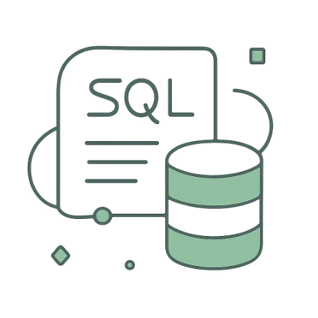


Technology Stack
Python
Pandas
NumPy
Snowflake
Primary scripting language for ETL, feature engineering, and model orchestration.
Exploratory data transforms and in-memory feature pivots.
High-performance numeric ops for vectorized feature computations.
Secure, scalable storage and SQL-based analytics (Bronze → Gold layers).
Matplotlib
SQL
Power BI
GitHub
Model diagnostics and static visualizations for analysis notebooks.
Set-based transformations, temporal joins, and analytic views.
Operational dashboards and drill-throughs for SecOps and leadership.
CI/CD for infra-as-code, ETL workflows, and reproducible model artifacts.

Slide 7


End-to-End Pipeline Architecture
Data Sources
Raw Layer
Bronze Layer
Silver → Gold
Caption: Data flows from edge ingestion (auth events) into an immutable Raw layer, then staged Bronze with schema validation, enriched Silver with feature joins and behavioral baselines, and curated Gold for BI and model serving. Alerts and risk scores feed SIEM and SecOps pipelines.
[Data Architecture Dependency Graph] — placeholder for detailed dependency visualization to be embedded in architecture repo.

Slide 8
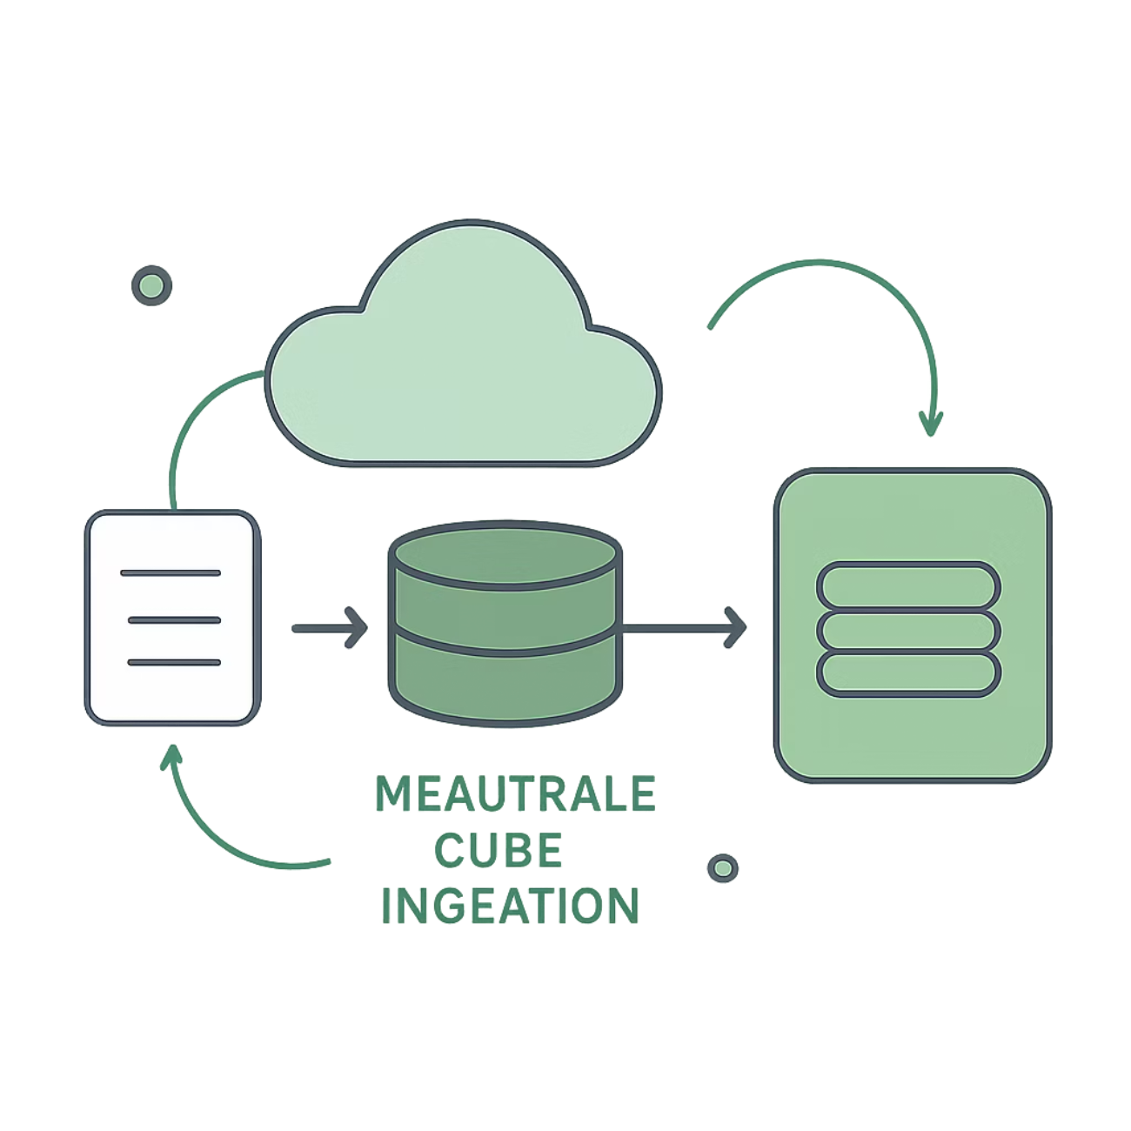

Raw & Bronze Layer Implementation — Deep Dive
State Transition Diagram
Strategy Breakdown
Ingestion: Event stream (Kafka/Kinesis) with schema registry; atomic event writes to immutable Raw storage.
Bronze Layer: Append-only tables with partitioning, ingestion metadata (ingest_ts, source, batch_id) and file-level checksums.
Versioning: Time-travel and snapshot snapshots for reproducible feature builds and incident forensics.
Operational Audit: Audit logs, lineage (ETL job_id), and data quality metrics (completeness, drift).
Security: Column-level encryption, role-based access, and masked/hashed identifiers.
Implementation notes: use micro-batches for enrichment while preserving event ordering; retain raw payloads for at least 12 months for investigations.
Bottom caption: Event → validate schema → write to Raw (immutable) → materialize Bronze (partitioned) → record provenance (job_id, commit_hash). Downstream Silver/Gold layers consume versioned Bronze snapshots for deterministic feature computation.

Slide 9
Data Ingestion Strategy
Goal: securely ingest raw login telemetry from files and streams into the Bronze layer while preserving immutability and supporting transactional, incremental loads. Steps: 1) Read raw CSV or stream data, validate the schema, and tag provenance. 2) Write atomically to Bronze as append-only Delta data. 3) Manage offsets and checkpoints for incremental processing and replay protection.
Key considerations: schema evolution, watermarking, idempotency, and encryption at rest
```python
df = spark.read.csv("/data/login_logs.csv", header=True)
df.write.format("delta").mode("append").save("/bronze/login_data")

Slide 10
Silver Layer Transformation
Purpose: turn Bronze records into a clean, queryable Silver dataset. Core mechanics: apply deterministic cleansing, remove duplicates, handle nulls explicitly, standardize protocols, and engineer initial security features such as session duration and failed-attempt counts.
Data Cleansing Framework
Feature Engineering Strategies
Data Transformation Code Snippet
Validate schema conformance
Standardize timestamps to UTC
Normalize protocol and user-agent fields
Fill or flag missing critical attributes
Derive failed_attempts and session_count
Encode device fingerprint and geohash
Calculate rolling windows for anomaly signals
Preserve lineage and provenance metadata
```python
silver_df = bronze_df.dropDuplicates()
silver_df = silver_df.na.fill("Unknown")

Slide 11

Gold Layer Enrichment
Objective: produce analytics-ready, business-curated datasets with risk scoring and KPI-ready aggregates. Gold is optimized for BI, ML training, and reporting.
Risk Scoring Rule Matrix
Login Classification & KPIs
Rules applied per login event to compute a dynamic risk score:
Derived metrics:
New Device: +25
New Location: +30
VPN Used: +20
Failed Attempts > 3: +15
High-Risk Logins: risk_score > threshold
Risk Distribution: buckets (low/medium/high)
Avg. Risk per User / Device / Geo
False positive rate and detection latency
Risk Score Engine — Rule Matrix Table
Risk KPI Aggregation
Condition
Score
Aggregate example queries produce:
Daily high-risk login counts
User risk trend (7/30 day windows)
Detection precision/recall for flagged sessions
New Device
+25
New Location
+30
VPN Used
+20
Thresholds must be tuned by SOC during deployment; scores are additive and calibrated against historical baselines.
Failed Attempts > 3
+15
[Risk Score Correlation Heatmap]

Slide 12
Data Loading & Analytics Warehouse
Goal: move curated Gold datasets into the production analytics warehouse with performance, governance, and stability.
Delta table lifecycle, partitioning, and query optimization
1 → 4: Downstream Loading Workflows
Optimization & Governance
1. Incremental materialized views (refresh policies)
2. Partitioned Delta tables (date/device/geohash)
3. Z-ordering & compaction for hot queries
4. Access controls: row-level & column masking
Auto-compact small files; vacuum with retention windows
Query acceleration via materialized aggregates and indexes
Audit logs, table versioning, and reproducible snapshots
Provision BI-ready datasets with descriptive metadata

Slide 13
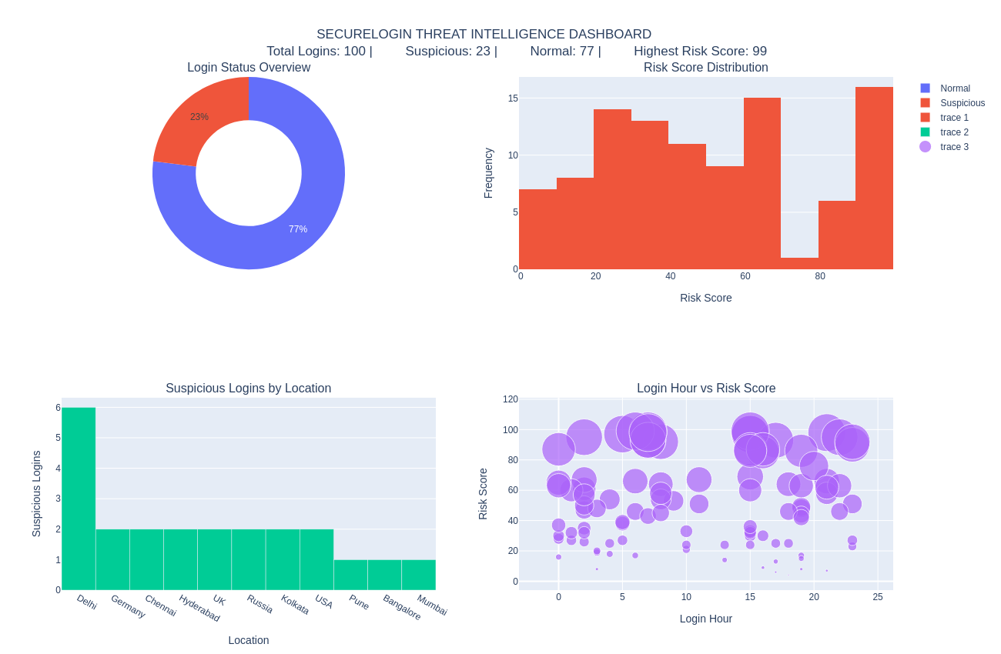
Interactive Analytics Dashboard

Slide 14






Project Features & Achievements
Features
Achievements
Suspicious Login Detection
Improved threat visibility across login surface
Automated risk assessment at event ingestion
Enhanced login security and incident triage speed
Faster anomaly detection with reduced false positives
Real-time flags for anomalous sessions
Risk Scoring Engine
Rule-based + model-enriched scoring per event
Deployment validated in staging with live replay tests and SOC tabletop exercises.
User Behavior Analytics
Baseline profiles and deviation detection
Dashboard Reporting
Operational KPIs and executive summaries
Security Monitoring
Alerts, playbooks, and SOC integrations

Slide 15
Challenges & Future Enhancements
Engineering Challenges
Planned Enhancements
Data quality: inconsistent or missing attributes
High-volume log processing overhead and small-file proliferation
Label noise causing false-positive detections
Latency constraints for near-real-time detection
Real-time streaming analytics with durable checkpoints
ML-based anomaly detection and online model serving
MFA and adaptive authentication integration
SIEM and SOAR pipeline integrations for automated response
Predictive threat intelligence via telemetry fusion
Thank You — Questions & Discussion
Closing Notes
Contact / Repo: [GitHub] • [security_contact@company.com]
Next: finalize SOC alert thresholds, validate ML models in production, schedule go/no-go with stakeholders.

