Slide 1

Travel and Itinerary Management System
Prepared by:
Pranish Kumar Ranjit
Sagar Nepal

Slide 2
Background
Traditionally, travelers use multiple platforms to research destinations, book services, and manage itineraries, making the process time-consuming and confusing.
Existing solutions are often fragmented, so there is a need for a single unified system that combines trip creation, activity planning, expense tracking, and recommendations.
With the growth of digital tools, the travel industry is shifting towards smart systems that provide convenience, personalization, and automation in travel planning.

Slide 3
TIMS :
The Travel & Itinerary Management System aims to simplify the process by offering a platform where users can explore destinations, plan day-to-day activities, manage costs, and share itineraries efficiently.

Slide 4

Problem Statement
Travel information in Nepal is spread across many places and not found in one platform.
Many travel agencies still plan trips manually, which takes more time and effort.
Travelers find it hard to manage their expenses and daily travel plans.

Slide 5
About TIMS:
The system is a web application that helps travelers plan and organize their trips in one place.
Users can create itineraries, add activities, and track expenses easily through the platform.
It also provides recommendations for destinations and attractions, making travel planning faster and more convenient.

Slide 6
Objectives:
To create itinerary creation system which offer a user-friendly interface with detailed descriptions, ratings, to help travelers make informed decisions.
To provide the expense tracking and discover attractions and destinations of the proposed itinerary.
To provide the hub for itinerary creation using auto-itinerary creating system.

Slide 7
Features:
Travelers can register, log in, and manage their profile.
Users can create trips, add day-to-day activities, and customize plans.
The system suggests destinations, attractions, and restaurants based on rating and price.
Users can record travel expenses and customize auto-generated itineraries.

Slide 8
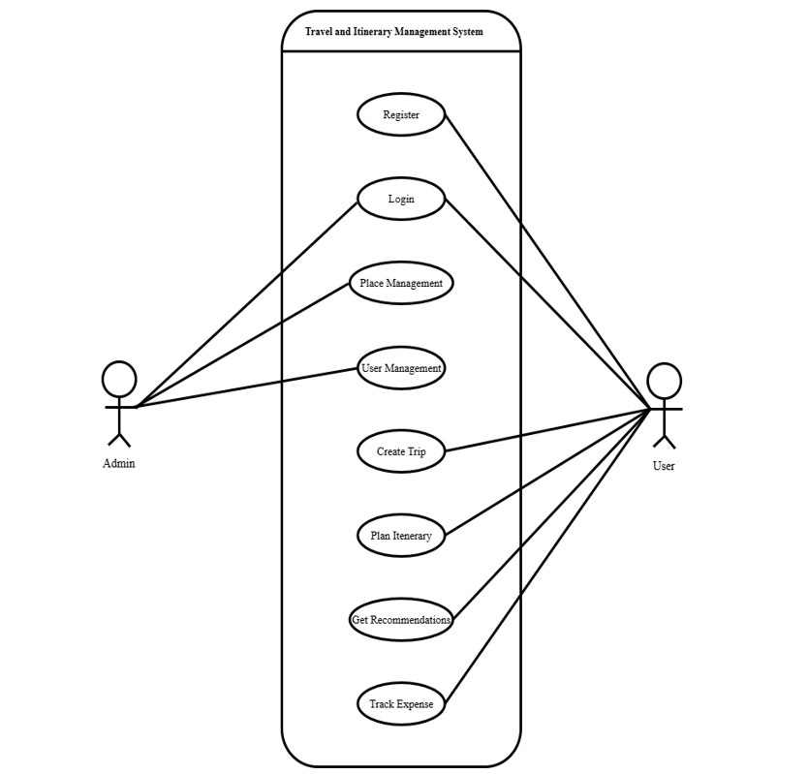
Use Case Diagram

Slide 9
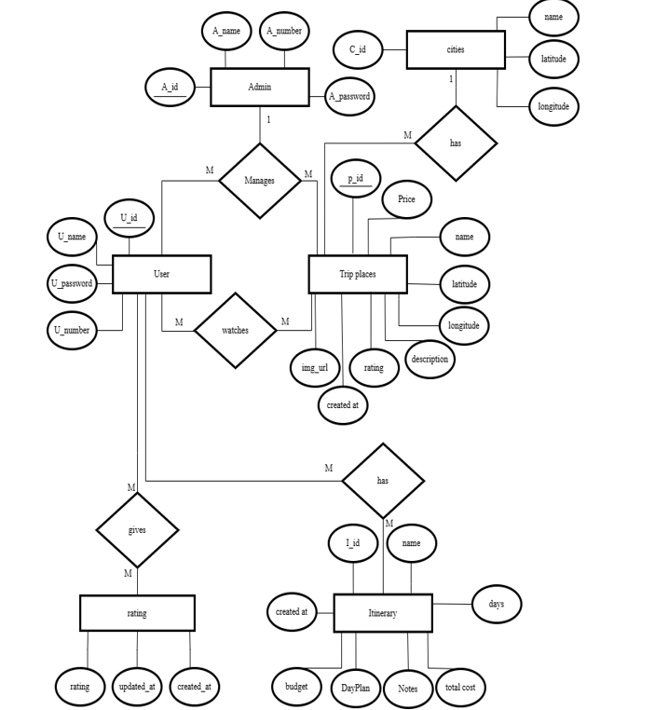
ER Diagram

Slide 10
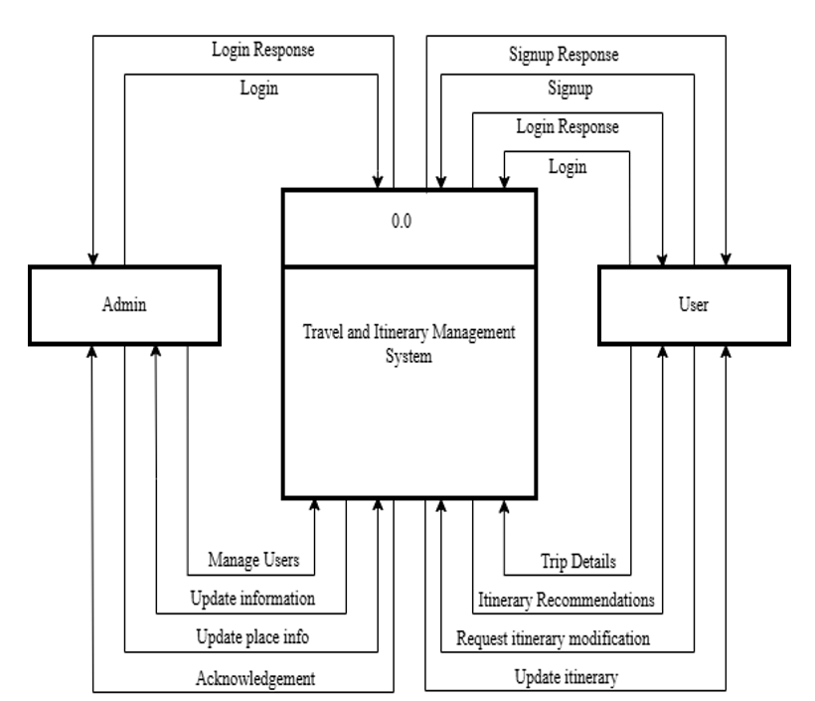
DFD Diagram

Slide 11
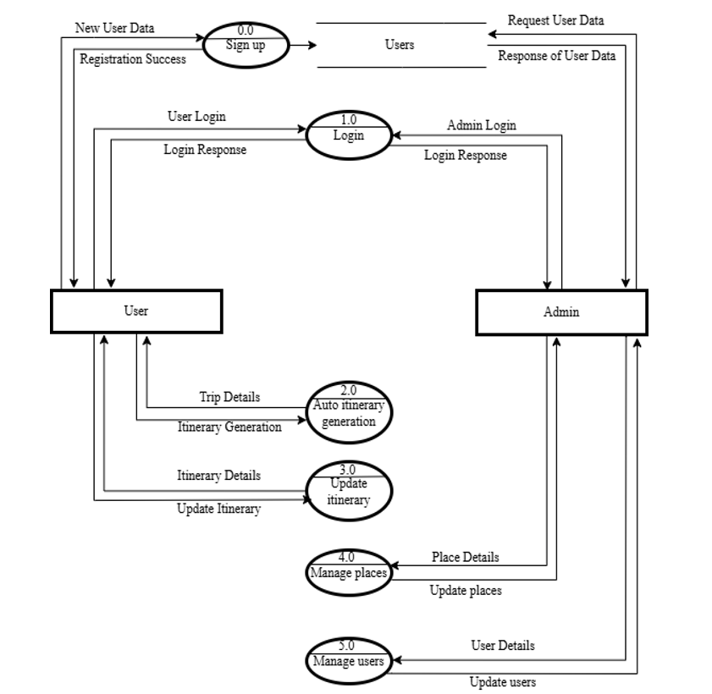
DFD Level 1:

Slide 12
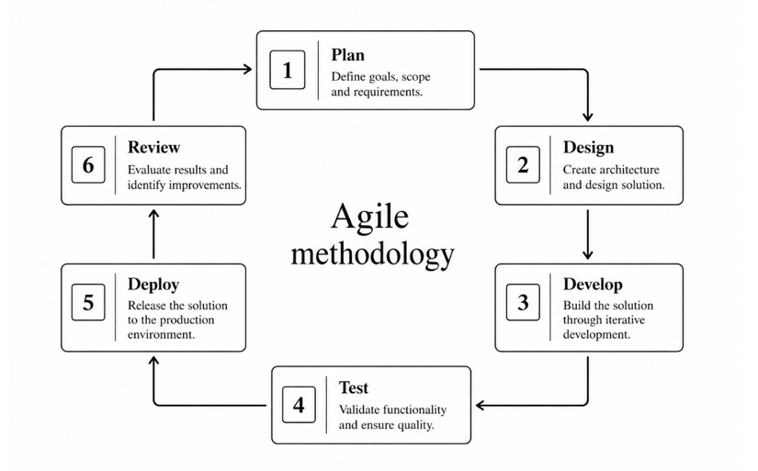
Methodology

Slide 13
Conclusions:
This system makes travel planning easy by letting users explore places, create itineraries, and estimate costs all in one platform.
It includes useful features like maps, budget planning (using smart calculations), and an admin system to manage cities and travel data efficiently.
Even though it currently has limited features and cities, it shows how technology can simplify trip planning and has strong potential to become a more advanced travel tool in the future.

Slide 14
Suggestions are appreciated !!
Thank You.

