Slide 1


Machine Learning
Intro
(Welcome)
#0

Slide 2

Table of Contents!
Overview
Approaches
Examples
Types
What is Machine Learning???
Different approaches for Machine Learning…
Where is Machine Learning used???
Different types of ML algorithms…

Slide 3

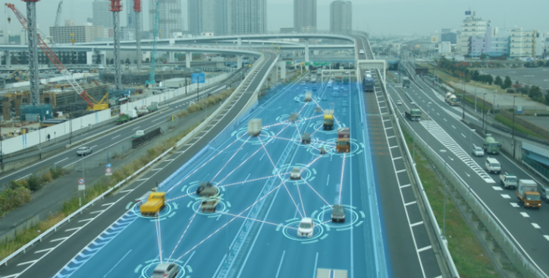

Introduction
Machine Learning is defined in different ways by different people with different perspectives.
Giving computers the ability to think.

Slide 4

—Arthur Samuel
1959
“It can be described as an algorithm to predict outcomes without being explicitly programmed.”

Slide 5
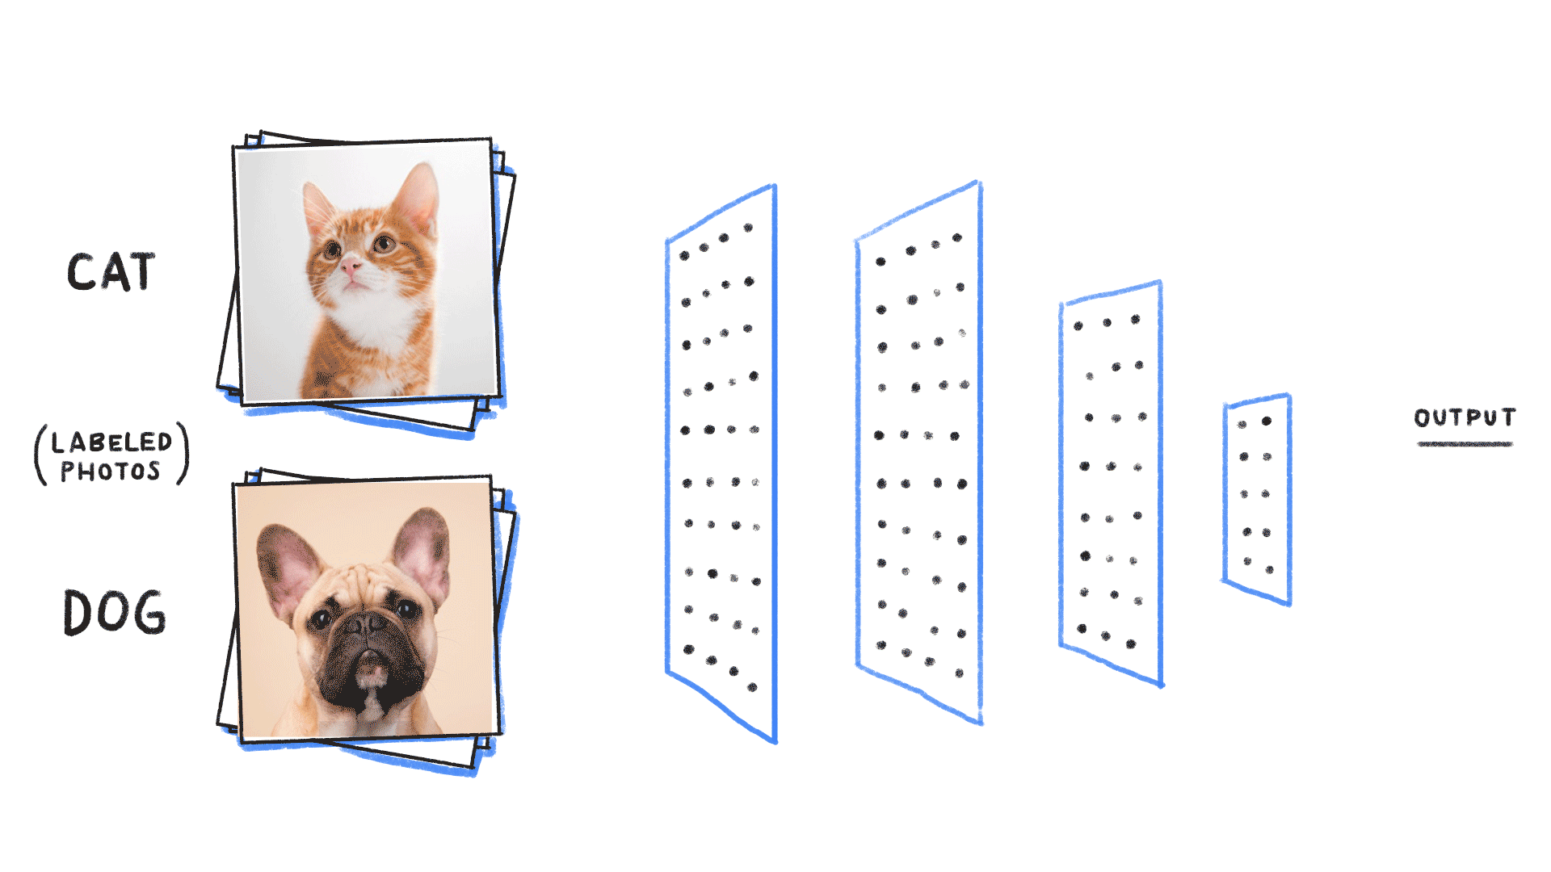
What Is This ML all About?
Predictions
Image Recognition
Speech Recognition
Medical Diagnosis
Scientific Data Analysis
Example of Image Recognition

Slide 6


Project Oriented
Research Oriented
Understanding the gist of algorithms used and implemented
Understanding the working of algorithms mathematically

Slide 7
Pre-Requisites
Mathematics
Python
Algebra, Statistics,
Calculus
Functions, Loops, Libraries

Slide 8
Requirements
Exam content
Jupyter Notebook
Python
Extra Libraries
Datasets
Best for Machine Leanring projects
Python 3.0 or more (recommended)
Already pre-installed if using Jupyter
Data to work on!!!

Slide 9
Why Python?
Simple Code
Used more
No. of Libraries
Not heavy, easily understandable
Used more than any other language for ML
R is also a good language for ML
Max. libraries for ML algorithms

Slide 10
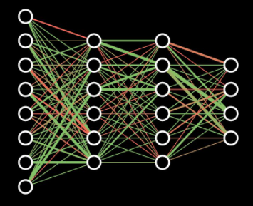
Types of ML Algorithms
Supervised Learning
Unsupervised Learning
Predicting with ‘labels’: output provided
Reinforcement Learning is another type of alorithm…
Predicting without ‘labels’:no supervision

Slide 11
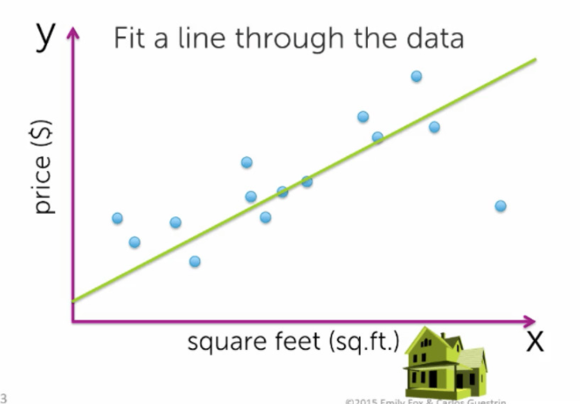

Supervised Learning I
Linear Regression
Example: Predicting the price of house using linear regression.
Continuous data
Single variable

Slide 12
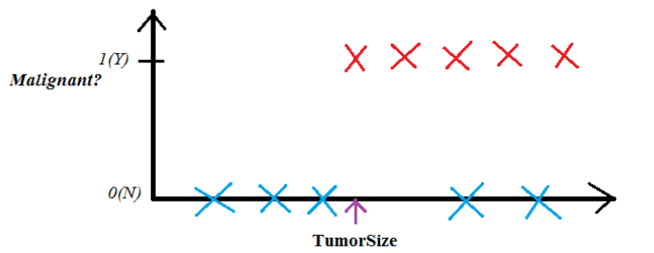
Supervised Learning II
Classification
Example: Classifying the patients with predicting tumor size.
Binary Classification

Slide 13
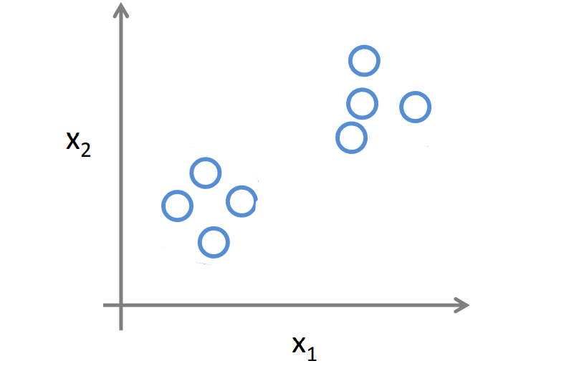
Unsupervised Learning
Cluster
Example: There are two different sets of data without any labels.

Slide 14

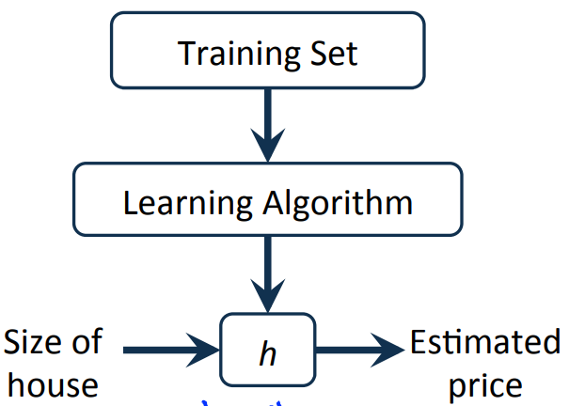
Model Representaion
Example:
This is the model representation for Linear Regression.

Slide 15
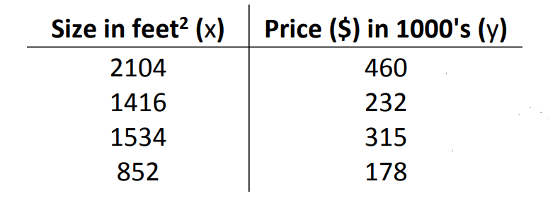
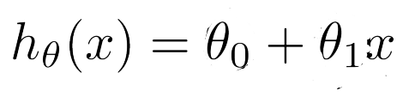
Mathematics Part
Hypothesis

Slide 16


Model Building Process Overview (Simple)
Step 1
Step 2
Step 3
Step 4
Gradient Descent
SL or USL???
Get the data to work on!
Cost Function

Slide 17

Cost Function
Minimizing errors of our predictions from the hypothesis
Short Intuition…

Slide 18

Roadmap for ML model
Data Collection
Training
Analyzing
Data Preparation
DELPLOYING

Slide 19
Resources
These are some resources for learning ML algorithms more effectively.
Datasets and Algorithms:
Kaggle Dataset
SciKit Learn Documentation
Google ML crash course
Udacity Basics of Machine Learning
CodewithHarry (For Python)
Krish Naik (For understanding algorithms)
These can help to visualize and understand the intuition easily.

Slide 20
Resources
Mathematics:
3Blue1Brown YouTube Channel
Moreover, I would be updating articles and blogs regarding Machine Learning and Deep Learning

