Slide 1

Parvatibai Genba Moze college of Engineering
Wagholi , Pune
Department of Computer Engineering
Internship Presentation on
C++ Development
Presented By – Pranoti Bartakke Guided By – Prof.Rupali Wagh

Slide 2
Introduction
C++ development typically involves writing code using an integrated development environment (IDE) such as visual studio or code::blocks.
The development process typically involves the following steps:
Requirements gathering: identify the needs and requirements of the application to be developed.
Design: create a design for the software, including the architecture, user interface, and functionality.
Testing: verify that the software meets the requirements and works correctly by testing it.
Deployment: deploy the software to the target environment and make it available for use by end-users.

Slide 3
Applications of C++ Development
Desktop software
Video games
Operating systems
Database systems
Web development

Slide 4
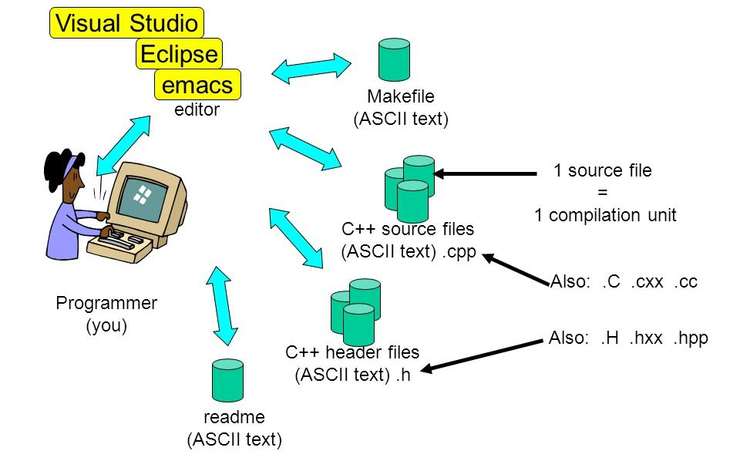
Tools and technologies used for development

Slide 5
Goals and Objectives
One of the primary goals of C++ development is to leverage the language’s performance capabilities to develop software that runs quickly and efficiently.
C++ developers aim to create code that is modular, well-organized, and easy to maintain and extend over time.
Faster a collaborative and productive development environment.
C++ development is not a static field, and developers must stay up-to-date with the latest tools, technologies, and best practices.

Slide 6
Scope
An internship in C++ development can be an excellent opportunity for me to gain practical experience in the field and develop their skills.
Learning the fundamentals of C++ programming
Collaboration with experienced developer
Hands-on experience in developing real-world
Networking opportunities

Slide 7
Methodology Analysis
User characteristics:
Task 1:
The online voting system should only allow eligible voters to participate in the voting process. This can be determined based on age, citizenship, residency , and other eligibility criteria.
Users of the online voting system should have basic computer literacy skills to navigate the online platform, follow instructions, and submit their votes.
Users should have trust in the technology used for the online voting system, as they will be relying on it to cast their votes.

Slide 8
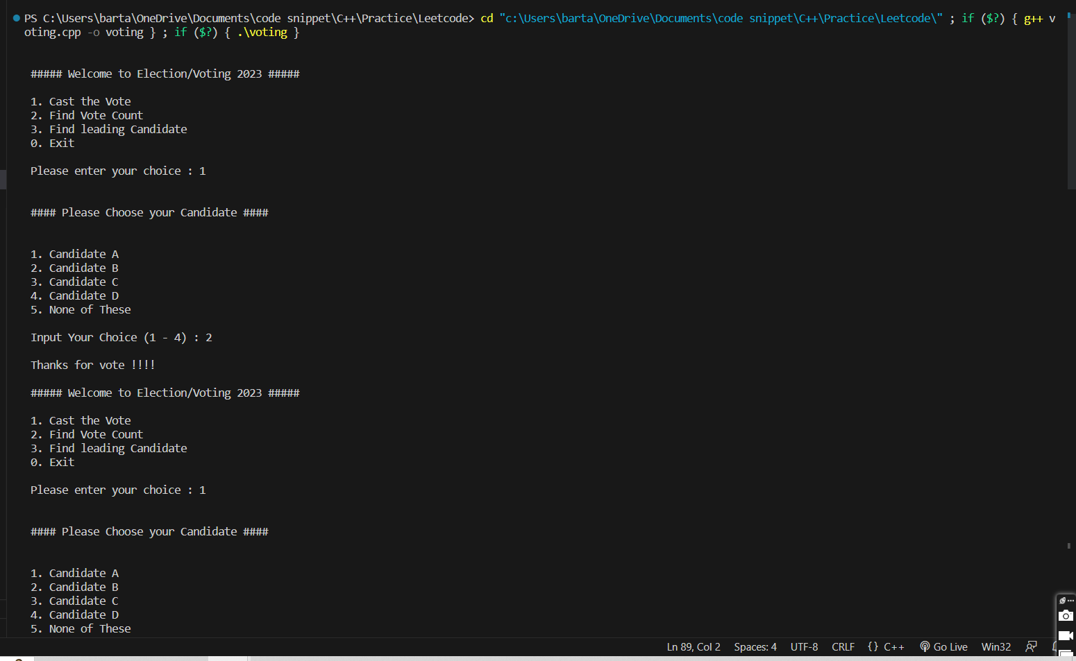
Task 1

Slide 9
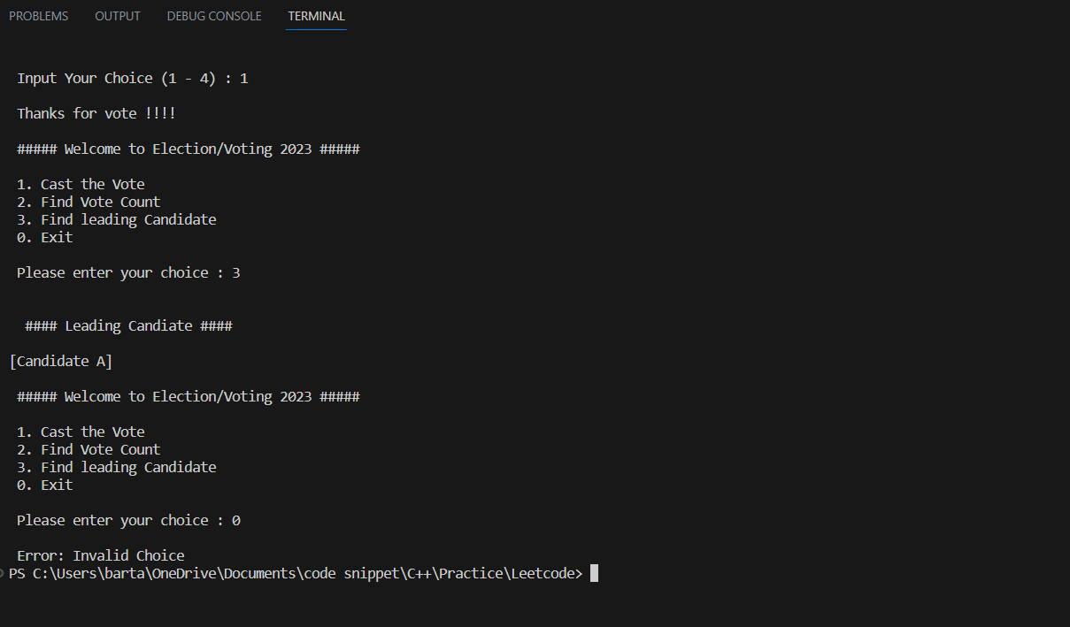
Task 1

Slide 10
Task 2
Players can range from children to adults. The user interface should be designed to accommodate users across different age ranges.
Players can have different levels of experience and skill in playing tic tac toe. The game should provide different difficulty levels to accommodate players with different skill levels.
He game should be designed to accommodate players from different language and cultural backgrounds. The game should be available in multiple languages and use symbols and icons that are meaningful to users from different cultures.
May have different levels of proficiency with technology and digital devices. The game should be designed to be accessible and easy to use for players with different levels of technological expertise.

Slide 11
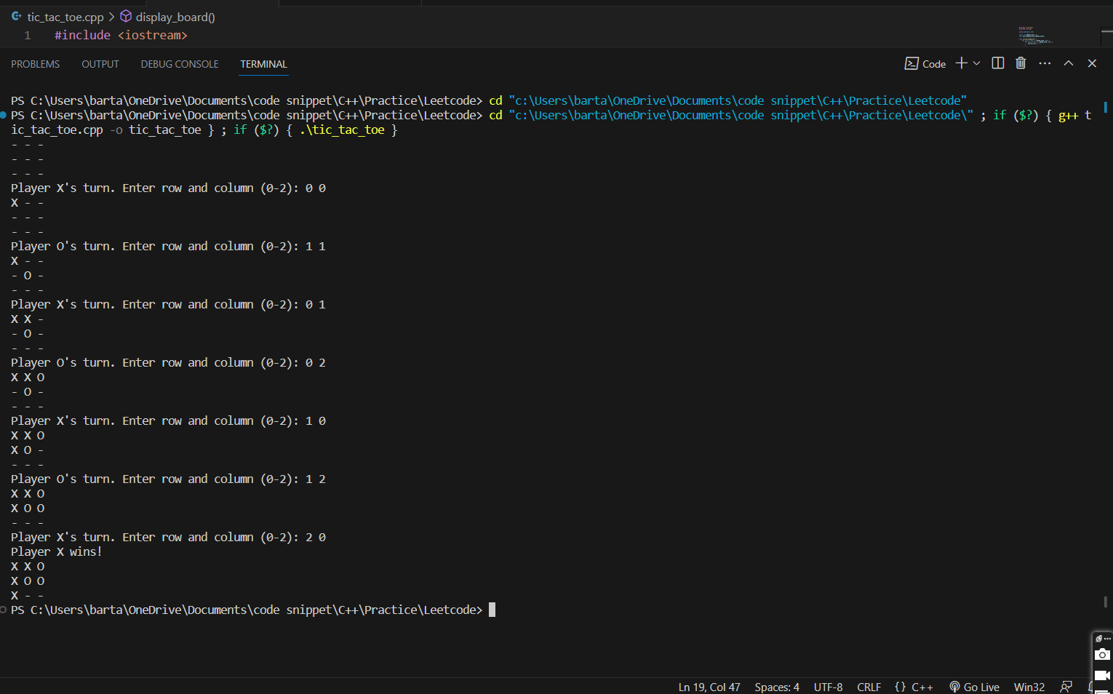
Task 2

Slide 12
Task 3
Users may be booking tickets for themselves or for a group of people, such as friends or family. The system should provide options for single-ticket and group-ticket bookings to accommodate different social contexts.
Players users may have different preferences for movie genres, actors, directors, and ratings. The system should provide options for searching and filtering movies based on these preferences.
By doing the analysis of movie reviews you can book the movie tickets.

Slide 13
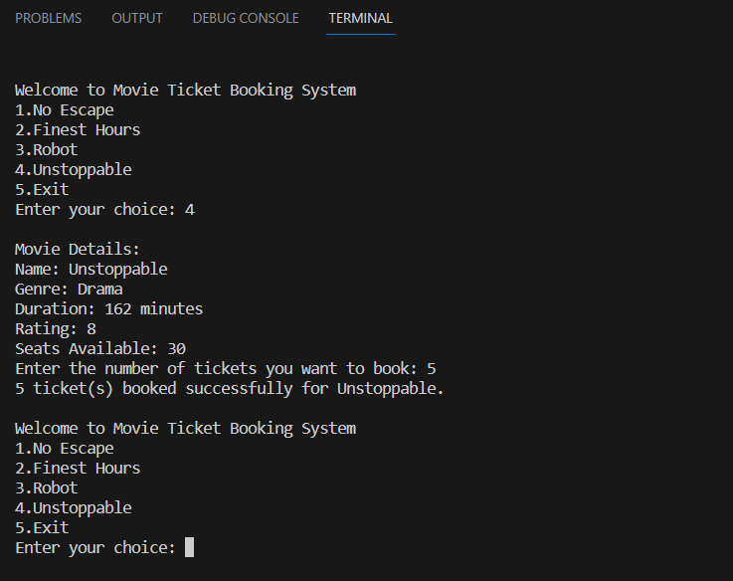
Task 3

Slide 14
Conclusion
The work experiences I encountered during the internship allowed me to develop projects using C++. I think I still require to work on my technical knowledge. But, the overall experience was positive, and everything I learned would be useful in my future career in this field.

