Slide 1

Astra – AI Financial Decision Engine
Project Name: Astra – AI Financial Decision Engine Tagline: “Make smarter financial decisions before you act” Team Name: Code-Rockers Event: DevCraft: Simon’s Command Line Date: (Add your date) Domain: FinTech + AI

Slide 2
Problem Statement
Many people, especially students and middle-class families, struggle with financial decisions such as:
Taking loans
Choosing investments
Managing expenses
Due to:
Lack of financial knowledge
Fear of risk
Overwhelming options
As a result, people either:
Avoid investing
Make poor financial decisions

Slide 3
Target Audience
Students and young professionals
First-time investors
Middle-class families
Non-finance background users

Slide 4
Existing Solutions
Platforms like:
Groww
Zerodha
INDmoney
Focus on:
Investing
Trading

Slide 5
Gaps & Opportunities
No guidance before decisions
Complex interfaces
Lack of personalization
No real-time decision analysis

Slide 6
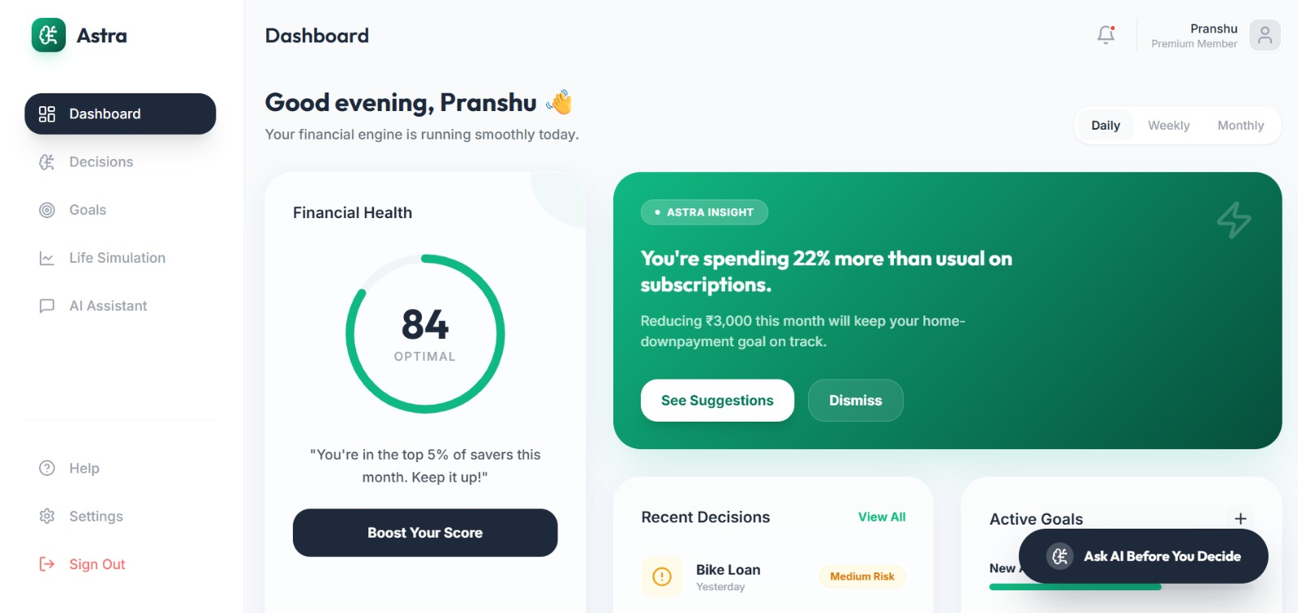
Your Solution
Astra – an AI-powered financial decision assistant that:
Helps users analyze decisions before acting
Provides risk evaluation
Suggests smarter alternatives

Slide 7
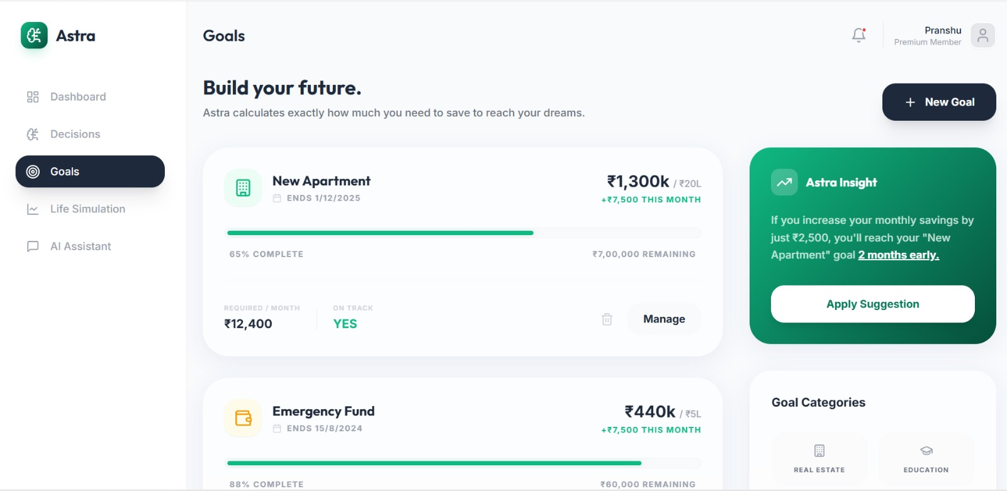
Key Features
🎤 Voice-based financial input
🧠 AI Decision Analyzer
📊 Risk scoring system
🎯 Goal-based planning
🔐 Privacy-first (user-triggered data only)
📈 Decision history tracking

Slide 8
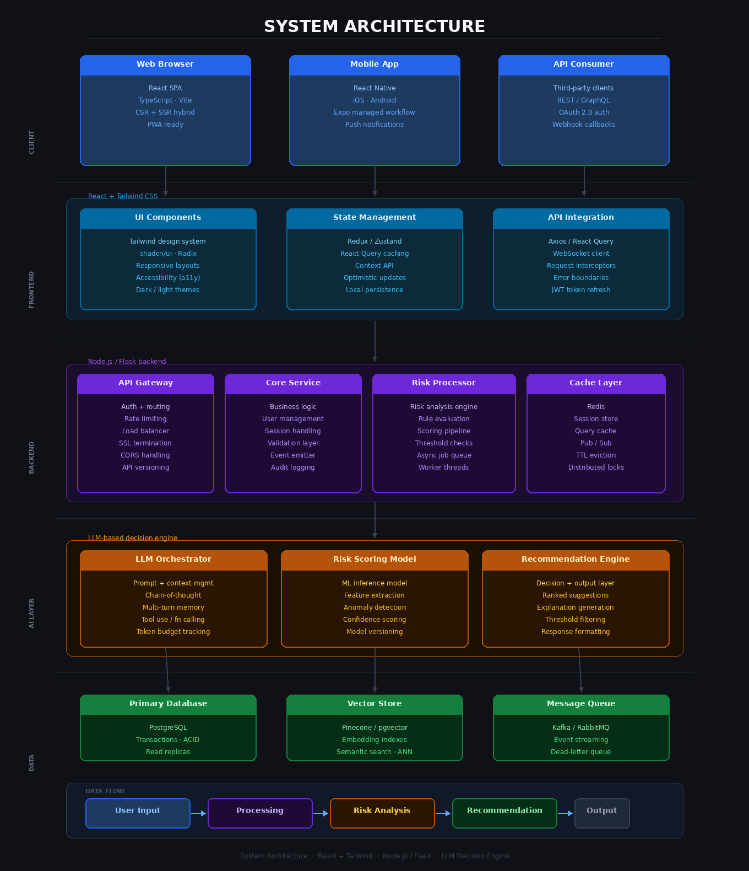
System Architecture

Slide 9
Tech Stack
Frontend: React, Tailwind
Backend: Node.js / Flask
AI: OpenAI API / LLM
Database: MongoDB / Firebase

Slide 10
Workflow
User inputs financial scenario
AI processes and extracts key data
System evaluates risk and impact
AI provides recommendation
Results shown in dashboard

Slide 11
Impact
Improves financial literacy
Reduces bad financial decisions
Encourages smart investing habits
Builds financial confidence

Slide 12
Future Scope
Regional language AI assistant
Integration with banking APIs
Predictive financial planning
Personalized financial coaching

Slide 13
Team Info
PRANSHU DEV :- FRONTEND
MOKSHITH :- BACKEND
JAGANNADA KAILASH :- PPT MAKER
PAVAN R :- MINI TASKS SOLVER AND RESEARCH

