Slide 1

Project Title: Plethora of knowledge App Team name: Aztecs College name: VIT Bhopal
Theme: The theme of the National Level “HACKCOVIT 2020” is the ongoing global pandemic COVID-19.The major concerns here are the impact of the COVID-19 on various sectors in the world be it education, agriculture, healthcare, environment etc.
Problem Statement: EDUCATION Around the world, billions of students have been impacted by the lockdown provoked by the COVID-19 pandemic and are out of school. Build a platform to help parents find free resources appropriate for their children's needs.

Slide 2



IDEA & APPROACH
It is very clear that people have not yet faced a situation like that this before and also everyone has to go through different things to cope up with their work, studies and various other things.
Around 1.3 billion learners across the world are not able to go to their academic institutions due to COVID-19 but right now they have the time and they should make productive use of it.
But something stills STOPS them?
They have time but they lack with the resources.
So we thought of something that can be done in order to cope up with this problem and what can be an easy solution to the problem that many of the learners are facing.
The basic idea is to provide a free platform to learners who are keen to learn and provide them the resources that they need.
Our platform will provide them with the resources so as to ease their problem, study and focus on their goal even in this time of the global pandemic.
We will be providing them with the E-books , NCERTs, course study material, paper banks, competitive competition notes , board paper solutions and various other materials that can be easily downloaded by them whenever they need it.
They can choose whatever books they wants, that they can find very easily on our platform free of cost.

Slide 3


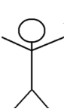


Technology Stack Use Cases
Plethora of knowledge App
Download material
Android App
User
Select Classes
Attempt Quiz
Select Subjects

Slide 4
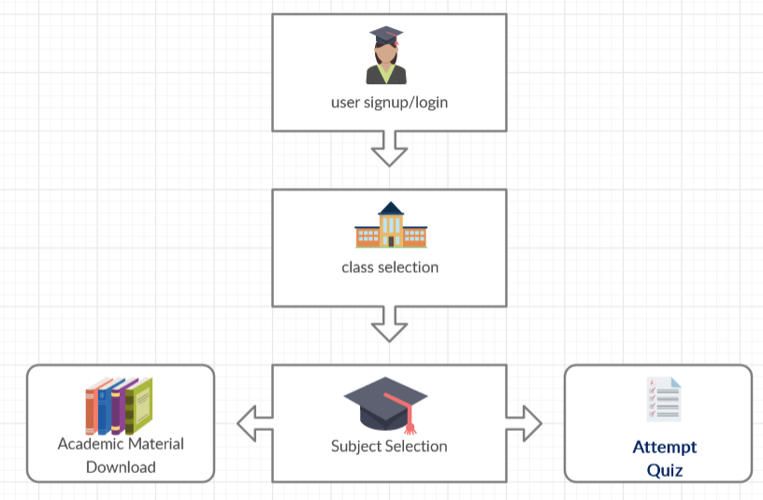
Block Diagram

Slide 5
Dependencies
Gradle build dependencies
dependencies { implementation fileTree(dir: 'libs', include: ['*.jar’])
implementation 'androidx.appcompat:appcompat:1.0.2’
implementation 'androidx.constraintlayout:constraintlayout:1.1.3’
implementation 'com.google.firebase:firebase-auth:19.3.1’
implementation 'com.google.firebase:firebase-storage:19.1.1’
testImplementation 'junit:junit:4.12' androidTestImplementation
'androidx.test.ext:junit:1.1.0' androidTestImplementation
'androidx.test.espresso:espresso-core:3.1.1'}

Slide 6
Social Impact Analysis with COVID19
The COVID-19 has resulted in schools shut all across the world. Globally, over 1.3 billion children are out of the classroom. As a result, education has changed dramatically, with the distinctive rise of e-learning, whereby teaching is undertaken remotely and on digital platforms.
Most of the students are willing to give their time to study but some of them have lack of resources ,which is an obstacle in their learning path and also they want the sources which can provide them free education as most of them are not in a condition to pay much for online material.
Parents are also worried about their children’s future .This is the golden opportunity for the students go study and get ahead in the race.
Utilizing the time that the students save while learning at home , they can use this time to upskill themselves in various fields.
Digital education can be accessible on clicks and to make that happen for free.
Almost everyone who is keen to study will obviously be waiting for a platform like this to be made accessible soon.

Slide 7
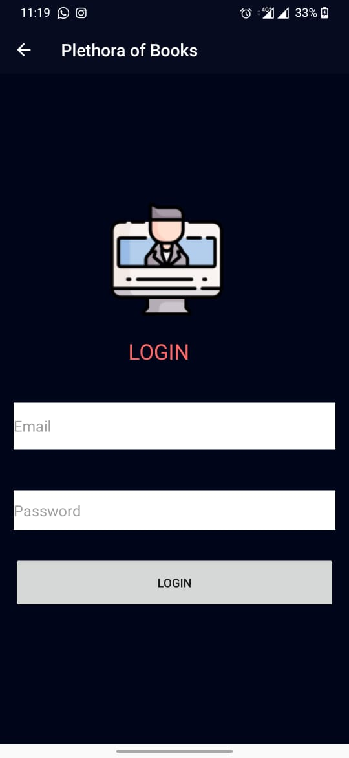
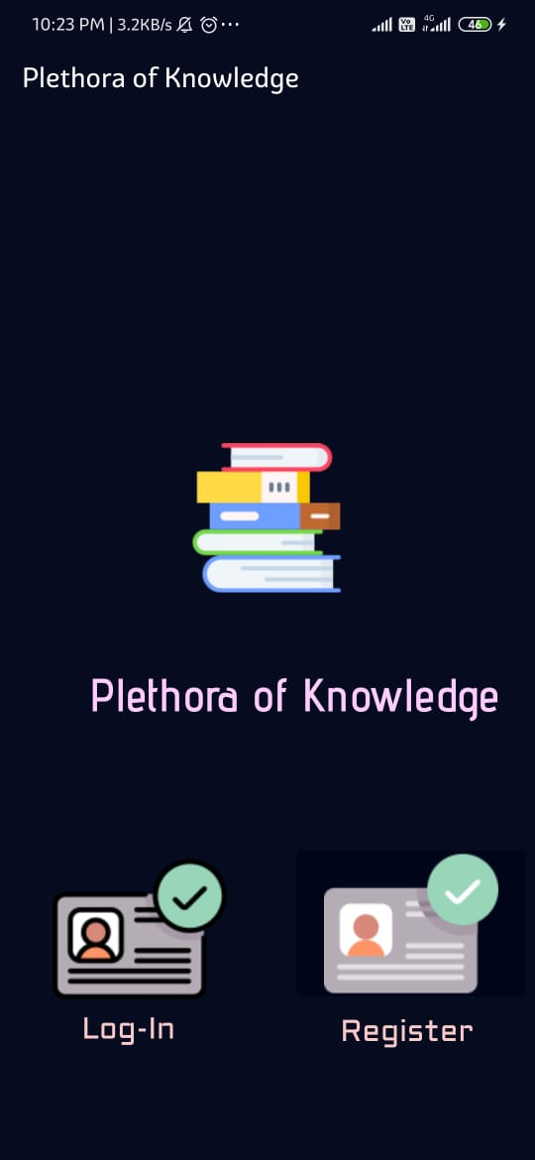
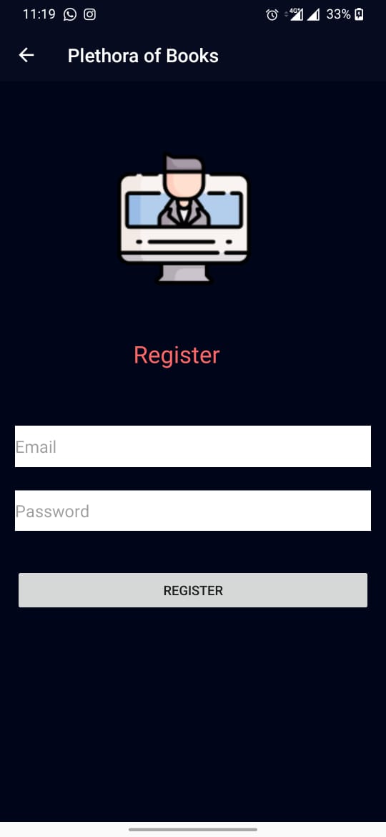
Implementation
If you are already a user
Redirected to
Login page
For New user
Log-in Page
Title Screen
Registration page

Slide 8
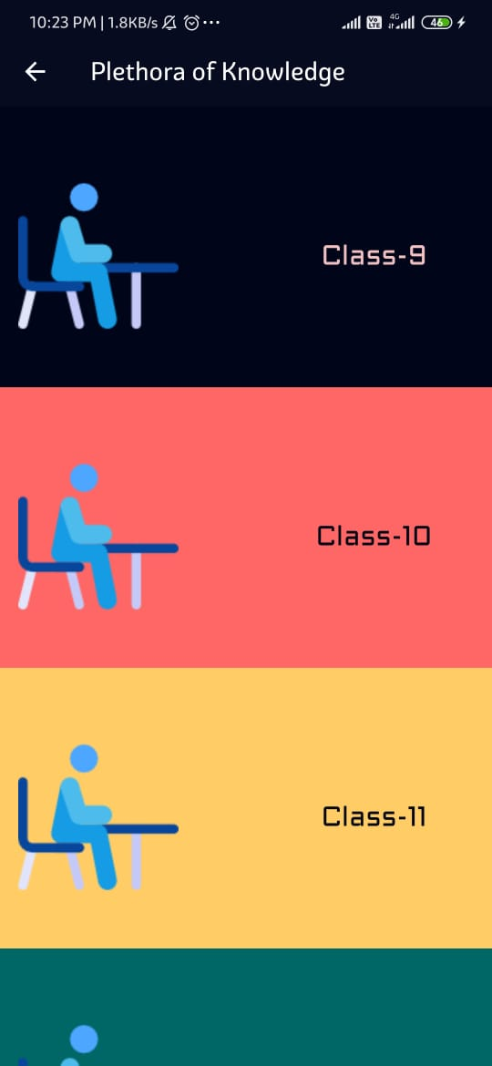
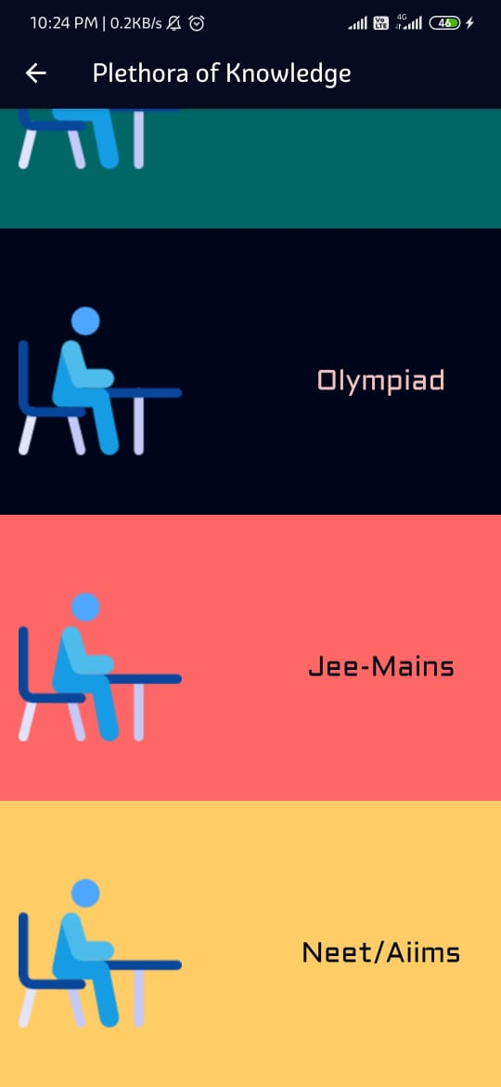
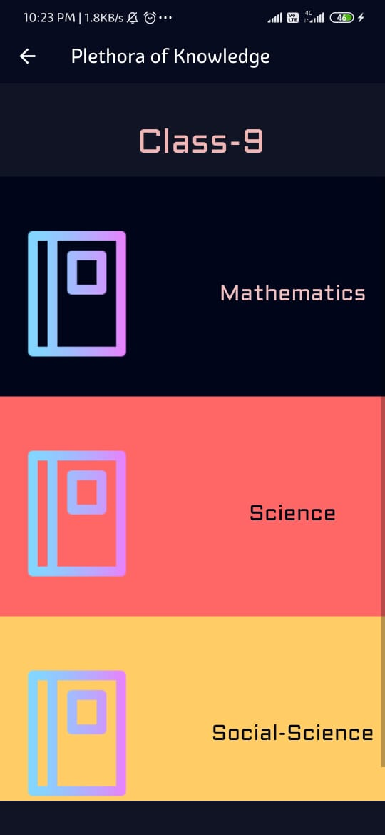
Scroll down
Select the class or exam for which you want to study.
Ex: Class 9 selected
Home Screen After Login
Class 9 Subjects Screen

Slide 9
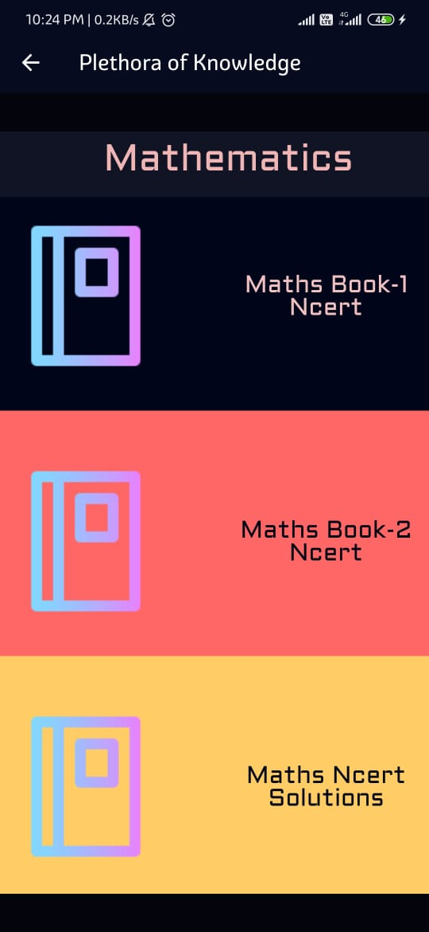
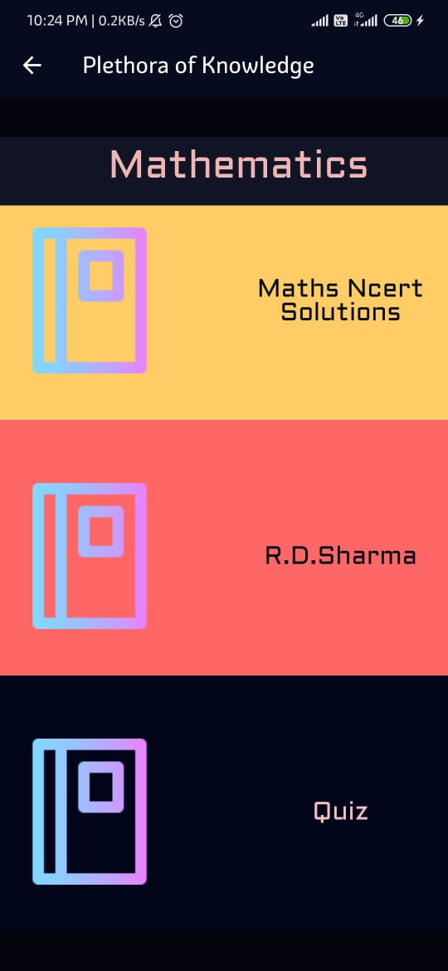
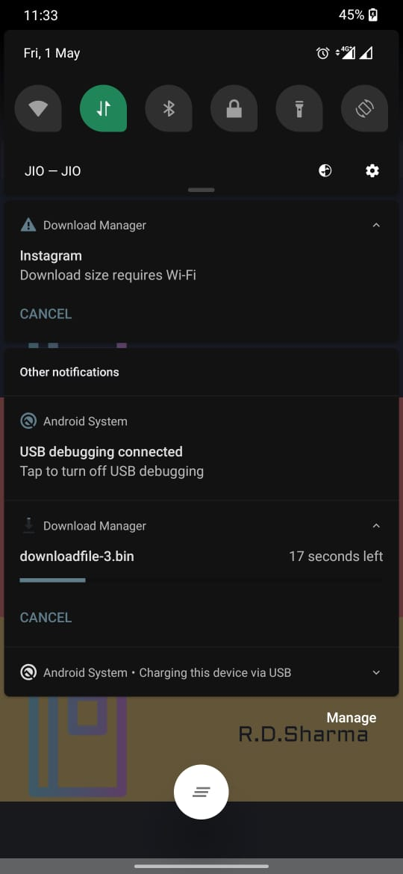
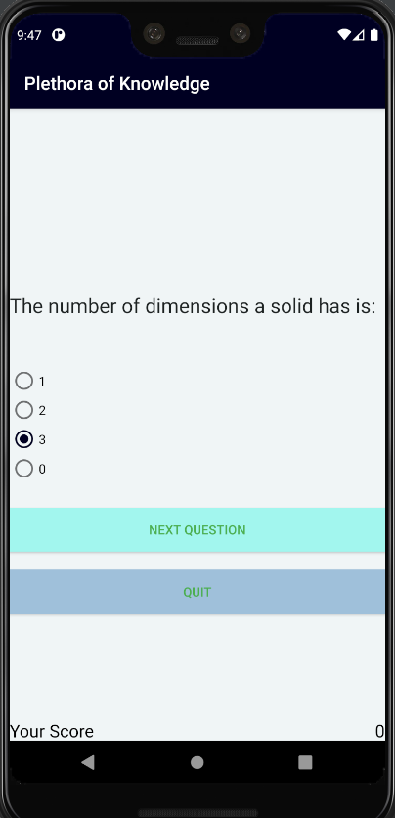
If you select
any material to be downloaded
If you select
mathematics
Mathematics Content Screen
Download Started
General Quiz window that is available for ALL subjects
Class 9 Subjects Screen
General Quiz window

Slide 10
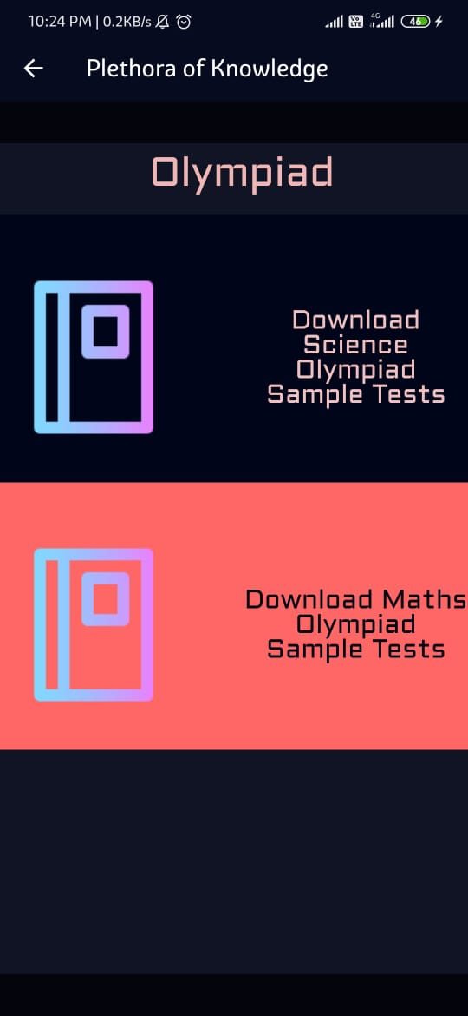
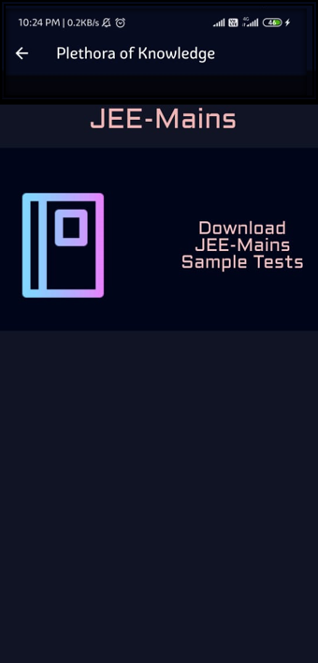
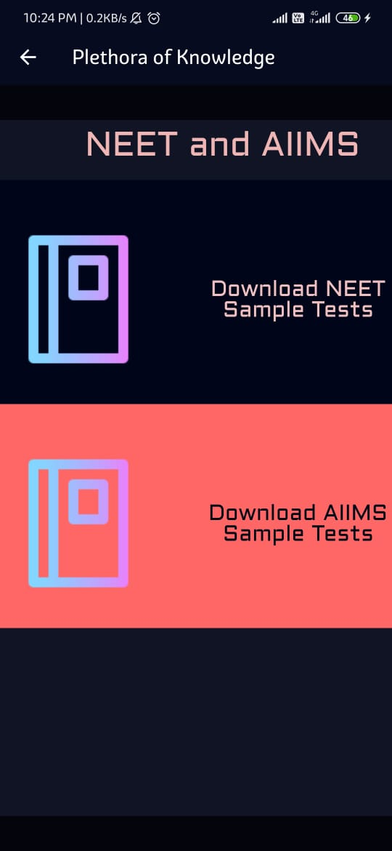
Olympiad Screen
JEE Mains Screen
NEET AIIMS Screen

Slide 11
Future Scope
As we know , there is a lot of content that is available for free on the internet, but what happens is that student are sometimes confused where to go and what to study. So we can provide them with the best tutorials that they need to get stronger in their skills.
Also this app can be later geared up to include various other sections like for different Engineering department , medical department, GATE, GRE, CAT etc. all these stuffs can also be provide on this same platform (credits will be given to the creator of the course and the permission will be taken care of for the © concerns.)
The latest placement related training , the internships posts, the future guidance, discussion forum, useful webinars links and various other event registrations can be summed up in the app so as to cover all the learner’s community.

Slide 12
Link to the project
GitHub link:
https://github.com/aztecs12/EDU_AZTECS
Google Drive link:
https://drive.google.com/file/d/14cI2Df2sdPcLV3upx7JVf8IH0iC_QlqL/view?usp=sharing

