Slide 1
UNDER THE GUIDANCE OF
DR. HIMADRI SHEKHAR DUTTA
IMPLEMENTATION OF DIGITAL IMAGE PROCESSING TECHNIQUES USING FPGA HARDWARE
Presented by :
Pranshu Chakraborty
Brijesh Mondal
Joydip Panja
Kanu Soren

Slide 2
INTRODUCTION
Image processing now-a-days have varied applications in the fields of medical imaging, whether metrology, digital photography, microscopy etc. Recent advances in the camera sensor technology has resulted in an overall decline in visual quality of recorded content, necessitating improvement of images through the use of post-processing.
This project features on developing suitable method for efficient way to perform hardware implementation for some of image processing algorithms that can be used in bio-medical applications.

Slide 3
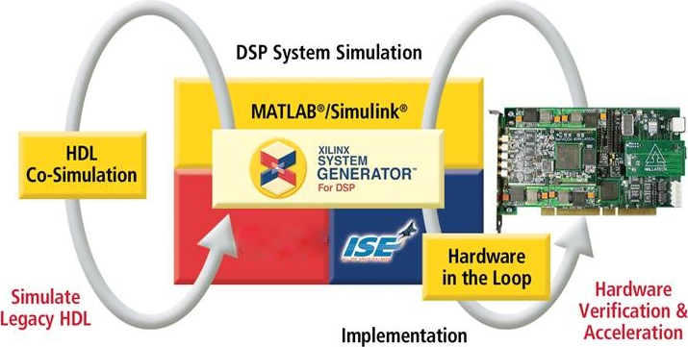
DESIGN FLOW
Developing algorithm models in MATLAB using Xilinx Block set for specific role.
Creating workspace in MATLAB Simulink to process image pixels in the form of multi dimensional image signals for input and output images
Performing hardware implementation of given algorithms on FPGA

Slide 4
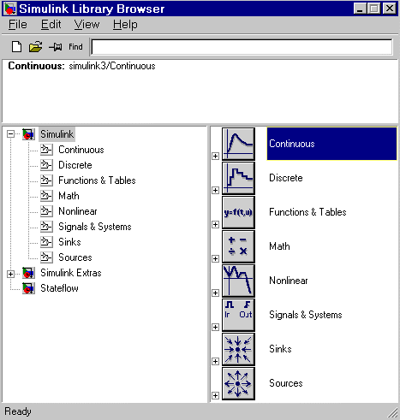
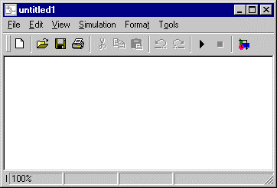
MATLAB SIMULINK
Simulink is a software package for modeling, simulating, and analyzing dynamical systems.
For modeling, Simulink provides a graphical user interface (GUI) for building models as block diagrams, using click-and-drag mouse operations.
Simulink Library
Simulink opens a new model window

Slide 5
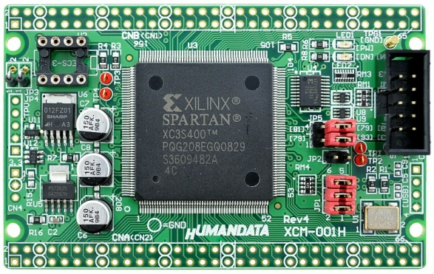
XILINX SYSTEM GENERATOR (ISE)
System Generator is a part of ISE Design suite and provides Xilinx DSP Block set such as adders, multipliers, registers, filters and memories for application specific design. These block leverage the Xilinx IP care generators to deliver optimized results for the selected device. Designs are captured in the DSP friendly Simulink modeling environment . All of the downstream FPGA implementation steps including synthesis and place and route are automatically performed to generate an FPGA programming file. Xilinx Block set provides close integration with MATLAB Simulink that helps in co-simulating the FPGA module

Slide 6
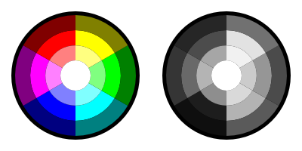
GRAYSCALE CONVERSION OF A COLOR IMAGE
Here we will take an image and through Xilinx ISE Design Suite 12 and MATLAB /Simulink 7.10 (R2010a) programming blocks, convert the image from color to gray scale. It does this using MATLAB programming to format the input, Simulink and Xilinx Programming blocks for the algorithm, and finally MATLAB programming for the output.

Slide 7
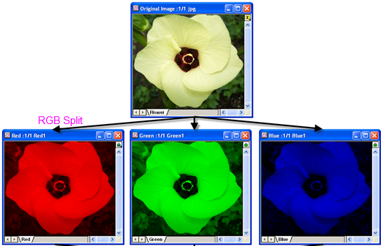
IMPLEMENTATION
Separating RGB signals in Workspace:
Save the files as “sysgenColorConverter_imageData.mat”, “sysgenColorConverter_PreLoadFcn.m”
& “sysgenColorConverter_StopFcn.m”
into the specified workspace folder.The former inherits the source image from sysgenColorConverter_imageData.mat and then allows that input to be made into Simulink blocks. The latter allows the output to be graphed into MATLAB.

Slide 8
A - sysgenColorConverter_imageData.mat
function importfile(fileToRead1)
%IMPORTFILE(FILETOREAD1)
% Imports data from the specified file
% FILETOREAD1: file to read
% Auto-generated by MATLAB on 19-Nov-2010 11:59:20
% Import the file
newData1 = load('-mat', fileToRead1);
% Create new variables in the base workspace from those fields.
vars = fieldnames(newData1);
for i = 1:length(vars)
assignin('base', vars{i}, newData1.(vars{i}));
end

Slide 9
B – sysgenColorConverter_PreLoadFcn.m
% sysgenColorConverter_imageData is a matrix loaded by the model from a .mat
% file before this script is run.
% We now separate out the red green and blue components from the image.
redSignal = sysgenColorConverter_imageData(:,:,1);
greenSignal = sysgenColorConverter_imageData(:,:,2);
blueSignal = sysgenColorConverter_imageData(:,:,3);
NPixels = size(redSignal,1) * size(redSignal,2);
% turn them into vectors (they were arrays):
redSignal = reshape(redSignal,1,NPixels);
greenSignal = reshape(greenSignal,1,NPixels);
blueSignal = reshape(blueSignal,1,NPixels);
% insert a column of 'time values' in front -- the from workspace
% block expects time followed by data on every row of the input
redSignal = [ double(0:NPixels-1)' double(redSignal)'];
greenSignal = [ double(0:NPixels-1)' double(greenSignal)'];
blueSignal = [ double(0:NPixels-1)' double(blueSignal)'];

Slide 10
C – sysgenColorConverter_StopFcn.m
if (exist('ySignal','var') & exist('NPixels','var'))
if ((~isempty(ySignal)))
designLatency = find(ySignal>0 & ySignal<1024);
if (isempty(designLatency))
return;
end
designLatency = designLatency(1);
imageSize = size(ySignal);
if (imageSize(1) >= designLatency+NPixels-1)
% The initial output of the design (pipeline stages)
% will be zeros and NaNs.
% For plotting, we just assume that the first non-zero, non-NaN
% output is the represents the first pixel.
h = figure;
clf;
set(h,'Name',' Color Conversion Results');
set(h,'Position',[100 50 1000 800]);
ySignalN = ySignal(designLatency:designLatency+NPixels-1);
ySignalN = ySignalN - (min(ySignalN));
ySignalN = ySignalN / (max(ySignalN));

Slide 11
subplot(2,3,2);
image(sysgenColorConverter_imageData), ...
axis equal, axis square, axis off, title 'Original Image';
subplot(2,3,4);
image(reshape([ySignalN ySignalN ySignalN], ...
sqrt(NPixels),sqrt(NPixels),3)), ...
axis equal, axis square, axis off, title 'Y Component';
prSignalN = prSignal(designLatency:designLatency+NPixels-1);
prSignalN = prSignalN - (min(prSignalN));
prSignalN = prSignalN / (max(prSignalN));
subplot(2,3,5);
image(reshape([prSignalN prSignalN prSignalN], ...
sqrt(NPixels),sqrt(NPixels),3)), ...
axis equal, axis square, axis off, title 'PR Component';
pbSignalN = pbSignal(designLatency:designLatency+NPixels-1);
pbSignalN = pbSignalN - (min(pbSignalN));
pbSignalN = pbSignalN / (max(pbSignalN));
subplot(2,3,6);
image(reshape([pbSignalN pbSignalN pbSignalN], ...
sqrt(NPixels),sqrt(NPixels),3)), ...
axis equal, axis square, axis off, title 'PB Component';
end end end

Slide 12
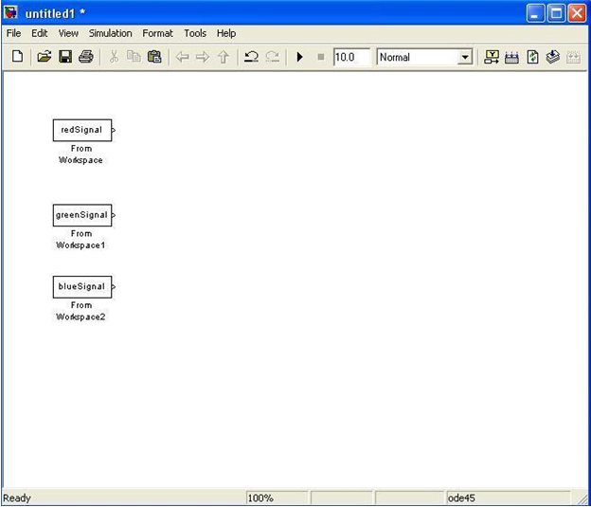
Setting Up Simulink Input Blocks:
First Simulink blocks must be created to inherit the Matlab output of the source file. This will be done by separating the output into separate RGB signals that are very important to grayscaling. Grayscaling works by adding weighted components of the Red, Green, and Blue signals of an image into a single desired linear luminance value

Slide 13
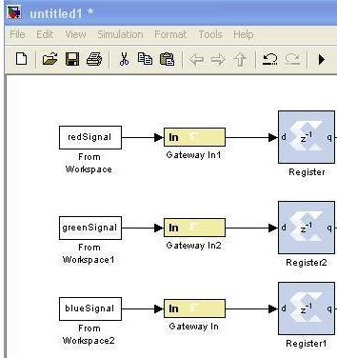
We connect the RGB outputs to the Gateway ins as shown by clicking on the Image From File, then holding control and clicking on each Gateway In. This will create an arrow from one block to the other.
Next, Registers must be added. Connect the outputs of the Gateway Ins into an individual register again creating the arrows from the output of the gateways to the inputs of the registers.

Slide 14
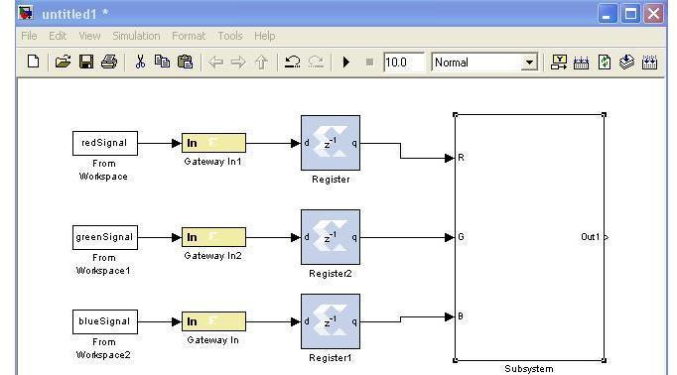
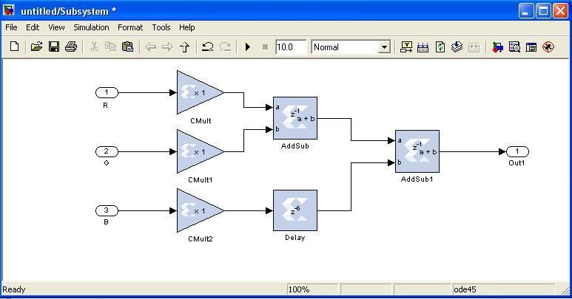
Creating the Subsystem:
To better organize our algorithm, a subsystem will be created. This application requires 3 inputs, so within this new Subsystem, there are 3 input s and 1 output.
Next, multipliers need to be added to weight the RGB components and then summing those resultant numbers.

Slide 15
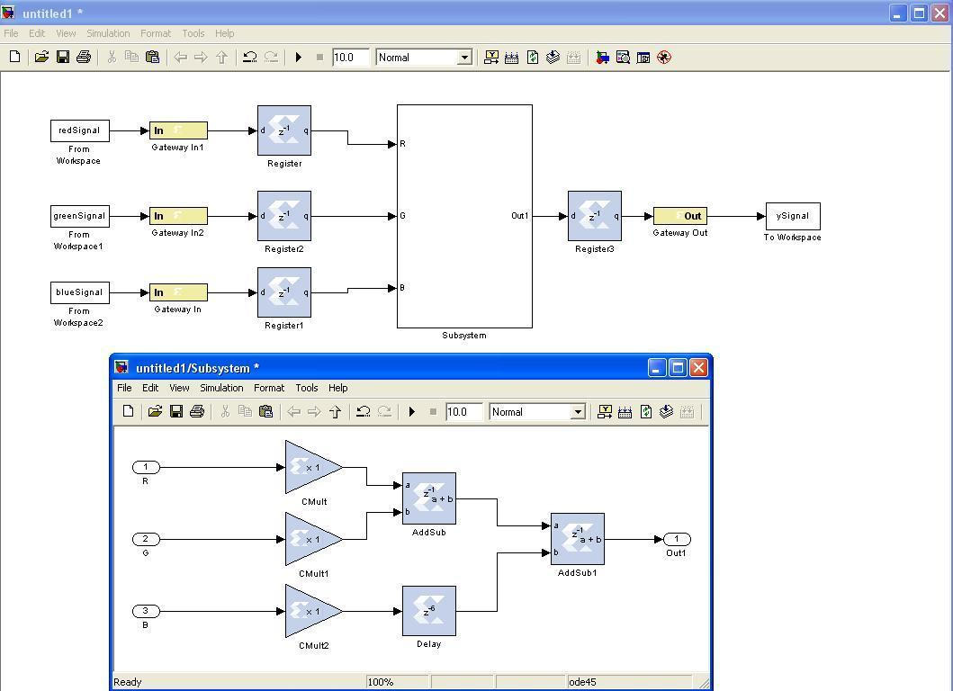
Setting up the Output Blocks:
First, the output will have to be converted via a Xilinx Register. The input to this register will be the output of the subsystem. The output of the register will go to a gateway out, almost a mirror to the input into the subsystem. Finally, the image must be outputted to a video source and its input is the Gateway Out block. This output will be sent to the MATLAB file “sysgenColorConverter _StopFcn.m” which will graph the output in Matlab.

Slide 16
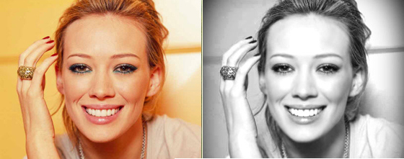
Running the Model:
To run the model we need to set the simulation time to “64*64 + 14.” This is to insure a proper clock and to avoid syncing errors in the calculations.
Next, run both sysgenColorConverter _imageData.mat and sysgenColorconverter PreLoadFcn.m in Matlab to generate the input source file. Now run the model.
Finally, run the sysgenColorConverter_StopFcn.m file which will output the generated grayscale image.

Slide 17
WORK TO BE DONE IN 8TH SEM
1> Some advance Image Processing Algorithm will be implemented using FPGA.
2> Practical application in the field of Medical Image Processing.
3> Optimization in terms of hardware like lower power dissipation, more %utilization of hardware resources, lower no. of FPGA components etc.

Slide 18
REFERENCES
“Integrating Custom Logic in Camera Frame Demo” by Jeffrey Olsen
http://www.egr.msu.edu/classes/ece480/capstone/fall10/group03/doc.html
Matlab/Simulink Version 7.10 Help
System Generator for DSP – Getting Started Guide by Xilinx
http://www.xilinx.com/support/sw_manuals/sysgen_gs.pdf

Slide 19
THANK YOU!!!

