Slide 1

BRITISH AIRWAYS
TASK 1: Web scraping to gain company insights

Slide 2
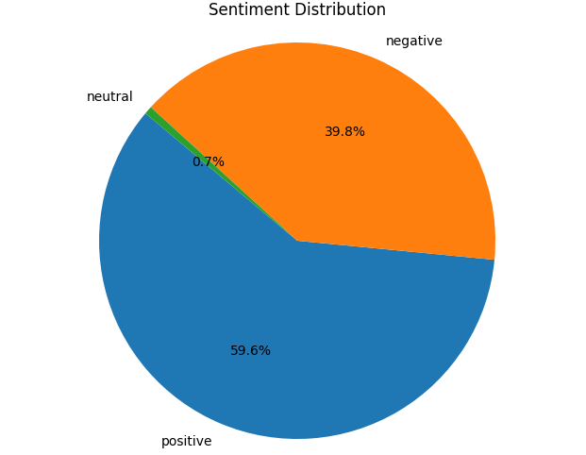
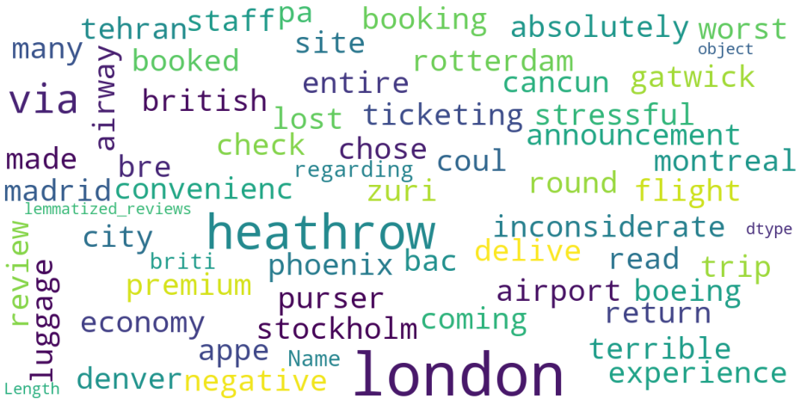
INSIGHTS FROM CUSTOMER REVIEWS
From cleaning 2000 reviews given by the customers, I obtained
Positive Reviews - 1191
Negative Reviews - 795
Neutral Reviews – 13
Word cloud of keywords used in reviews:

