Slide 1
INVESTMENT ASSIGNMENT SUBMISSION
Name: Pranshu Srivastava

Slide 2
Spark Funds – Global Investment Trends
The objective is to identify the best sectors, countries, and a suitable investment type for making investments. The overall strategy is to invest where others are investing, implying that the 'best' sectors and countries are the ones 'where most investors are investing'.
Spark Funds has two minor constraints for investments:
It wants to invest between 5 to 15 million USD per round of investment
It wants to invest only in English-speaking countries because of the ease of communication with the companies it would invest in
Using data from crunchbase.com, investment data(rounds2), companies information and sector information, we can identify the potential area where Spark Funds can invest.
It was identified the venture funding type suits the Spark Funds investment range. USA, Great Britain and India are top 3 most invested countries.
USA’s top 3 most invested sectors are Others, Cleantech / Semiconductors and Social, Finance, Analytics, Advertising
GBR’s top 3 most invested sectors are Others, Cleantech / Semiconductors and Social, Finance, Analytics, Advertising
IND’s top 3 most invested sectors are Others, News, Search and Messaging and Social, Finance, Analytics, Advertising

Slide 3
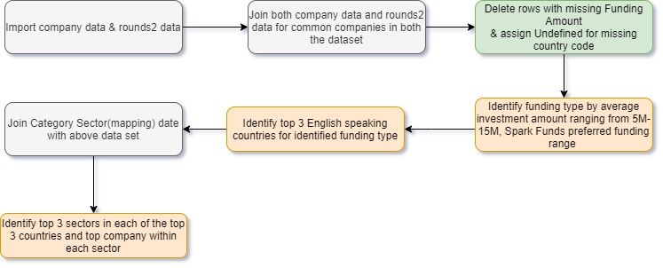
Analysis Methodology

Slide 4
Data Cleansing Criteria
Removal of all empty raised amount rows
All missing country code are replaced with undefined
First sub category of each company will be assumed as primary category

Slide 5
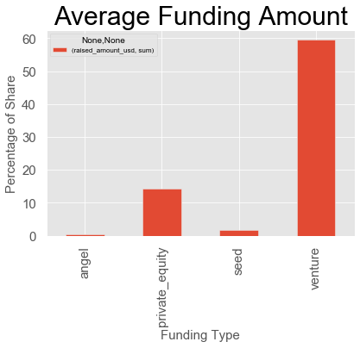
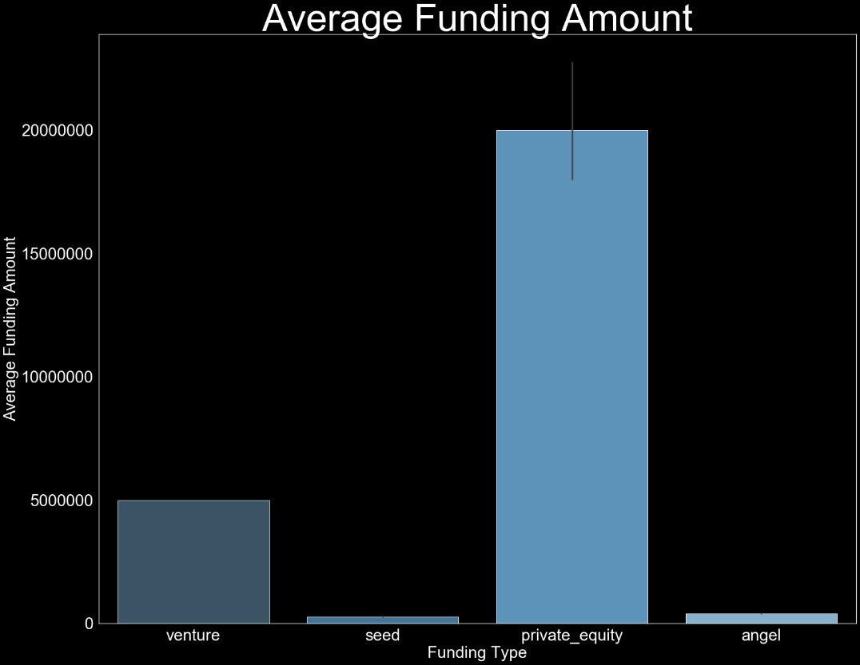
Investment Distribution by Type
On analyzing the data by investment type,
Venture has average funding amount between 5M -15M
Venture contribute highest to total investment amount with approx. 60%

Slide 6
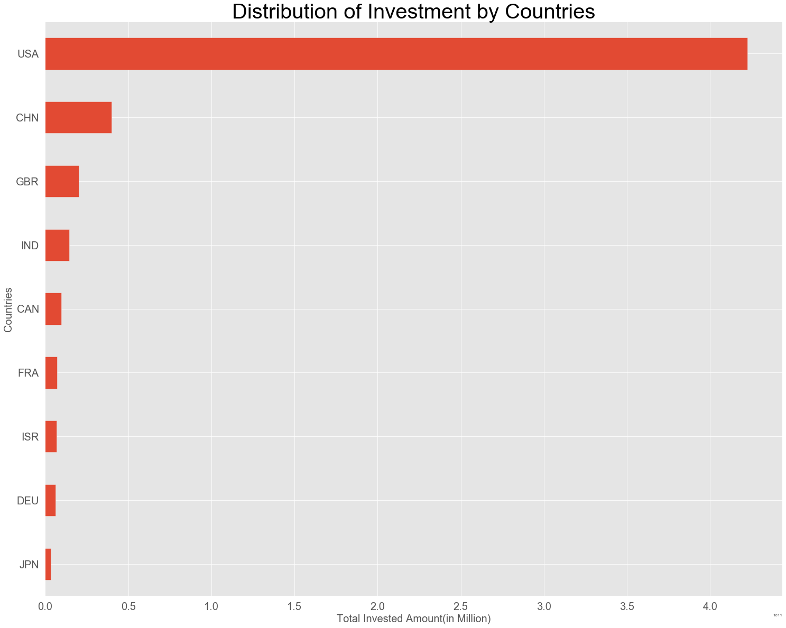
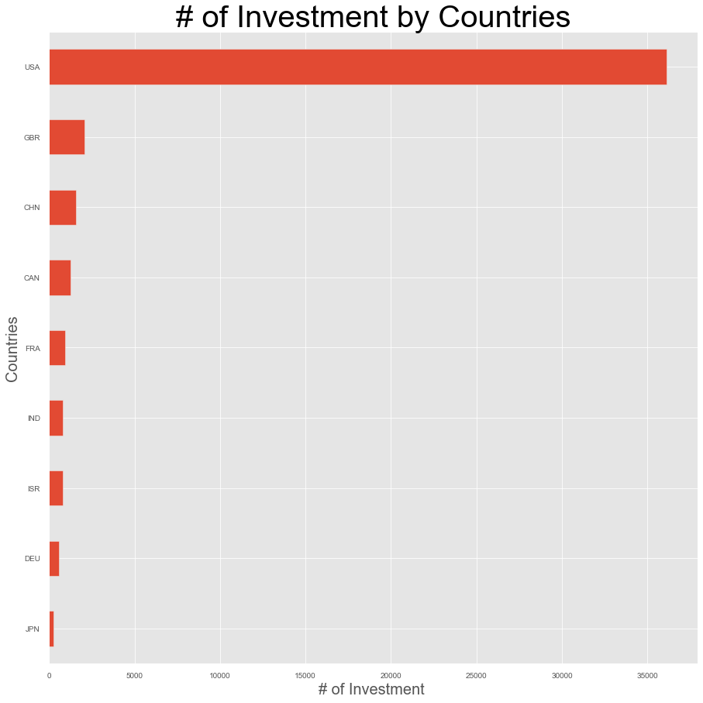
Distribution of Venture investment by countries
Top invested English countries by amount are USA, Great Britain & India

Slide 7
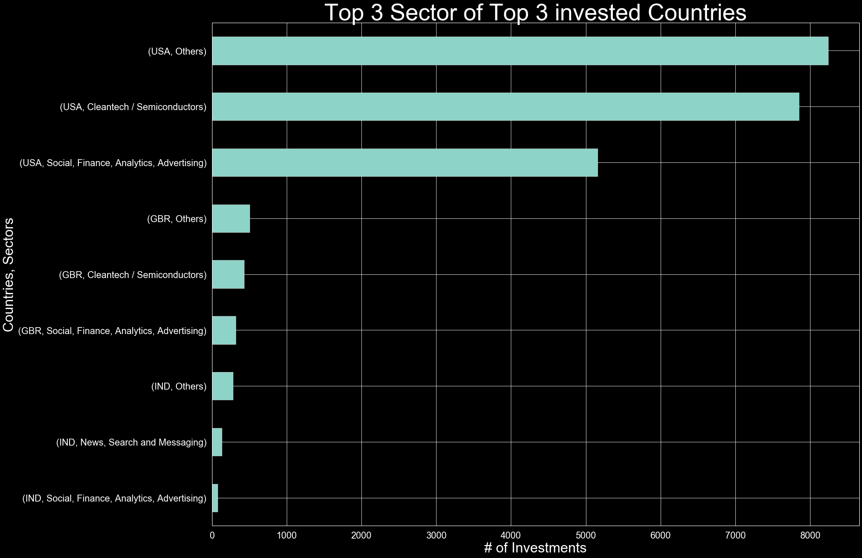
Top 3 Sectors within each Country

Slide 8
Conclusion - Venture Investment
Venture investment is best suited investment based on the capital required for investment
USA, Britain & India are the top English speaking countries by investment amount
Top sectors to invest within each country
Top companies with top 2 sectors within each country
USA | Britain | India
Others | Others | Others
Cleantech / Semiconductors | Cleantech / Semiconductors | News, Search and Messaging
Social, Finance, Analytics, Advertising | Social, Finance, Analytics, Advertising | Social, Finance, Analytics, Advertising
USA | Britain | India
SoFi | OneWeb | Flipkart
Freescale Semiconductor | Immunocore | Quikr

