Slide 1
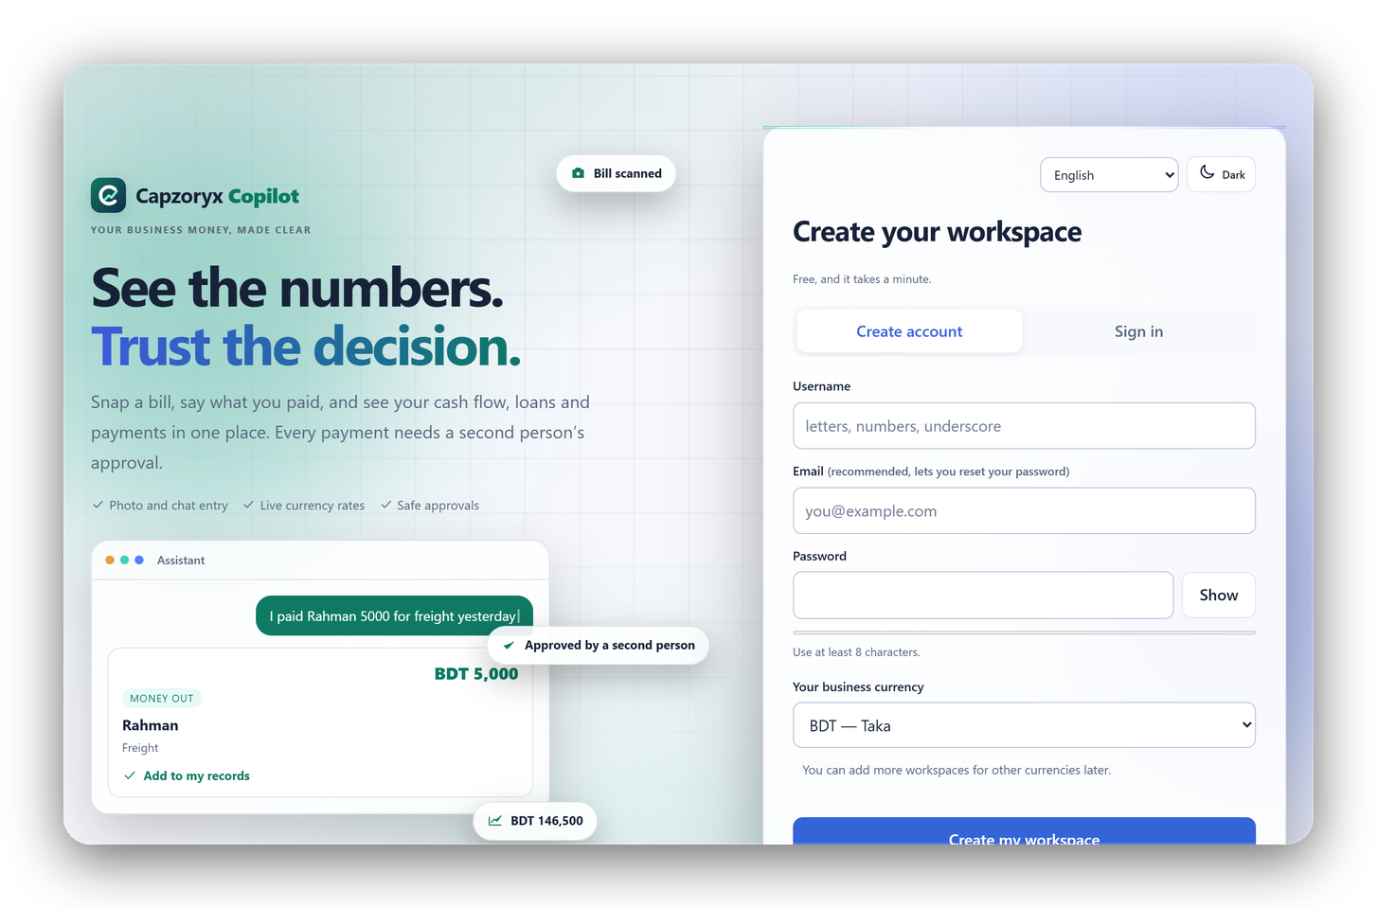

2026 SHENZHEN INTERNATIONAL FINTECHATHON
INTERNATIONAL TRACK · TOPIC E: SME FINANCE COPILOT
Capzoryx
Copilot
AI that helps small businesses decide. Without ever taking control of their money.
TEAM CAPZORYX · BANGLADESH
The real landing page · 37 languages · free to start
Live product · Source code · Tested decision controls
Capzoryx Copilot · AI as a financial participant · 10-minute pitch
01 / 13
Notes:
Good day. We are Team Capzoryx from Bangladesh, and this is Capzoryx Copilot, our entry for Topic E, the SME Finance Copilot. The theme is AI as a financial participant, so we asked what a small business owner really needs from an AI. Not a robot that moves money. A copilot that helps them decide, and never takes control of their money. Everything you will see today is real, running software. The live product and the source code are linked on this slide.

Slide 2
01 / THE SME PROBLEM
Profitable on paper. Short of cash in reality.
Three questions small-business owners answer too late.
01
02
03
When will cash run short?
Which financing truly fits?
Which payment is safe?
Receipts and supplier deadlines rarely arrive together.
The lowest advertised rate can hide a higher effective cost.
Duplicate invoices and rushed approvals put working capital at risk.
The gap is not a lack of data. It is the lack of a trusted next decision.
We start with SMEs in Bangladesh. The engine is not local: 37 languages, 150+ currencies.
Capzoryx Copilot · 2026 Shenzhen International FinTechathon · Topic E
02 / 13
Notes:
A small business can look profitable on paper and still run out of cash. The owner faces three questions, usually too late. When will cash run short? Which financing really fits? Which payment is safe? Receipts and supplier deadlines rarely line up, the lowest advertised rate can hide a higher real cost, and a duplicate invoice paid in a hurry drains working capital. The gap is not a lack of data. It is the lack of a trusted next decision. We start with Bangladeshi small businesses, but the engine speaks 37 languages and more than 150 currencies.

Slide 3
02 / THE CAPZORYX APPROACH
A verified decision, not a blind guess.
One workspace turns business records into informed, controlled action.
SEE
DECIDE
CONTROL
Bills, balances, due dates and a cash outlook for 7 and 30 days.
Compare loans by effective rate, total cost and fit.
A second person approves; every step is audited.
VERIFIED EVIDENCE
EXACT MATH
POLICY + APPROVAL
AUDIT
AI may propose. Deterministic code calculates. People approve.
Capzoryx Copilot · 2026 Shenzhen International FinTechathon · Topic E
03 / 13
Notes:
Our approach has three verbs: see, decide, control. See: bills, balances, due dates and a seven and thirty day cash outlook. Decide: compare loans by effective annual rate, total cost and how well they fit the cash flow. Control: a second person approves every payment, and every step is written into a signed audit trail. The chain at the bottom is the point. Evidence first, then exact math, then policy and approval, then audit. The AI may propose. Deterministic code calculates. People approve.

Slide 4
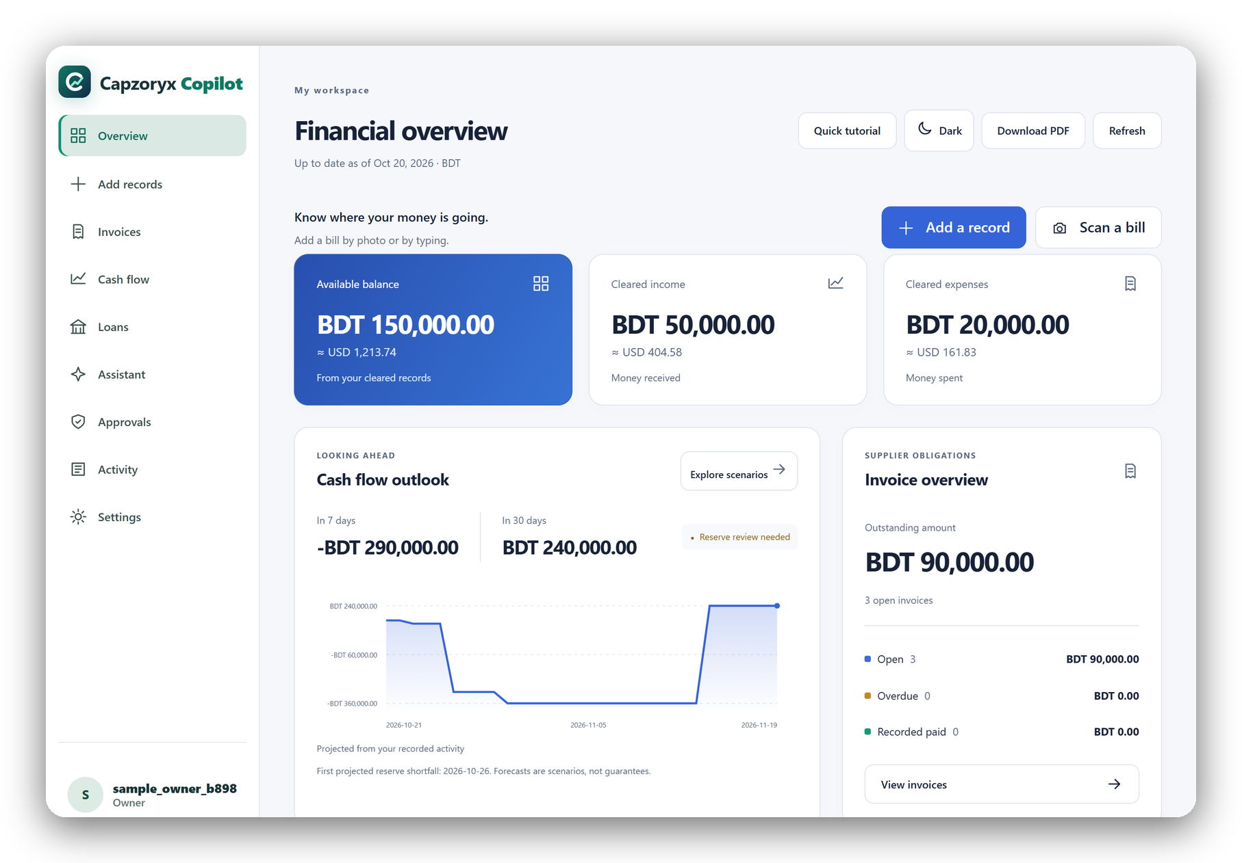
03 / THE PRODUCT: OVERVIEW
From records to a clear financial picture.
BDT 150,000
cleared balance, with an approximate USD value beside it
7 and 30 days
a deterministic cash outlook that flags the first reserve breach
1 click
“Try a sample business” loads fictional data so every feature can be tested
Real screen, local copy, fictional sample business.
Capzoryx Copilot · 2026 Shenzhen International FinTechathon · Topic E
04 / 13
Notes:
This is the real Overview screen, from a local copy of our app, using the built-in sample business. All data is fictional. At a glance: a cleared balance of 150,000 taka, with an approximate dollar value beside it, and a cash outlook that flags the first reserve breach. Notice the navigation: Add records, Invoices, Cash flow, Loans, Assistant, Approvals, Activity. And for judges, there is a one-click button, Try a sample business, so you can test every feature in seconds without entering anything.

Slide 5
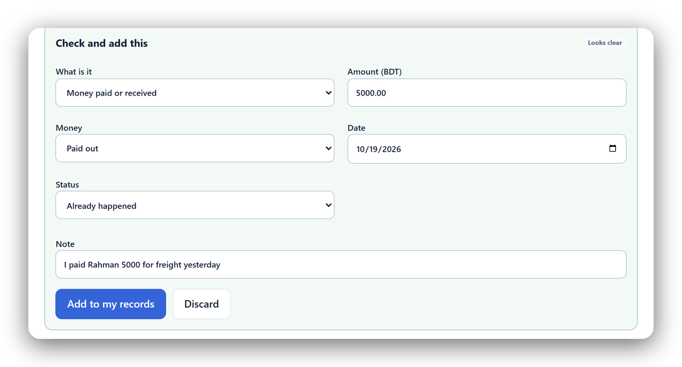
03 / THE PRODUCT: ADD RECORDS
Snap it or type it. You confirm.
“I paid Rahman 5000 for freight yesterday”
Photo of a bill or receipt
Read by the optional cloud model.
A typed sentence
Becomes a draft, even without cloud AI.
A plain form
Cash activity or an unpaid supplier invoice.
You always check the draft. Recording something never sends money.
Capzoryx Copilot · 2026 Shenzhen International FinTechathon · Topic E
05 / 13
Notes:
Small business owners do not want to fill in forms, so records can arrive three ways. A photo of a bill or receipt, which uses an optional cloud model. A typed sentence, like: I paid Rahman 5000 for freight yesterday. That becomes a draft, and it works even without cloud AI. Or a plain form. In every case, the app shows a draft card and the owner checks it before anything is saved. Amounts are kept exactly, and recording something never sends money. The human stays in charge from the very first step.

Slide 6
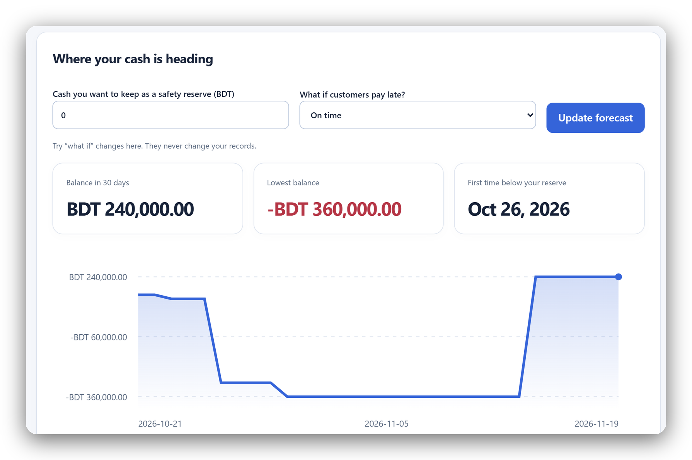
04 / DEMO SCENARIO
The cash gap shows up six days early.
BDT 150,000
cleared cash today
BDT 420,000
material bill, due in 6 days
−BDT 360,000
lowest balance in 30 days
Customers pay BDT 600,000 on day 25.
Fictional sample business, BDT, safety reserve 0.
Capzoryx Copilot · 2026 Shenzhen International FinTechathon · Topic E
06 / 13
Notes:
Here is our demo story, a fictional exporter. It has 150,000 taka in cleared cash today. But a material bill of 420,000 is due in six days. The chart shows the dip: the lowest projected balance is minus 360,000, and the first reserve breach is on the 26th. Customers will pay 600,000 on day 25, so the business is not failing. It is short of cash for almost three weeks. The forecast is a deterministic scenario, not a prediction, and it shows the problem six days early, while there is still time to act.

Slide 7
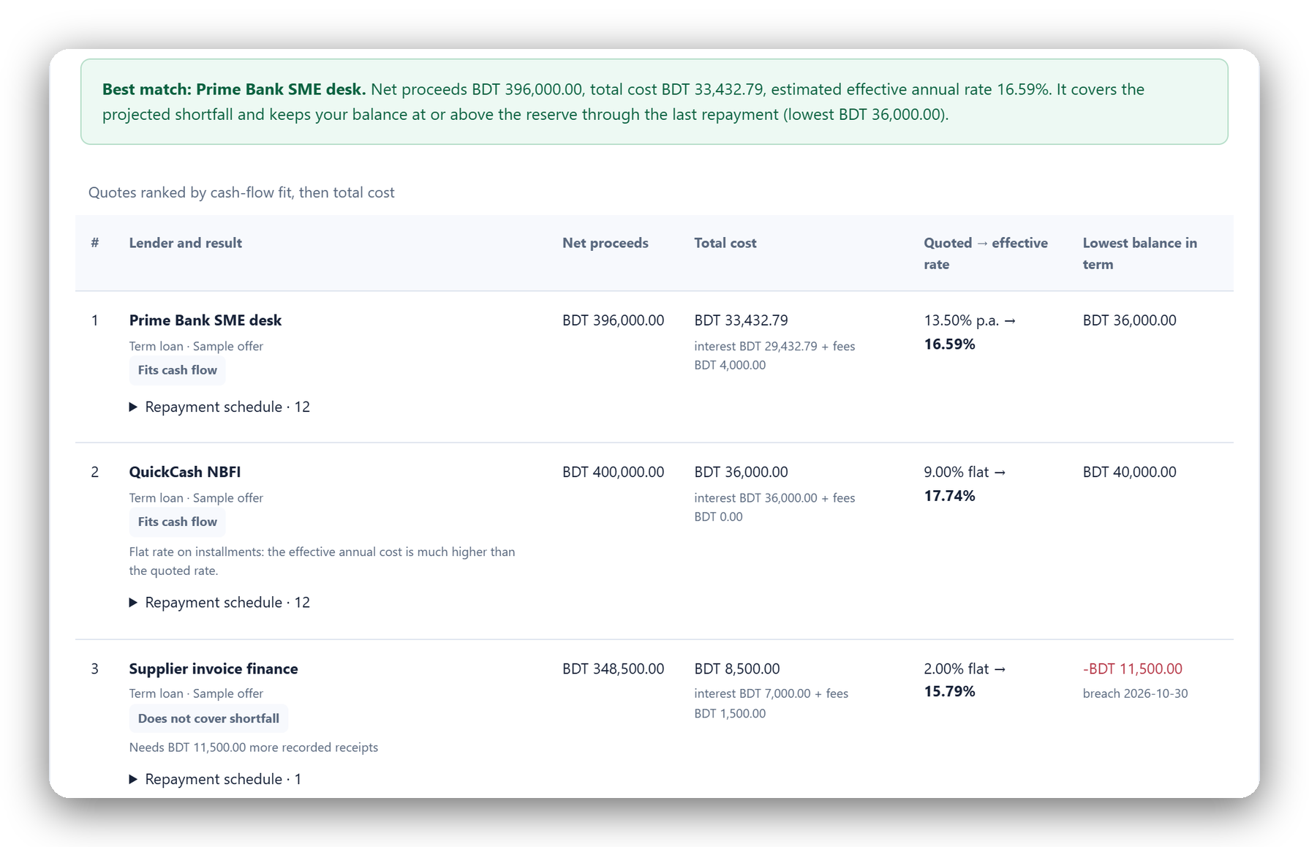
05 / FINANCING INTELLIGENCE
The cheapest-looking rate can cost more.
16.59%
Bank term loan, 13.5% reducing. Best match.
17.74%
“9% flat” NBFI offer. The real annual cost.
15.79%
Supplier finance. Cheapest, but too small for the gap.
Three fictional quotes, entered by hand. Not lender offers.
Exact schedules · effective annual rate · cash-flow fit
Capzoryx Copilot · 2026 Shenzhen International FinTechathon · Topic E
07 / 13
Notes:
Now the decision. The owner types in three offers from lenders. We calculate every repayment exactly and convert each offer to an effective annual rate. The bank term loan at 13.5 percent reducing balance has an effective rate of 16.59 percent, and it fits the cash flow. It is the best match. The offer that says nine percent flat is actually 17.74 percent a year, a rate trap. Supplier finance is the cheapest at 15.79 percent, but it is too small to cover the gap. These quotes are entered by the user, and we do not check eligibility.

Slide 8

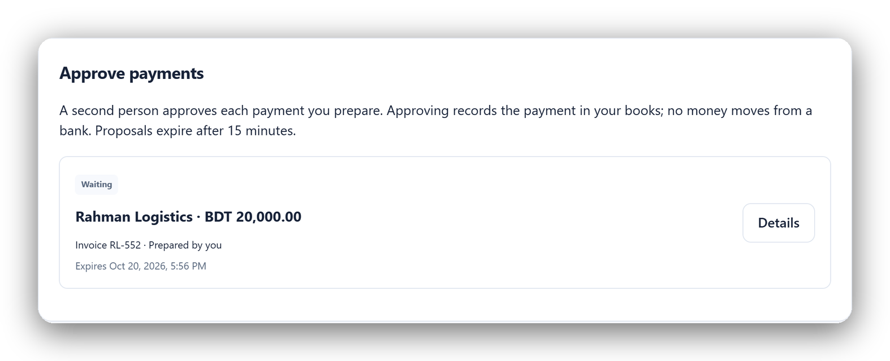
06 / SAFETY AS A FEATURE
The model can suggest. It cannot approve.
01
02
03
04
05
SOURCE
EXACT MATH
AI PROPOSES
HUMAN APPROVES
LEDGER + AUDIT
Invoice + payee
Amount + reserve
Typed tools only
Other account
Once, signed
NO BANK CREDENTIALS
A resent invoice with an “ignore duplicate checks” memo is paused.
NO AI PAYMENT EXECUTION
NO SELF-APPROVAL
Approving records a posting in the books. Capzoryx never sends a bank transfer.
Capzoryx Copilot · 2026 Shenzhen International FinTechathon · Topic E
08 / 13
Notes:
Safety is a feature, and this is the slide we care about most. Every consequential action crosses a deterministic policy boundary. The source is an invoice and a payee. Exact math checks the amount and the reserve. The AI may only propose, through typed, bounded tools. Then a different human account must approve, and the ledger entry is posted once and signed. On the left, a resent invoice carrying a hidden instruction to ignore duplicate checks is simply paused. On the right, a payment waits for a second person. No bank credentials, no AI payment execution, no self-approval.

Slide 9
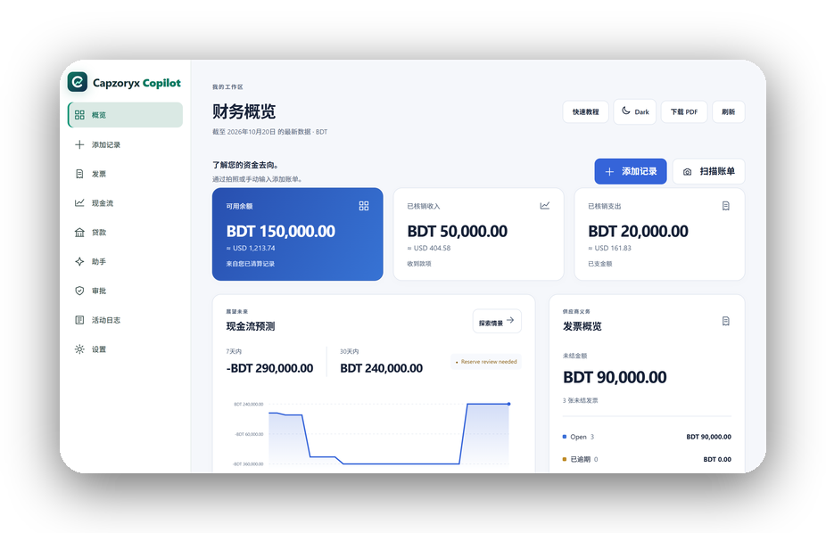
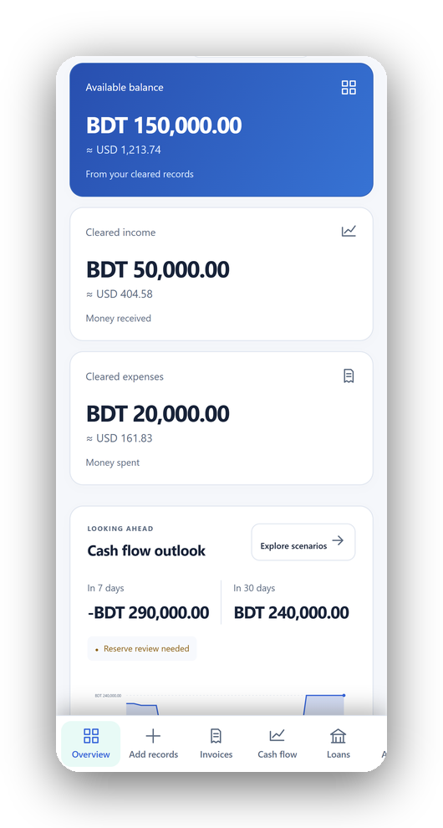
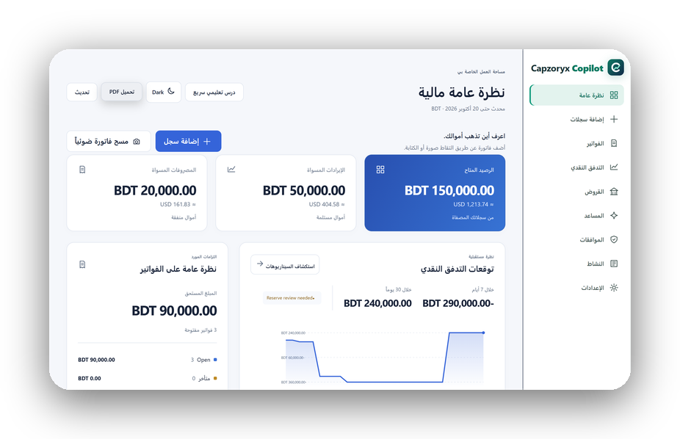
07 / BUILT FOR REAL USE
Built for real use, not just a demo.
Accounts
Sharing with roles
Two-step sign-in with an authenticator app
Approver or viewer, by invitation link
37 languages
Photo, chat, form
简体中文
Right-to-left layouts included
Every draft is checked by you
PDF report
150+ currencies
Phone
Plus a full backup file
Live conversion on the overview
العربية · right to left
Capzoryx Copilot · 2026 Shenzhen International FinTechathon · Topic E
09 / 13
Notes:
We built this for real use, not only for a demo. People sign up with accounts and can switch on two-step sign-in with an authenticator app. They can share a workspace with an accountant or a teammate, as an approver or as view-only. The interface comes in 37 languages, including Chinese, and right-to-left layouts such as Arabic. It works on a phone-sized screen. Records come by photo, chat or form, there is a PDF report and a backup file, and conversion between currencies uses live rates. Everything stays free to start.

Slide 10
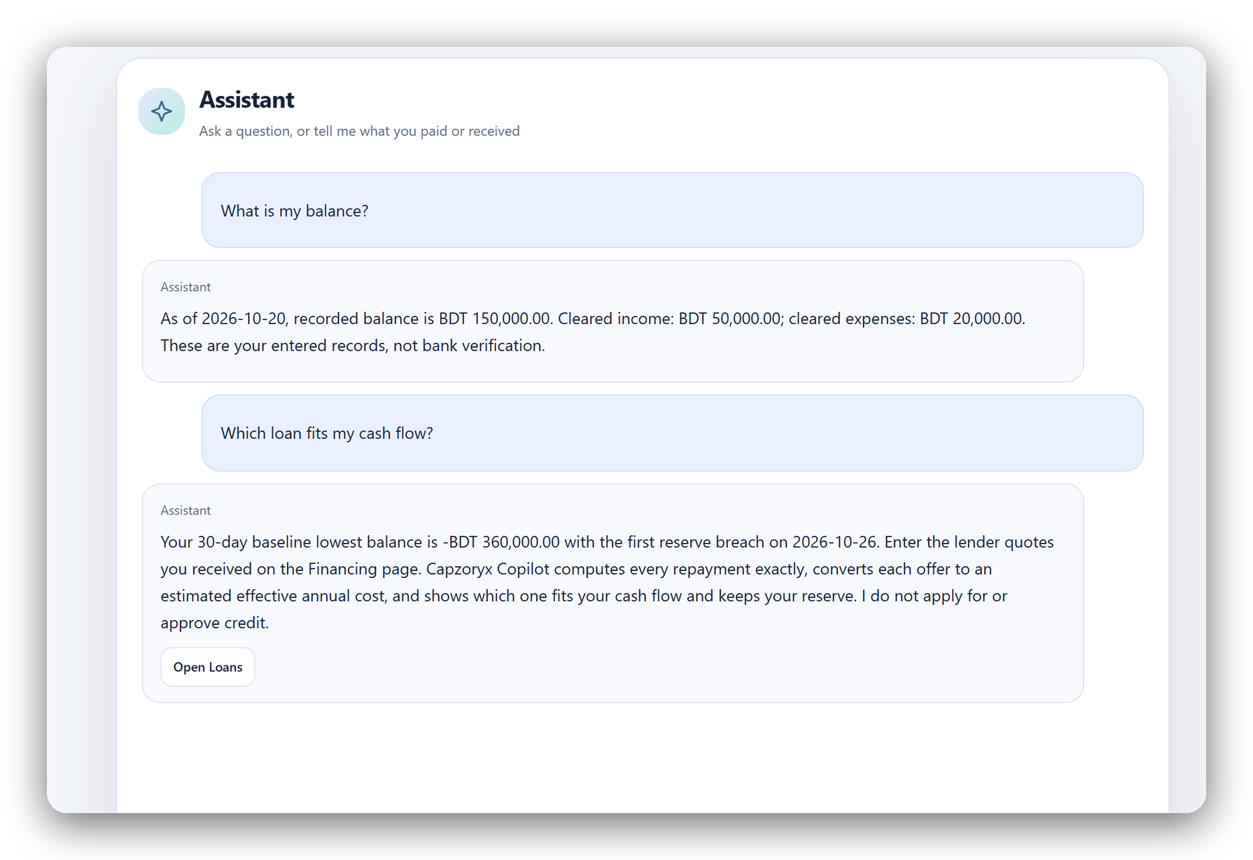
08 / LOCAL-FIRST INTELLIGENCE
Intelligent assistance, with permission built in.
LOCAL FIRST
Balance, bills and how-to questions are answered on the device.
CONSENT GATE
Optional online help asks before anything is shared.
OFF-TOPIC STAYS OFF
25 of 25 off-topic test prompts were declined, none sent online.
“Answers on your device” · figures come from your own records.
Capzoryx Copilot · 2026 Shenzhen International FinTechathon · Topic E
10 / 13
Notes:
The assistant is local first. Questions about the balance, the bills, or how the site works are answered on the device, from the owner's own figures, with the numbers shown. A smarter online model is optional, and it asks permission before anything is shared. Anything off topic is declined and never sent anywhere: on our fresh test, 25 of 25 off-topic prompts were handled that way. The assistant has no approve or pay tool. Even if it misunderstood a request, the server enforces roles and approvals.

Slide 11
09 / HOW IT WORKS
Trust boundaries are part of the architecture.
Financial authority stays in the policy engine, not in the AI model.
FRONTEND
POLICY + FINANCE API
PERSISTENT STATE
React 19 · TypeScript
FastAPI · Pydantic
Turso / libSQL
Vercel
Render
SQLite locally
Entry, dashboards, chat, consent
Exact money, roles, reserve, approvals
Ledger, journal, signed audit chain
OPTIONAL CLOUD AI · EXPLANATIONS ONLY
Typed tools · consent first · no approve or execute tool
Server-derived identity · exact integer money · append-only ledger · strict CSP · scrypt-hashed passwords
Capzoryx Copilot · 2026 Shenzhen International FinTechathon · Topic E
11 / 13
Notes:
A quick look at the architecture, because trust boundaries matter. The front end is React and TypeScript on Vercel. The policy and finance engine is FastAPI on Render, where money is exact, roles are enforced and approvals happen. State lives in a libSQL database with a signed, linked audit chain. The optional cloud AI sits to the side. It can only explain, using typed tools and consent. It has no approve or execute tool. Financial authority stays inside the policy engine, never inside the model.

Slide 12
10 / TECHNICAL EVIDENCE
We test the controls, and disclose the limits.
Internal verification, re-run on 20 October 2026. Not independent certification.
490
60 / 60
14,280
73.7%
backend tests
black-box probes
randomized scenarios
fresh-prompt accuracy
Roles, money, approvals; run in CI
Auth, inputs, sessions, isolation
Financing engine: 119 seeds × 120 rounds
70 of 95 unseen prompts, run once
WHAT WE DO NOT CLAIM
No bank connection · Lender quotes are user-entered · Forecasts are scenarios, not predictions · Decision support, not autonomy
Sources: docs/SECURITY_SELF_ASSESSMENT.md · docs/LOCAL_ASSISTANT_EVALUATION.md · deck_build/verify_claims.py
Capzoryx Copilot · 2026 Shenzhen International FinTechathon · Topic E
12 / 13
Notes:
Here is our evidence, from internal checks that we re-ran on the 20th of October. We have 490 backend tests. Sixty of sixty black-box probes passed against a local server. A randomized check of 14,280 financing scenarios found money conserved exactly. And on 95 fresh, unseen prompts, the on-device assistant was right 73.7 percent of the time. We say that number plainly, because it is the honest one, and the failures are safe ones. What we do not claim: no bank connection, user-entered quotes, scenarios not predictions, decision support not autonomy, and no independent certification.

Slide 13

Capzoryx Copilot
AI should improve
financial judgment.
Not replace human control.
NEXT, WHEN GOVERNANCE IS READY
SCAN FOR THE LIVE DEMO
Bank and wallet statement import · bill reminders · validated integrations and a security review
capzoryx-copilot.vercel.app
github.com/Pranto-404/capzoryx-copilot
A decision-support prototype, not an autonomous bank.
TEAM CAPZORYX · BANGLADESH
Capzoryx Copilot · The future of financial AI is verifiable
13 / 13
Notes:
To close: AI should improve financial judgment, not replace human control. Next, when governance is ready, we would add bank and wallet statement import, bill reminders, and validated integrations with a security review. You can scan the code now to open the live product, with the sample business one click away, or visit our GitHub page. Thank you, from Team Capzoryx in Bangladesh. We would be glad to take your questions.

