Slide 1
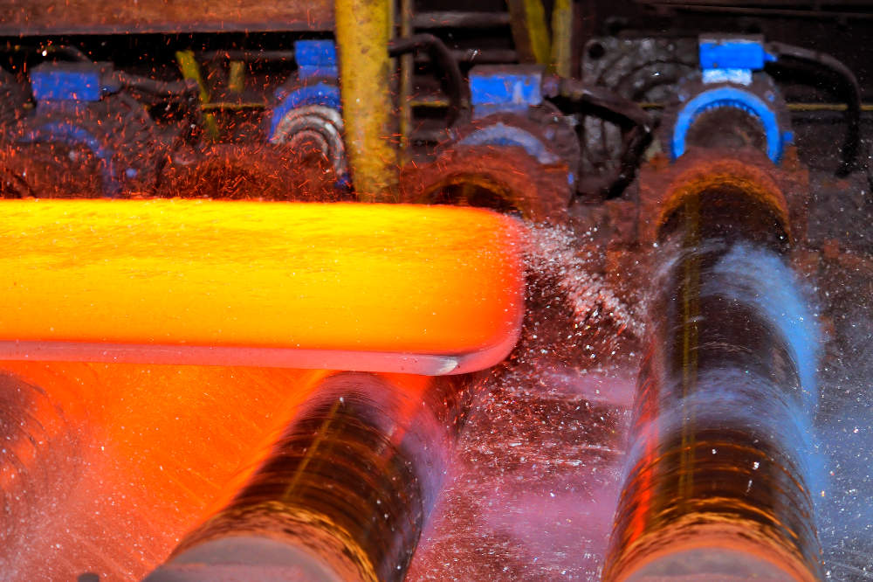

Welcome to the Lecture on Metal Forming Processes
Department of Mechanical
Engineering
BAUST, Khulna
Presented by-
Utpol Kumar Paul
Lecturer
Department of Mechanical Engineering
BAUST, Khulna

Slide 2
Metal Forming Processes
Metal forming is a manufacturing process that reshapes metal into desired forms through mechanical deformation, without adding or removing material, relying on plastic deformation where force exceeds the metal's yield strength.
Key methods include:
Forging (hammering/pressing between dies)
Rolling (compressing between rollers)
Extrusion (pushing through a die)
Drawing (pulling through a die)
Sheet metalworking (bending, stamping, deep drawing).
Department of Mechanical Engineering
Bangladesh Army University of Science and Technology, BAUST Khulna

Slide 3
Metal Forming Processes
Objectives
Are used to achieve optimum mechanical properties in the metal.
Reduces any internal voids or cavities present, and thus make the metal dense.
The impurities present in the metal also get elongated with the grains.
And in the process, they get broken and dispersed throughout the metal.
This decreases the harmful effects of the impurities and improves the mechanical strength.
Department of Mechanical Engineering
Bangladesh Army University of Science and Technology, BAUST Khulna

Slide 4
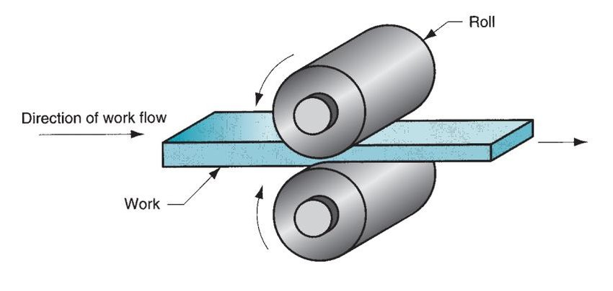
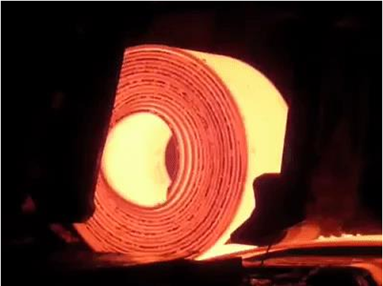
Metal Forming Processes
Rolling
Department of Mechanical Engineering
Bangladesh Army University of Science and Technology, BAUST Khulna

Slide 5
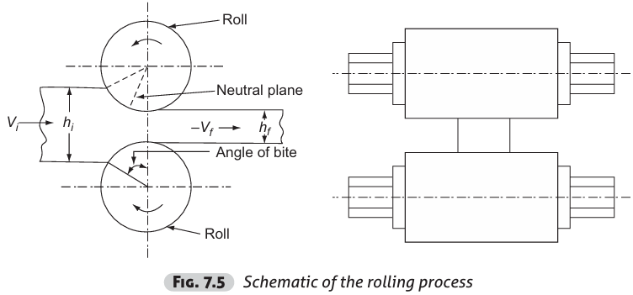
Metal Forming Processes
Rolling
Very economical for producing a large volume of material with a constant cross-section.
The metal is compressed between two rotating rolls for reducing its cross-sectional area.
It is one of the most widely used process, because of its higher productivity and low cost.
Department of Mechanical Engineering
Bangladesh Army University of Science and Technology, BAUST Khulna

Slide 6
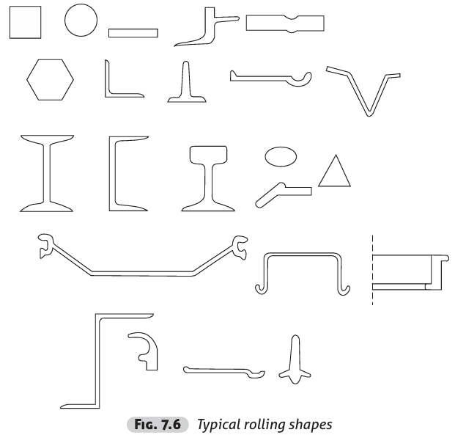
Metal Forming Processes
Rolling
Rolling would be able to produce components having constant cross section through out its length.
Many shapes such as I, T, L, and channel sections are possible as shown in Fig. 7.6, but not very complex shapes.
It is also possible to produce special sections, such as railway wagon wheels by rolling individual pieces.
Rolling is normally a hot working process unless specifically mentioned as cold rolling.
The metal is taken into rolls by friction and subsequently compressed to obtain the final shape.
Rougher rolls would be able to achieve a greater reduction than smoother rolls.
Department of Mechanical Engineering
Bangladesh Army University of Science and Technology, BAUST Khulna

Slide 7
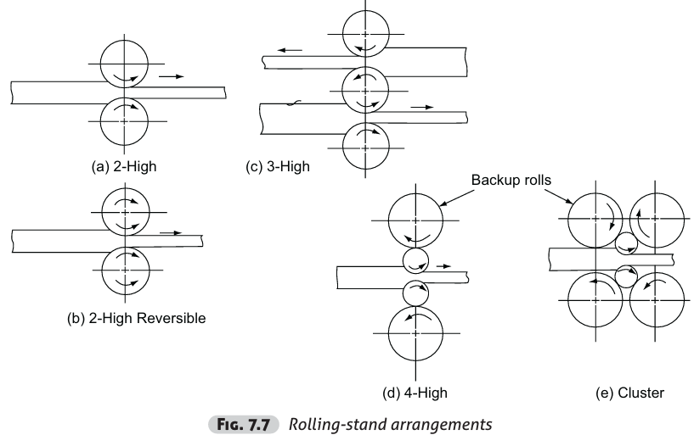
Metal Forming Processes
Rolling-Stand Arrangement
Department of Mechanical Engineering
Bangladesh Army University of Science and Technology, BAUST Khulna

Slide 8
Metal Forming Processes
Rolling-Stand Arrangement
The arrangement of rolls in a rolling mill, also called rolling stand, varies depending on the application.
The names of the rolling-stand arrangements are generally given by the number of rolls employed.
The first one, the 2-high non-reversing rolling-stand arrangement is the most common arrangement.
Department of Mechanical Engineering
Bangladesh Army University of Science and Technology, BAUST Khulna

Slide 9
Metal Forming Processes
Roll Passes
The roll-pass sequence can be broadly categorized into three types:
Breakdown passes
Roughing passes
Finishing passes
The final rolled products such as plates, flats, sheets, rounds and sections are obtained in a number of passes starting from billets or slabs.
For rolling the flat products, plain cylindrical rolls are used.
But for sections, grooved rolls are used.
Department of Mechanical Engineering
Bangladesh Army University of Science and Technology, BAUST Khulna

Slide 10
Metal Forming Processes
Roll Passes
Breakdown Passes:
These are used for reducing the cross-sectional area nearer to what is desired. These would be the first to be present in the sequence.
Roughing Passes:
In these passes also, the cross-section gets reduced, but along with it, the shape of the rolled material comes nearer to the final shape.
Finishing Passes:
These are the final passes, which give the required shape of the rolled section. Generally the finishing pass follows a leader pass.
Department of Mechanical Engineering
Bangladesh Army University of Science and Technology, BAUST Khulna

Slide 11
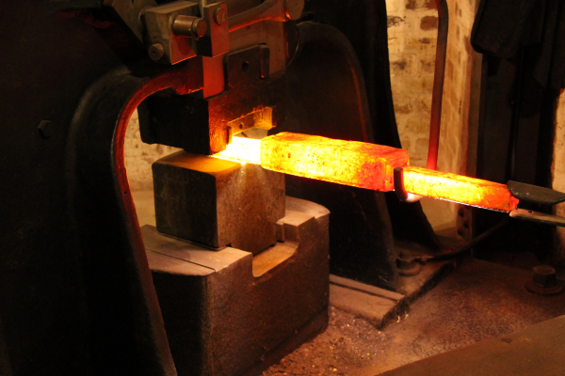
Metal Forming Processes
Forging
Department of Mechanical Engineering
Bangladesh Army University of Science and Technology, BAUST Khulna

Slide 12
Metal Forming Processes
Forging
Forging is the operation where the metal is heated and then a force is applied to manipulate the metal in such a way that the required final shape is obtained.
This is the oldest of the metal-working processes known to mankind since the copper age.
Forging is generally a hot-working operation though cold forging is used sometimes.
Department of Mechanical Engineering
Bangladesh Army University of Science and Technology, BAUST Khulna

Slide 13
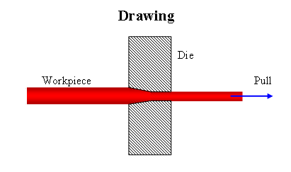
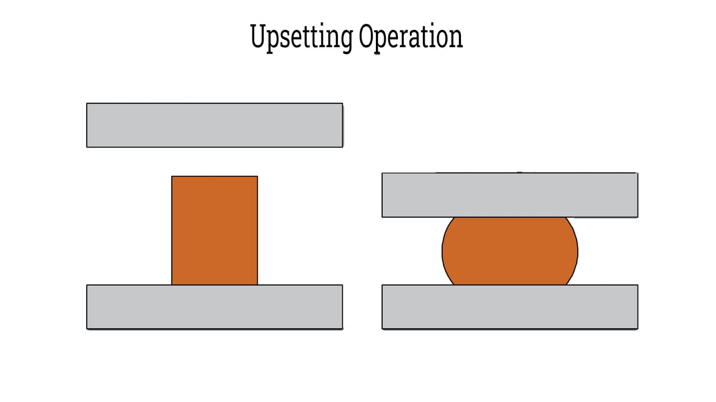
Metal Forming Processes
Forging Operation
Two Types of operations are used in Forging:
Drawing out
Metal gets elongated with a Reduction in the cross-sectional area.
The force is to be applied Perpendicular to the length axis.
2. Upsetting
Increase the cross-sectional area of the stock at the expense of its length.
Force is applied in a direction parallel to the length axis.
Department of Mechanical Engineering
Bangladesh Army University of Science and Technology, BAUST Khulna

Slide 14
Metal Forming Processes
Forging Types
There are four types of forging methods, which are generally used.
Smith Forging
This is the traditional forging operation done openly or in open dies by the village blacksmith or modern shop floor by manual hammering or by power hammers.
2. Drop Forging
This is the operation done in closed impression dies by means of the drop hammers.
Here the force for shaping the component is applied in a series of blows
3. Press Forging
Similar to drop forging, the press forging is also done in closed-impression dies with the exception that the force is a continuous squeezing type applied by the hydraulic presses.
4. Machine Forging
Unlike the drop or press forging where the material is drawn out, in machine forging, the material is only upset to get the desired shape.
Department of Mechanical Engineering
Bangladesh Army University of Science and Technology, BAUST Khulna

Slide 15
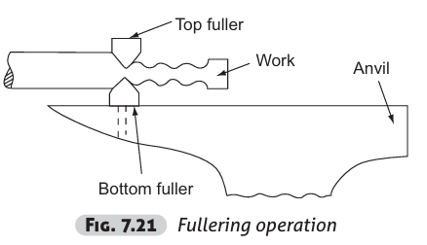
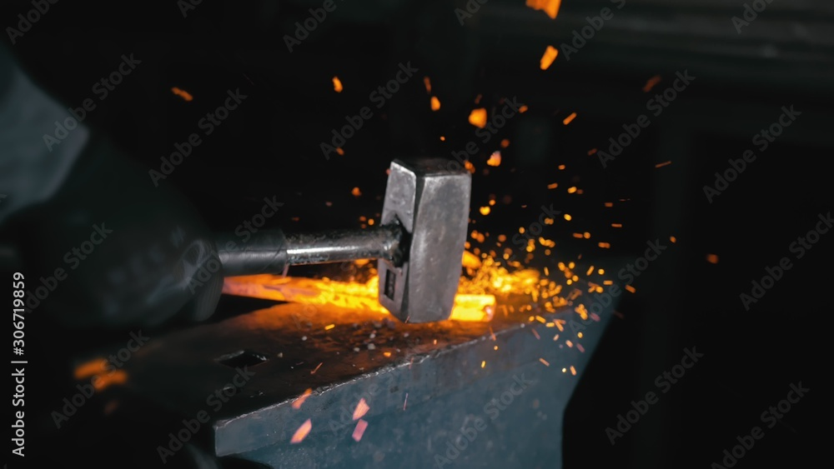
Metal Forming Processes
Smith Forging
The process involves heating the stock in the blacksmith’s hearth and then beating it over the anvil.
To get the desired shape, the operator has to manipulate the component in between the blows.
The types of operations available are fullering, flattening, bending, upsetting and swaging.
In fullering, the material cross-section is decreased and the length increased.
Department of Mechanical Engineering
Bangladesh Army University of Science and Technology, BAUST Khulna

Slide 16
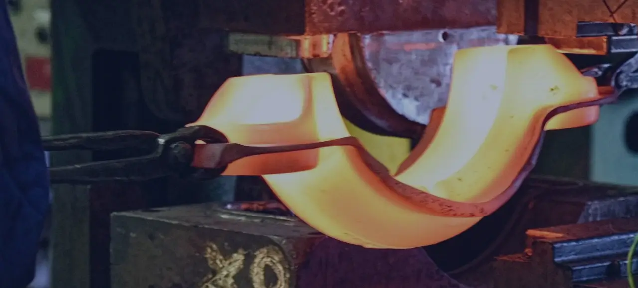
Metal Forming Processes
Drop Forging
Drop forging utilizes a closed-impression die to obtain the desired shape of the component.
The shaping is done by the repeated hammering given to the material in the die cavity.
The equipment used for delivering the blows are called drop hammers.
The drop-forging die consists of two halves.
The lower half of the die is fixed to the anvil of the machine, while the upper half is fixed to the ram.
The heated stock is kept in the lower die while the ram delivers four to five blows on the metal, in quick succession so that the metal spreads and completely fills the die cavity.
Department of Mechanical Engineering
Bangladesh Army University of Science and Technology, BAUST Khulna

Slide 17
Metal Forming Processes
Limitations of Drop Forging
However, too complex shapes with internal cavities, deep pockets, re-entrant shapes, etc. Cannot be obtained in drop forging.
Due to the limitation of the withdrawal of the finished forging from the die.
The typical products obtained in drop forging are
1. Crank
2. Crankshaft
3. Connecting rod
4. Wrench, crane hook, etc.
Department of Mechanical Engineering
Bangladesh Army University of Science and Technology, BAUST Khulna

Slide 18
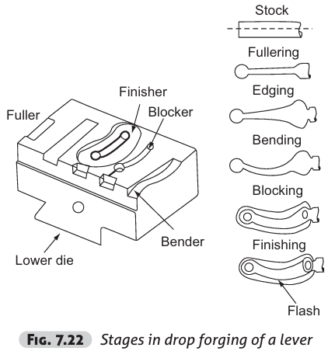
Metal Forming Processes
Steps involved in Drop forging
Fullering impression
A reduction in cross-section with no upsetting, the very first step is to reduce the stock to the desired size.
The impression machined in the die to achieve this is called fullering impression.
2. Edging impression
Also called ‘preform’
this stage is required to gather the exact amount of material required at each cross-section of the finished component.
Department of Mechanical Engineering
Bangladesh Army University of Science and Technology, BAUST Khulna

Slide 19
Metal Forming Processes
Steps involved in Drop forging
3. Bending Impression
This is required for those parts, that have a bent shape.
4. Blocking Impression
Also called ‘semifinishing’ impression, blocking is a step before finishing.
In forging, it is very difficult for the material to flow to deep pockets, sharp corners, etc.
Hence, before the actual shape is obtained, the material is allowed to have one or more blocking impressions where it acquires the shape very near to the final one.
Department of Mechanical Engineering
Bangladesh Army University of Science and Technology, BAUST Khulna

Slide 20
Metal Forming Processes
Steps involved in Drop forging
5. Finishing Impression
This is the final impression where the actual shape required is obtained.
In order to ensure that the metal completely fills the die cavity, a little extra metal is added to the stock.
This extra metal will form the flash and surrounds the forging in the parting plane.
6. Trimming
In this stage, the extra flash present around the forging is trimmed to get the forging in the usable form.
Department of Mechanical Engineering
Bangladesh Army University of Science and Technology, BAUST Khulna

Slide 21
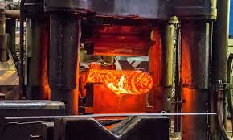
Metal Forming Processes
Press Forging
Press-forging dies are similar to drop-forging dies as also the process.
In press forging, the metal is shaped not by means of a series of blows as in drop forging,
But by means of a single continuous squeezing action.
This squeezing is obtained by means of hydraulic presses.
Because of the continuous action of the hydraulic presses, the material gets uniformly deformed throughout its entire depth.
Department of Mechanical Engineering
Bangladesh Army University of Science and Technology, BAUST Khulna

Slide 22
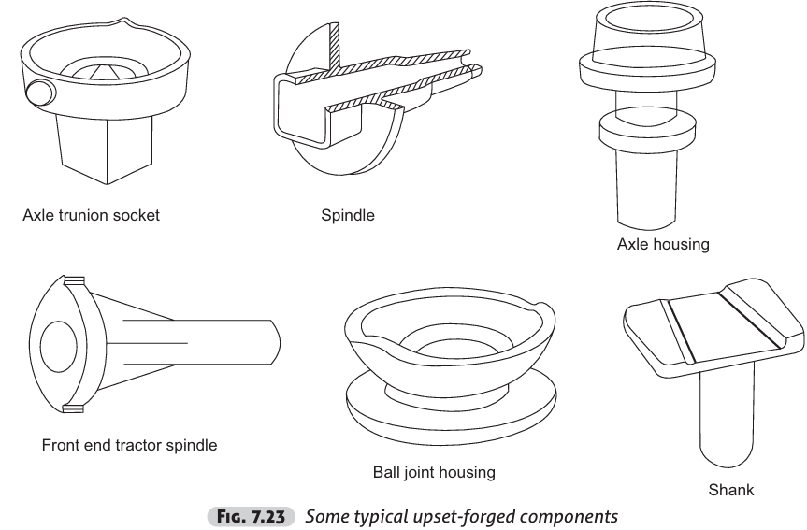
Metal Forming Processes
Machine Forging
As it involves the upsetting operation, sometimes it is simply called upset forging.
Though both drop and press forgings are also done by machines, historically, only upset forging is referred to as machine forging.
Originally this was developed for making the bolt heads in a continuous fashion, but now there is fairly larger number of diverse uses for this process.
Because of the beneficial grain flow obtained from upsetting, it is used for making gear blanks, shafts, axles and similar parts.
Some typical examples of upset forgings are shown in Fig. 7.23.
Department of Mechanical Engineering
Bangladesh Army University of Science and Technology, BAUST Khulna

Slide 23
Metal Forming Processes
Forging Defects
1. Unfilled Sections (some sections of the die cavity are not completely filled)
2. Cold Shut (a small crack at the corners of the forging)
3. Scale Pits (irregular depressions on the surface of the forging.)
4. Die Shift (the misalignment of the two die halves)
5. Flakes (internal ruptures caused by the improper cooling of the large forging. )
6. Improper Grain Flow (improper design of the die, metal not following the final intended directions.)
Department of Mechanical Engineering
Bangladesh Army University of Science and Technology, BAUST Khulna

Slide 24
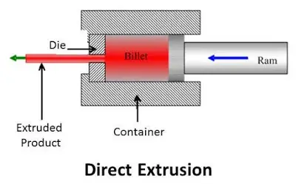
Metal Forming Processes
Extrusion
Extrusion is the process of confining the metal in a closed cavity and then allowing it to flow from only one opening so that the metal will take the shape of the opening.
The operation is identical to the squeezing of toothpaste out of the toothpaste tube.
Department of Mechanical Engineering
Bangladesh Army University of Science and Technology, BAUST Khulna

Slide 25
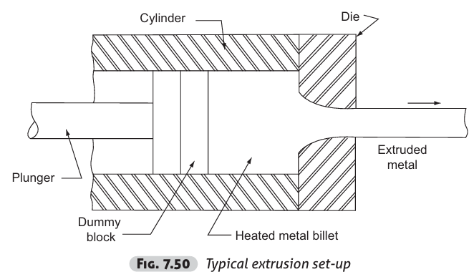
Metal Forming Processes
Extrusion Principle
A typical extrusion process is presented in Fig. 7.50. The equipment consists of a cylinder or container into which the heated metal billet is loaded.
On one end of the container, the die plate with the necessary opening is fixed.
From the other end, a plunger or ram compresses the metal billet against the container walls and the die plate, thus forcing it to flow through the die opening, acquiring the shape of the opening.
The extruded metal is then carried by the metal handling system as it comes out of the die.
A dummy block which is a steel disc of about 40 mm (0.50 to 0.75 of diameter) thick with a diameter slightly less than the container is kept between the hot billet and the ram to protect it from the heat and pressure.
Department of Mechanical Engineering
Bangladesh Army University of Science and Technology, BAUST Khulna

Slide 26
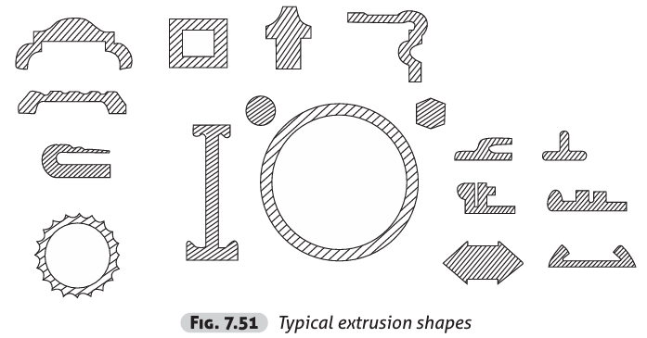
Metal Forming Processes
Typical Extrusion Shapes
Department of Mechanical Engineering
Bangladesh Army University of Science and Technology, BAUST Khulna

Slide 27
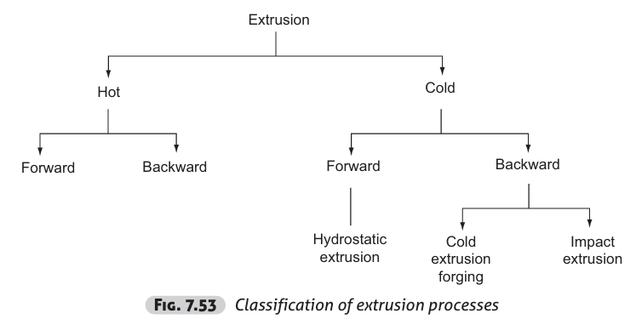
Metal Forming Processes
Classification Extrusion Processes
Department of Mechanical Engineering
Bangladesh Army University of Science and Technology, BAUST Khulna

Slide 28
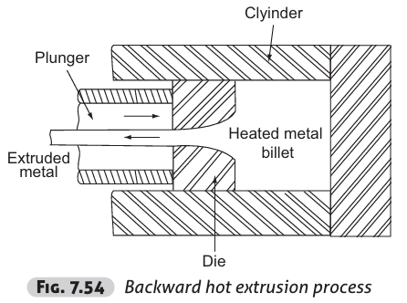
Metal Forming Processes
Classification Extrusion Processes
1. Forward hot extrusion: described earlier
2. Backward hot extrusion:
In order to completely overcome the friction.
The billet in the container remains stationary and hence no friction.
Also, the extrusion pressure is not affected by the length of the billet in the extrusion press since friction is not involved.
Department of Mechanical Engineering
Bangladesh Army University of Science and Technology, BAUST Khulna

Slide 29
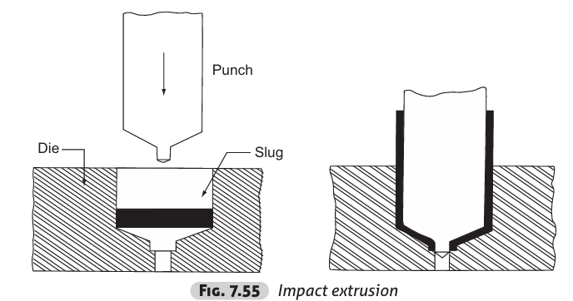
Metal Forming Processes
Classification Extrusion Processes
3. Forward cold extrusion: It is identical to forward hot extrusion except the fact that this process requires higher pressure than that of hot extrusion.
4. Impact extrusion:
Softer materials
Such as aluminium
And its alloys
Department of Mechanical Engineering
Bangladesh Army University of Science and Technology, BAUST Khulna

Slide 30
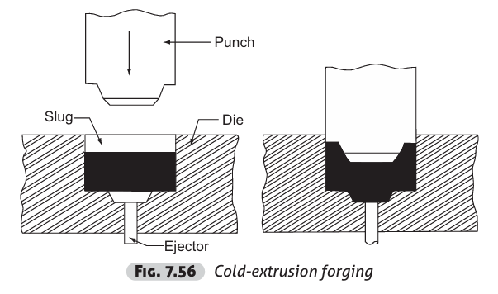
Metal Forming Processes
Classification Extrusion Processes
5. Cold extrusion forging:
The side walls are much thicker
And their height is smaller
Department of Mechanical Engineering
Bangladesh Army University of Science and Technology, BAUST Khulna

Slide 31
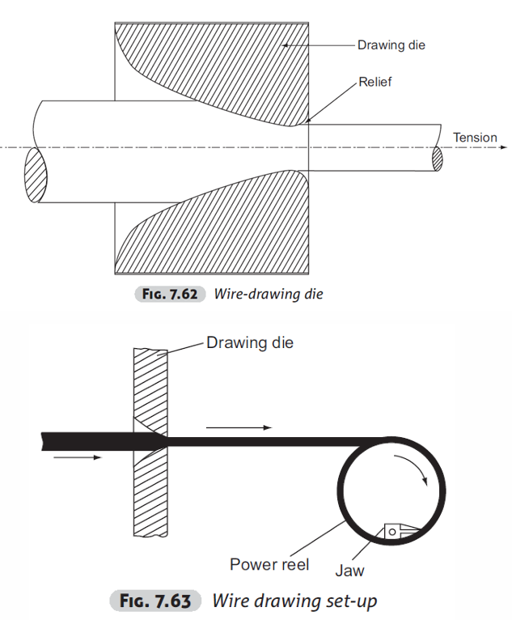
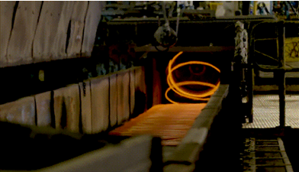
Metal Forming Processes
Wire drawing
A wire by definition, is circular with small diameters so that it is flexible.
The process of wire drawing is to obtain wires from rods of bigger diameter through a die (Conical Shape).
Wire drawing is always a cold-working process.
Department of Mechanical Engineering
Bangladesh Army University of Science and Technology, BAUST Khulna

