Slide 1

AI-Based Fraud Detection in Mobile Transactions
Using Isolation Forest & Random Forest
Pranav Dinesh Ahire — MSCDAD
National College of Ireland

Slide 2
Project Aim, Vision & Motivation
Vision: To enhance fraud prevention in mobile financial systems using smart, scalable AI models.
Aim: To detect and reduce fraudulent mobile transactions by comparing unsupervised and supervised ML techniques.
Motivation:
Mobile money is growing rapidly (e.g., M-Pesa), but fraud is rising.
Traditional rule-based fraud systems are no longer effective.
AI offers real-time, intelligent fraud detection capabilities.

Slide 3
Objectives & Dataset
Dataset: PaySim (6M+ mobile money transactions, highly imbalanced).
Use Isolation Forest for anomaly detection (imbalanced data).Use Random Forest on balanced data (via downsampling).
Use Random Forest on balanced data (via downsampling).
Compare models using Precision, Recall, Accuracy, F1-Score.

Slide 4
Key Features & Demonstration
Key features: type, amount, balances before/after (origin & dest).
Fraud mostly in TRANSFER and CASH_OUT transactions.
Isolation Forest: High accuracy, low fraud recall.
Random Forest: 97.5% F1-score, strong fraud detection.
Visual: Model performance comparison bar chart (included in report).

Slide 5
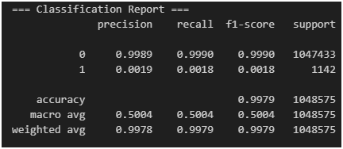
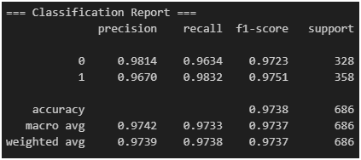
Results & Insights
Isolation Forest (Unsupervised)
Random Forest (Supervised, Balanced Data)

Slide 6
Business Impact & Conclusion
Prevents early-stage fraud → reduces loss & reputational risk.
Assists fraud analysts → fewer false positives.
Scalable for mobile banking apps.
Conclusion: Random Forest (on balanced data) is superior.

Slide 7
Impact on Finance & Banking Domain
Fraud detection is crucial in mobile banking systems like M-Pesa.
AI-driven models improve detection speed and reduce financial loss.
Random Forest enhances fraud recall & precision → fewer false positives.
Supports real-time monitoring and decision intelligence (like Mastercard, JPMorgan).
Aligns with industry use of ML for fraud prevention (e.g., HSBC, PayPal, AmEx).

Slide 8
THANK YOU

