Slide 1
DSA GROUP PROJECT ATTENDANCE Monitoring and MANAGEMENT SYSYTEM

Slide 2
GROUP MEMBERS
. Pranvkumar Suhas Kshirsagar
SAP ID-(590011587)
Saurav Sahlot
SAP ID-(590014311)
Tanmay Sharma
SAP ID-(590011578)

Slide 3
Introduction
A system to monitor and track student attendance.
Implemented in C using:
Hash Tables
Linked Lists
File I/O

Slide 4
Features:
Load student data from a file.
Add, delete, and search students.
Mark daily attendance by subject.
View detailed attendance per student.
Generate an attendance report for a subject

Slide 5
PROBLEM STATEMENT
The Attendance Management and Monitoring System is designed to track and manage student attendance across multiple subjects efficiently. Traditional paper-based attendance systems are prone to errors, difficult to analyse, and time-consuming to maintain. This system provides a digital solution that allows teachers to:
- Record attendance quickly and accurately
- Generate detailed attendance reports
- Search and view individual student attendance records
- Manage student information in a centralised database

Slide 6
ALGORITHM
Start.
Initialise:
Empty hashTable[TABLE_SIZE].
Empty subjectList[MAX_SUBJECTS], set subjectCount = 0.
Repeat until user selects Exit:
a) Display Menu.
b) Input choice.
c) Process choice:
1. Load Students:
Input filename.
For each line: Read ID, Name; insert into hash table.
2. Generate Report:
Input the subject name and report file name.
Find or add a subject.
For each student:
-Write ID, Name, and attendance (P/A) for the subject to file.

Slide 7
ALGORITHM
3. Search Student:
Input ID.
Search the hash table by the last 4 digits.
Display student details if found.
4. Delete Student:
Input ID.
Search and delete a student from the hash table.
5. Insert Student:
Input ID and Name.
If ID exists, show error.
Else, insert into the hash table.
6. Mark Attendance:
Input the subject name and day.
Repeatedly input student IDS (last 4 digits):
Mark as present.
7. View Attendance:
Input ID.
Display attendance for all subjects and days.
8. Exit:
Free memory.
End program.
End.

Slide 8
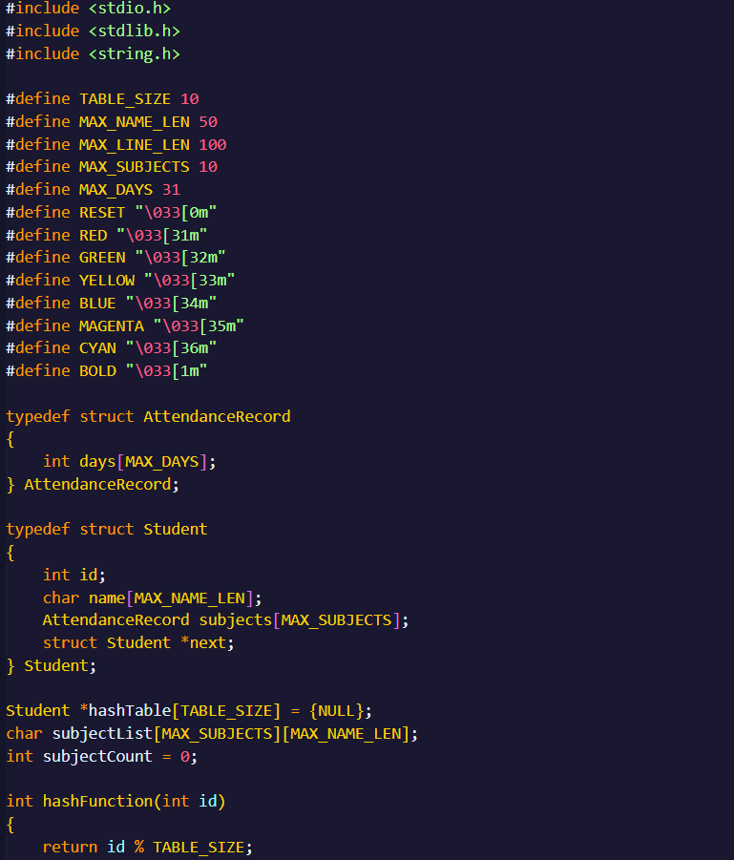
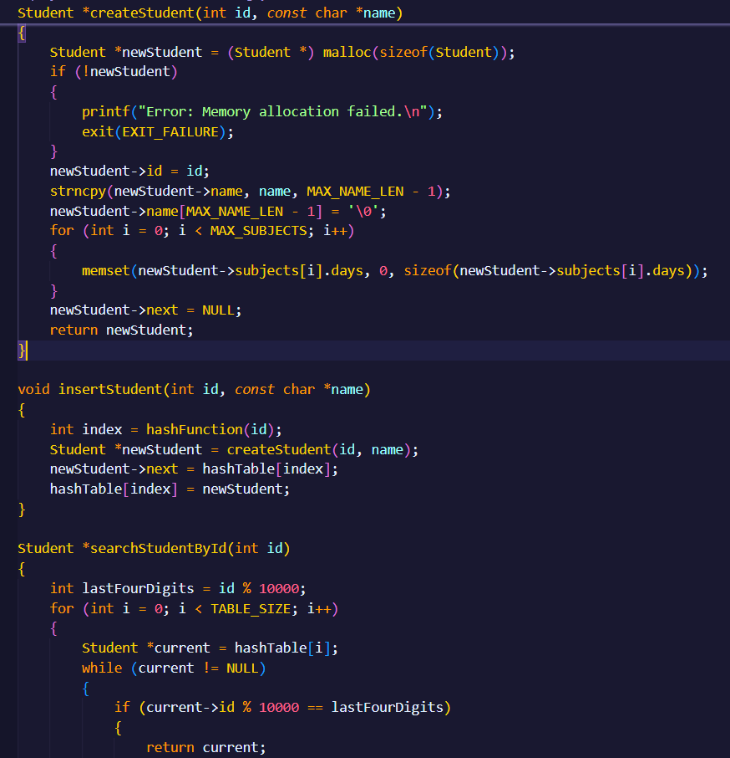
CODE

Slide 9
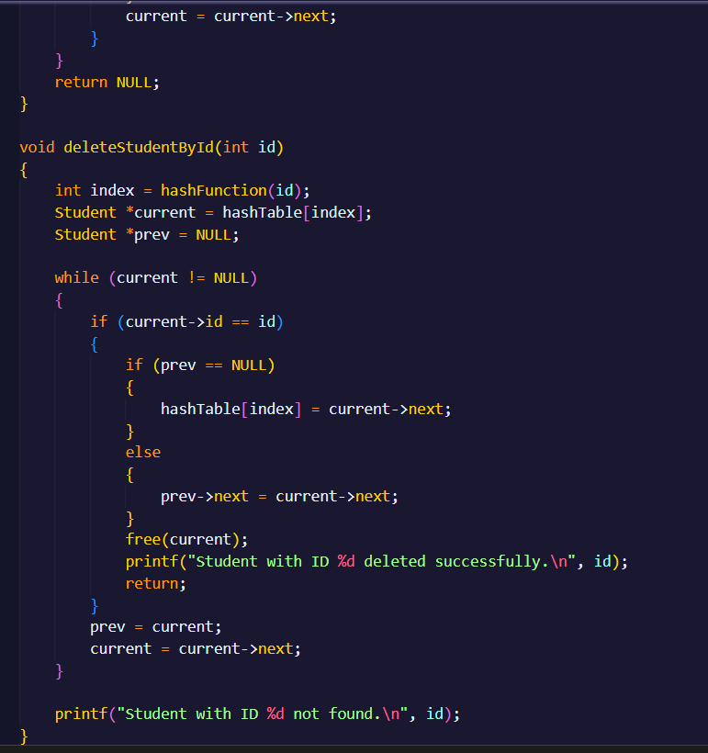
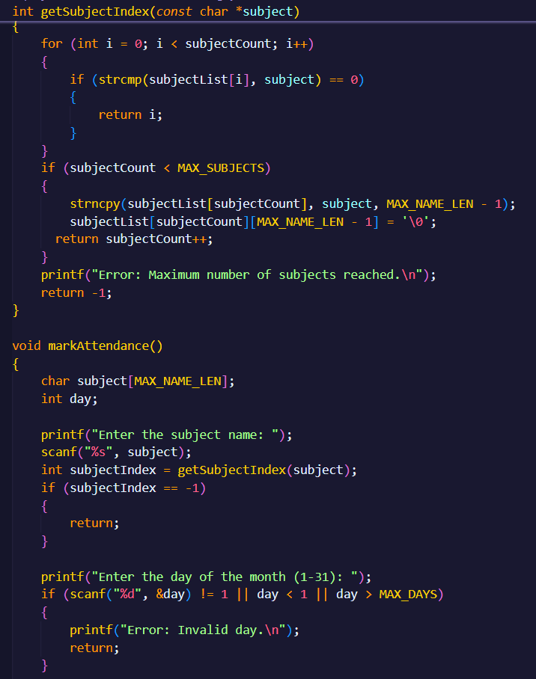
CODE

Slide 10
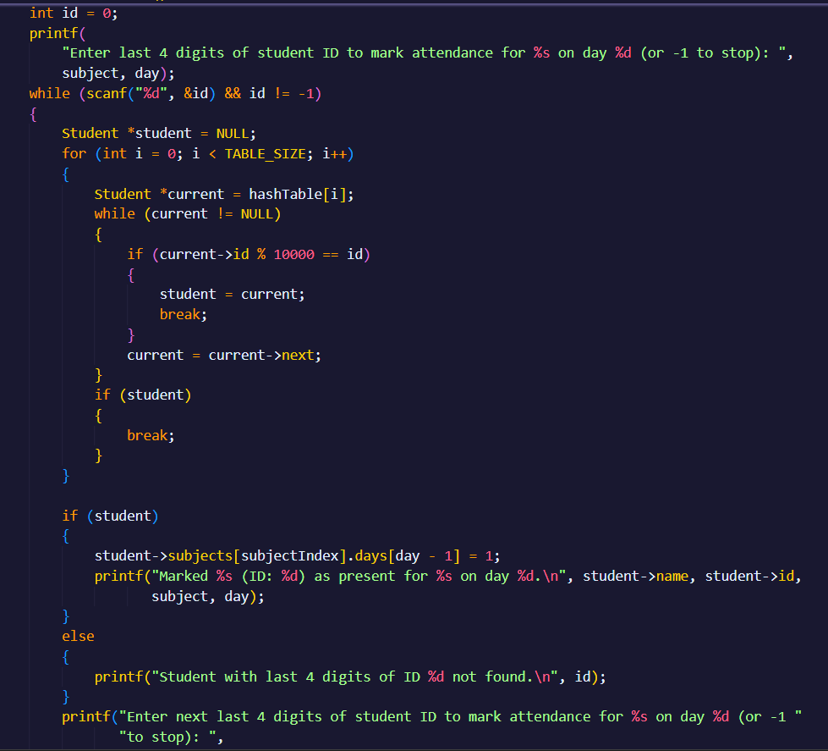
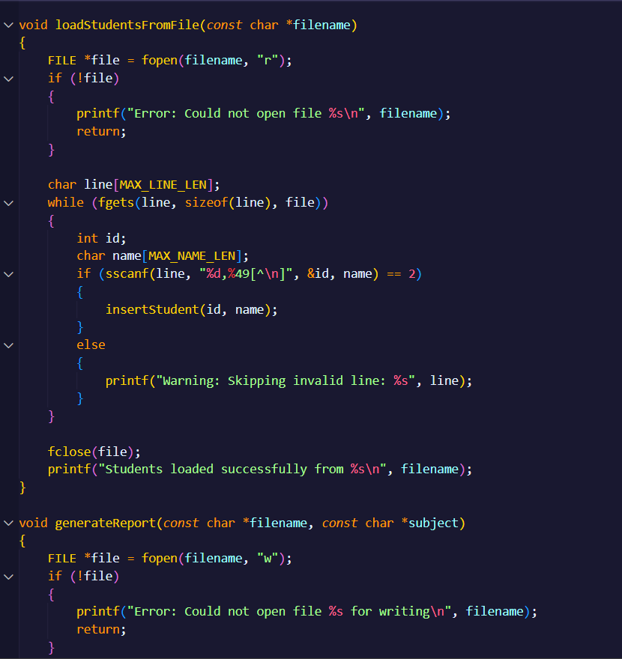
CODE

Slide 11
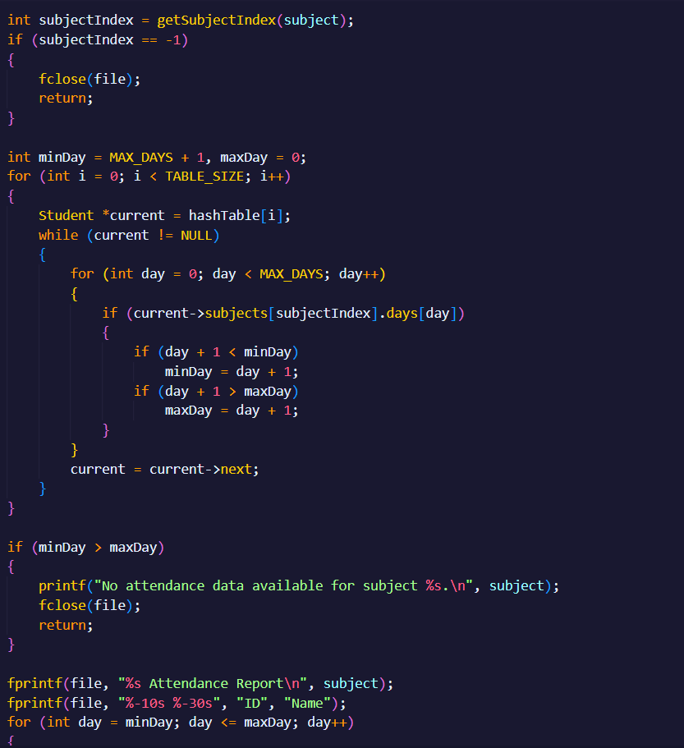
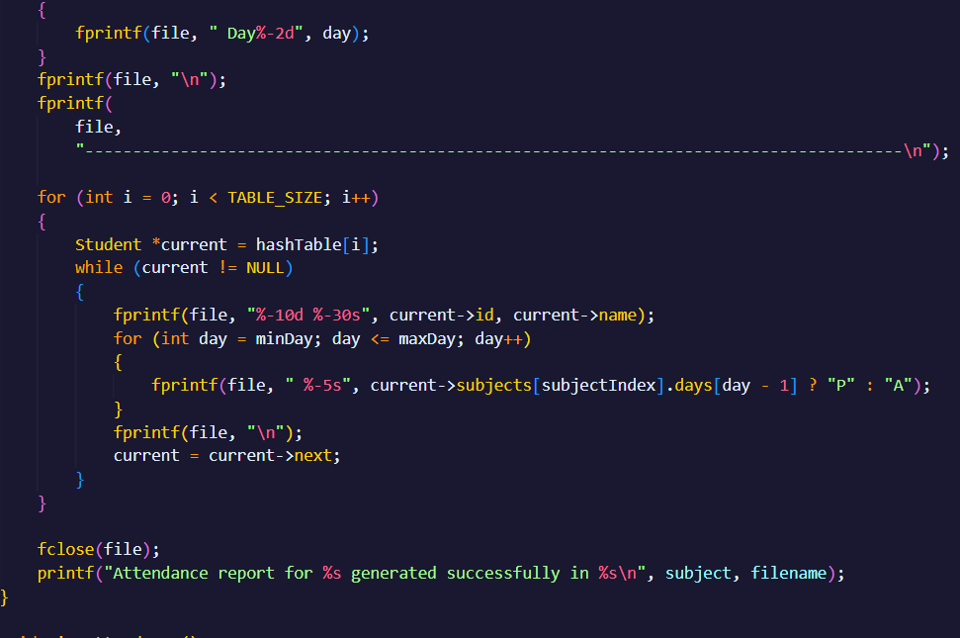

Slide 12
Important Structures in the Attendance Management System Code
1.AttendanceRecord Structure
Tracks daily attendance for a subject
Uses an array where each element represents a day (1-31)
Stores 1 for present, 0 for absent
2. Student Structure
The main structure representing a student
Contains:
Student ID
Student name
The array of attendance records (one per subject)
Next pointer for hash table collision handling

Slide 13
Important Structures in the Attendance Management System Code
3. Hash Table Implementation
Array of pointers to Student structures
Uses separate chaining for collision resolution
Size defined by TABLE_SIZE (10 in this implementation)
4. Subject List
2D array storing subject names
subjectCount tracks number of subjects added
MAX_SUBJECTS defines maximum number of subjects (10)

Slide 14
Important Structures in the Attendance Management System Code
5. Constants for Configuration
6. Colour Constants for UI
Used for colored output in the console interface
These structures work together to:
Store student information efficiently using a hash table
Track attendance across multiple subjects
Handle up to 31 days of attendance data per subject
Support basic CRUD operations on student records
Generate attendance reports

Slide 15
Real-World Optimizations
Hashing Improvement:
Use a better hash function (e.g., djb2) to reduce collisions.
Partial ID Search:
Store students in a secondary BST for faster partial ID lookup.
Attendance Compression:
Use bitmasking instead of an array of int to save space.
Persistent Storage:
Save the entire hash table to disk for quick reloading.

Slide 16
Time Complexity
operation | Average | Worst case
Insert student | O(1) | O(n)
Search student | O(1) | O(n)
Delete student | O(1) | O(n)
Mark attendance | O(n) | O(n)
Generate report | O(n*m) | O(n*m)

Slide 17
Time Complexity
operation | Average case | Worst case
View Attendance | O(s*d) | O(n)
Space Complexity: O( n + m + s ) ,where; n = number of students. m = total attendance records s = number of subjects

Slide 18
Positive Aspects✅
1. Well-Structured Code Organization
Clear separation of concerns with dedicated functions for different operations
Modular design makes it easier to maintain and extend
2. Efficient Data Storage
Uses hash table with separate chaining for student records (O(1) average case for insert/search)
Compact storage of attendance data (1 bit per day per subject)
3. Robust Input Handling
Basic input validation for days (1-31) and student IDs
Checks for memory allocation failures
Handles file operations with error checking

Slide 19
Positive Aspects
4. File I/O Capabilities
Can load student data from CSV files
Generates formatted attendance reports to files
5. Memory Management
Proper cleanup with freeHashTable() function
No apparent memory leaks in the main operations

Slide 20
Negative Aspects ❌
1. Technical Limitations
Fixed-size arrays limit scalability (MAX_SUBJECTS, MAX_DAYS)
A small hash table size (10 buckets) will degrade performance with many students
No threading - large operations will block the interface
2. Code Quality Issues
Inconsistent error handling (some functions exit, others return)
Magic numbers used (like part*10+1 in viewAttendance)
Some functions are too long (markAttendance, viewAttendance)

Slide 21
Negative Aspects ❌
3. Missing Features
No way to edit existing attendance records
No support for different months/years
No student absence statistics or analytics
No notification system for poor attendance
4. Performance Concerns
Linear search through hash table chains could be slow for large datasets
Report generation rewrites the entire file each time
No indexing for faster searches

Slide 22
Thank you

