Slide 1

Project Title -
[Student Name
College Name- ]
AICTE STU ID : (its available in your offer letter)

Slide 2

PROBLEM STATEMENT
(Agricultural activities are influenced by seasonal variations in environmental conditions, farming practices, resource availability and market conditions. As a result, agricultural performance may differ from one season to another. However, raw agricultural data does not clearly explain how agricultural performance changes across seasons or what patterns can be observed in different seasonal conditions. The problem is to analyze the given agricultural dataset and investigate seasonal differences in agricultural performance by identifying meaningful patterns, trends, relationships and variations within the available data.

Slide 3
Project Description
This project analyzes agricultural activities across different seasons, geographical regions, crops and farming conditions.
The dataset contains information related to:
Crop production and yield
Environmental conditions
Water and irrigation usage
Fertilizer and pesticide usage
Soil characteristics
Revenue, cost and profit
Disease and pest risk
Analysis Approach
The project follows a structured data analytics workflow:
Data Collection → Data Cleaning → Exploratory Analysis → Seasonal Comparison → Statistical Analysis → Visualization → Insights → Recommendations

Slide 4

WHO ARE THE END USERS?
Farmers
Select suitable crops and seasons
Improve resource utilization
Understand yield and profitability patterns
Agricultural Planners & Government Departments
Support seasonal agricultural planning
Identify regional performance differences
Plan resource allocation
Agricultural Organizations
Compare crop performance
Analyze resource efficiency
Monitor seasonal risks
Agricultural Analysts / Researchers
Study seasonal trends
Investigate relationships between environmental and agricultural factors
Support evidence-based decision-making

Slide 5

Technology Used
Technology | Purpose
Python | Data analysis and statistical computation
Google Colab | Development and execution environment
Pandas | Data loading, cleaning and aggregation
NumPy | Numerical operations
Matplotlib | Data visualization
Seaborn | Statistical visualization
SciPy | Statistical hypothesis testing
Scikit-learn | Data preprocessing / normalization
CSV Dataset | Primary data source

Slide 6
RESULTS

Slide 7
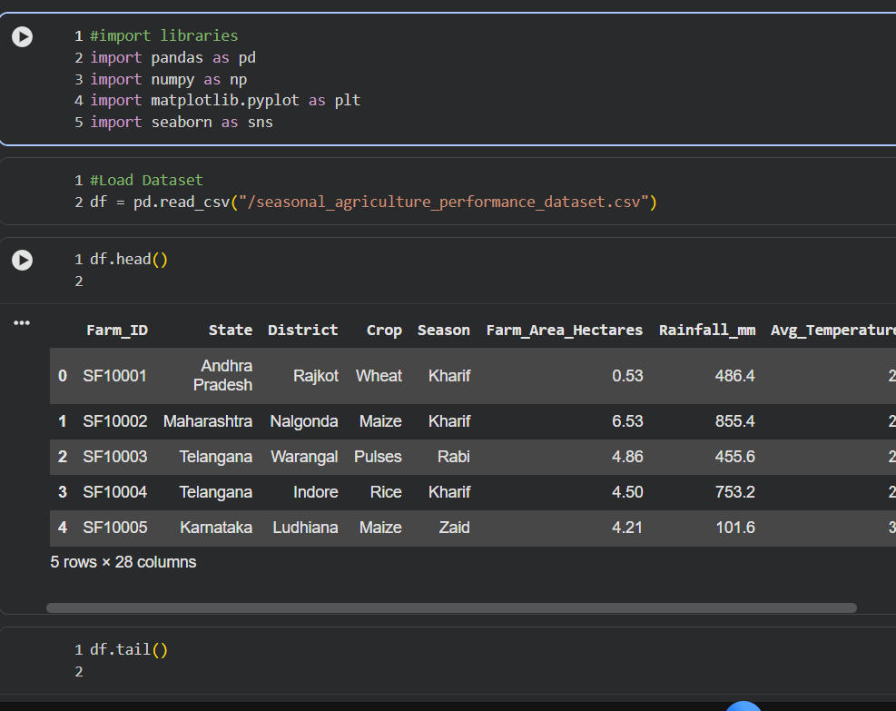
RESULTS

Slide 8
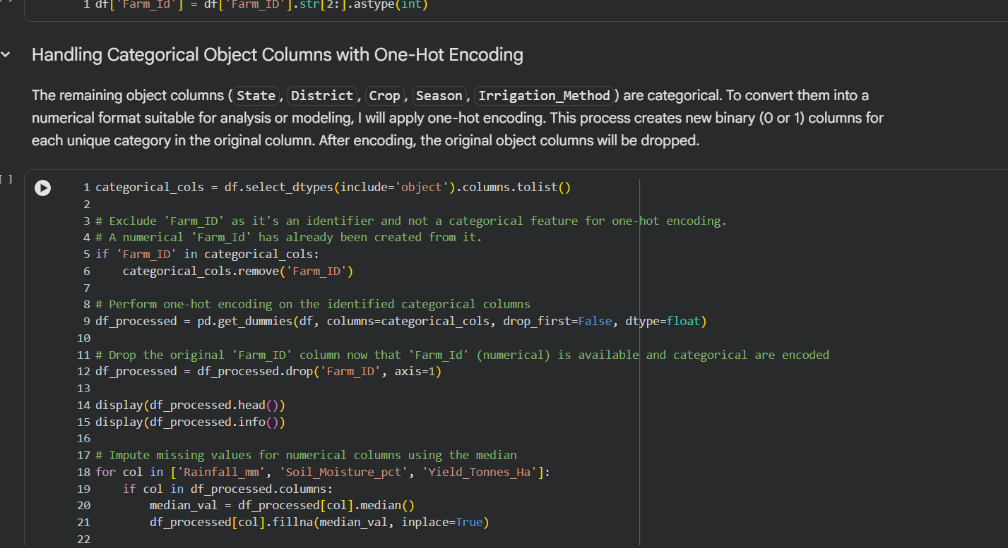
RESULTS

Slide 9
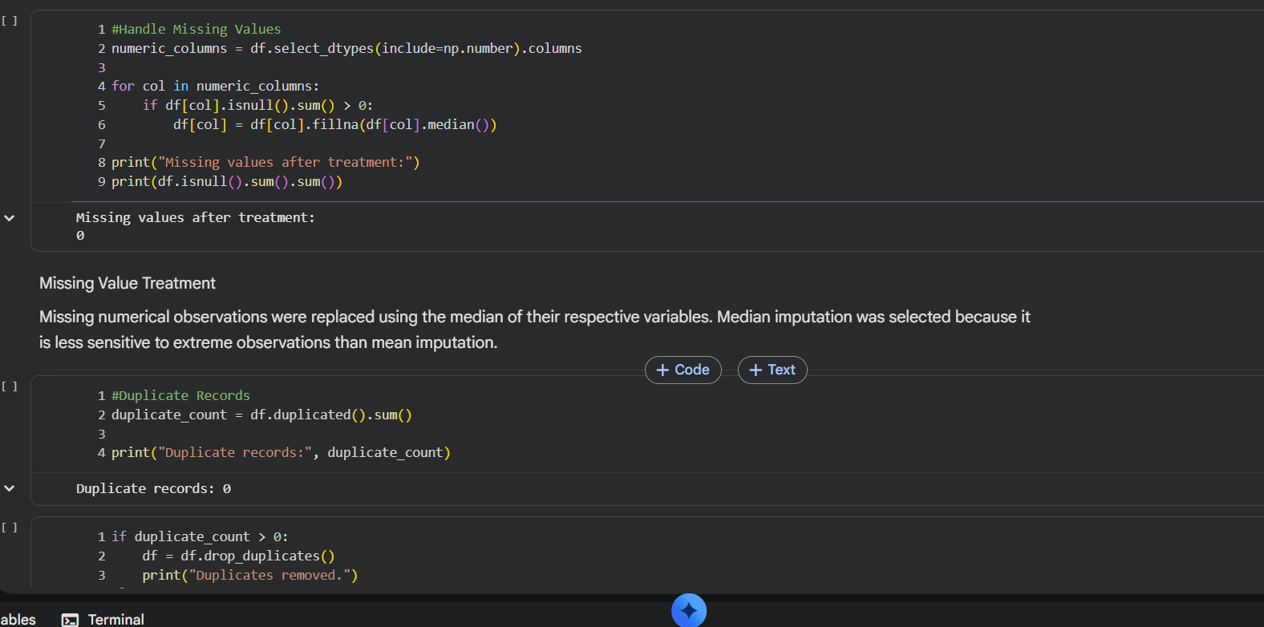
RESULTS

Slide 10
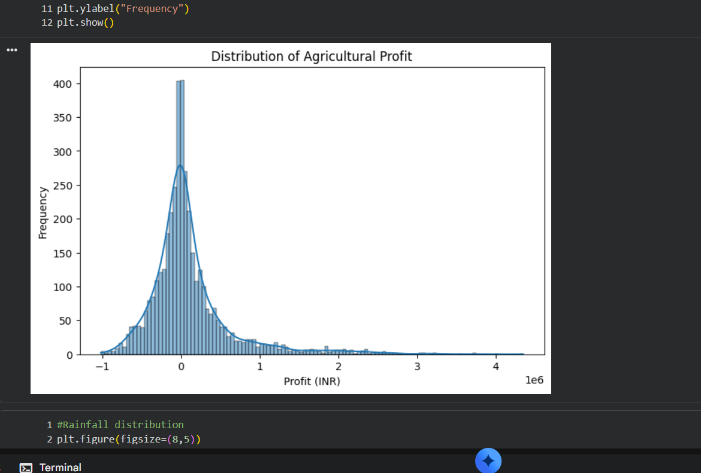
RESULTS

Slide 11
Future scope
1. AI-Based Crop Yield Prediction
Develop machine-learning models to predict crop yield for different seasons.
Use historical factors such as rainfall, temperature, soil conditions, irrigation and fertilizer usage.
Predict expected yield before or during a growing season.
This can help farmers plan crop selection and resource allocation.
2. Real-Time Weather Integration
Integrate live weather and rainfall data.
Analyze how changing weather conditions may affect seasonal agricultural performance.
Provide timely information for seasonal planning.
3. Smart Irrigation Recommendation
Develop a system that recommends optimal water usage based on:
  Crop
  Season
  Soil moisture
  Rainfall
  Temperature
The objective would be to improve water efficiency while maintaining productivity.

Slide 12
GitHub Link
https://github.com/Prapti-Thombre/Seasonal-Agriculture-Performance-Analysis-

Slide 13
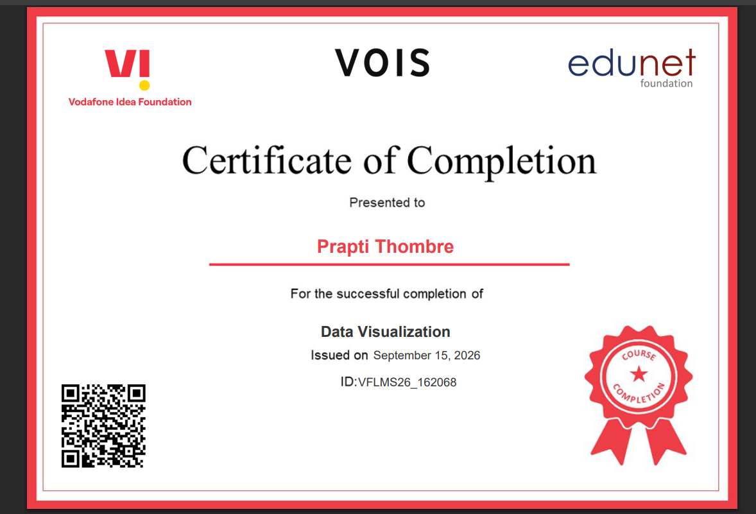
VOIS Course completion certificate -
Course name- Data Visualization

Slide 14
Thank you
.
.

