Slide 1
zip-handler

Slide 2
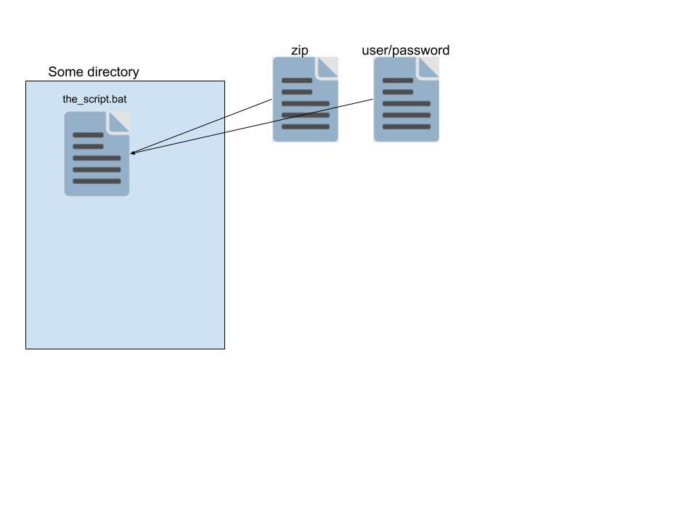
Script flow
Run script
Input: zip-file, username/password file
In script:
Create temporary directories for the zip, git, and repository
Unzip the input file
Download portable version of git
Clone repository

Slide 3
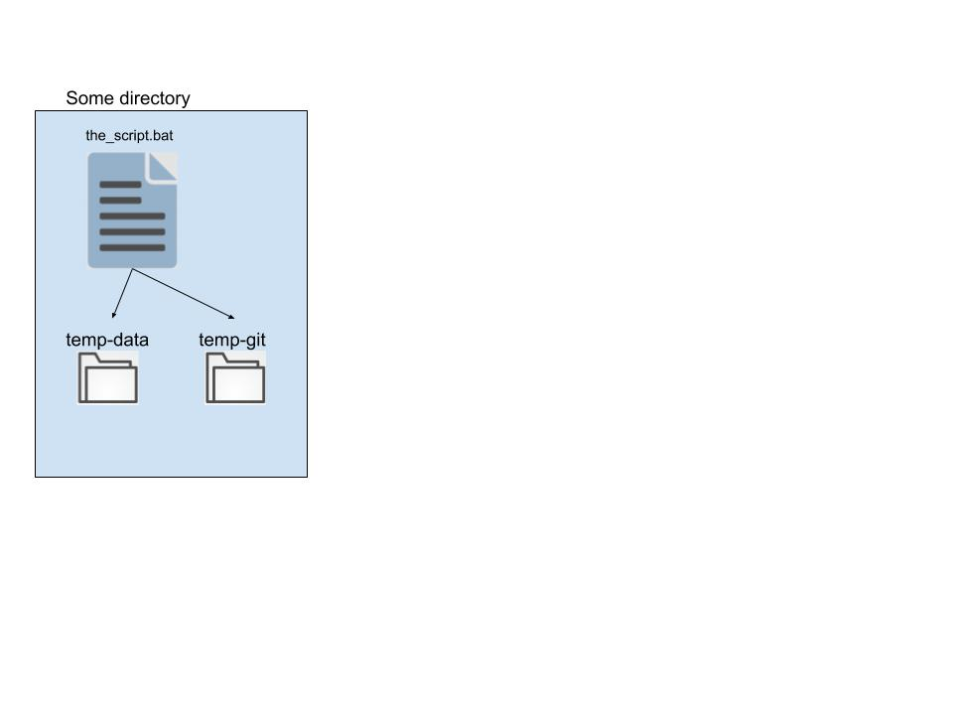
Script flow
Run script
Input: zip-file, username/password file
In script:
Create temporary directories for the zip, git, and repository, unzip the input file
Download portable version of git
Clone repository

Slide 4
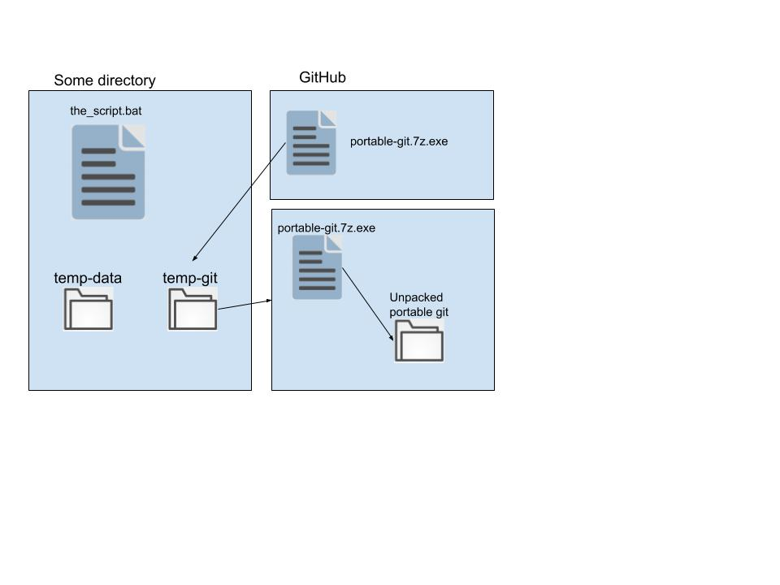
Script flow
Run script
Input: zip-file, username/password file
In script:
Create temporary directories for the zip, git, and repository, unzip the input file
Download portable version of git
Clone repository

Slide 5
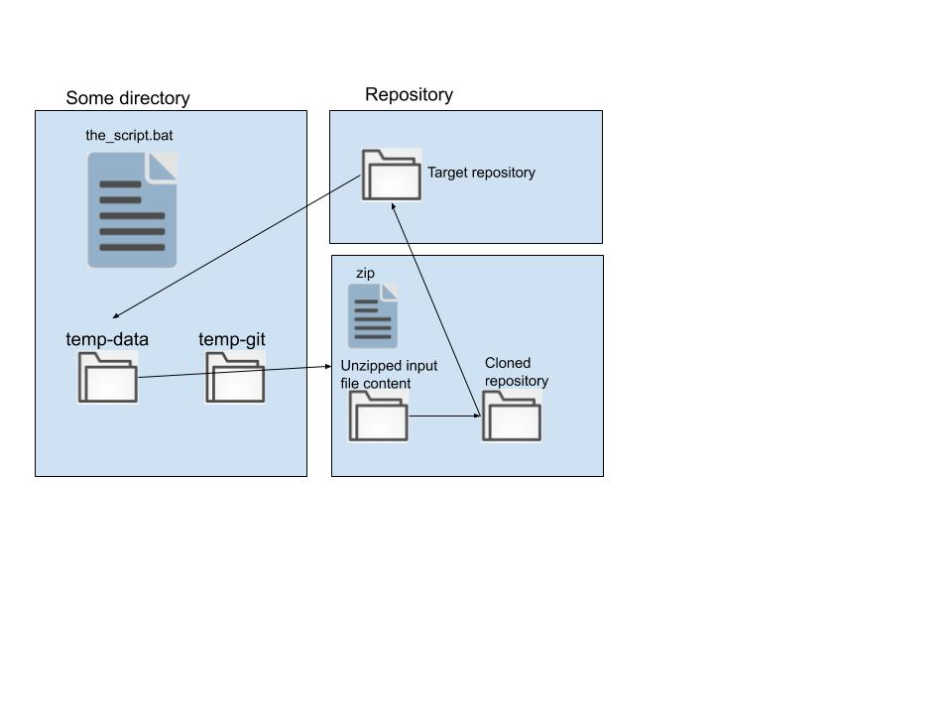
Script flow
Run script
Input: zip-file, username/password file
In script:
Create temporary directories for the zip, git, and repository, unzip the input file
Download portable version of git
Clone repository

Slide 6
Script flow
In script:
Copy content of unzipped input file into cloned repository
Push it back
Push zip to artifactory with the commit hash as name, for traceability
Clean up

Slide 7
Script flow
In script:
Copy content of unzipped input file into cloned repository
Push it back
Push zip to artifactory with the commit hash as name, for traceability
Clean up

Slide 8

Script flow
In script:
Copy content of unzipped input file into cloned repository
Push it back
Push zip to artifactory with the commit hash as name, for traceability
Clean up

Slide 9
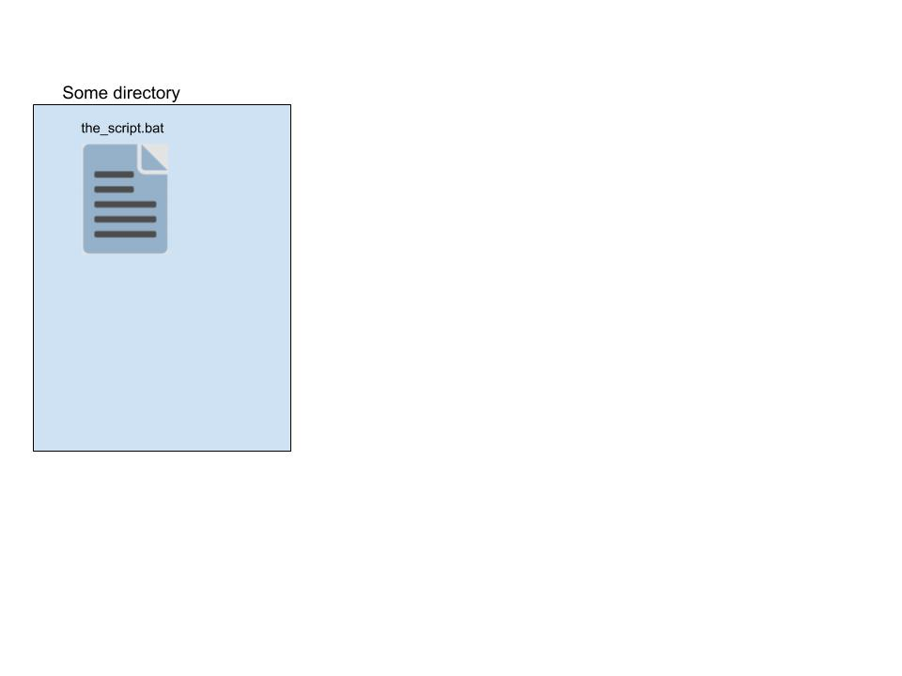
Script flow
In script:
Copy content of unzipped input file into cloned repository
Push it back
Push zip to artifactory with the commit hash as name, for traceability
Clean up

