Slide 1
Predicting Bazel Build Times
Reproduction and improvement of the paper's build-time prediction pipeline
UE24CS352A Machine Learning Mini-Project
[Name 1, SRN] [Name 2, SRN]
Notes:
Introduce the team and the one-line goal: predict Bazel build CPU time, check the paper's pipeline, fix what is wrong, and measure honestly.

Slide 2
Problem and motivation
Bazel builds and tests large code bases; some builds are slow and use a lot of CPU
Goal: predict the CPU time (ms) of the next build before running it
Inputs: dominant changed-file path prefix and file type (paper's idea)
Why it matters: developers can plan, resources and energy are saved
Our scope: reproduce the paper's approach, check it, correct it, measure it
Notes:
Regression problem. Target is CPU time in milliseconds taken from the Build Event Protocol.

Slide 3
Dataset (from the paper's repository)
500
1.8 s
37 s
builds of bazelbuild/bazel
median CPU time
maximum (skewed data)
Per build: prefix (8 values), type (4 values), CPU time
Split in build order: train 299 / validation 100 / test 100, no overlap
Build 1 (cold start, 44.9 s) dropped; no new data collected
Notes:
About 30% of builds are near no-op rebuilds of roughly 0.6 s. CSV values were checked against the 500 raw JSON files.

Slide 4
The paper's approach
Features: most common path prefix + most common file type of the changed files
Feature cross: prefix x type (lets a linear model learn combinations)
Model: TensorFlow linear regression, SGD; metric RMSE
Reported average RMSE: 5736 ms without cross, 5628 ms with cross
Reported test plots: flat lines near 7,500 ms
Notes:
These numbers are taken from the paper. The flat test lines are explained on the next slide.

Slide 5
Issues in the original implementation
Issue | Evidence
Test model is never trained (predicts 0) | RMSE of predicting 0 = 7,459 ms = the flat line
Validation / test overlap (.loc inclusive) | Row 400 in both, row 300 unused
Features paired with the wrong build | Explain 3.6% of variance (chance up to 8.4%); previous row: 28.0%
Substring matching in extractor | 20 of 60 site/ rows labelled C/C++ (not fixable)
Grid search not in the code | Hyperparameters cannot be traced
Notes:
Alignment: the script checks out HEAD~1, saves that commit's diff, then runs an incremental build, so the build rebuilds the PREVIOUS row's change set. Mechanism inferred from code and data.

Slide 6
Our pipeline: baseline vs corrected
Original CSVs
(prefix, type, CPU)
One-hot + feature cross
Ridge regression (alpha on validation)
Test once
Model A: paper baseline
Model B: corrected pipeline
Build i features -> CPU time of build i
(the original pairing)
Build i-1 features -> CPU time of build i
(change set actually rebuilt)
Same features, same model, same split. Only the pairing differs. Not a new algorithm. Not an exact TensorFlow copy (scikit-learn Ridge).
Notes:
No leakage: inputs are prefix, type and their cross only. Scrambling the test targets left saved models identical.

Slide 7
Which build's features matter?
Only the previous build's features give real signal
Computed on train + validation builds only
Test builds were not used for this check
Notes:
Offsets from alignment_check.csv. Out-of-sample validation R2, ridge alpha 1 with feature cross.

Slide 8
Results on the test set (100 builds)
Model | RMSE | MAE | R2
Mean predictor | 5821 | 4299 | -0.012
Model A: paper baseline | 5818 | 4299 | -0.011
Model B: corrected | 5354 | 3645 | 0.144
Bootstrap gain of B over A: RMSE +464 ms (95% CI 185 to 698); MAE +657 ms.
Gain is real but modest: validation R2 0.40, test R2 0.14.
It comes from cheap builds (MAE 1.3 s vs 3.2 s). Expensive builds: B not better.
Notes:
Metrics in ms on the original scale. Model A is essentially a constant: validation picked the strongest regularisation, so it is a favourable baseline.

Slide 9
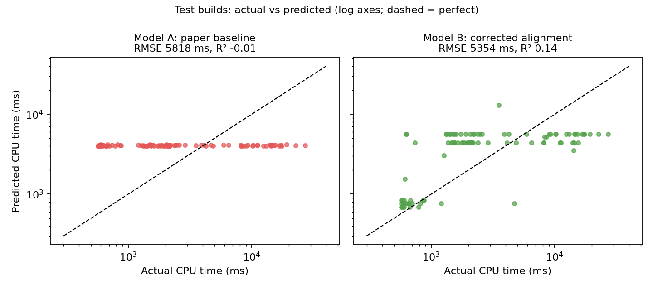
Actual vs predicted (test builds)
Model A is almost a flat line. Model B separates cheap builds (site/, src/test) from real rebuilds, but cannot rank the expensive ones.
Notes:
Log axes; dashed line is a perfect prediction.

Slide 10
Live demo
python src/demo.py --list
python src/demo.py --prefix src/main --type JAVA
python src/demo.py --prefix site/ --type JAVA
python src/demo.py
src/main change -> about 4.4 s predicted; site/ change -> about 0.7 s
Last command replays test builds: predicted vs actual
Full run: preprocessing, training, evaluation take a few seconds
Notes:
Show python src/evaluate.py output too if time allows. Prediction is for the next incremental build, given the change set about to be rebuilt.

Slide 11
Conclusion and future work
The paper's test results are from an untrained model; its features were paired with the wrong builds
After fixing evaluation and pairing: test RMSE 5354 vs 5818 ms, R2 0.14 vs -0.01
Limits: 500 builds, 100 test builds, coarse features, inferred cause, extractor labelling artefact
Next: number of changed files, dependency features, more builds and projects, tree models
Notes:
Be honest: modest but real improvement; bootstrap interval excludes zero.

