Slide 1

AGENTIC AI · CLINICAL CLAIM REVIEW
Clinical Review Agent
An agentic AI copilot that turns a flagged diagnosis into a complete,
evidence-cited, policy-validated review package a human can approve.
GraphRAG
MedGemma
Human-in-the-loop
Deterministic Rules
Reviewer copilot proof of concept · Demo data only — not for real clinical, coding, or payment decisions

Slide 2




WHY THIS MATTERS
Even a tiny gain in reviewer productivity is worth a fortune
Cotiviti's Medical Record Coding operation already runs at massive scale — with humans still in the loop on every chart. That combination is exactly where an agentic copilot pays off.
10M+
97%+
$2B+
100%
CHARTS / YEAR
AVG. ACCURACY
PER YEAR
HUMAN REVIEW
Medical records processed by the coding operation annually
Average coding accuracy across reviewed charts
Appropriate incremental risk-adjustment revenue to MA clients
Coded charts & NLP findings reviewed by certified human coders
The takeaway: large volume + humans still central + high dollar stakes = even a small lift in reviewer speed or accuracy has significant financial value.
Clinical Review Agent
02

Slide 3





THE PROBLEM
One reviewer, one question, a very long chart
A reviewer receives four things...
The claim
Submitted diagnoses to verify
A long patient chart
...then manually searches everything to answer one question:
Clinical notes across many encounters
“Is this diagnosis actually
supported by the patient's
medical record?”
Labs & results
Values scattered across dates
A policy / review rule
Existing NLP surfaces candidate conditions — but a human still has to gather the proof, spot contradictions, and apply the rules, page by page.
Documentation requirements
Clinical Review Agent
03

Slide 4






THE SOLUTION
An agentic copilot that does the searching for them
The copilot combines the chart, claims, and a small policy library into one evidence-backed review package. It does the gathering; the reviewer keeps the decision.
Finds evidence
Cites exact text
Flags contradictions
Locates candidate conditions across the whole chart
Pins supporting text to source, date & page
Detects where notes disagree with each other
Validates policy
Builds the package
Human approves
Checks findings against configured rules
Assembles a cited, structured review case
Reviewer approves, rejects, or escalates
Important: the AI never makes the final coding or payment decision. It prepares the review package — a human reviewer approves or rejects it.
Clinical Review Agent
04

Slide 5


DEMO SCOPE
One diagnosis family, three deliberately different outcomes
Focused MVP diagnosis: Type 2 diabetes mellitus with chronic kidney disease (CKD) stage 3
Case 1
Case 2
Case 3
SITUATION
SITUATION
SITUATION
Relationship clearly documented in a current note
Diabetes and CKD appear only separately — no link
Newer specialist evidence contradicts old support
EXPECTED RESULT
EXPECTED RESULT
EXPECTED RESULT
Supported
Insufficient Evidence
Contradicted
Three cases — not one happy path — because a useful copilot must know when to support, when to abstain, and when to flag a conflict.
Clinical Review Agent
05

Slide 6









SYSTEM ARCHITECTURE
How the pieces fit together
React Frontend
Reviewer workspace & actions
MedGemma (LM Studio)
Neo4j Graph DB
ChromaDB Vector DB
Semantic extraction
+ explanation writing
Relationship evidence
+ GraphRAG retrieval
Semantic search over
notes & labs
FastAPI Backend
LangGraph calls these three engines
API door · loads case data
Deterministic Rules
Decides the AI status
LangGraph Orchestrator
Controls the agent workflow
Evidence-Cited Result
Status + cited proof
Human Reviewer
Final action
SQLite Audit Log
Stores the decision
Clinical Review Agent
06

Slide 7

THE STACK
Every tool has one specific job
React
FastAPI
Reviewer UI & workspace
Backend API layer
LangGraph
MedGemma
Agent workflow orchestration
Clinical semantic extraction + explanation
Neo4j
ChromaDB
Graph relationships & evidence paths
Semantic search over notes & labs
SQLite
LM Studio
Immutable audit log of decisions
Runs MedGemma locally
Clinical Review Agent
07

Slide 8
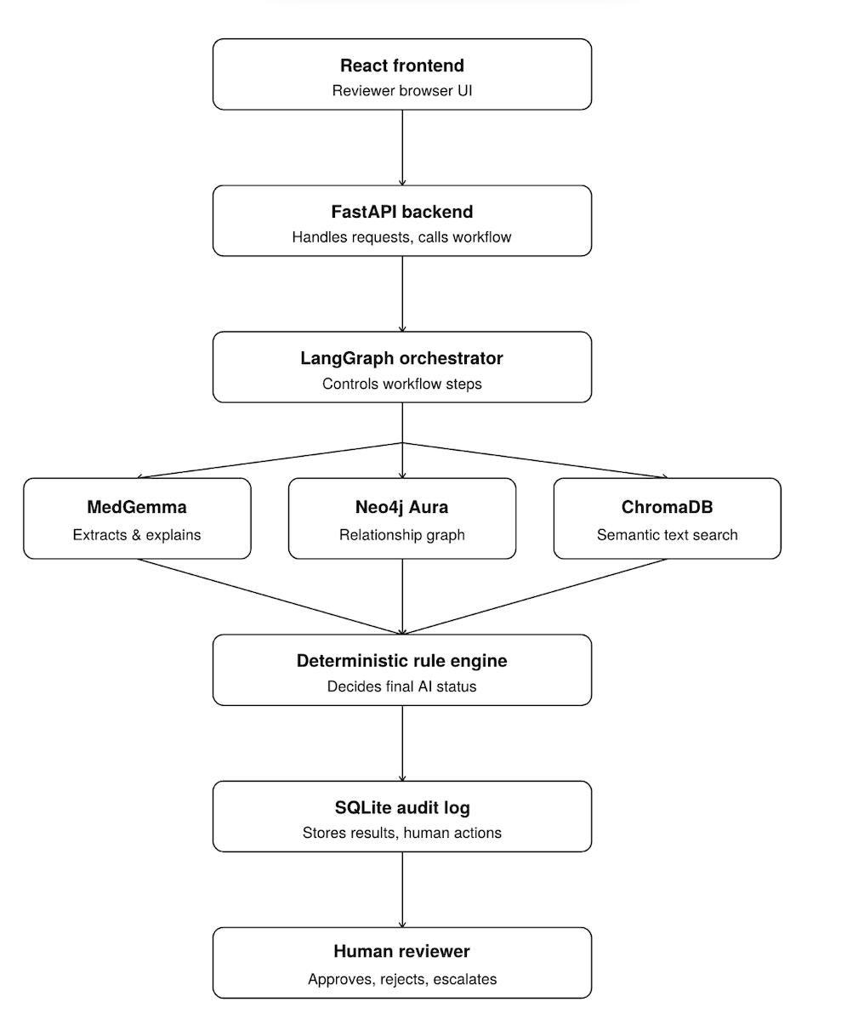

Slide 9

WHY A GRAPH DATABASE
A normal DB stores rows. Neo4j stores relationships.
Text search might find diabetes in one note and CKD in another, then wrongly make the claim look supported. A graph separates condition evidence from relationship evidence.
Normal database
Neo4j graph
Stores rows in separate tables
Stores the connections directly
Note table · “mentions CKD”
Claim → SUBMITS → Diagnosis
Lab table · “eGFR 42”
Note → SUPPORTS_RELATIONSHIP → Diabetes-with-CKD
Claim table
Newer Note → CONTRADICTS → CKD stage 3
Policy table
Evidence → SATISFIES → Policy Requirement
Tells you what each note says — but not how they connect.
Answers relationship questions: are diabetes & CKD explicitly linked? Is newer evidence contradicting older? Which evidence satisfies policy?
Clinical Review Agent
08

Slide 10
TWO KINDS OF RAG
ChromaDB finds the pages · Neo4j proves what they mean
Vector RAG — ChromaDB
GraphRAG — Neo4j
“Which text looks relevant?”
“How is that evidence connected?”
Searches note & lab text by meaning, not exact keywords — finds related snippets even with different words.
Retrieves connected evidence paths & relationships — proving support, contradiction, and policy satisfaction.
Working together on one claim
ChromaDB
MedGemma
Neo4j
Rules
retrieves relevant text (this patient only)
reads it, extracts relationship edges
stores & queries the connected graph
combine the answer into a status
Patient-scoped: every ChromaDB query is filtered by case / patient ID — even with 500 diabetes charts, only the selected patient's notes are searched.
Clinical Review Agent
09

Slide 11


AGENTIC WORKFLOW
LangGraph makes it an agent, not a single prompt
1. Load case
claim, notes, labs, policy
The agent can branch
2. Retrieve evidence
ChromaDB semantic + graph
Missing evidence
→ search again, wider
3. MedGemma extracts edges
relationships from chart text
Contradiction exists
→ run conflict analysis
4. Neo4j stores / retrieves
graph paths & contradictions
Invalid citation
→ retry validation once
5. Apply deterministic rules
decide the AI status
Still unresolved
→ escalate to a human
6. Explain + validate citations
MedGemma writes, IDs checked
Because the workflow can search again, analyze conflicts, retry, or escalate — it behaves like a controlled agentic process, not one function call.
Clinical Review Agent
10

Slide 12

THE AI LAYER
MedGemma has exactly two jobs — and neither decides the status
Job 1 — Semantic graph extraction
Job 2 — Explanation generation
Reads claim + notes + labs + policy and proposes graph edges:
After the rules decide the status, MedGemma explains it in plain, reviewer-friendly language:
NOTE-001 → SUPPORTS_RELATIONSHIP → REL-DM2-CKD3
“The diagnosis is contradicted because newer specialist evidence no longer supports active CKD stage 3.”
NOTE-005 → CONTRADICTS → COND-CKD3
LAB-011 → WEAKENS → COND-CKD3
MedGemma never gets unchecked control
Python validates every proposed edge — rejecting fake node IDs, unknown relationship types, and malformed edges — before anything is stored. Deterministic rules, not the model, decide the final status. This is what keeps the copilot safe.
Clinical Review Agent
11

Slide 13


HUMAN-IN-THE-LOOP
AI recommends a status — the human chooses the action
AI STATUS
HUMAN ACTION
Generated by the system
Chosen by the certified reviewer
Supported
Approve
Insufficient Evidence
Reject
Contradicted
Request Documentation
Unsupported
Escalate
Requires Expert Review
Every action is written to the SQLite audit log with timestamp, reviewer, and model metadata.
Clinical Review Agent
12

Slide 14

VALUE
Why this matters for reviewers
The goal is not to replace reviewers — it's to give them a faster, clearer, evidence-cited starting point.
Less manual searching
Evidence in one place
Contradictions surfaced
No more scanning every chart page by hand
Supporting proof organized and cited
Conflicting notes are easy to spot
Auditable packages
Human stays in control
Relationship-aware
Every decision logged and traceable
The reviewer makes the final call
GraphRAG, not just flat text search
Clinical Review Agent
13

Slide 15
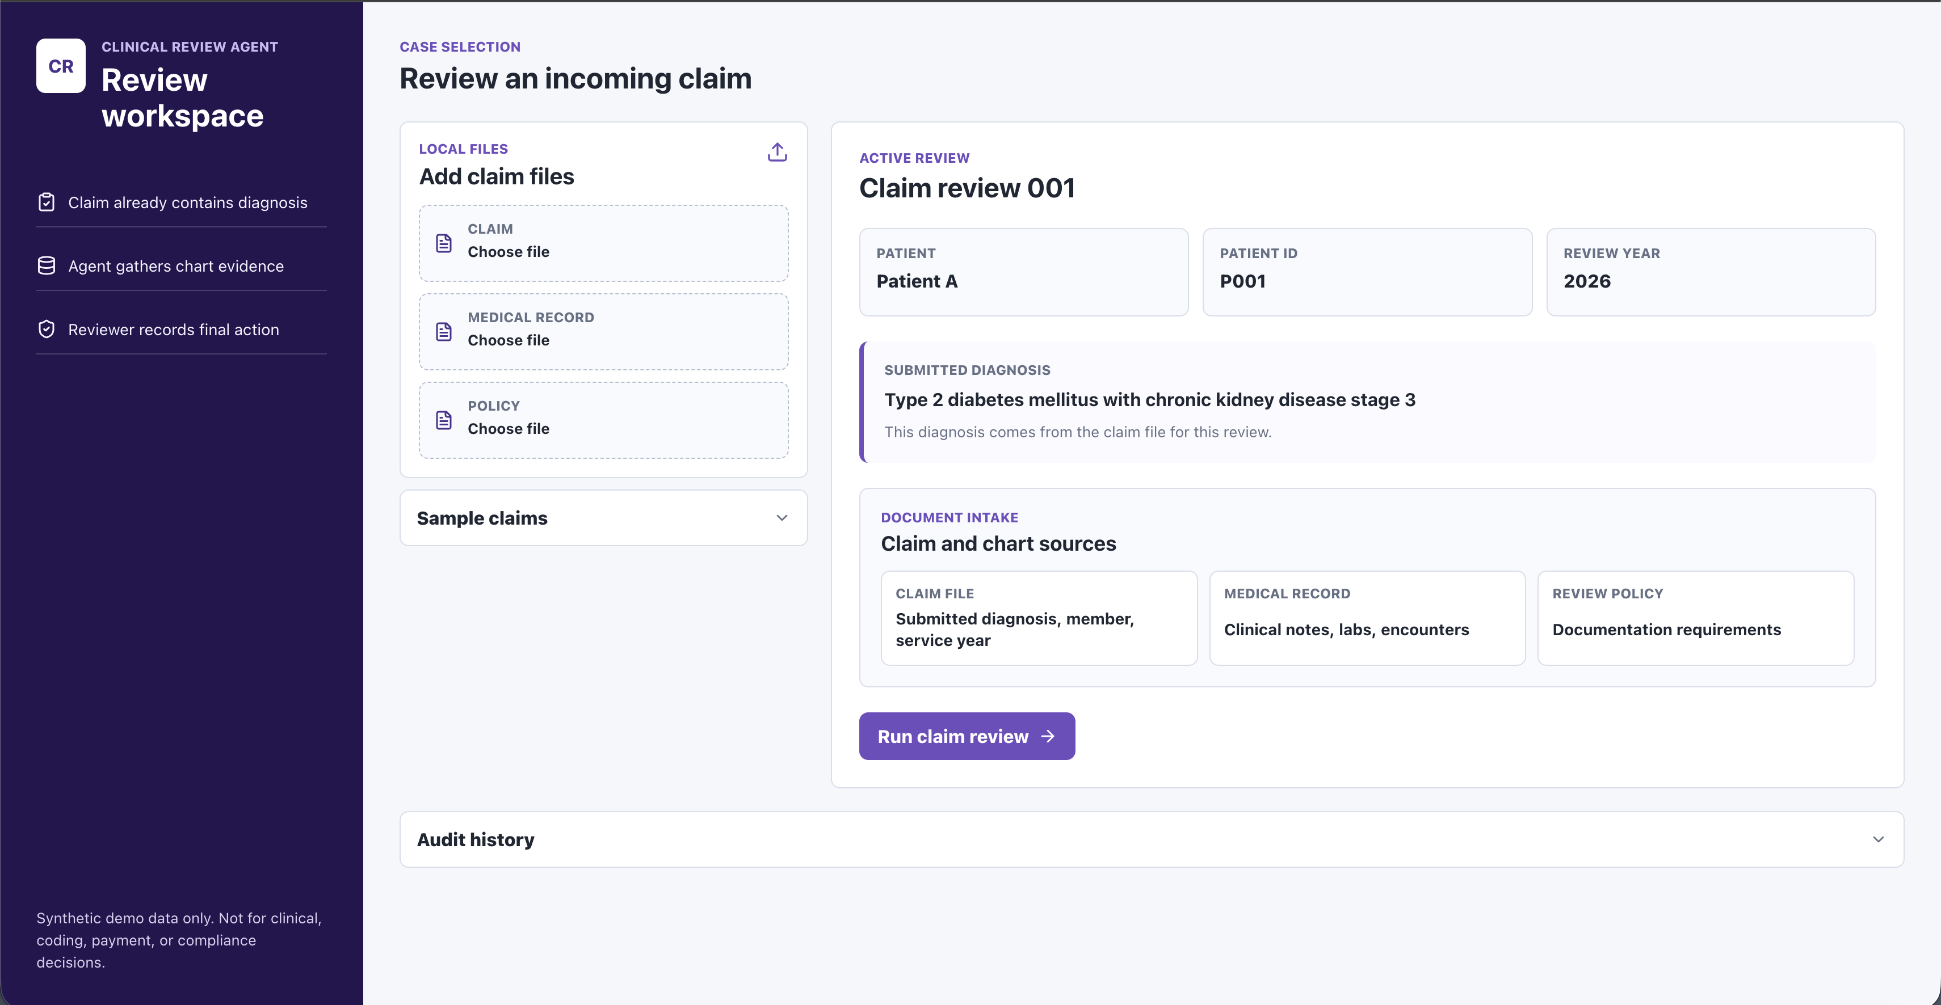

LIVE DEMO
The reviewer workspace in action
Walkthrough
1
Select an incoming claim review
2
Click Run Claim Review → LangGraph starts
3
System returns a status + explanation
4
Expand evidence, policy gaps & trace
ADD IMAGE HERE
Screenshot: claim review screen — status, evidence sections & graph
5
View the connected evidence graph
6
Record Approve / Reject / Escalate
7
Decision stored in audit history
Clinical Review Agent
14

Slide 16


HONESTY & ROADMAP
Current limitations and where it goes next
Current MVP limitations
Next steps
Uses synthetic demo data & policies
Local-only deployment
Not production clinical software
Upload flow is demo-level, no full PDF/OCR
Policies are simplified
MedGemma extraction needs more validation
Real PDF / chart parsing & OCR
Stronger clinical entity extraction
More diagnosis & policy types
Authentication & role-based access
Cloud deployment
Reviewer feedback loop
Model evaluation dashboard
Clinical Review Agent
15

Slide 17
THE TAKEAWAY
The Clinical Review Agent turns a flagged diagnosis into an evidence-cited, graph-validated, human-reviewable case package.
ChromaDB
Neo4j
MedGemma
Rules
Human
finds the text
proves the links
reads meaning
decide status
final call
Agentic AI · GraphRAG · local medical LLM · human review — working together to make clinical claim review more efficient and auditable.
Proof of concept · Demo data only — not for real clinical, coding, or payment decisions.

