Slide 1
Tensorflow Serving for Production
Prarthana Bataju
2018.01.22

Slide 2
Tensorflow Serving
Tensorflow is a open source machine learning library and tensorflow serving is built to handle it on the server.
Separate library from tensorflow but we use with tensorflow.
High-performance serving system for machine learning models.
Handles all the infrastructure, maintaining life cycle, handling client servers and many more.
Meant for production and battle tested by Google.
To deploy tensorflow model:
Docker
Is a light weight version of a virtual image machine that runs without the overhead of running a full OS inside it.
Bazel
Is a google tool to download all the dependencies.

Slide 3
Tensorflow Serving Architecture
Green box: server ; Blue box: client
File System : Store the model on the sever.
The library will load the model and see which version to use and use the latest version to serve the model.
Serve means when client send the request it will going to return the result.
File System
Publish new
versions to
be applied
Scan and
load models
gRPC request
Model V1
Version Manager
Session Bundler
Predict
Loader
gRPC client
Model V2
Prediction
Serves the aspired models
gRPC response
Tensorflow Serving
This can be a remote or local client
* Check the version->Feed it into the loader->Manager maintain the lifecycle->Call it from our client

Slide 4
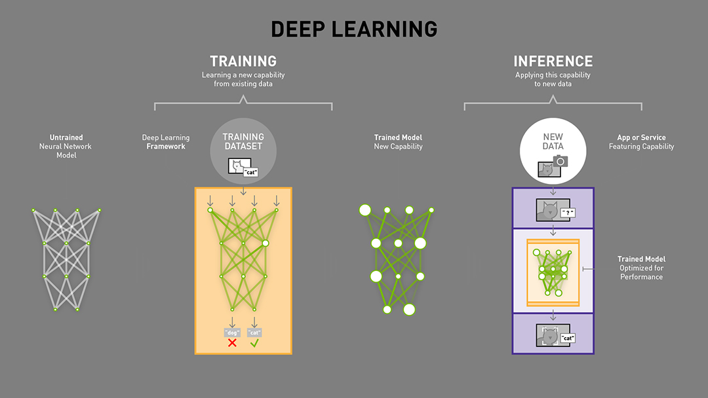
Tensorflow serving is meant for Inference(managing models, giving versioned access)
Can serve multiple models simultaneously
Can serve multiple versions of the same model
We have some untrained neural network model
Then we trained it, then we can test on our own data so that it classify correctly, then after it is done then we can perform INFERENCE.
INFERENCE, Is applying the capability of this model to some new data set, so that the consumer would probably be using for production use.

Slide 5
Implementation Flow
Install docker
Clone tensorflow serving
D O C K E R
Create docker image (install all dependencies like pip, bazel, grpc)
Run docker container
Clone tensorflow serving into container
*Problem : Memory allocation error
Install Inception and run serve locally
Push to the Cloud using AWS server or Google Kubernets

Slide 6
Part 0: Create a Docker Image
Part 1: Run the image in local container
Part 2:Deploy in Kubernetes
Run container
Start the server
GCloud project login
Clone, configure and build Tensorflow Serving in a container
Query the server
Create a container cluster
Upload the Docker image
Export Inception Mode in a container
Create kubernetes Deployment and Service
Commit image for deployment
Query the model

Slide 7
saved_model.pb variables
Train and save TF model in protobuf
Tensorflow
Tensorflow Serving
Cloud Platform
Docker
Kubernets or
Amazon Server
saved_model.pb
variables

Slide 8
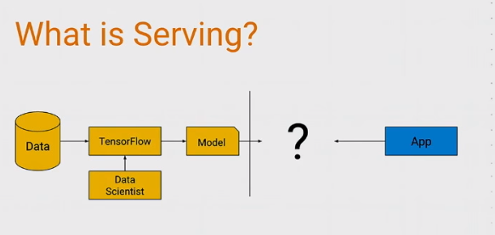
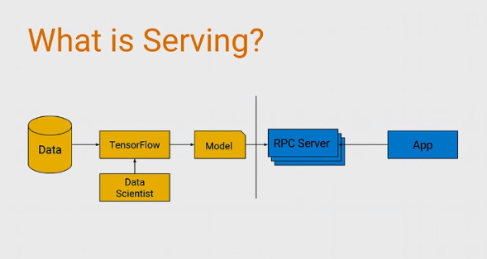

Slide 9
Setup Development Environment
Install docker
Clone the tensorflow serving repo
Create docker image with all required dependencies(pip, bazel, grpc)
Run docker container locally.
Clone tensorflow serving into container
Build bazel tool from inside our container.
Dependencies needed : tensorflow serving; pre-trained Inception model
After tensorflow serving, Install inception model
Run it and gRPC server locally.
After running on our local sever,
Wanna push this to the cloud? Well using Google cloud and the automatic container management tool (https://kubernetes.io/) we can

