Slide 1
IBM University Engagement Project Submission
“Exploring the Power of Agentic AI with IBM Granite and IBM Bob”

Slide 2

Project Tile – [AI-Powered Mental Health Awareness and Suicide Prevention Agent]
Domain of Project – [Healthcare]
Student Name | Recent Passport Photo | Email ID | Mobile number [WhatsApp]
 |  | prarthanapanikar@gmail.com | 9529614558
Panikar Prarthanna Sumesh.

Slide 3
Problem Statement -
Problem Statement : AI-Powered Mental Health Awareness and Suicide Prevention Agent
The Challenge
Mental health disorders such as stress, anxiety, depression, and emotional burnout are increasing worldwide. Many people hesitate to seek professional help due to stigma, lack of awareness, limited access to mental health resources, or financial constraints. Individuals experiencing emotional distress often do not receive timely guidance, which can worsen their condition and, in severe cases, lead to suicidal thoughts.
The Objective
Build an Agentic AI-powered Mental Health Awareness & Suicide Prevention Agent that is empathetic, proactive, and safe.
The solution should:
Promote Awareness & Education – Share accessible resources on mindfulness, coping strategies, and self-care.
Enable Early Detection (RAG) – Use Retrieval-Augmented Generation to identify distress signals in conversations, journaling inputs, or safe online data.
Provide Empathetic Support – Build a conversational agent that listens actively and responds with empathy (with clear disclaimers: not a substitute for professional medical advice).
Predict & Prevent Risks – Forecast stress peaks, suggest preventive strategies, and issue alerts when high-risk signals are detected (with consent). 5
Connect to Human Support – Link users to helplines, counselors, or community support for timely intervention.

Slide 4
Proposed Solution -
The proposed solution is an intelligent AI-Powered Mental Health Awareness and Suicide Prevention Agent developed using IBM watsonx Orchestrate, IBM Granite Models, and IBM Cloud.
The agent acts as a compassionate virtual mental health assistant that provides emotional support, mental health education, stress management techniques, and wellness recommendations.
The system analyzes user conversations to understand emotions and offers personalized guidance while maintaining privacy and following responsible AI principles.
The solution consists of four intelligent agents:
1. Emotional Support Agent
Provides empathetic conversations
Reduces feelings of loneliness
Encourages positive thinking
2. Mental Health Awareness Agent
Educates users about anxiety, depression, stress, panic attacks, and emotional wellness
Promotes mental health awareness
3. Wellness Recommendation Agent
Suggests meditation
Breathing exercises
Sleep improvement tips
Healthy daily habits
4. Crisis Support Agent
Detects high-risk emotional conversations
Encourages users to contact trusted people
Recommends seeking professional mental health support
Provides emergency guidance in crisis situations
IBM watsonx Orchestrate manages workflow automation while IBM Granite Models generate intelligent, empathetic, and context-aware responses.
Overall, the solution promotes mental wellness, emotional resilience, early intervention, and responsible AI.

Slide 5
Technology Used
IBM Bob platform -For designing and orchestrating multi-agent workflows visually
IBM Grainte model - for eg – ibm-granite-3-2-8b – For natural language understanding, reasoning, and personalization
IBM Cloud – It provides the infrastructure to build, deploy, and scale the Nutrition Agent efficiently. IBM Cloud enables a reliable, secure, and scalable environment for deploying the Nutrition Agent.
RAG– RAG to fetch real data first, then generate intelligent answers, making the Nutrition Agent more trustworthy and effective.
IBM Watsonx.ai - For model deployment, embeddings, and AI governance
Vector Database (FAISS/Chroma) – For RAG-based nutritional data retrieval

Slide 6
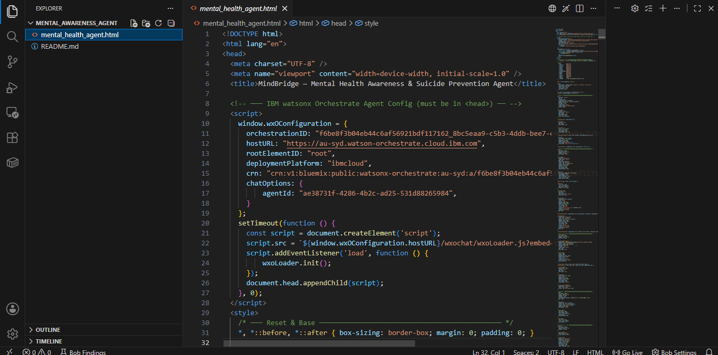
Required Files created using IBM bob -
Index.html

Slide 7
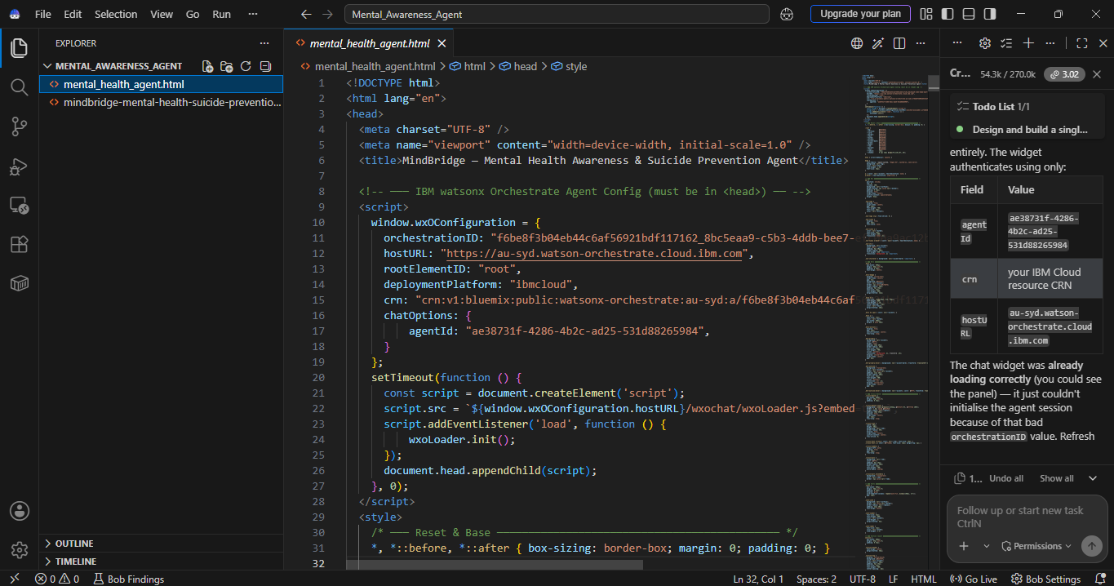
IBM Bob Screenshots:

Slide 8

Architecture blueprint for IBM bob:

Slide 9

Role of Agentic AI in the solution
Role of Agentic AI in Nutrition Agent
Agentic AI enables the Mental Health Agent to function as an autonomous and intelligent assistant rather than a traditional chatbot.
Different AI agents collaborate to:
Understand user emotions.
Provide personalized emotional support.
Recommend stress management techniques.
Detect signs of emotional crisis.
Deliver responsible and empathetic responses.
Encourage professional help when needed.
Continuously adapt responses based on conversation context.
This multi-agent architecture ensures accurate, safe, and human-centered assistance

Slide 10


Token Usage
11,761 token are used
Before Prompt
After the Prompt
·
·
·

Slide 11
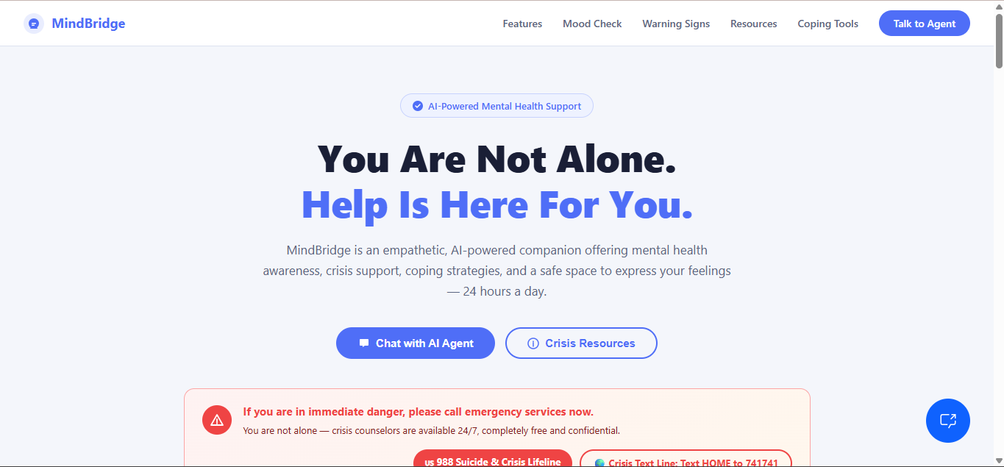
Project Output Screenshot
Please put IBM Bob output screenshots with 2-3 prompts.
You can take 2-3 more slides for each screenshot
·
·
·

Slide 12
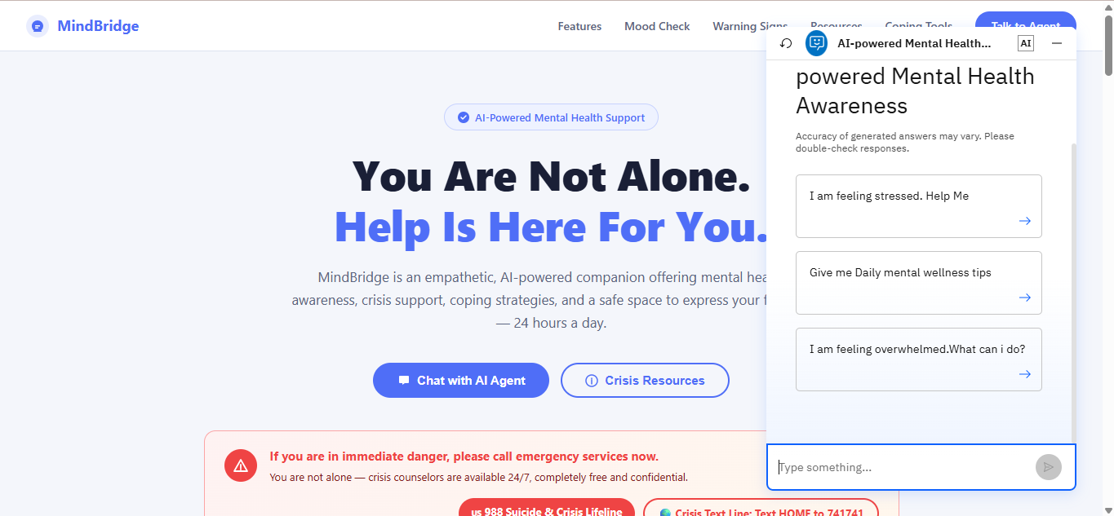
Project Output Screenshot
Please put IBM Bob output screenshots with 2-3 prompts.
You can take 2-3 more slides for each screenshot
·
·
·

Slide 13
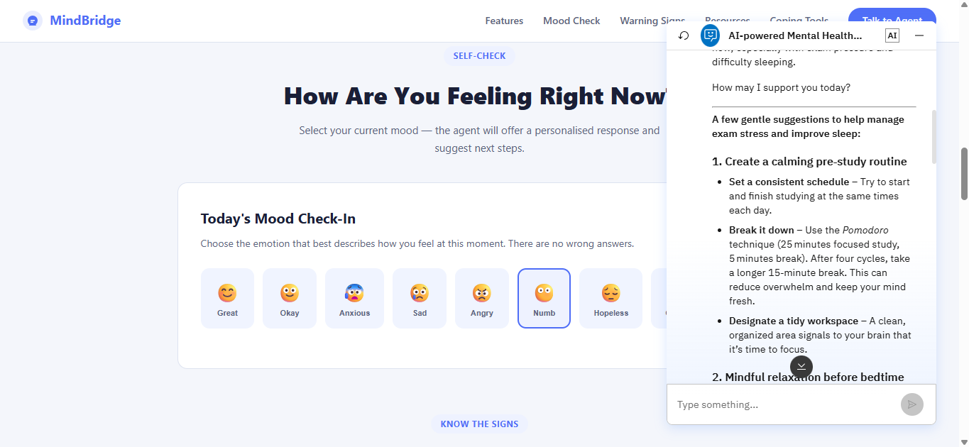
Project Output Screenshot
Please put IBM Bob output screenshots with 2-3 prompts.
You can take 2-3 more slides for each screenshot
·
·
·

Slide 14
Novelty and Uniqueness
Multi-Agent AI Architecture
Emotion-aware conversations
Responsible AI implementation
Personalized wellness recommendations
Crisis-aware responses
Mental health education
IBM Granite-powered reasoning
IBM watsonx Orchestrate workflow automation
Scalable IBM Cloud deployment
Privacy-focused and ethical AI

Slide 15
Git Hub Link
Link : https://github.com/PrarthanaPanikar/AI-Powered-Mental-Health-Awareness-Suicide-Prevention-Agent.git
·
·
·

Slide 16
Future Scope
Scopes:
Integration with wearable health devices.
Real-time emotion detection using voice analysis.
AI-powered multilingual mental health support.
Personalized therapy recommendations.
Integration with hospitals and mental health professionals.
Mobile application deployment.
Predictive mental health risk analysis.
Community support and peer-to-peer assistance.
AI-powered mood tracking dashboard.
Continuous learning using user feedback.
·
·
·

Slide 17
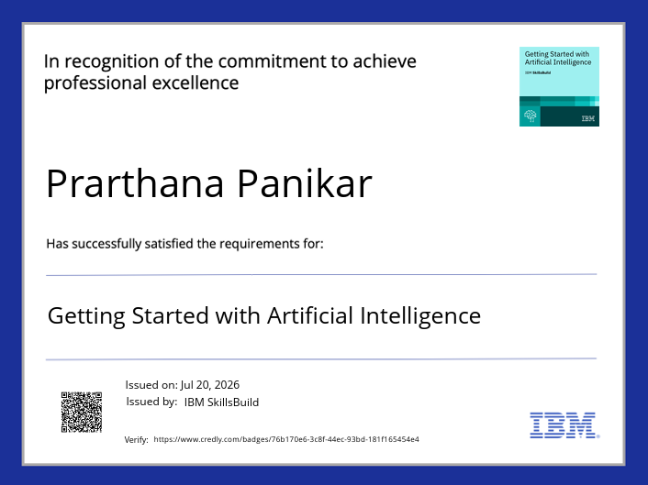
Certificates Earned:
Getting Started with Artificial Intelligence

Slide 18
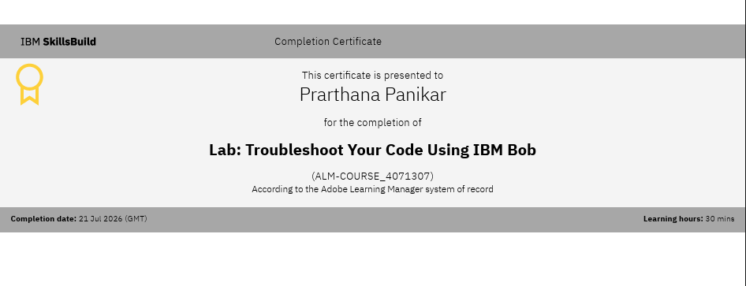
Certificates Earned:​

Slide 19


