Slide 1

JAVA PROGRAMMING (20IS403)
Abhishek S. Rao
Asst. Professor
Dept. of IS&E
NMAMIT, Nitte

Slide 2
Inheritance
A class that is inherited is the superclass.
A class that does the inheriting is the subclass.
A subclass is a specialized version of a superclass.
A subclass inherits all the instance variables and methods from the superclass and adds its own unique elements.
Inheritance is facilitated in Java with the help of the keyword extends.

Slide 3
class subclass-name extends superclass-name
{
// body of class
}
Class A
{
}
Class B extends A
{
}

Slide 4
class A
{ int i, j;
void showij()
{ System.out.println("i and j: " + i + " " + j);
}
}
class B extends A
{
int k;
void showk()
{ System.out.println("k: " + k);
}
void sum()
{
System.out.println("i+j+k: " + (i+j+k));
}
}

Slide 5
class SimpleInheritance
{ public static void main(String args[])
{
A superOb = new A();
SuperOb.i = 10;
superOb.j = 20;
System.out.println("Contents of superOb: ");
superOb.showij();
B subOb = new B();
subOb.i = 7;
subOb.j = 8;
subOb.k = 9;
System.out.println("Contents of subOb: ");
subOb.showij();
subOb.showk();
subOb.sum();
}
}

Slide 6
Member Access and Inheritance
derived cannot access members of the superclass that have been declared as private.

Slide 7
/* In a class hierarchy, private members remain private to their class */
class A
{ int i;
private int j; // private to A
void setij(int x, int y)
{ i = x;
j = y;
}
}
// A's j is not accessible here.
class B extends A
{
int total;
void sum()
{
total = i + j; // ERROR, j is not accessible here
}
}

Slide 8
//This program uses inheritance to extend Box.
class Box {
double width;
double height;
double depth;
// construct clone of an object
Box(Box ob)
{ // pass object to constructor
width = ob.width;
height = ob.height;
depth = ob.depth;
}
Box(double w, double h, double d)
{
width = w;
height = h;
depth = d;
}

Slide 9
// constructor used when no dimensions specified
Box()
{
width = -1; // use -1 to indicate
height = -1; // an uninitialized
depth = -1; // box
}
// constructor used when cube is created
Box(double len)
{
width = height = depth = len;
}
// compute and return volume
double volume()
{
return width * height * depth;
}
}

Slide 10
class BoxWeight extends Box
{ double weight;
BoxWeight(double w, double h, double d, double m) //constructor for BoxWeight
{ width = w;
height = h;
depth = d;
weight = m;
}
}
class DemoBoxWeight {
public static void main(String args[]) {
BoxWeight mybox1 = new BoxWeight(10, 20, 15, 34.3);
BoxWeight mybox2 = new BoxWeight(2, 3, 4, 0.076);
double vol;
vol = mybox1.volume();
System.out.println("Volume of mybox1 is " + vol);
System.out.println(“Weight of mybox1 is " + mybox1.weight);

Slide 11
System.out.println();
vol = mybox2.volume();
System.out.println("Volume of mybox2 is " + vol);
System.out.println(“Weight of mybox2 is " + mybox2.weight);
}
}

Slide 12
In the previous example BoxWeight class inherits all of the characteristics of the class
Box and adds to them the weight component.
For ex:
//Here Box is extended to include color
class ColorBox extends Box
{
int color; //color of Box
ColorBox(double w, double h, double d, int c)
{
width = w;
height = h;
depth = d;
color = c;
}
}

Slide 13
A superclass variable can reference a subclass object
class RefDemo
{
public static void main(String args[])
{
BoxWeight weightbox = new BoxWeight(3, 5, 7, 8.37);
Box plainbox = new Box();
double vol;
vol = weightbox.volume();
System.out.println("Volume of weightbox is " + vol);
System.out.println(“Weight of weightbox is " + weightbox.weight);
System.out.println();
plainbox = weightbox;
vol = plainbox.volume();
System.out.println("Volume of plainbox is " + vol);
//The following statement is invaild because plainbox does not define a weight member.
//System.out.println(“Weight of plainbox is " + plainbox.weight);
} }

Slide 14
In the previous example,
weightbox is a reference to BoxWeight objects and plainbox is a reference to Box objects. Since BoxWeight is a subclass of Box, it is permissible to assign plainbox a reference to the weightbox object.
The type of the reference variable (not the type of the object) determines what members can be accessed.
i.e, when a reference to a subclass object is assigned to a superclass reference variable, we will have access to only those parts of the object defined by the superclass.
Hence plainbox can’t access weight even when it refers to a BoxWeight object.

Slide 15
Creating a Multilevel Hierarchy
Up to this point, we have been using simple class hierarchies that consist of only a superclass and a subclass. However, you can build hierarchies that contain as many layers of inheritance as you like. As mentioned, it is perfectly acceptable to use a subclass as a superclass of another.
For example, given three classes called A, B, and C, C can be a subclass of B, which is a subclass of A. When this type of situation occurs, each subclass inherits all of the traits found in all of its superclasses.

Slide 16
class Box
{
private double width;
private double height;
private double depth;
// construct clone of an object
Box(Box ob)
{
// pass object to constructor
width = ob.width;
height = ob.height;
depth = ob.depth;
}
// constructor used when all dimensions specified
Box(double w, double h, double d)
{
width = w;
height = h;
depth = d;
}

Slide 17
// constructor used when no dimensions specified
Box()
{
width = -1; // use -1 to indicate
height = -1; // an uninitialized
depth = -1; // box
}
// constructor used when cube is created
Box(double len)
{
width = height = depth = len;
}
// compute and return volume
double volume()
{
return width * height * depth;
}
}

Slide 18
// Add weight.
class BoxWeight extends Box
{
double weight; // weight of box
// construct clone of an object
BoxWeight(BoxWeight ob)
{
// pass object to constructor
super(ob);
weight = ob.weight;
}
// constructor when all parameters are specified
BoxWeight(double w, double h, double d, double m)
{
super(w, h, d); // call superclass constructor
weight = m;
}
// default constructor
BoxWeight()
{
super();
weight = -1;
}

Slide 19
// constructor used when cube is created
BoxWeight(double len, double m)
{
super(len);
weight = m;
}
}
// Add shipping costs.
class Shipment extends BoxWeight
{
double cost;
// construct clone of an object
Shipment(Shipment ob)
{
// pass object to constructor
super(ob);
cost = ob.cost;
}
// constructor when all parameters are specified
Shipment(double w, double h, double d, double m, double c)
{
super(w, h, d, m); // call superclass constructor
cost = c;
}

Slide 20
// default constructor
Shipment()
{
super();
cost = -1;
}
// constructor used when cube is created
Shipment(double len, double m, double c)
{
super(len, m);
cost = c;
}
}

Slide 21
class DemoShipment
{
public static void main(String args[])
{
Shipment shipment1 = new Shipment(10, 20, 15, 10, 3.41);
Shipment shipment2 = new Shipment(2, 3, 4, 0.76, 1.28);
double vol;
vol = shipment1.volume();
System.out.println("Volume of shipment1 is " + vol);
System.out.println("Weight of shipment1 is “ + shipment1.weight);
System.out.println("Shipping cost: $" + shipment1.cost);
System.out.println();
vol = shipment2.volume();
System.out.println("Volume of shipment2 is " + vol);
System.out.println("Weight of shipment2 is “ + shipment2.weight);
System.out.println("Shipping cost: $" + shipment2.cost);
}
}

Slide 22
The output of this program is shown here:
Volume of shipment1 is 3000.0
Weight of shipment1 is 10.0
Shipping cost: $3.41
Volume of shipment2 is 24.0
Weight of shipment2 is 0.76
Shipping cost: $1.28

Slide 23
When Constructors Are Called
class A
{ A()
{
System.out.println("Inside A's constructor.");
}
}
class B extends A
{ B()
{
System.out.println("Inside B's constructor.");
}
}

Slide 24
class C extends B
{
C()
{
System.out.println("Inside C's constructor.");
}
}
class CallingCons
{
public static void main(String args[])
{
C c = new C();
}
}

Slide 25
The output from this program is shown here:
Inside A’s constructor
Inside B’s constructor
Inside C’s constructor

Slide 26
METHOD OVERRIDING

Slide 27
// Method overriding.
class A
{
int i, j;
A(int a, int b)
{
i = a;
j = b;
}
// display i and j
void show()
{
System.out.println("i and j: " + i + " " + j);
}
}

Slide 28
class B extends A
{ int k;
B(int a, int b, int c)
{ super(a, b);
k = c;
}
// display k – this overrides show() in A
void show()
{
System.out.println("k: " + k);
}
}
class Override
{
public static void main(String args[])
{
B subOb = new B(1, 2, 3);
subOb.show(); // this calls show() in B
}
}

Slide 29
Using super
When a subclass needs to refer to its immediate superclass, it can do so by use of the keyword super.
super has two general forms.
To call the superclass’ constructor.
The second is used to access a member of the superclass that has been hidden by a member of a subclass.

Slide 30
Using super to Call Superclass Constructors
A subclass can call a constructor method defined by its superclass by use of the following form of super:
super(parameter-list);
Here, parameter-list specifies any parameters needed by the constructor in the superclass.
super( ) must always be the first statement executed inside a subclass’ constructor.

Slide 31
// BoxWeight now uses super to initialize its Box attributes.
class BoxWeight extends Box
{
double weight; // weight of box
// initialize width, height, and depth using super()
BoxWeight(double w, double h, double d, double m)
{
super(w, h, d); // call superclass constructor
weight = m;
}
}

Slide 32
A Second Use for super
The second is used to access a member of the superclass that has been hidden by a member of a subclass.
This usage has the following general form:
super.member
Here, member can be either a method or an instance variable.
This second form of super is most applicable to situations in which member names of a subclass hide members by the same name in the superclass.

Slide 33
// Using super to overcome name hiding.
class A
{ int i;
}
// Create a subclass by extending class A.
class B extends A
{
int i; // this i hides the i in A
B(int a, int b)
{ super.i = a; // i in A
i = b; // i in B
}
void show()
{
System.out.println("i in superclass: " + super.i);
System.out.println("i in subclass: " + i);
}
}

Slide 34
class UseSuper
{
public static void main(String args[])
{
B subOb = new B(1, 2);
subOb.show();
}
}

Slide 35
Accessing superclass version of an overridden method using super
If we wish to access the superclass version of an overridden function, we can do This by using super.

Slide 36
class A
{
int i, j;
A(int a, int b)
{
i = a;
j = b;
}
void show()
{
System.out.println("i and j: " + i + " " + j);
}
}
class B extends A
{
int k;
B(int a, int b, int c)
{
super(a, b);
k = c;
}
void show()
{
super.show(); // this calls A's show()
System.out.println("k: " + k);
}
}

Slide 37
Method overriding occurs only when the names and the type signatures of the two methods are identical. If they are not, then the two methods are simply overloaded.

Slide 38
// Methods with differing type signatures are overloaded – not overridden.
class A
{ int i, j;
A(int a, int b)
{ i = a;
j = b;
}
void show()
{ System.out.println("i and j: " + i + " " + j);
}
}

Slide 39
class B extends A
{
int k;
B(int a, int b, int c)
{ super(a, b);
k = c;
}
void show(String msg)
{ System.out.println(msg + k);
}
}
class Override
{
public static void main(String args[])
{
B subOb = new B(1, 2, 3);
subOb.show("This is k: "); // this calls show() in B
subOb.show(); // this calls show() in A
}}

Slide 40
Dynamic method dispatch
The mechanism by which a call to an overridden method is resolved at runtime , rather than compile time is known as dynamic method dispatch.
It is the type of the object being referred to (not the type of the reference variable) that determines which version of an overridden method will be executed.
class A
{
void callme()
{ System.out.println(“Inside A’s callme method”);
}
}
class B extends A
{
//override callme()
void callme()
{ System.out.println(“Inside B’s callme method”);
}
}

Slide 41
class C extends B
{ //override callme()
void callme()
{ System.out.println(“Inside C’s callme method”);
}
}
class Dispatch
{
public static void main(String args[])
{ A a = new A(); //object of type A
B b = new B(); //object of type B
C c= new C(); //object of type C
A r; //obtain a reference of type A
r = a; // r refers to an A object
r.callme(); // calls A’s version of callme
r = b; // r refers to an B object
r.callme(); // calls B’s version of callme
r = c; // r refers to an C object
r.callme(); //calls C’s version of callme
} }

Slide 42
Inside A s callme method
Inside B s callme method
Inside C s callme method

Slide 43
final
All methods and variables can be overridden by default in subclasses. If we wish to prevent subclasses from overriding the members of the superclass, we can declared them as final using the keyword final.
final int a=10;
final void disp();
Making a method final ensures that the functionality defined in this method will never be altered in any way.
Similarly the value of final variable can never be changed.
A class that cannot be subclasses is called final class. This is done by defining a class as final.
final class A { }
final class B extends A { }

Slide 44
Using final to prevent overriding
class A
{
final void meth()
{
System.out.println(“This is a final method. “);
}
}
class B extends A
{
void meth()
{ //Error! Can’t override.
System.out.println(“Illegal!”);
}
}
Overriding a final method results in compile-time error.

Slide 45
Using final to prevent Inheritance
If we want to prevent a class being inherited, its declaration must be preceded with the keyword final.
It is illegal to declare a class as both abstract and final since an abstract class is incomplete by itself and relies upon its subclasses to provide complete implementations.
final class A
{
//…
}
// The following class is illegal.
class B extends A
{
// ERROR! Can’t subclass A
//…..
}

Slide 46
abstract
We can indicated that a method must always be redefined in a subclass, thus making overriding compulsory.
This can be done by keyword abstract.
abstract class shape
{
abstract void draw();
}
When a class contains one or more abstract methods it should be declared as abstract.

Slide 47
Using abstract Classes
We can not create the object of abstract class
The abstract methods of an abstract class must be defined in its subclass
We can not declare abstract constructors or abstract static methods
Any subclass of an abstract class must either implement all of the abstract methods in the superclass, or be itself declared abstract.

Slide 48
abstract class A
{
abstract void callme();
void callmetoo()
{ System.out.println(“This is a concrete method. “);
}
}
class B extends A
{ void callme()
{ System.out.println(“B’s implementation of callme.”);
}
}
class AbstractDemo
{ public static void main(String args[])
{ B b = new B();
b.callme();
b.callmetoo();
}
}

Slide 49
// Using abstract methods and classes.
abstract class Figure
{
double dim1;
double dim2;
Figure(double a, double b)
{
dim1 = a;
dim2 = b;
}
// area is now an abstract method
abstract double area();
}
class Rectangle extends Figure
{
Rectangle(double a, double b)
{
super(a, b);
}

Slide 50
// override area for rectangle
double area()
{
System.out.println("Inside Area for Rectangle.");
return dim1 * dim2;
}
}
class Triangle extends Figure
{
Triangle(double a, double b)
{
super(a, b);
}
// override area for right triangle
double area()
{
System.out.println("Inside Area for Triangle.");
return dim1 * dim2 / 2;
}
}

Slide 51
class AbstractAreas
{
public static void main(String args[])
{
// Figure f = new Figure(10, 10); // illegal now
Rectangle r = new Rectangle(9, 5);
Triangle t = new Triangle(10, 8);
Figure figref; // this is OK, no object is created
figref = r;
System.out.println("Area is " + figref.area());
figref = t;
System.out.println("Area is " + figref.area());
}
}

Slide 52
Packages and Interfaces
Two of Java’s most innovative features: packages and interfaces.
Packages are containers for classes that are used to keep the class name space compartmentalized.
For example, a package allows you to create a class named List, which you can store in your own package without concern that it will collide with some other class named List stored elsewhere.
Packages are stored in a hierarchical manner and are explicitly imported into new class definitions.

Slide 53
Through the use of the interface keyword, Java allows you to fully abstract the interface from its implementation. Using interface, you can specify a set of methods that can be implemented by one or more classes.
The interface, itself, does not actually define any implementation. Although they are similar to abstract classes, interfaces have an additional capability: A class can implement more than one interface. By contrast, a class can only inherit a single superclass.

Slide 54
packages are container for classes that are used to keep the class name compartmentalized.
package is both a naming and visibility control mechanism.
Defining a package
To create a package include a package command as the first statement in a Java source file.
Any classes declared within that file will belong to the specified package.
If we omit the package statement, the class names are put into the default package, which has no name.

Slide 55
General form :
package pkg;
Ex: package MyPackage;
We can create a hierarchy of package.
General form
package pkg1[.pkg2[.pkg3]];
Ex: package java.awt.image

Slide 56
Finding packages and CLASSPATH
First, by default, the Java run-time system uses the current working directory as its starting point. Thus, if our package is in the current directory, or a subdirectory of the current directory, it will be found.
Second, we can specify a directory path or paths by setting the CLASSPATH environmental variable.
We can use –classpath option with java and javac to specify the path to our class.

Slide 57
Consider the following package specification.
package MyPack;
In order for a program to find MyPack, one of the 3 things must be true.
Either the program is executed from a directory immediately above MyPack.
CLASSPATH must be set to include the path to MyPack.
The –classpath option must specify the path to MyPack when the program is run via java.

Slide 58
When second two options are used, the classpath must not include MyPack itself.
It must specify the path to MyPack.
For ex: in windows if the path is to MyPack is
C:\MyPrograms\java\MyPack
Then the classpath to MyPack is
C:\MyPrograms\java

Slide 59
package MyPack;
class prg
{
public static void main(String args[])
{
System.out.println(“first program to illustrate package”);
}
}
Name the above file as prg.java and put it in a directory called MyPack.
Next compile the file, make sure that resulting class file is also in MyPack.
Run the program using
java MyPack.prg

Slide 60
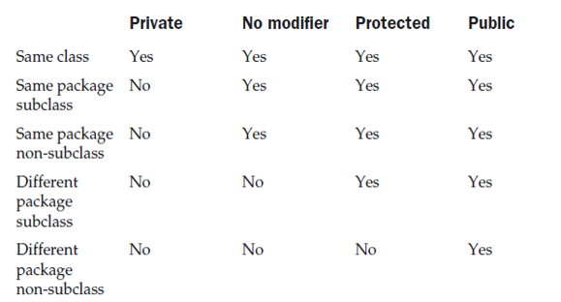
Access Protection

Slide 61
Example has two packages p1 , p2 and five classes.
The source for the first package defines three classes: Protection, Derived and SamePackage.
The first class defines four int variables in each of the legal protection modes.
The variable n is declared with the default protection, n_pri is private, n_pro is protected, and n_pub is public.
The second class, Derived, is a subclass of Protection in the same package p1.
This grants Derived access to every variable in Protection except for n_pri, the private one.
The third class, SamePackage, is not a subclass of Protection, but is in the same package and also has access to all but n_pri.

Slide 62
package p1
class protection
{
}
class derived extends protection
{
}
class samepackage
{
}
package p2
class protection2 extends p1.protection
{
}
class otherpackage
{
}

Slide 63
Protection.java
package p1;
public class Protection
{
int n = 1;
private int n_pri = 2;
protected int n_pro = 3;
public int n_pub = 4;
public Protection()
{
System.out.println("base constructor");
System.out.println("n = " + n);
System.out.println("n_pri = " + n_pri);
System.out.println("n_pro = " + n_pro);
System.out.println("n_pub = " + n_pub);
}
}

Slide 64
Derived.java
package p1;
class Derived extends Protection
{
Derived()
{
System.out.println("derived constructor");
System.out.println("n = " + n);
// class only
// System.out.println("n_pri = " + n_pri);
System.out.println("n_pro = " + n_pro);
System.out.println("n_pub = " + n_pub);
}
}

Slide 65
SamePackage.java
package p1;
class SamePackage
{
SamePackage()
{
Protection p = new Protection();
System.out.println("same package constructor");
System.out.println("n = " + p.n);
// class only
// System.out.println("n_pri = " + p.n_pri);
System.out.println("n_pro = " + p.n_pro);
System.out.println("n_pub = " + p.n_pub);
}
}

Slide 66
Protection2.java
package p2;
class Protection2 extends p1.Protection
{
Protection2()
{
System.out.println("derived other package constructor");
// class or package only
// System.out.println("n = " + n);
// class only
// System.out.println("n_pri = " + n_pri);
System.out.println("n_pro = " + n_pro);
System.out.println("n_pub = " + n_pub);
}
}

Slide 67
OtherPackage.java
package p2;
class OtherPackage
{
OtherPackage()
{
p1.Protection p = new p1.Protection();
System.out.println("other package constructor");
// class or package only
// System.out.println("n = " + p.n);
// class only
// System.out.println("n_pri = " + p.n_pri);
// class, subclass or package only
// System.out.println("n_pro = " + p.n_pro);
System.out.println("n_pub = " + p.n_pub);
}
}

Slide 68
Importing Packages
Java includes the import statement to bring certain classes, or entire packages, into visibility.
Once imported, a class can be referred to directly, using only its name.
In a Java source file, import statements occur immediately following the package statement (if it exists) and before any class definitions.
This is the general form of the import statement:
import pkg1[.pkg2].(classname|*);
import java.util.Date;
import java.io.*;
import java.awt.*;

Slide 69
All of the standard Java classes included with Java are stored in a package called java.
The basic language functions are stored in a package inside of the java package called java.lang.
We have to import every package or class that we want to use, but since Java is useless without much of the functionality in java.lang, it is implicitly imported by the compiler for all programs.
This is equivalent to the following line being at the top of all of our programs:
import java.lang.*;

Slide 70
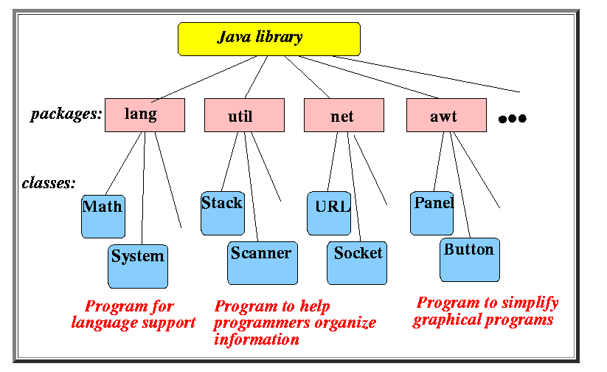

Slide 71
import statement is optional.
import java.util.*;
class MyDate extends Date
{
}
The same example without the import statement looks like this:
class MyDate extends java.util.Date
{
}

Slide 72
Multiple Inheritance
Multiple Inheritance is a feature of object-oriented concept, where a class can inherit properties of more than one parent class. The problem occurs when there exist methods with same signature in both the super classes and subclass. On calling the method, the compiler cannot determine which class method to be called and even on calling which class method gets the priority.

Slide 73
class Test extends Parent1, Parent2
{
public static void main(String args[])
{
Test t = new Test();
t.fun();
}
}
// First Parent class
class Parent1
{
void fun()
{
System.out.println("Parent1");
}
}
// Second Parent Class
class Parent2
{
void fun()
{
System.out.println("Parent2");
}
}

Slide 74
java supports multiple inheritance using interfaces not classes.
class Color
{
public void red()
{
System.out.println("Color Red");
}
}
interface IFlyable
{
void fly();
}
interface IEatable
{
void eat();
}

Slide 75
class Bird extends Color implements IFlyable,IEatable
{
//Implement method of interfaces
public void fly()
{
System.out.println("Bird flying");
}
public void eat()
{
System.out.println("Bird eats");
}
//It can have more own methods.
}

Slide 76
public class Program
{
public static void main(String[] args)
{
Bird b = new Bird();
b.eat();
b.fly();
b.red();
}
}

Slide 77
Hierarchical Inheritance
class Animal
{
void eat()
{
System.out.println("eating...");}
}
class Dog extends Animal
{
void bark()
{
System.out.println("barking...");
}
}
}
class Cat extends Animal
{
void meow()
{
System.out.println("meowing...");
}
}
class TestInheritance3
{
public static void main(String args[])
{
Cat c=new Cat();
c.meow();
c.eat();
c.bark();
}
}

Slide 78
Hybrid Inheritance
class GrandParent
{
void fun()
{
System.out.println("Grandparent");
}
}
// First Parent class
class Parent1 extends GrandParent
{
void fun()
{
System.out.println("Parent1");
}
}

Slide 79
class Parent2 extends GrandParent
{
void fun()
{
System.out.println("Parent2");
}
}
// Error : Test is inheriting from multiple
// classes
class Test extends Parent1, Parent2
{
public static void main(String args[])
{
Test t = new Test();
t.fun();
}
}

Slide 80
The above problems handled for Default Methods and Interfaces
interface PI1
{
// default method
default void show()
{
System.out.println("Default PI1");
}
}
interface PI2
{
// Default method
default void show()
{
System.out.println("Default PI2");
}
}

Slide 81
class TestClass implements PI1, PI2
{
// Overriding default show method
public void show()
{
// use super keyword to call the show
// method of PI1 interface
PI1.super.show();
// use super keyword to call the show
// method of PI2 interface
PI2.super.show();
}
public static void main(String args[])
{
TestClass d = new TestClass();
d.show();
}
}

Slide 82
Interfaces

Slide 83
An interface is basically a kind of class.
Like classes, interfaces contains method signatures and variables.
The difference is that interfaces define only abstract methods and final variables.
Interface do not specify any code to implement the methods.
Interfaces are designed to support dynamic method resolution at runtime.

Slide 84
Defining an interface
access interface name
{
return-type method-name1(parameter-list);
return-type method-name2(parameter-list);
type final-varname1 = value;
type final-varname2 = value;
// ...
return-type method-nameN(parameter-list);
type final-varnameN = value;
}
Methods are declared with no bodies.
All variables are implicitly final and static.

Slide 85
interface interfacename
{
variable declaration
method declaration
}
Example:
interface item
{
static final int code=1000;
void display();
}

Slide 86
Example
interface Callback
{
void callback(int param);
}
Implementing Interfaces
access class classname [extends superclass] [implements interface [,interface...]]
{
// class-body
}

Slide 87
class Client implements Callback
{
// Implement Callback's interface
public void callback(int p)
{
System.out.println("callback called with " + p);
}
}
When we implement an interface method, it must be declared as public.

Slide 88
We can also define additional members.
class Client implements Callback
{
// Implement Callback's interface
public void callback(int p)
{
System.out.println("callback called with " + p);
}
void nonIfaceMeth()
{
System.out.println(“Added method");
}
}

Slide 89
Accessing Implementations Through Interface References
class TestIface
{
public static void main(String args[])
{
Callback c = new Client();
c.callback(42);
}
}
c can be used to access the callback() method, it can not access any other members of the Client class.

Slide 90
// Another implementation of Callback.
class AnotherClient implements Callback
{
// Implement Callback's interface
public void callback(int p)
{
System.out.println("Another version of callback“+(p+10));
}
}

Slide 91
class TestIface2
{
public static void main(String args[])
{
Callback c = new Client();
AnotherClient ob = new AnotherClient();
c.callback(42);
c = ob; // c now refers to AnotherClient object
c.callback(42);
}
}
OUTPUT: callback called with 42
another version of callback 52.

Slide 92
Partial Implementations
If a class includes an interface but does not fully implement the methods defined by that interface, then that class must be declared as abstract.
For example:
abstract class Incomplete implements Callback
{
int a, b;
void show()
{
System.out.println(a + " " + b);
}
// ...
}

Slide 93
Nested interface
An interface can be declared a member of a class or another interface. Such interface is called a member interface.
Ex: class A
{
public interface prg
{
void disp();
}
}

Slide 94
Applying Interfaces
// Define an integer stack interface.
interface IntStack
{
void push(int item); // store an item
int pop(); // retrieve an item
}

Slide 95
// An implementation of IntStack that uses fixed storage.
class FixedStack implements IntStack
{
private int stck[];
private int tos;
// allocate and initialize stack
FixedStack(int size)
{
stck = new int[size];
tos = -1;
}
// Push an item onto the stack
public void push(int item)
{
if(tos==stck.length-1) // use length member
System.out.println("Stack is full.");
else
stck[++tos] = item;
}

Slide 96
// Pop an item from the stack
public int pop()
{
if(tos < 0)
{
System.out.println("Stack underflow.");
return 0;
}
else
return stck[tos--];
}
}

Slide 97
class IFTest
{
public static void main(String args[])
{
FixedStack mystack1 = new FixedStack(5);
FixedStack mystack2 = new FixedStack(8);
// push some numbers onto the stack
for(int i=0; i<5; i++) mystack1.push(i);
for(int i=0; i<8; i++) mystack2.push(i);
// pop those numbers off the stack
System.out.println("Stack in mystack1:");
for(int i=0; i<5; i++)
System.out.println(mystack1.pop());
System.out.println("Stack in mystack2:");
for(int i=0; i<8; i++)
System.out.println(mystack2.pop());
}
}

Slide 98
Variables in Interfaces
We can use interfaces to import shared constants into multiple classes by simply declaring an inteface that contains variables that are initialized to the desired values.
interface SharedConstants
{ int NO = 0;
int YES = 1;
int MAYBE = 2;
int LATER = 3;
}
class A implements SharedConstants
{ int x;
A() { x=1; }
int fun()
{
if (x > 1 ) return NO; else return YES;
}
}

Slide 99
Interfaces Can Be Extended
// One interface can extend another.
interface A
{
void meth1();
}
// B now includes meth1() and meth2() .
interface B extends A
{
void meth2();
}

Slide 100
// This class must implement all of A and B
class MyClass implements B
{
public void meth1()
{
System.out.println("Implement meth1().");
}
public void meth2()
{
System.out.println("Implement meth2().");
}
}

Slide 101
class prg
{
public static void main(String arg[])
{
MyClass ob = new MyClass();
ob.meth1();
ob.meth2();
}
}
Any class that implements an interface must implement all methods defined by that interface.

Slide 102
interface Area
{
final static float pi=3.14f;
float findArea(int x, int y);
}
class Rectangle implements Area
{
public float findArea(int x, int y)
{
return (x*y);
}
}
class Triangle implements Area
{
public float findArea(int x, int y)
{
return (x*y*1/2);
}
}

Slide 103
class interfacePrg
{
public static void main(String args[])
{
Rectangle r = new Rectangle();
Triangle t = new Triangle();
Area a;
a= r;
System.out.println("Area of rectangle ="+a.findArea(10,20));
a= t;
System.out.println("Area of triangle ="+a.findArea(5,10));
}
}

Slide 104
Abstract class | Interface
1) Abstract class can have abstract and non-abstract methods. | Interface can have only abstract methods.
2) Abstract class doesn't support multiple inheritance. | Interface supports multiple inheritance.
3) Abstract class can have final, non-final, static and non-static variables. | Interface has only static and final variables.
4) Abstract class can provide the implementation of interface. | Interface can't provide the implementation of abstract class.
5) The abstract keyword is used to declare abstract class. | The interface keyword is used to declare interface.
6)Example: public abstract class Shape { public abstract void draw(); } | Example: public interface Drawable { void draw(); }

Slide 105
interface calculate
{
void cal(int item);
}
class display implements calculate
{
int x;
public void cal(int item)
{
x = item * item;
}
}
class interfaces
{
public static void main(String args[])
{
display arr = new display;
arr.x = 0;
arr.cal(2);
System.out.print(arr.x);
}
}

Slide 106
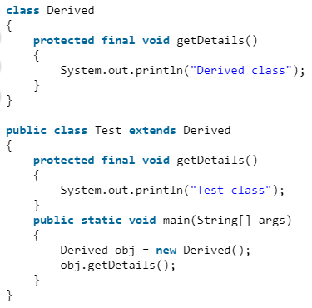

Slide 107
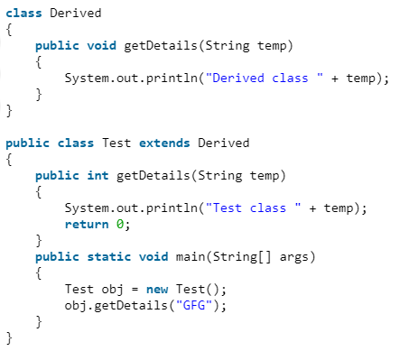

Slide 108
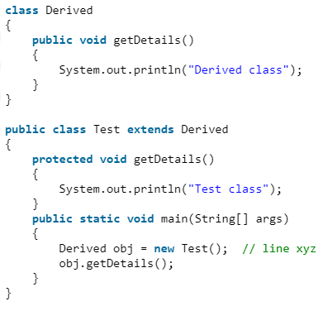

Slide 109
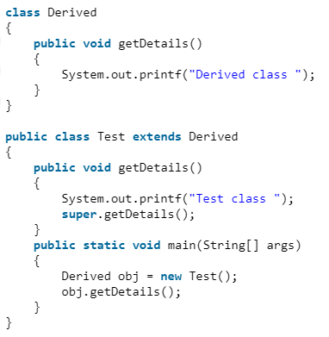

Slide 110
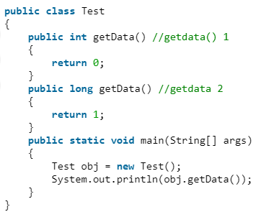

Slide 111
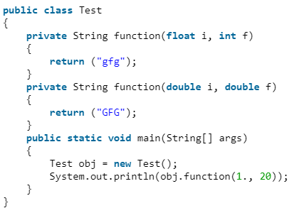

Slide 112
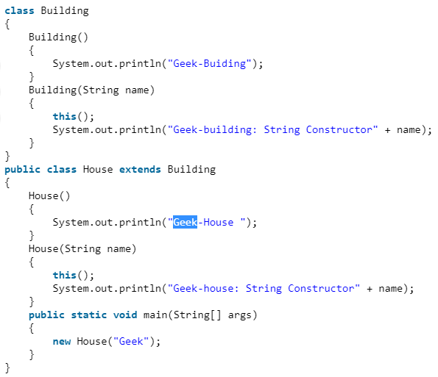

Slide 113
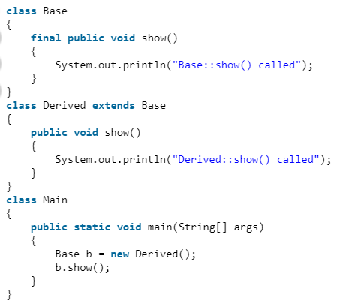

Slide 114
Exception Handling: Exception-Handling Fundamentals
An exception is an abnormal condition that arises in a code sequence at run time.
An exception is a run-time error.
In computer languages that do not support exception handling, errors must be checked and handled manually typically through the use of error codes, and so on.
Java’s exception handling avoids these problems.

Slide 115
Java try block is used to enclose the code that might throw an exception. It must be used within the method.
If an exception occurs at the statement of try block, the rest of the block code will not execute. So, it is recommended not to keeping the code in try block that will not throw an exception.
Java try block must be followed by either catch or finally block.
Java catch block is used to handle the Exception by declaring the type of exception within the parameter. The declared exception must be the parent class exception ( i.e., Exception) or the generated exception type. However, the good approach is to declare the generated type of exception.
The catch block must be used after the try block only. You can use multiple catch block with a single try block.

Slide 116
Java finally block is a block that is used to execute important code such as closing connection, stream etc.
Java finally block is always executed whether exception is handled or not.
Java finally block follows try or catch block.
The "throw" keyword is used to throw an exception.
The "throws" keyword is used to declare exceptions. It doesn't throw an exception. It specifies that there may occur an exception in the method. It is always used with method signature.

Slide 117
This is the general form of an exception-handling block:
try
{
// block of code to monitor for errors
}
catch (ExceptionType1 exOb)
{
// exception handler for ExceptionType1
}
catch (ExceptionType2 exOb)
{
// exception handler for ExceptionType2
}
// ...
finally
{
// block of code to be executed before try block ends
}

Slide 118
A Java exception is an object that describes an exceptional (that is, error) condition that has occurred in a piece of code.
When an exceptional condition arises, an object representing that exception is created and thrown in the method that caused the error.
Exceptions can be generated by the Java run-time system, or they can be manually generated by our code.

Slide 119
class Exc0
{
public static void main(String args[])
{
int d = 0;
int a = 42 / d;
System.out.println(“This code is safe”);
}
}

Slide 120
When the Java run-time system detects the attempt to divide by zero, it constructs a new exception object and then throws this exception.
This causes the execution of Exc0 to stop, because once an exception has been thrown, it must be caught by an exception handler and dealt with immediately.
Any exception that is not caught by our program will ultimately be processed by the default handler.
The default handler displays a string describing the exception, prints a stack trace from the point at which the exception occurred, and terminates the program.
Here is the output generated when this example is executed.
java.lang.ArithmeticException: / by zero
at Exc0.main(Exc0.java:4)

Slide 121
class Exc1
{
static void subroutine()
{
int d = 0;
int a = 10 / d;
}
public static void main(String args[])
{
Exc1.subroutine();
}
}

Slide 122
The resulting stack trace from the default exception handler shows how the entire call stack is displayed:
java.lang.ArithmeticException: / by zero
at Exc1.subroutine(Exc1.java:4)
at Exc1.main(Exc1.java:7)

Slide 123
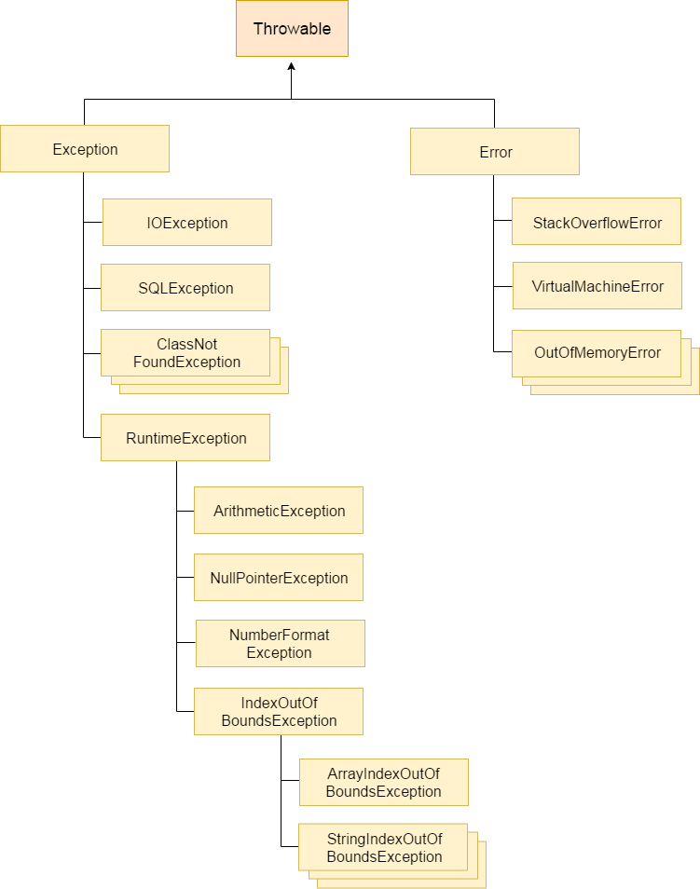
Exception Hierarchy

Slide 124
Types of Exceptions
In Java, exceptions are broadly categorized into two sections: checked exceptions and unchecked exceptions
Checked Exceptions – are the exceptions that are checked at compile time. If some code within a method throws a checked exception, then the method must either handle the exception or it must specify the exception using throws keyword. These are derived from the Exception class. For example, IOException and FileNotFoundException are checked exceptions.
Unchecked Exceptions – These are not recoverable and occur at runtime. These are derived from java.lang.RuntimeException class. For example, NullPointerException and IllegalArgumentException are unchecked exceptions.

Slide 125
Using try and catch
class Exc2
{
public static void main(String args[])
{ int d, a;
try
{ // monitor a block of code.
d = 0;
a = 42 / d;
System.out.println("This will not be printed.");
}
catch (ArithmeticException e)
{ // catch divide-by-zero error
System.out.println("Division by zero.");
}
System.out.println("After catch statement.");
}
}

Slide 126
This program generates the following output:
Division by zero.
After catch statement.

Slide 127
import java.util.Random;
class HandleError
{
public static void main(String args[])
{
int a=0, b=0, c=0;
Random r = new Random();
for(int i=0; i<32000; i++)
{
try
{
b = r.nextInt();
c = r.nextInt();
a = 12345 / (b/c);
}
catch (ArithmeticException e)
{
System.out.println("Division by zero.");
a = 0; // set a to zero and continue
}
System.out.println("a: " + a);
}}
}

Slide 128
Displaying a Description of an Exception
catch (ArithmeticException e)
{
System.out.println("Exception: " + e);
a = 0; // set a to zero and continue
}
When this version is substituted in the program, and the program is run, each divide-by-zero error displays the following message:
Exception: java.lang.ArithmeticException: / by zero

Slide 129
Multiple catch Clauses
class MultiCatch
{
public static void main(String args[])
{
try
{
int a = args.length;
System.out.println("a = " + a);
int b = 42 / a;
int c[] = { 1 };
c[42] = 99;
}
catch(ArithmeticException e)
{
System.out.println("Divide by 0: " + e);
}
catch(ArrayIndexOutOfBoundsException e)
{ System.out.println("Array index oob: " + e);
}
System.out.println("After try/catch blocks.");
}
}

Slide 130
C:\>java MultiCatch
a = 0
Divide by 0: java.lang.ArithmeticException: / by zero
After try/catch blocks.
C:\>java MultiCatch TestArg
a = 1
Array index oob: java.lang.ArrayIndexOutOfBoundsException
After try/catch blocks.

Slide 131
When we use multiple catch statements, it is important to remember that exception subclasses must come before any of their superclasses.
This is because a catch statement that uses a superclass will catch exceptions of that type plus any of its subclasses. Thus, a subclass would never be reached if it came after its superclass. Further, in Java, unreachable code is an error.
For example, consider the following program:

Slide 132
class SuperSubCatch
{
public static void main(String args[])
{
try
{
int a = 0;
int b = 42 / a;
}
catch(ArithmeticException e)
{ // ERROR - unreachable
System.out.println("This is never reached.");
}
catch(Exception e)
{
System.out.println("Generic Exception catch.");
}
}
}

Slide 133
If we try to compile this program, we will receive an error message stating that the second catch statement is unreachable because the exception has already been caught.
Since ArithmeticException is a subclass of Exception, the first catch statement will handle all Exception-
based errors, including ArithmeticException.
This means that the second catch statement will never execute.
To fix the problem, reverse the order of the catch statements.

Slide 134
Nested try Statements
class NestTry
{ public static void main(String args[])
{ try
{ int a = args.length;
int b = 42 / a;
System.out.println("a = " + a);
try
{ if(a==1)
a = a/(a-a); // division by zero
if(a==2)
{
int c[] = { 1 };
c[42] = 99; // generate an out-of-bounds exception
}
}
catch(ArrayIndexOutOfBoundsException e)
{ System.out.println("Array index out-of-bounds: " + e);
}
}
catch(ArithmeticException e)
{ System.out.println("Divide by 0: " + e);
}
}}

Slide 135
C:\>java NestTry
Divide by 0: java.lang.ArithmeticException: / by zero
C:\>java NestTry One
a = 1
Divide by 0: java.lang.ArithmeticException: / by zero
C:\>java NestTry One Two
a = 2
Array index out-of-bounds: java.lang.ArrayIndexOutOfBoundsException

Slide 136
/* Try statements can be implicitly nested via calls to methods. */
class MethNestTry
{ static void nesttry(int a)
{ try
{ if(a==1)
a = a/(a-a); // division by zero
if(a==2)
{ int c[] = { 1 };
c[42] = 99; // generate an out-of-bounds exception
}
}
catch(ArrayIndexOutOfBoundsException e)
{ System.out.println("Array index out-of-bounds: " + e); }
}
public static void main(String args[])
{ try { int a = args.length;
int b = 42 / a;
System.out.println("a = " + a);
nesttry(a);
}
catch(ArithmeticException e)
{ System.out.println("Divide by 0: " + e);
}
} }

Slide 137
throw
The throw keyword in Java is used to explicitly throw an exception from a method or any block of code. We can throw either checked or unchecked exception. The throw keyword is mainly used to throw custom exceptions.
The general form of throw is shown here:
throw ThrowableInstance;
The flow of execution of the program stops immediately after the throw statement is executed and the nearest enclosing try block is checked to see if it has a catch statement that matches the type of exception. If it finds a match, controlled is transferred to that statement otherwise next enclosing try block is checked and so on. If no matching catch is found then the default exception handler will halt the program.

Slide 138
Nested try Statements
// Demonstrate throw.
class ThrowDemo
{
static void demoproc()
{
try
{
throw new NullPointerException("demo");
}
catch(NullPointerException e)
{ System.out.println("Caught inside demoproc.");
throw e; // rethrow the exception
}
}

Slide 139
public static void main(String args[])
{
try
{
demoproc();
}
catch(NullPointerException e)
{
System.out.println("Recaught: " + e);
}
}
}
Caught inside demoproc.
Recaught: java.lang.NullPointerException: demo

Slide 140
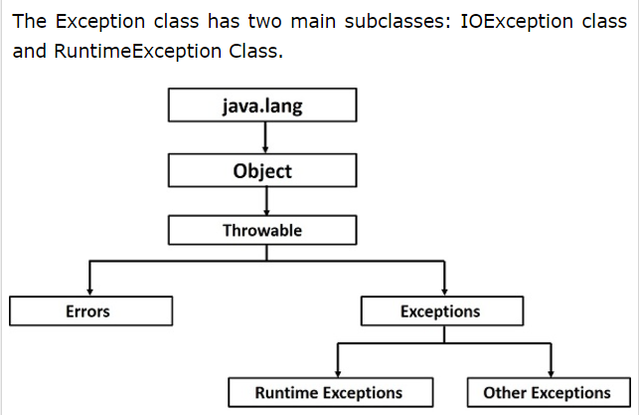
Exception Hierarchy

Slide 141
throws
If a method is capable of causing an exception that it does not handle, it must specify this behavior so that callers of the method can guard themselves against that exception.
We can do this by including a throws clause in the method’s declaration.
A throws clause lists the types of exceptions that a method might throw.

Slide 142
This is the general form of a method declaration that includes a throws clause:
type method-name(parameter-list) throws exception-list
{
// body of method
}
Here, exception-list is a comma-separated list of the exceptions that a method can throw.

Slide 143
// This program contains an error and will not compile.
class ThrowsDemo
{
static void throwOne()
{
System.out.println("Inside throwOne.");
throw new IllegalAccessException("demo");
}
public static void main(String args[])
{
throwOne();
}
}

Slide 144
// This is now correct.
class ThrowsDemo
{
static void throwOne() throws IllegalAccessException
{
System.out.println("Inside throwOne.");
throw new IllegalAccessException("demo");
}
public static void main(String args[])
{ try
{ throwOne();
}
catch (IllegalAccessException e)
{
System.out.println("Caught " + e);
}
}
}

Slide 145
Here is the output generated by running this example program:
inside throwOne
caught java.lang.IllegalAccessException: demo

Slide 146
import java.io.*;
class M
{
void method()throws IOException
{
throw new IOException("device error");
}
}
public class Testthrows2
{
public static void main(String args[])
{

Slide 147
try
{
M m=new M();
m.method();
}
catch(Exception e)
{
System.out.println("exception handled");
}
System.out.println("normal flow...");
}
}

Slide 148
The differences between throw and throws are:
Point of usage:
throw keyword is used inside a function. It is used when it is required to throw an Exception logically.
void Demo() throws ArithmeticException, NullPointerException
{
// Statements where exceptions might occur.
throw new ArithmeticException();
}
throws keyword is in the function signature. It is used when the function has some statements that can lead to some exceptions.
void Demo()
{
// Statements where exceptions might occur.
}

Slide 149
Number of exceptions thrown:
throw keyword is used to throw an exception explicitly. It can throw only one exception at a time.
For example:
throw new IOException();
throws keyword can be used to declare multiple exceptions, separated by comma. Whichever exception occurs, if matched with the declared ones, is thrown automatically then. For example:
// throwing multiple exceptions
void Demo() throws ArithmeticException, NullPointerException
{
// Statements where exceptions might occur.
}

Slide 150
Syntax:
Syntax of throw keyword includes the instance of the Exception to be thrown. For example:
throw new IOException();
Syntax of throws keyword includes the class names of the Exceptions to be thrown. For example:
// throwing multiple exceptions by class names
void Demo() throws ArithmeticException, NullPointerException
{
// Statements where exceptions might occur.
}

Slide 151
Propagation of Exceptions:
throw keyword cannot propagate checked exceptions. It is only used to propagate the unchecked Exceptions that are not checked using throws keyword.
For example:
void main() throws IOException
{
// Using throw for ArithmeticException
// as it is unchecked in throws
throw new ArithmeticException();
}
throws keyword is used to propagate the checked Exceptions only. For example:
void main() throws IOException
{
}

Slide 152
Checked Exceptions
SQLException
IOException
ClassNotFoundException
FileNotFoundException
Unchecked Exceptions
ArithmeticException
ArrayIndexOutOfBoundsException
NumberFormatException
NullPointerException
IllegalArgumentException

Slide 153
finally
finally executes a block of code that will be executed after a try/catch block has completed and before the code following the try/catch block.
The finally block will execute whether or not an exception is thrown.
If an exception is thrown, the finally block will execute even if no catch statement matches the exception.
Used to perform certain house-keeping operations such as closing files and releasing system resources.

Slide 154
class prg2
{
public static void main(String args[])
{
try
{ int a = 8/2;
}
catch(Exception e)
{
System.out.println("error"+e);
}
finally
{
System.out.println("finally");
}
System.out.println(“successful");
}
}

Slide 155
class prg2
{
public static void main(String args[])
{
try
{
int a = 8/0;
}
catch(Exception e)
{
System.out.println("error"+e);
}
finally
{
System.out.println("finally");
}
System.out.println(“successful");
}
}

Slide 156
// Demonstrate finally.
class FinallyDemo
{
static void procA()
{
try
{
System.out.println("inside procA");
throw new RuntimeException("demo");
}
finally
{
System.out.println("procA's finally");
}
}
// Return from within a try block.
static void procB()
{
try
{
System.out.println("inside procB");
return;
}
finally
{
System.out.println("procB's finally");
}
}

Slide 157
// Execute a try block normally.
static void procC()
{
try
{
System.out.println("inside procC");
}
finally
{
System.out.println("procC's finally");
}
}
public static void main(String args[])
{
try
{ procA();
}
catch (Exception e)
{ System.out.println("Exception caught");
}
procB();
procC();
}
}

Slide 158
Here is the output generated by the preceding program:
inside procA
procA’s finally
Exception caught
inside procB
procB’s finally
inside procC
procC’s finally

Slide 159
Creating our Own Exception Subclasses
// This program creates a custom exception type.
class MyException extends Exception
{
private int detail;
MyException(int a)
{
detail = a;
}
public String toString()
{
return "MyException[" + detail + "]";
}
}

Slide 160
class ExceptionDemo
{
static void compute(int a) throws MyException
{
System.out.println("Called compute(" + a + ")");
if(a > 10)
throw new MyException(a);
System.out.println("Normal exit");
}
public static void main(String args[])
{
try
{
compute(1);
compute(20);
}
catch (MyException e)
{
System.out.println("Caught " + e);
}
}
}

Slide 161
Called compute(1)
Normal exit
Called compute(20)
Caught MyException[20]

Slide 162
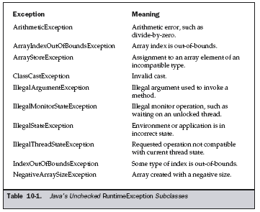
Java’s Built-in Exceptions

Slide 163
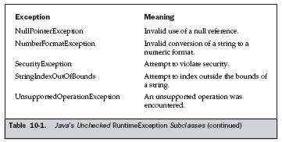

Slide 164
