Slide 1
Unit-3
Multithreaded Programming &
Input / Output

Slide 2
The Java Thread Model
The Java run-time system depends on threads for many things, and all the class libraries are designed with multithreading in mind. In fact, Java uses threads to enable the entire environment to be asynchronous. This helps reduce inefficiency by preventing the waste of CPU cycles.
Single-threaded systems use an approach called an event loop with polling. Once this polling mechanism returns with, say, a signal that a network file is ready to be read, then the event loop dispatches control to the appropriate event handler. Until this event handler returns, nothing else can happen in the system. This wastes CPU time. It can also result in one part of a program dominating the system and preventing any other events from being processed.
The benefit of Java’s multithreading is that the main loop/polling mechanism is eliminated.

Slide 3
Threads exist in several states:
A thread can be running. It can be ready to run as soon as it gets CPU time.
A running thread can be suspended, which temporarily suspends its activity.
A suspended thread can then be resumed, allowing it to pick up where it left off.
A thread can be blocked when waiting for a resource.
At any time, a thread can be terminated, which halts its execution immediately. Once terminated, a thread cannot be resumed.

Slide 4
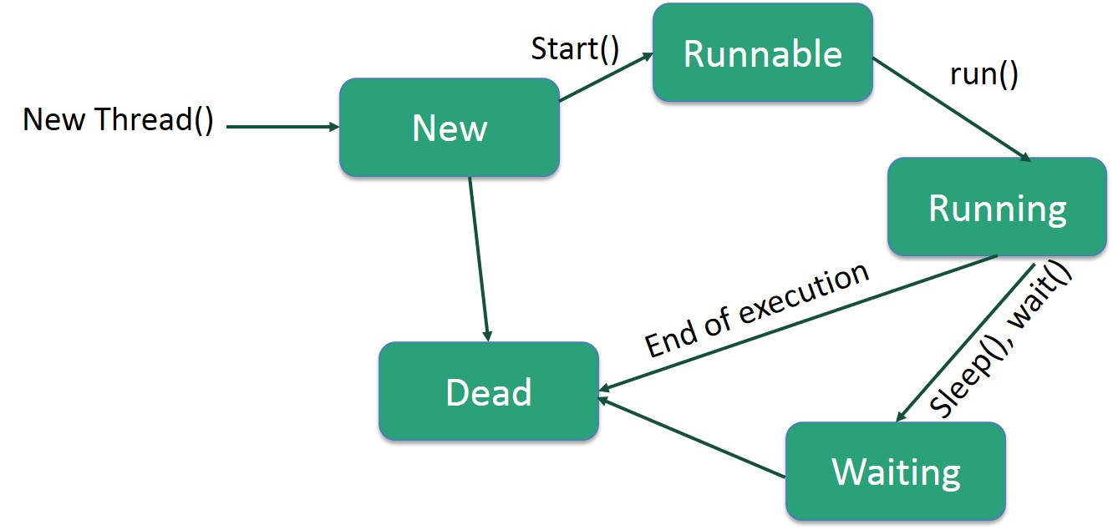
Life Cycle of a Thread
A thread goes through various stages in its life cycle. For example, a thread is born, started, runs, and then dies. The following diagram shows the complete life cycle of a thread.

Slide 5
Following are the stages of the life cycle −
New − A new thread begins its life cycle in the new state. It remains in this state until the program starts the thread. It is also referred to as a born thread.
Runnable − After a newly born thread is started, the thread becomes runnable. A thread in this state is considered to be executing its task.
Waiting − Sometimes, a thread transitions to the waiting state while the thread waits for another thread to perform a task. A thread transitions back to the runnable state only when another thread signals the waiting thread to continue executing.
Timed Waiting − A runnable thread can enter the timed waiting state for a specified interval of time. A thread in this state transitions back to the runnable state when that time interval expires or when the event it is waiting for occurs.
Terminated (Dead) − A runnable thread enters the terminated state when it completes its task or otherwise terminates.

Slide 6
Java Thread Priority in Multithreading
Java assigns to each thread a priority that determines how that thread should be treated with respect to the others. Thread priorities are integers that specify the relative priority of one thread to another.
Whenever we create a thread in Java, it always has some priority assigned to it. Priority can either be given by JVM while creating the thread or it can be given by programmer explicitly. Accepted value of priority for a thread is in range of 1 to 10. There are 3 static variables defined in Thread class for priority.
public static int MIN_PRIORITY: This is minimum priority that a thread can have. Value for this is 1.
public static int NORM_PRIORITY: This is default priority of a thread if do not explicitly define it. Value for this is 5.
public static int MAX_PRIORITY: This is maximum priority of a thread. Value for this is 10.

Slide 7
Synchronization
Because multithreading introduces an asynchronous behavior to your programs, there must be a way for you to enforce synchronicity when you need it.
For example, if you want two threads to communicate and share a complicated data structure, such as a linked list, you need some way to ensure that they don’t conflict with each other. That is, you must prevent one thread from writing data while another thread is in the middle of reading it.
For this purpose, Java implements an elegant twist on an age-old model of inter-process synchronization: the monitor.
The monitor is a control mechanism first defined by C.A.R. Hoare. You can think of a monitor as a very small box that can hold only one thread. Once a thread enters a monitor, all other threads must wait until that thread exits the monitor. In this way, a monitor can be used to protect a shared asset from being manipulated by more than one thread at a time.

Slide 8
The Thread Class and the Runnable Interface
Java’s multithreading system is built upon the Thread class, its methods, and its companion interface, Runnable.
Thread encapsulates a thread of execution. Since you can’t directly refer to the ethereal state of a running thread, you will deal with it through its proxy, the Thread instance that spawned it.
To create a new thread, your program will either extend Thread or implement the Runnable interface.

Slide 9
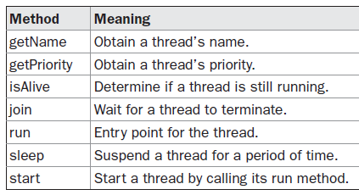
The Thread class defines several methods that help manage threads:

Slide 10
The Main Thread
When a Java program starts up, one thread begins running immediately. This is usually called the main thread of your program, because it is the one that is executed when your program begins.
The main thread is important for two reasons:
• It is the thread from which other “child” threads will be spawned.
• Often, it must be the last thread to finish execution because it performs various shutdown actions.
Although the main thread is created automatically when your program is started, it can be controlled through a Thread object. To do so, you must obtain a reference to it by calling the method currentThread( ), which is a public static member of Thread.
Its general form is shown here: static Thread currentThread( )
This method returns a reference to the thread in which it is called. Once you have a reference to the main thread, you can control it just like any other thread.

Slide 11
class CurrentThreadDemo
{
public static void main(String args[])
{
Thread t = Thread.currentThread();
System.out.println("Current thread: " + t);
t.setName("My Thread");
System.out.println("After name change: " + t);
try {
for(int n = 5; n > 0; n--)
{
System.out.println(n);
Thread.sleep(1000);
}
}
catch (InterruptedException e) {
System.out.println("Main thread interrupted");}
}
}

Slide 12
Creating a Thread
In the most general sense, you create a thread by instantiating an object of type Thread.
Java defines two ways in which this can be accomplished:
• You can implement the Runnable interface.
• You can extend the Thread class, itself.
The following two sections look at each method, in turn.

Slide 13
Implementing Runnable
The easiest way to create a thread is to create a class that implements the Runnable interface.
Runnable abstracts a unit of executable code. You can construct a thread on any object that implements Runnable. To implement Runnable, a class need only implement a single method called run( ), which is declared like this:
public void run( )
Inside run( ), you will define the code that constitutes the new thread. It is important to understand that run( ) can call other methods, use other classes, and declare variables, just like the main thread can.
The only difference is that run( ) establishes the entry point for another, concurrent thread of execution within your program. This thread will end when run( ) returns.

Slide 14
After you create a class that implements Runnable, you will instantiate an object of type
Thread from within that class. Thread defines several constructors. The one that we will use is shown here:
Thread(Runnable threadOb, String threadName)
In this constructor, threadOb is an instance of a class that implements the Runnable interface. This defines where execution of the thread will begin. The name of the new thread is specified by threadName.
After the new thread is created, it will not start running until you call its start( ) method, which is declared within Thread. In essence, start( ) executes a call to run( ). The start( ) method is shown here:
void start( )

Slide 15
class NewThread implements Runnable
{
Thread t;
NewThread()
{
t = new Thread(this, "Demo Thread");
System.out.println("Child thread: " + t);
t.start(); // Start the thread
}

Slide 16
public void run()
{
try
{
for(int i = 5; i > 0; i--)
{
System.out.println("Child Thread: " + i);
Thread.sleep(500);
}
}
catch (InterruptedException e)
{
System.out.println("Child interrupted.");
}
System.out.println("Exiting child thread.");
}
}

Slide 17
class ThreadDemo
{
public static void main(String args[])
{
new NewThread(); // create a new thread
try
{
for(int i = 5; i > 0; i--)
{
System.out.println("Main Thread: " + i);
Thread.sleep(1000);
}
}
catch (InterruptedException e)
{
System.out.println("Main thread interrupted.");
}
System.out.println("Main thread exiting.");
}
}

Slide 18
Extending Thread
The second way to create a thread is to create a new class that extends Thread, and then to create an instance of that class. The extending class must override the run( ) method, which is the entry point for the new thread. It must also call start( ) to begin execution of the new thread. Here is the preceding program rewritten to extend Thread:
class NewThread extends Thread
{
NewThread()
{
// Create a new, second thread
super("Demo Thread");
System.out.println("Child thread: " + this);
start(); // Start the thread
}

Slide 19
// This is the entry point for the second thread.
public void run()
{
try
{
for(int i = 5; i > 0; i--)
{
System.out.println("Child Thread: " + i);
Thread.sleep(500);
}
}
catch (InterruptedException e)
{
System.out.println("Child interrupted.");
}
System.out.println("Exiting child thread.");
}
}

Slide 20
class ExtendThread
{
public static void main(String args[])
{
new NewThread(); // create a new thread
try
{
for(int i = 5; i > 0; i--)
{
System.out.println("Main Thread: " + i);
Thread.sleep(1000);
}
}
catch (InterruptedException e)
{
System.out.println("Main thread interrupted.");
}
System.out.println("Main thread exiting.");
}
}

Slide 21
class MultiThreadDemo {
public static void main(String args[]) {
new NewThread("One"); // start threads
new NewThread("Two");
new NewThread("Three");
try {
// wait for other threads to end
Thread.sleep(10000);
} catch (InterruptedException e) {
System.out.println("Main thread Interrupted");
}
System.out.println("Main thread exiting.");
}
}
class NewThread implements Runnable {
String name; // name of thread
Thread t;
NewThread(String threadname) {
name = threadname;
t = new Thread(this, name);
System.out.println("New thread: " + t);
t.start(); // Start the thread
}
// This is the entry point for thread.
public void run() {
try {
for(int i = 5; i > 0; i--) {
System.out.println(name + ": " + i);
Thread.sleep(1000);
}
} catch (InterruptedException e) {
System.out.println(name + "Interrupted");
}
System.out.println(name + " exiting.");
}
}

Slide 22
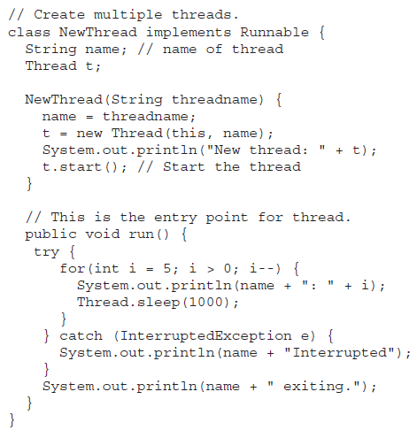
Creating Multiple Threads

Slide 23
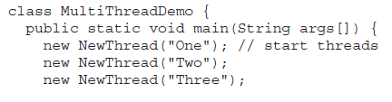
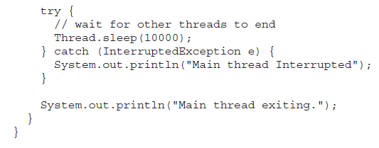

Slide 24
isAlive() and join() methods of Thread Class in Java
How can one thread know when another thread has ended? Thread provides a means by which you can answer this question. Java multi-threading provides two ways to find that
isAlive() : It tests if this thread is alive. A thread is alive if it has been started and has not yet died. There is a transitional period from when a thread is running to when a thread is not running. After the run() method returns, there is a short period of time before the thread stops. If we want to know if the start method of the thread has been called or if thread has been terminated, we must use isAlive() method. This method is used to find out if a thread has actually been started and has yet not terminated.

Slide 25
join() : When the join() method is called, the current thread will simply wait until the thread it is joining with is no longer alive. Or we can say the method that you will more commonly use to wait for a thread to finish is called join( ).
final void join( ) throws InterruptedException
This method waits until the thread on which it is called terminates. Its name comes from the concept of the calling thread waiting until the specified thread joins it. Additional forms of join( ) allow you to specify a maximum amount of time that you want to wait for the specified thread to terminate.
Example demonstrates that uses join( ) to ensure that the main thread is the last to stop. It also demonstrates the isAlive( ) method.

Slide 26
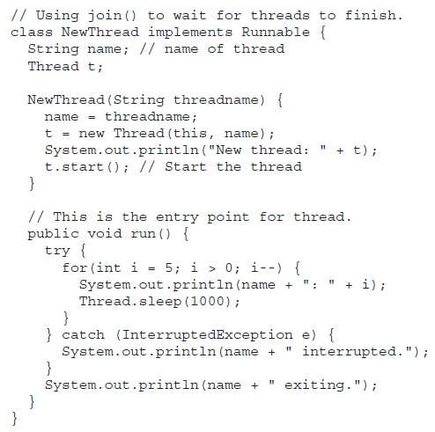

Slide 27
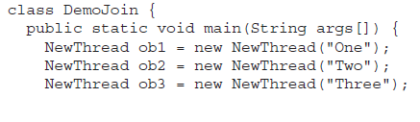

Slide 28
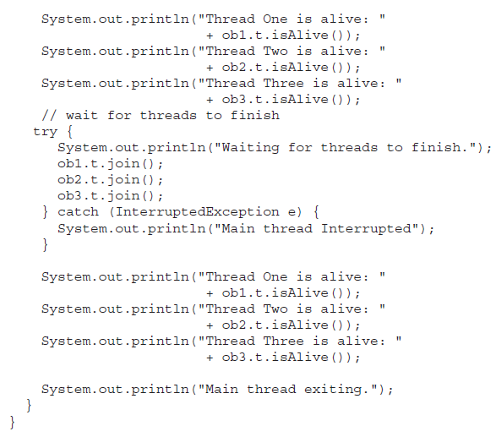

Slide 29
// Using join() to wait for threads to finish.
class NewThread implements Runnable {
String name; // name of thread
Thread t;
NewThread(String threadname) {
name = threadname;
t = new Thread(this, name);
System.out.println("New thread: " + t);
t.start(); // Start the thread
}
// This is the entry point for thread.
public void run() {
try {
for(int i = 5; i > 0; i--) {
System.out.println(name + ": " + i);
Thread.sleep(1000);
}
} catch (InterruptedException e) {
System.out.println(name + " interrupted.");
}
System.out.println(name + " exiting.");
}
}
class DemoJoin {
public static void main(String args[]) {
NewThread ob1 = new NewThread("One");
NewThread ob2 = new NewThread("Two");
NewThread ob3 = new NewThread("Three");
System.out.println("Thread One is alive: "
+ ob1.t.isAlive());
System.out.println("Thread Two is alive: "
+ ob2.t.isAlive());
System.out.println("Thread Three is alive: "
+ ob3.t.isAlive());
// wait for threads to finish
try {
System.out.println("Waiting for threads to finish.");
ob1.t.join();
ob2.t.join();
ob3.t.join();
} catch (InterruptedException e) {
System.out.println("Main thread Interrupted");
}
System.out.println("Thread One is alive: "
+ ob1.t.isAlive());
System.out.println("Thread Two is alive: "
+ ob2.t.isAlive());
System.out.println("Thread Three is alive: "
+ ob3.t.isAlive());
System.out.println("Main thread exiting.");
}
}

Slide 30
Thread Priorities
Thread priorities are used by the thread scheduler to decide when each thread should be allowed to run.
In theory, higher-priority threads get more CPU time than lower-priority threads.
In practice, the amount of CPU time that a thread gets often depends on several factors besides its priority.
A higher-priority thread can also preempt a lower-priority one. For instance, when a lower-priority thread is running and a higher-priority thread resumes (from sleeping or waiting on I/O, for example), it will preempt the lower priority thread.

Slide 31
To set a thread’s priority, use the setPriority( ) method, which is a member of Thread.
This is its general form:
final void setPriority(int level)
Here, level specifies the new priority setting for the calling thread. The value of level must be within the range MIN_PRIORITY and MAX_PRIORITY. Currently, these values are 1 and 10, respectively.
To return a thread to default priority, specify NORM_PRIORITY, which is currently 5. These priorities are defined as static final variables within Thread.
You can obtain the current priority setting by calling the getPriority( ) method of Thread, shown here:
final int getPriority( )

Slide 32
import java.lang.*;
class ThreadDemo extends Thread
{
public void run()
{
System.out.println("Inside run method");
}
public static void main(String[]args)
{
ThreadDemo t1 = new ThreadDemo();
ThreadDemo t2 = new ThreadDemo();
ThreadDemo t3 = new ThreadDemo();
System.out.println("t1 thread priority : " + t1.getPriority()); // Default 5
System.out.println("t2 thread priority : " + t2.getPriority()); // Default 5
System.out.println("t3 thread priority : " + t3.getPriority()); // Default 5

Slide 33
t1.setPriority(2);
t2.setPriority(5);
t3.setPriority(8);
// t3.setPriority(21); will throw IllegalArgumentException
System.out.println("t1 thread priority : " + t1.getPriority()); //2
System.out.println("t2 thread priority : " + t2.getPriority()); //5
System.out.println("t3 thread priority : " + t3.getPriority());//8
System.out.print(Thread.currentThread().getName());
System.out.println("Main thread priority : "+ Thread.currentThread().getPriority());
Thread.currentThread().setPriority(10);
System.out.println("Main thread priority : "+ Thread.currentThread().getPriority());
}
}

Slide 34
import java.lang.*;
class ThreadDemo extends Thread
{
public void run()
{
System.out.println("Inside run method");
}
public static void main(String[]args)
{
Thread.currentThread().setPriority(6);
System.out.println("main thread priority : " + Thread.currentThread().getPriority());
ThreadDemo t1 = new ThreadDemo();
System.out.println("t1 thread priority : “ + t1.getPriority());
}
}

Slide 35
Synchronization
When two or more threads need access to a shared resource, they need some way to ensure that the resource will be used by only one thread at a time. The process by which this is achieved is called synchronization.
Key to synchronization is the concept of the monitor (also called a semaphore). A monitor is an object that is used as a mutually exclusive lock, or mutex. Only one thread can own a monitor at a given time. When a thread acquires a lock, it is said to have entered the monitor.
All other threads attempting to enter the locked monitor will be suspended until the first thread exits the monitor. These other threads are said to be waiting for the monitor. A thread that owns a monitor can reenter the same monitor if it so desires.

Slide 36
Java provides a way of creating threads and synchronizing their task by using synchronized blocks. Synchronized blocks in Java are marked with the synchronized keyword. A synchronized block in Java is synchronized on some object. All synchronized blocks synchronized on the same object can only have one thread executing inside them at a time. All other threads attempting to enter the synchronized block are blocked until the thread inside the synchronized block exits the block.

Slide 37
class PrintDemo
{
public void printCount()
{
try
{
for(int i = 5; i > 0; i--)
{
System.out.println("Counter --- " + i );
}
}
catch (Exception e)
{
System.out.println("Thread interrupted.");
}
}
}

Slide 38
class ThreadDemo extends Thread
{
private Thread t;
private String threadName;
PrintDemo PD;
ThreadDemo( String name, PrintDemo pd)
{
threadName = name;
PD = pd;
}
public void run()
{
synchronized(PD)
{
PD.printCount();
}
System.out.println("Thread " + threadName + " exiting.");
}

Slide 39
public void start ()
{
System.out.println("Starting " + threadName );
if (t == null)
{
t = new Thread (this, threadName);
t.start ();
}
}
}

Slide 40
public class TestThread
{
public static void main(String args[])
{
PrintDemo PD = new PrintDemo();
ThreadDemo T1 = new ThreadDemo( "Thread - 1 ", PD );
ThreadDemo T2 = new ThreadDemo( "Thread - 2 ", PD );
T1.start();
T2.start();
try
{
T1.join();
T2.join();
}
catch ( Exception e)
{
System.out.println("Interrupted");
}
}
}

Slide 41
Inter-thread communication in Java
Inter-thread communication or Co-operation is all about allowing synchronized threads to communicate with each other.
Cooperation (Inter-thread communication) is a mechanism in which a thread is paused running in its critical section and another thread is allowed to enter (or lock) in the same critical section to be executed. It is implemented by following methods of Object class:
wait()
notify()
notifyAll()

Slide 42
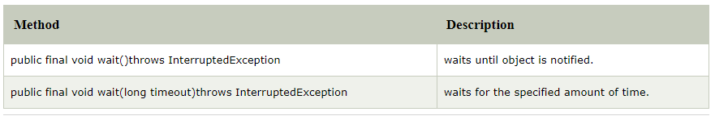
wait() method
Causes current thread to release the lock and wait until either another thread invokes the notify() method or the notifyAll() method for this object, or a specified amount of time has elapsed. The current thread must own this object's monitor, so it must be called from the synchronized method only otherwise it will throw exception.

Slide 43
notify() method
Wakes up a single thread that is waiting on this object's monitor. If any threads are waiting on this object, one of them is chosen to be awakened. The choice is arbitrary and occurs at the discretion of the implementation. Syntax:
public final void notify()
notifyAll() method
Wakes up all threads that are waiting on this object's monitor. Syntax:
public final void notifyAll()

Slide 44
Threads enter to acquire lock.
Lock is acquired by one thread.
Now thread goes to waiting state if you call wait() method on the object. Otherwise, it releases the lock and exits.
If you call notify() or notifyAll() method, thread moves to the notified state (runnable state).
Now thread is available to acquire lock.
After completion of the task, thread releases the lock and exits the monitor state of the object.

Slide 45
class Customer
{
int amount=10000;
synchronized void withdraw(int amount)
{
System.out.println("going to withdraw...");
if(this.amount<amount)
{
System.out.println("Less balance; waiting for deposit...");
try{wait();}
catch(Exception e){}
}
this.amount-=amount;
System.out.println("withdraw completed...");
}

Slide 46
synchronized void deposit(int amount)
{
System.out.println("going to deposit...");
this.amount+=amount;
System.out.println("deposit completed... ");
notify();
}
}

Slide 47
class Test
{
public static void main(String args[])
{
final Customer c=new Customer();
new Thread()
{
public void run()
{
c.withdraw(15000);
}
}.start();
new Thread()
{
public void run()
{
c.deposit(10000);
}
}.start();
}
}

Slide 48
Deadlock in Java
Deadlock in java is a part of multithreading. Deadlock can occur in a situation when a thread is waiting for an object lock, that is acquired by another thread and second thread is waiting for an object lock that is acquired by first thread. Since, both threads are waiting for each other to release the lock, the condition is called deadlock.

Slide 49
public class TestDeadlockExample1
{
public static void main(String[] args)
{
final String resource1 = "ratan jaiswal";
final String resource2 = "vimal jaiswal";
Thread t1 = new Thread()
{
public void run()
{
synchronized (resource1)
{
System.out.println("Thread 1: locked resource 1");
try { Thread.sleep(100);} catch (Exception e) {}
synchronized (resource2)
{
System.out.println("Thread 1: locked resource 2");
}
}
}
};

Slide 50
Thread t2 = new Thread()
{
public void run()
{
synchronized (resource2)
{
System.out.println("Thread 2: locked resource 2");
try { Thread.sleep(100);} catch (Exception e) {}
synchronized (resource1)
{
System.out.println("Thread 2: locked resource 1");
}
}
}
};
t1.start();
t2.start();
}
}

Slide 51
Suspending, Resuming, and Stopping Threads
A thread is automatically destroyed when the run() method has completed. But it might be required to kill/stop a thread before it has completed its life cycle. Previously, methods suspend(), resume() and stop() were used to manage the execution of threads. But these methods were deprecated by Java 2 because they could result in system failures. Modern ways to suspend/stop a thread are by using a boolean flag and Thread.interrupt() method.
Suspend() method is deadlock prone. If the target thread holds a lock on object when it is suspended, no thread can lock this object until the target thread is resumed. Calling suspend() will put thread in waiting state.

Slide 52
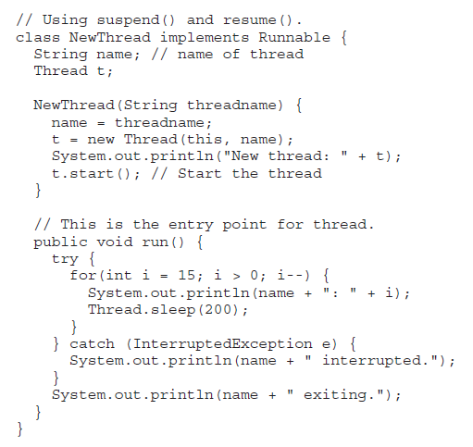

Slide 53
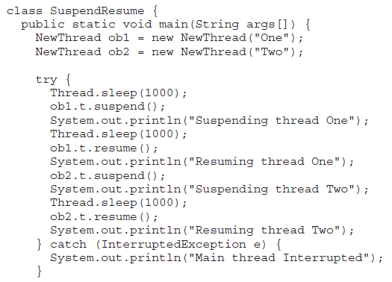

Slide 54
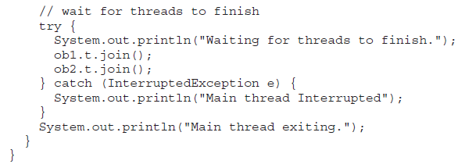

Slide 55
One: 10
One: 9
One: 8
One: 7
One: 6
Resuming thread Two
Waiting for threads to finish.
Two: 5
One: 5
Two: 4
One: 4
Two: 3
One: 3
Two: 2
One: 2
Two: 1
One: 1
Two exiting.
One exiting.
Main thread exiting.
New thread: Thread[One,5,main]
One: 15
New thread: Thread[Two,5,main]
Two: 15
One: 14
Two: 14
One: 13
Two: 13
One: 12
Two: 12
One: 11
Two: 11
Suspending thread One
Two: 10
Two: 9
Two: 8
Two: 7
Two: 6
Resuming thread One
Suspending thread Two

Slide 56
Lifecycle and States of a Thread in Java
A thread in Java at any point of time exists in any one of the following states. A thread lies only in one of the shown states at any instant:
New
Runnable
Blocked
Waiting
Timed Waiting
Terminated

Slide 57
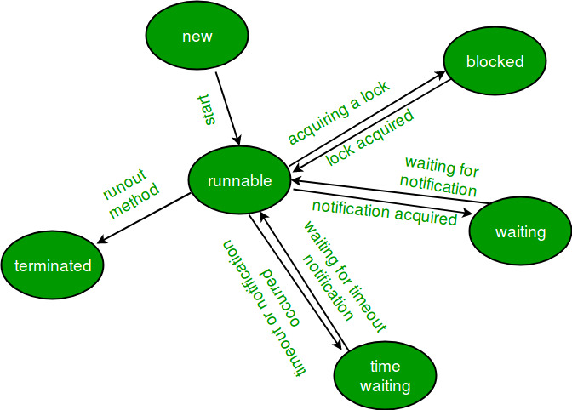
The diagram shown below represent various states of a thread at any instant of time.

Slide 58
New Thread: When a new thread is created, it is in the new state. The thread has not yet started to run when thread is in this state. When a thread lies in the new state, it’s code is yet to be run and hasn’t started to execute.
Runnable State: A thread that is ready to run is moved to runnable state. In this state, a thread might actually be running or it might be ready run at any instant of time. It is the responsibility of the thread scheduler to give the thread, time to run. A multi-threaded program allocates a fixed amount of time to each individual thread. Each and every thread runs for a short while and then pauses and relinquishes the CPU to another thread, so that other threads can get a chance to run. When this happens, all such threads that are ready to run, waiting for the CPU and the currently running thread lies in runnable state.

Slide 59
Blocked/Waiting state: When a thread is temporarily inactive, then it’s in one of the following states:
Blocked
Waiting
For example, when a thread is waiting for I/O to complete, it lies in the blocked state. It’s the responsibility of the thread scheduler to reactivate and schedule a blocked/waiting thread. A thread in this state cannot continue its execution any further until it is moved to runnable state. Any thread in these states does not consume any CPU cycle.
A thread is in the blocked state when it tries to access a protected section of code that is currently locked by some other thread. When the protected section is unlocked, the schedule picks one of the thread which is blocked for that section and moves it to the runnable state. Whereas, a thread is in the waiting state when it waits for another thread on a condition. When this condition is fulfilled, the scheduler is notified and the waiting thread is moved to runnable state.
If a currently running thread is moved to blocked/waiting state, another thread in the runnable state is scheduled by the thread scheduler to run. It is the responsibility of thread scheduler to determine which thread to run.

Slide 60
Timed Waiting: A thread lies in timed waiting state when it calls a method with a time out parameter. A thread lies in this state until the timeout is completed or until a notification is received. For example, when a thread calls sleep or a conditional wait, it is moved to a timed waiting state.
Terminated State: A thread terminates because of either of the following reasons:
Because it exists normally. This happens when the code of thread has entirely executed by the program.
Because there occurred some unusual erroneous event, like segmentation fault or an unhandled exception.
A thread that lies in a terminated state does no longer consumes any cycles of CPU.

Slide 61
Timed Waiting: A thread lies in timed waiting state when it calls a method with a time out parameter. A thread lies in this state until the timeout is completed or until a notification is received. For example, when a thread calls sleep or a conditional wait, it is moved to a timed waiting state.
Terminated State: A thread terminates because of either of the following reasons:
Because it exists normally. This happens when the code of thread has entirely executed by the program.
Because there occurred some unusual erroneous event, like segmentation fault or an unhandled exception.
A thread that lies in a terminated state does no longer consumes any cycles of CPU.
In Java, to get the current state of the thread, use Thread.getState() method to get the current state of the thread. Java provides java.lang.Thread.State class that defines the ENUM constants for the state of a thread.

Slide 62
class thread implements Runnable
{
public void run()
{
try
{
Thread.sleep(1500);
}
catch (InterruptedException e)
{
e.printStackTrace();
}
System.out.println("State of thread1 while it called join() method on thread2 -"+ Test.thread1.getState());

Slide 63
try
{
Thread.sleep(200);
}
catch (InterruptedException e)
{
e.printStackTrace();
}
}
}

Slide 64
public class Test implements Runnable
{
public static Thread thread1;
public static Test obj;
public static void main(String[] args)
{
obj = new Test();
thread1 = new Thread(obj);
System.out.println("State of thread1 after creating it - " + thread1.getState());
thread1.start();
System.out.println("State of thread1 after calling .start() method on it - " +
thread1.getState());
}

Slide 65
public void run()
{
thread myThread = new thread();
Thread thread2 = new Thread(myThread);
// thread1 created and is currently in the NEW state.
System.out.println("State of thread2 after creating it - "+ thread2.getState());
thread2.start();
// thread2 moved to Runnable state
System.out.println("State of thread2 after calling .start() method on it - " +
thread2.getState());
// moving thread1 to timed waiting state

Slide 66
try
{
//moving thread1 to timed waiting state
Thread.sleep(200);
}
catch (InterruptedException e)
{
e.printStackTrace();
}
System.out.println("State of thread2 after calling .sleep() method on it - "+
thread2.getState() );

Slide 67
try
{
// waiting for thread2 to die
thread2.join();
}
catch (InterruptedException e)
{
e.printStackTrace();
}
System.out.println("State of thread2 when it has finished it's execution - " +
thread2.getState());
}
}

Slide 68
Input / Output

Slide 69
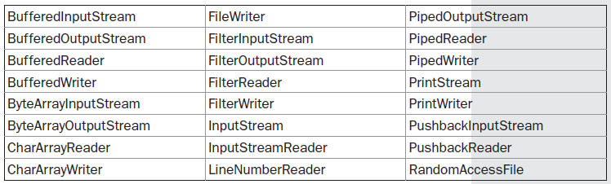
The Java I/O Classes and Interfaces:
The I/O classes defined by java.io are listed here:

Slide 70
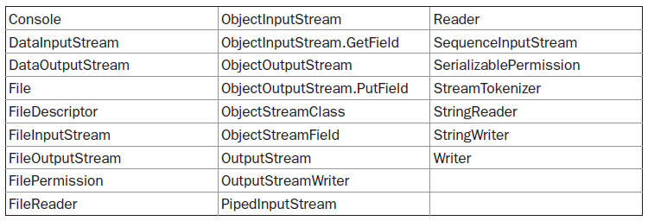
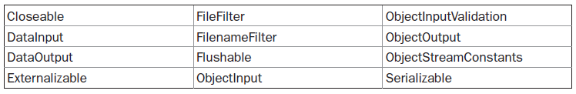
The following interfaces are defined by java.io:

Slide 71
File
Although most of the classes defined by java.io operate on streams, the File class does not.
It deals directly with files and the file system. That is, the File class does not specify how information is retrieved from or stored in files; it describes the properties of a file itself.
A File object is used to obtain or manipulate the information associated with a disk file, such as the permissions, time, date, and directory path, and to navigate subdirectory hierarchies.

Slide 72
The following constructors can be used to create File objects:
File(String directoryPath)
File(String directoryPath, String filename)
File(File dirObj, String filename)
File(URI uriObj)
Here, directoryPath is the path name of the file, filename is the name of the file or subdirectory, dirObj is a File object that specifies a directory, and uriObj is a URI object that describes a file.

Slide 73
The following example creates three files: f1, f2, and f3. The first File object is constructed with a directory path as the only argument. The second includes two arguments; the path and the filename. The third includes the file path assigned to f1 and a filename; f3 refers to the same file as f2.
File f1 = new File("/");
File f2 = new File("/","autoexec.bat");
File f3 = new File(f1,"autoexec.bat");

Slide 74
The following example creates three files: f1, f2, and f3. The first File object is constructed with a directory path as the only argument. The second includes two arguments; the path and the filename. The third includes the file path assigned to f1 and a filename; f3 refers to the same file as f2.
File f1 = new File("/");
File f2 = new File("/","autoexec.bat");
File f3 = new File(f1,"autoexec.bat");
NOTE:
Java does the right thing with path separators between UNIX and Windows conventions. If you use a forward slash (/) on a Windows version of Java, the path will still resolve correctly. Remember, if you are using the Windows convention of a backslash character (\), you will need to use its escape sequence (\\) within a string.

Slide 75
File defines many methods that obtain the standard properties of a File object. For example, getName( ) returns the name of the file, getParent( ) returns the name of the parent directory, and exists( ) returns true if the file exists, false if it does not.

Slide 76
import java.io.File;
class FileDemo {
static void p(String s) {
System.out.println(s);
}
public static void main(String args[]) {
File f1 = new File("/java/COPYRIGHT");
p("File Name: " + f1.getName());
p("Path: " + f1.getPath());
p("Abs Path: " + f1.getAbsolutePath());
p("Parent: " + f1.getParent());
p(f1.exists() ? "exists" : "does not exist");
p(f1.canWrite() ? "is writeable" : "is not writeable");
p(f1.canRead() ? "is readable" : "is not readable");
p("is " + (f1.isDirectory() ? "" : "not" + " a directory"));
p(f1.isFile() ? "is normal file" : "might be a named pipe");
p(f1.isAbsolute() ? "is absolute" : "is not absolute");
p("File last modified: " + f1.lastModified());
p("File size: " + f1.length() + " Bytes");
}}

Slide 77
When you run this program, you will see something similar to the following:
File Name: COPYRIGHT
Path: /java/COPYRIGHT
Abs Path: /java/COPYRIGHT
Parent: /java
exists
is writeable
is readable
is not a directory
is normal file
is absolute
File last modified: 812465204000
File size: 695 Bytes

Slide 78
Directories
A directory is a File that contains a list of other files and directories. When you create a Fileobject and it is a directory, the isDirectory( ) method will return true. In this case, you can call list( ) on that object to extract the list of other files and directories inside.

Slide 79
import java.io.File;
class DirList
{
public static void main(String args[])
{
String dirname = "/java";
File f1 = new File(dirname);
if (f1.isDirectory())
{
System.out.println("Directory of " + dirname);
String s[] = f1.list();
for (int i=0; i < s.length; i++)
{
File f = new File(dirname + "/" + s[i]);
if (f.isDirectory())
{
System.out.println(s[i] + " is a directory");
}

Slide 80
else
{
System.out.println(s[i] + " is a file");
}
}
}
else
{
System.out.println(dirname + " is not a directory");
}
}
}

Slide 81
Directory of /java
bin is a directory
lib is a directory
demo is a directory
COPYRIGHT is a file
README is a file
index.html is a file
include is a directory
src.zip is a file
src is a directory

Slide 82
Using FilenameFilter
You will often want to limit the number of files returned by the list( ) method to include
only those files that match a certain filename pattern, or filter.
String[ ] list(FilenameFilter FFObj)
In this form, FFObj is an object of a class that implements the FilenameFilter interface.
FilenameFilter defines only a single method, accept( ), which is called once for each file in a list. Its general form is given here:
boolean accept(File directory, String filename)
The accept( ) method returns true for files in the directory specified by directory that should be included in the list (that is, those that match the filename argument), and returns false for those files that should be excluded.

Slide 83
import java.io.*;
public class OnlyExt implements FilenameFilter
{
String ext;
public OnlyExt(String ext)
{
this.ext = "." + ext;
}
public boolean accept(File dir, String name)
{
return name.endsWith(ext);
}
}

Slide 84
import java.io.*;
class DirListOnly
{
public static void main(String args[])
{
String dirname = "/java";
File f1 = new File(dirname);
FilenameFilter only = new OnlyExt("html");
String s[] = f1.list(only);
for (int i=0; i < s.length; i++)
{
System.out.println(s[i]);
}
}
}

Slide 85
The Closeable and Flushable Interfaces
1. Closeable interface (of Closeable Flushable Java)
The Closeable interface includes only one abstract method, close(). When close() method is called, the system resources held by the stream object are released and can be used by other part of the program (avoids memory leaks). Many stream classes implement this interface and overrides the close() method. Any class that implements this interface can use close() method to close the stream handle. Also, if the super class implements this interface, the sub class can use this method. For example, the InputStream implements this method and its subclass FileInputStream can use close() method. For that matter, all the streams can use close() method as the super classes of all streams, InputStream, OutputStream, Reader and Writer, implement Closeable interface.
2. Flushable interface (of Closeable Flushable Java)
The Flushable interface includes only one method – flush(). Many destination streams implement this interface and overrides the flush() method. When this method is called, the data held in the buffers is flushed out to the destination file to write.

Slide 86
The Stream Classes
Java’s stream-based I/O is built upon four abstract classes: InputStream, OutputStream, Reader, and Writer.
InputStream and OutputStream are designed for byte streams. Reader and Writer are designed for character streams. The byte stream classes and the character stream classes form separate hierarchies. In general, you should use the character stream classes when working with characters or strings, and use the byte stream classes when working with bytes or other binary objects.

Slide 87
The Byte Streams
The byte stream classes provide a rich environment for handling byte-oriented I/O. A byte stream can be used with any type of object, including binary data. This versatility makes byte streams important to many types of programs.
InputStream
InputStream is an abstract class that defines Java’s model of streaming byte input. It implements the Closeable interface. Most of the methods in this class will throw an IOException on error conditions.
OutputStream
OutputStream is an abstract class that defines streaming byte output. It implements the Closeable and Flushable interfaces. Most of the methods in this class return void and throw an IOException in the case of errors.

Slide 88
FileInputStream
The FileInputStream class creates an InputStream that you can use to read bytes from a file.
FileInputStream is meant for reading streams of raw bytes such as image data. For reading streams of characters, consider using FileReader.
Its two most common constructors are shown here:
FileInputStream(String filepath)
FileInputStream(File fileObj)
Either can throw a FileNotFoundException. Here, filepath is the full path name of a file, and fileObj is a File object that describes the file.

Slide 89
int read() : Reads a byte of data from this input stream.
int read(byte[] b) :Reads up to b.length bytes of data from this input stream into an array of bytes.
int read(byte[] b, int off, int len) : Reads up to len bytes of data from this input stream into an array of bytes.
long skip(long n) : Skips over and discards n bytes of data from the input stream.
int available() : Returns an estimate of the number of remaining bytes that can be read (or skipped over) from this input stream .
void close() : Closes this file input stream and releases any system resources associated with the stream.
FileDescriptor getFD() :Returns the FileDescriptor object that represents the connection to the actual file in the file system being used by this FileInputStream.
FileChannel getChannel() :Returns the unique FileChannel object associated with this file input stream.

Slide 90
import java.io.*;
class ReadFile
{
public static void main(String args[]) throws IOException
{
FileInputStream fin= new FileInputStream("file1.txt");
System.out.println(fin.getChannel());
System.out.println(fin.getFD());
System.out.println("Number of remaining bytes:"+fin.available());
/*Original File content:
* This is my first line
* This is my second line*/
fin.skip(4);
System.out.println("FileContents :");
int ch;
while((ch=fin.read())!=-1)
System.out.print((char)ch);
fin.close();
}
}

Slide 91
The java.io.FileInputStream.getChannel() returns the unique FileChannel object associated with this file input stream. The position of the returned channel the number of bytes read from the file so far.
fis = new FileInputStream("C://test.txt");
while((i = fis.read())!=-1)
{
fc = fis.getChannel();
pos = fc.position();
c = (char)i;
System.out.print("No of bytes read: "+pos);
System.out.println("; Char read: "+c);
}

Slide 92
The getFD() method of Java FileOutputStream class is used to get the FileDescriptor associated with this stream.
java.io.FileDescriptor@43a25848

Slide 93
FileOutputStream
FileOutputStream class belongs to byte stream and stores the data in the form of individual bytes. It can be used to create text files. A file represents storage of data on a second storage media like a hard disk or CD.
Methods:
void close() : Closes this file output stream and releases any system resources associated with this stream.
protected void finalize() : Cleans up the connection to the file, and ensures that the close method of this file output stream is called when there are no more references to this stream.
void write(byte[] b) : Writes b.length bytes from the specified byte array to this file output stream.
void write(byte[] b, int off, int len) : Writes len bytes from the specified byte array starting at offset off to this file output stream.
void write(int b) : Writes the specified byte to this file output stream.

Slide 94
import java.io.*;
class FileOutputStreamDemo
{
public static void main(String args[]) throws IOException
{
String source = "Now is the time for all good men\n"
+ " to come to the aid of their country\n"
+ " and pay their due taxes.";
byte buf[] = source.getBytes();
OutputStream f0 = new FileOutputStream("file1.txt");
for (int i=0; i < buf.length; i += 2)
{
f0.write(buf[i]);
}
f0.close();

Slide 95
OutputStream f1 = new FileOutputStream("file2.txt");
f1.write(buf);
f1.close();
OutputStream f2 = new FileOutputStream("file3.txt");
f2.write(buf,buf.length-buf.length/4,buf.length/4);
f2.close();
}
}

Slide 96
Here are the contents of each file after running this program. First, file1.txt:
Nwi h iefralgo e
t oet h i ftercuty n a hi u ae.
Next, file2.txt:
Now is the time for all good men
to come to the aid of their country
and pay their due taxes.
Finally, file3.txt:
nd pay their due taxes.

Slide 97
The Character Streams:
While the byte stream classes provide sufficient functionality to handle any type of I/O operation, they cannot work directly with Unicode characters. Since one of the main purposes of Java is to support the “write once, run anywhere” philosophy, it was necessary to include direct I/O support for characters.
Stream – A sequence of data. Input Stream: reads data from source. Output Stream: writes data to destination.
In Java, characters are stored using Unicode conventions. Character stream automatically allows us to read/write data character by character. For example FileReader and FileWriter are character streams used to read from source and write to destination.

Slide 98
Reader
Reader is an abstract class that defines Java’s model of streaming character input. It implements the Closeable and Readable interfaces.
Writer
Writer is an abstract class that defines streaming character output. It implements the Closeable, Flushable, and Appendable interfaces.
FileReader
The FileReader class creates a Reader that you can use to read the contents of a file. Its two most commonly used constructors are shown here:
FileReader(String filePath)
FileReader(File fileObj)
Either can throw a FileNotFoundException. Here, filePath is the full path name of a file, and fileObj is a File object that describes the file.

Slide 99
Methods:
public int read () throws IOException – Reads a single character. This method will block until a character is available, an I/O error occurs, or the end of the stream is reached.
public int read(char[] cbuff) throws IOException – Reads characters into an array. This method will block until some input is available, an I/O error occurs, or the end of the stream is reached.
public abstract int read(char[] buff, int off, int len) throws IOException –Reads characters into a portion of an array. This method will block until some input is available, an I/O error occurs, or the end of the stream is reached.
Parameters: cbuf – Destination buffer off – Offset at which to start storing characters len – Maximum number of characters to read
public void close() throws IOException closes the reader.

Slide 100
public long skip(long n) throws IOException –Skips characters. This method will block until some characters are available, an I/O error occurs, or the end of the stream is reached. Parameters: n – The number of characters to skip

Slide 101
public long skip(long n) throws IOException –Skips characters. This method will block until some characters are available, an I/O error occurs, or the end of the stream is reached. Parameters: n – The number of characters to skip

Slide 102
import java.io.*;
class FileReaderDemo
{
public static void main(String args[]) throws IOException
{
FileReader fr = new FileReader("FileReaderDemo.java");
BufferedReader br = new BufferedReader(fr);
String s;
while((s = br.readLine()) != null)
{
System.out.println(s);
}
fr.close();
}
}

Slide 103
FileWriter
FileWriter creates a Writer that you can use to write to a file. Its most commonly used constructors are shown here:
FileWriter(String filePath)
FileWriter(String filePath, boolean append)
FileWriter(File fileObj)
FileWriter(File fileObj, boolean append)
They can throw an IOException. Here, filePath is the full path name of a file, and fileObj is a File object that describes the file. If append is true, then output is appended to the end of the file.

Slide 104
Methods:
public void write (int c) throws IOException – Writes a single character.
public void write (char [] stir) throws IOException – Writes an array of characters.
public void write(String str)throws IOException – Writes a string.
public void write(String str,int off,int len)throws IOException – Writes a portion of a string. Here off is offset from which to start writing characters and len is number of character to write.
public void flush() throws IOException flushes the stream
public void close() throws IOException flushes the stream first and then closes the writer.

Slide 105
import java.io.*;
class FileWriterDemo
{
public static void main(String args[]) throws IOException
{
String source = "Now is the time for all good men\n"
+ " to come to the aid of their country\n"
+ " and pay their due taxes.";
char buffer[] = new char[source.length()];
source.getChars(0, source.length(), buffer, 0);
FileWriter f0 = new FileWriter("file1.txt");
for (int i=0; i < buffer.length; i += 2)
{
f0.write(buffer[i]);
}
f0.close();

Slide 106
FileWriter f1 = new FileWriter("file2.txt");
f1.write(buffer);
f1.close();
FileWriter f2 = new FileWriter("file3.txt");
f2.write(buffer,buffer.length-buffer.length/4,buffer.length/4);
f2.close();
}
}

Slide 107
FileWriter f1 = new FileWriter("file2.txt");
f1.write(buffer);
f1.close();
FileWriter f2 = new FileWriter("file3.txt");
f2.write(buffer,buffer.length-buffer.length/4,buffer.length/4);
f2.close();
}
}

Slide 108
Number of threads in below java program is
public class ThreadExtended extends Thread
{
public void run()
{
System.out.println("\nThread is running now\n");
}
public static void main(String[] args)
{
ThreadExtended threadE = new ThreadExtended();
threadE.start();
}
}

Slide 109
What will be the order of output of the program?
class Test extends Thread
{
public void run()
{
System.out.println("Run");
}
}
class Myclass
{
public static void main(String[] args)
{
Test t = new Test();
t.start();
System.out.println("Main");
}
}

Slide 110
What will be the output of the program?
class Test implements Runnable
{
public void run()
{
System.out.println("Run");
}
}
class Myclass
{
public static void main(String[] args)
{
Test t = new Test();
t.start();
System.out.println("Main");
}
}

Slide 111
What will be the output of the program?
class Test implements Runnable
{
public void run()
{
System.out.println("Run");
}
}
class Myclass
{
public static void main(String[] args)
{
Thread t1 = new Thread();
t1.start();
System.out.println("Main");
}
}

Slide 112
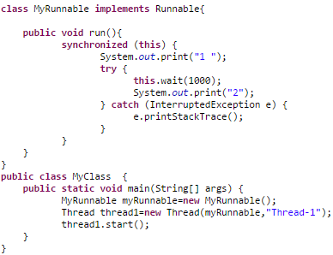

Slide 113
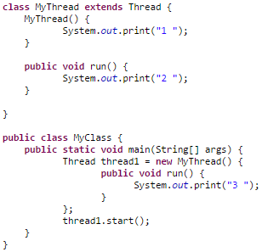

Slide 114
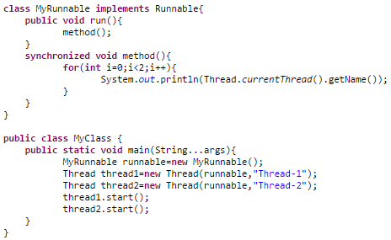

Slide 115
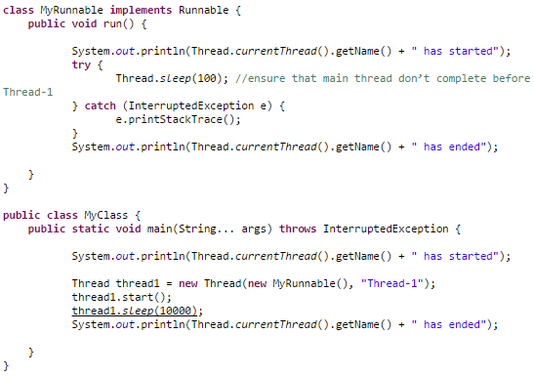

Slide 116
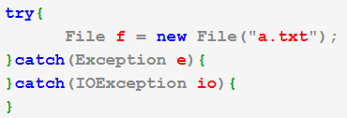
What is the output of the code?

