Slide 1


PDILL - Airflow Implementation Plan

Slide 2
Table Of Contents
Airflow Architecture Overview
Talk About PDILL DAG
Talk About Code Part
Deployment Strategy
Talk about celery executor
Data Masking Functional Use Case
Non Function Use Case
Success Criteria
Test Cases and Results
Roles and Responsibilities
Questions regarding Git Repository Creation
Celery and Rabbit MQ Installation

Slide 3

What is Airflow?
Airflow is a platform to programmatically author, schedule and monitor workflows
Use Airflow to author workflows as Directed Acyclic Graphs (DAGs) of tasks.
The Airflow scheduler executes your tasks on an array of workers while following the specified dependencies.
Rich command line utilities make performing complex surgeries on DAGs a snap. The rich user interface makes it easy to visualize pipelines running in production, monitor progress, and troubleshoot issues when needed.

Slide 4
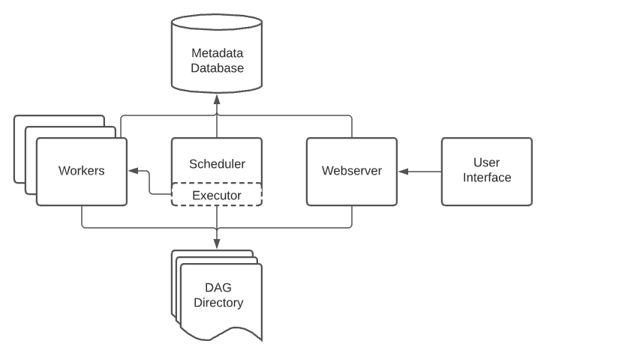
Airflow Architecture Overview
A scheduler, which handles both triggering scheduled workflows, and submitting Tasks to the executor to run.
An executor, which handles running tasks. In the default Airflow installation, this runs everything inside the scheduler, but most production-suitable executors actually push task execution out to workers.
A webserver, which presents a handy user interface to inspect, trigger and debug the behaviour of DAGs and tasks.
A folder of DAG files, read by the scheduler and executor (and any workers the executor has)
A metadata database, used by the scheduler, executor and webserver to store state.

Slide 5
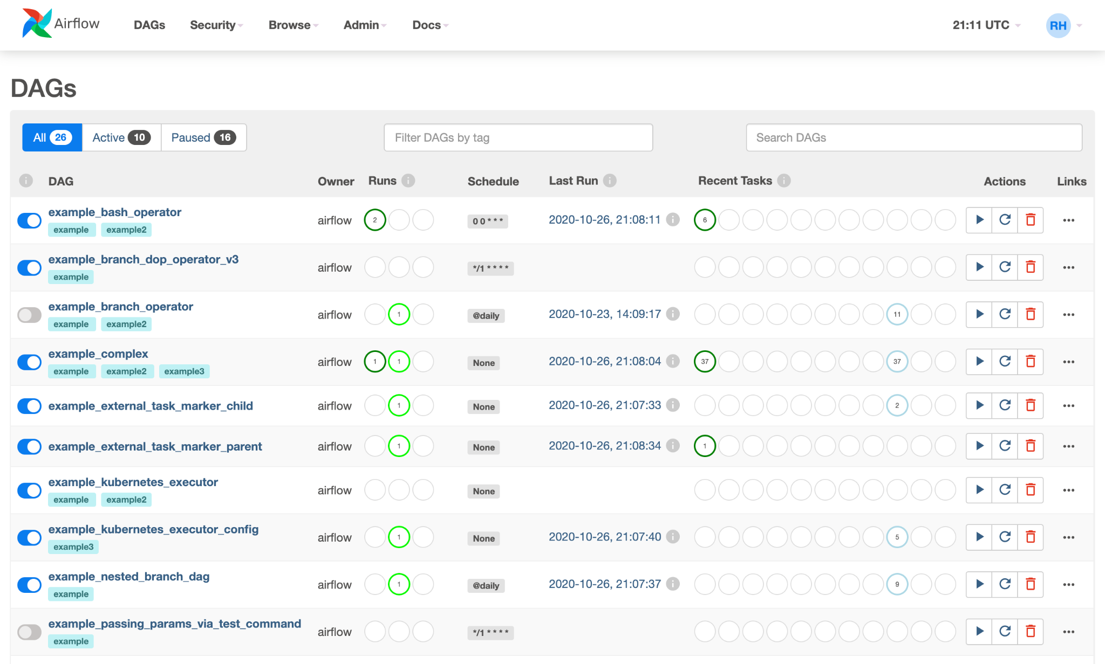
Airflow User Interface
Airflow comes with a user interface that lets you see what DAGs and their tasks are doing, trigger runs of DAGs, view logs, and do some limited debugging and resolution of problems with your DAGs.
It's generally the best way to see the status of your Airflow installation as a whole, as well as diving into individual DAGs to see their layout, the status of each task, and the logs from each task.

Slide 6
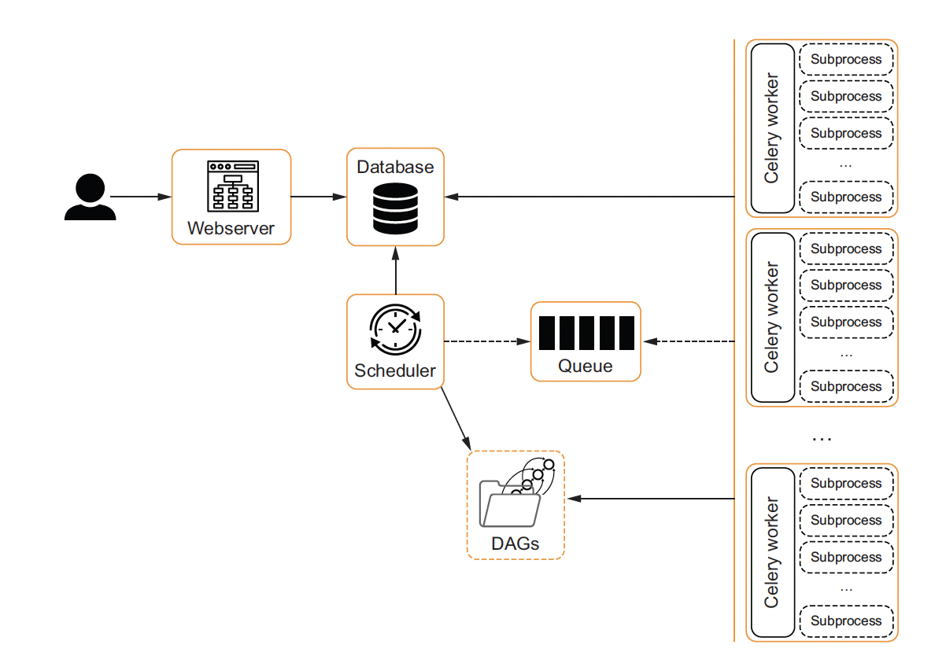
Airflow With Celery Executor
Horizontal scaling possible due to Celery Executor
Possible to handle spikes in workload by adding more edge nodes
It uses Message Queues Such as RabbitMQ or Redis to serve tasks to the workers on edge nodes
Each node Needs to connect to the Database as well as the DAGs folder
Database is connected through a client in each node
DAGs are served through a shared filesystem or Container Images (Needs Redeployment everytime there are changes to the DAGs)

Slide 7
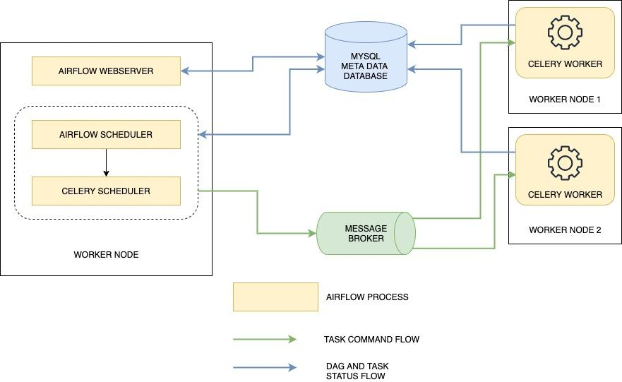
Airflow Celery Executor
RabbitMQ is a message broker. Its job is to manage communication between multiple services by operating message queues. It provides an API for other services to publish and to subscribe to the queues.
Celery is a task queue. It can distribute tasks on multiple workers by using a protocol to transfer jobs from the main application to Celery workers. It relies on a message broker to transfer the messages.

Slide 8
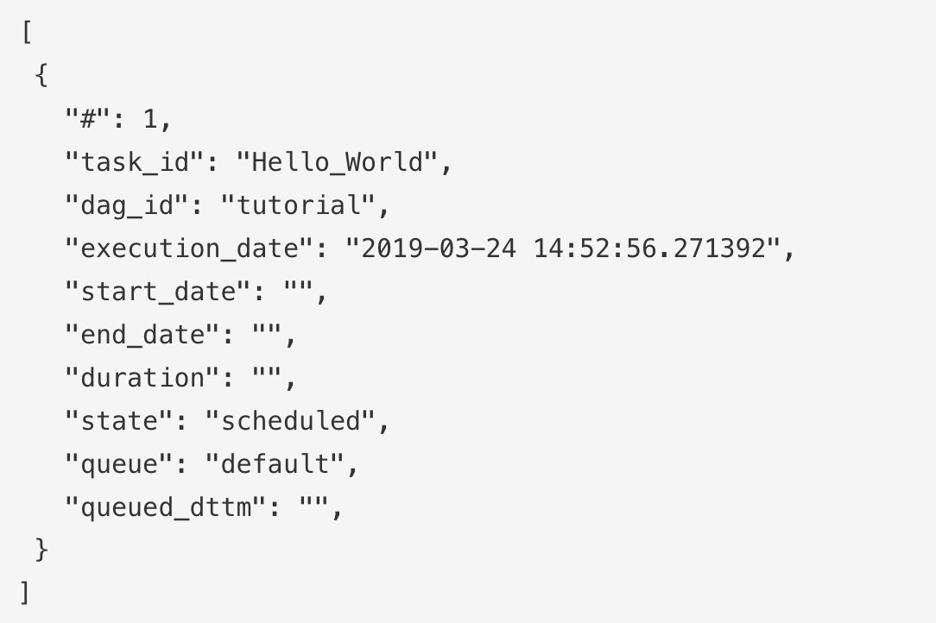
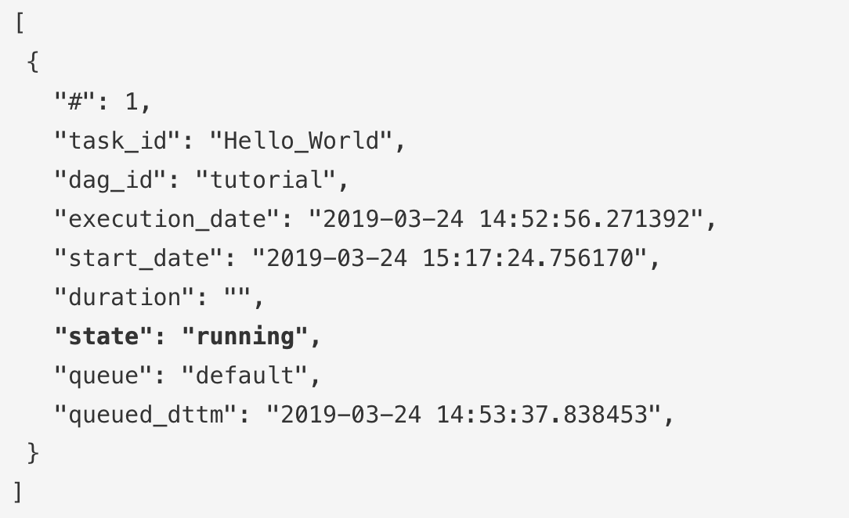
Airflow Celery Executor
The scheduler creates a new task instance in the metadata database with the scheduled state
Then the scheduler uses the Celery Executor which sends the task to the message broker. RabbitMQ queues can be explored from the management UI on port 15672. You can see the number of messages in the queue and open each message
If you look closely at the payload created by the Celery Executor, you will see that it contains the command that the celery worker should execute
The celery worker updates the metadata to set the status of the task instance to running
The celery worker executes the command. The worker status can be monitored from the Flower web interface by running airflow flower. It is a simple web server on which celery workers regularly report their status.

Slide 9

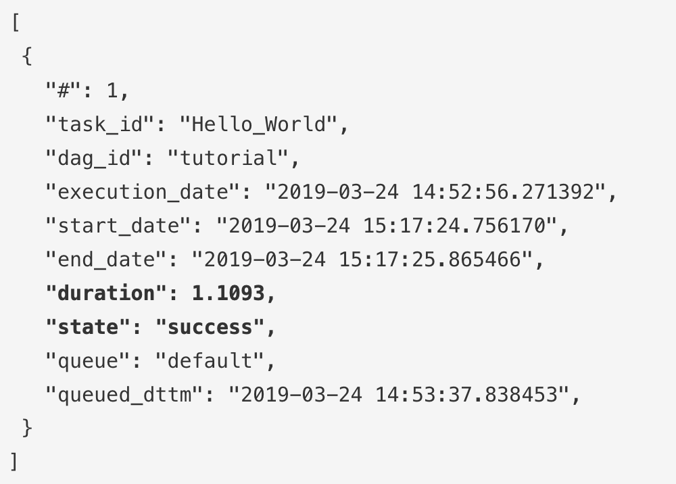
Airflow Celery Executor
The celery worker executes the command. The worker status can be monitored from the Flower web interface by running airflow flower. It is a simple web server on which celery workers regularly report their status.
Once the task is finished, the celery worker updates the metadata to set the status of the task instance to success:
Actual Flower UI Image

Slide 10
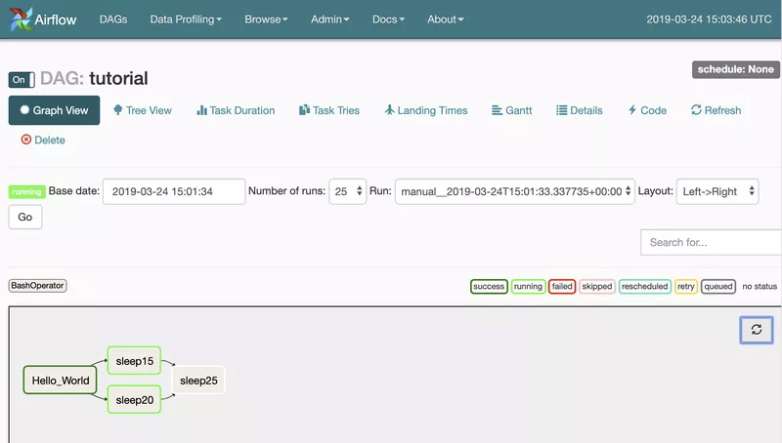
Multiple Tasks Running with Celery Executor
What we want to achieve with a Celery Executor is to distribute the workload on multiple nodes. It only makes sense if multiple tasks are running at the same time.
In our example, just after the Hello_World task is completed, the scheduler pushes both sleep15 and sleep20 tasks to the queue to be executed by the celery workers.
We can check with Flower that each celery worker received one task from the queue and that they are executing their assigned task simultaneously:

Slide 11
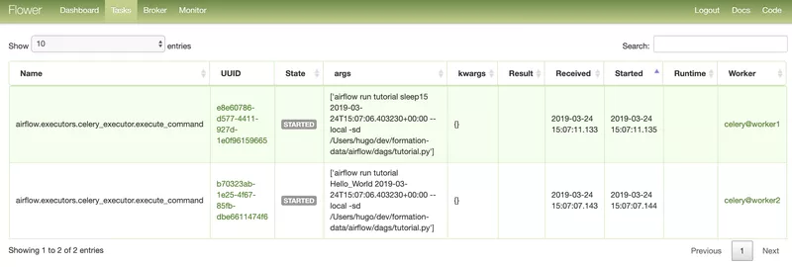
Multiple Tasks Running with Celery Executor
The scheduler now waits for both tasks to be reported as successful before sending the next one to the queue.

Slide 12
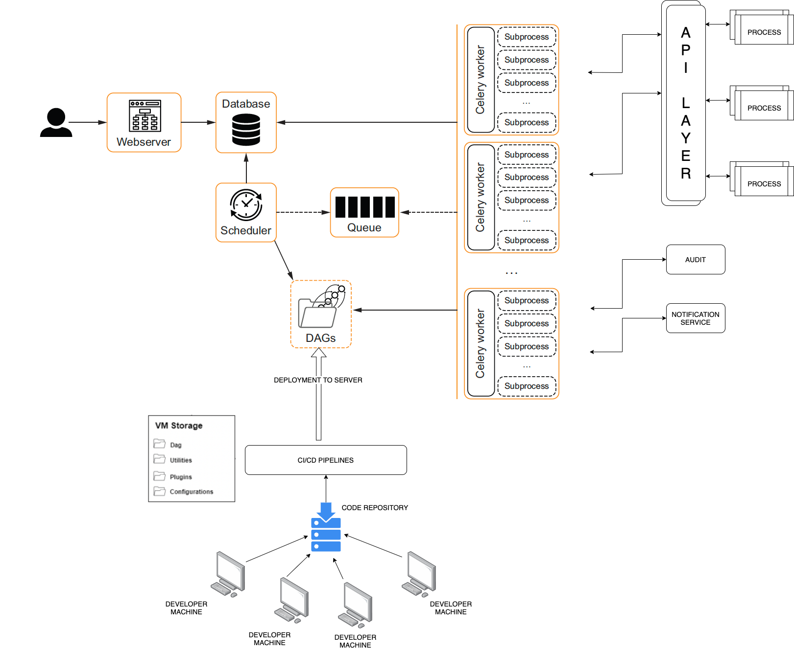
PDIL Architecture with Airflow-Celery
User Interacts with DAG through the Airflow Webserver
Airflow metadata database is hosted on a separate server
Scheduler connects with the metadata database through a SQL client
Airflow uses Celery to distribute data across the various nodes
Each node has a Celery worker installed on the node
Celery depends on the message broker to distribute tasks to the nodes
The Celery worker then executes the tasks
The edge nodes communicate with API layer to trigger processes and orchestrate
The edge nodes also perform audit tasks and send out notifications
Developers build DAG on local machine
Code is deployed through CI/CD pipelines

Slide 13
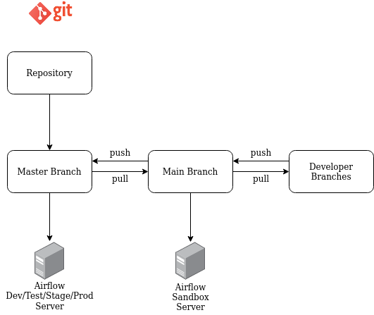
Code Management
The code for creating the jobs will be written in Python and managed on a repository either on github or Azure Dev Ops
The Airflow webserver will be hosted on Sandbox, Dev, Test, Stage and Prod server, the code for deployment on each branch will be deployed on the Master and Main branch.
For making enhancements to the code or adding new jobs the latest code deployed on each environment will be pulled from master/main branch and committed to a side branch(Developer Branch) for development purposes and then undergo a PR process involving code review and code approvals after which the new code will be deployed on the servers.

Slide 14
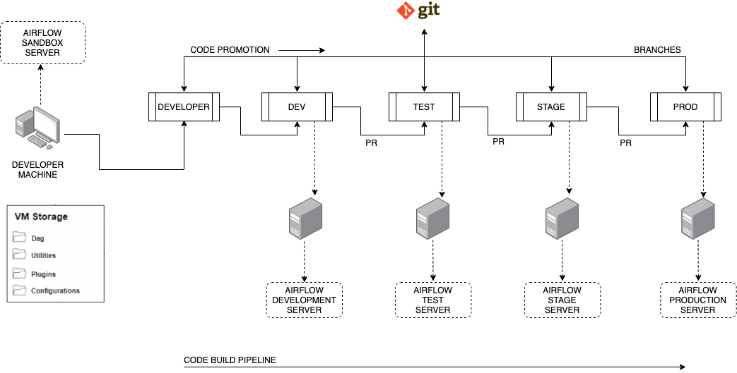
Code Promotion
The code for Airflow will be initially hosted on sandbox server where all the POC and enhancements are worked on.
After which the code will be pushed to dev server after going a PR process involving code review and code approval.
Once the code is ready to be pushed to Test it will again go through the same PR process and then to stage and prod.
If there are any issues observed in the code on test the code will be debugged and changed on dev and then again promoted to test, stage and prod.
** Note: The Dev, Test, Stage and Prod servers share the same configuration with respect to access and network settings.

Slide 15
Airflow Tech Stack
Airflow Version: 1.10.10
Airflow Machine Type:
Airflow Machine OS: Ubuntu 18.04 LTS
Airflow Backend Database: Postgres SQL
Language: Python 3.x
Environment deployed: Sandbox, Dev, Test, Stage and Prod
Code Management: Github/ADO

Slide 16
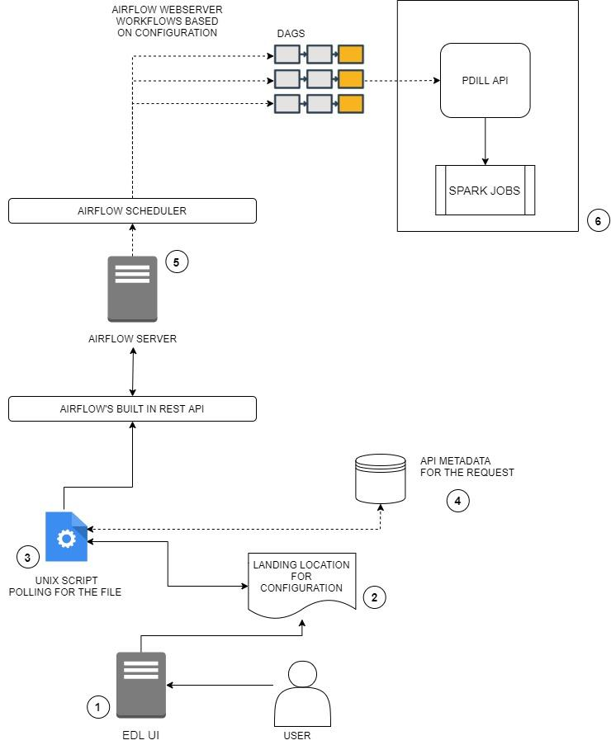
Airflow Trigger Architecture
The user using the EDL UI creates a configuration file which is stored on a local storage.
The local storage is used to store the EDL configuration files which are based on an on-prem location where there is a designated directory available to fetch files from.
The Unix Polling Script is used as a file watcher that watches the above-designated location continuously for new files and triggers the dags on the airflow scheduler for each configuration file present on the local storage.
Airflow dags running on the airflow webserver are triggered using the Airflow REST API.
Airflow dags that are triggered send a POST request to PDILL API that processes the data using underlying jobs.

Slide 17
Airflow Trigger Architecture
Questions
How many servers will airflow need to talk to in order to trigger workflows?
What would the configuration file contain?
Is the EDL configuration file a one-time use configuration?
Will the configurations be unique?
Is there a naming convention defined for the configuration file?
On what basis can I decide which dag is supposed to be triggered?

