Slide 1
RECOMMENDING A GOOD SMALL-SCALE BUSINESS START UP IN BANGALORE

Slide 2
Knowing what to start and where to start
find out the right place to start business
find out right business in the place where you choose to start
Multiply the business by finding similar places where your business will see more profit

Slide 3
Data acquisition and cleaning
Bangalore location coordinates
All neighborhoods names in and around Bangalore
Latitude and longitude values of all the neighborhoods

Slide 4
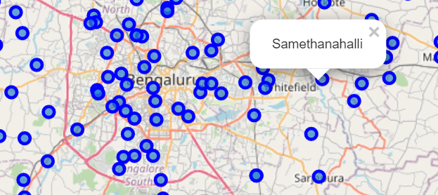
Using folium Map feature
Folium map feature is used to locate the neighborhoods with their latitude and longitude values

Slide 5
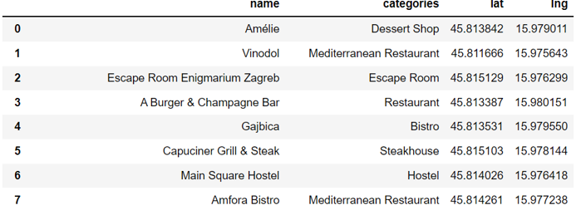
Foursquare location data
This feature is used for exploring venues and categories around the neighbors specified in dataset

Slide 6
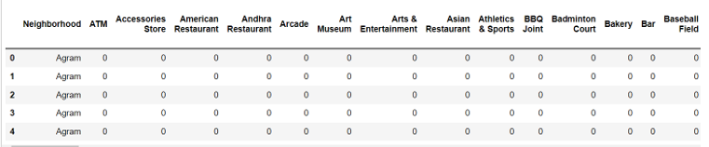
One Hot Encoding over venue category
This transforms the categorical variable into 0’s and 1’s for carrying out normalization

Slide 7
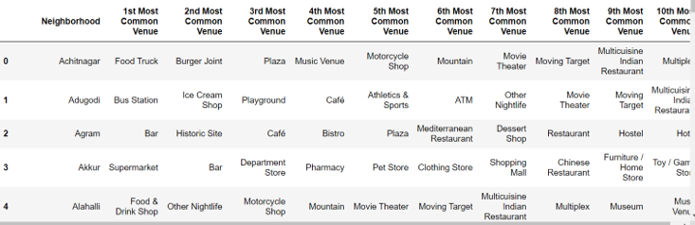
Result
The resulting data frame consists of top most common and famous categories for each venue based on which the person could start his business

Slide 8
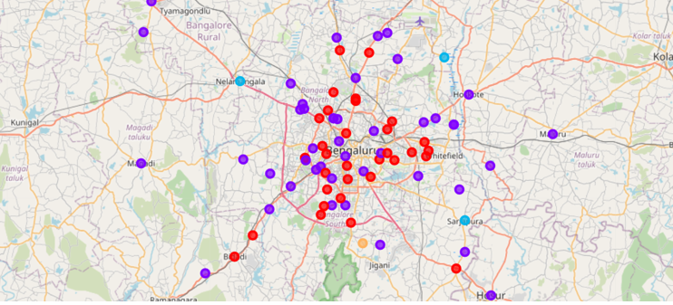
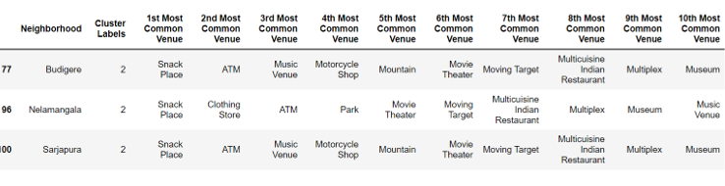
Result Continuation…
The similar neighborhoods are grouped in one cluster which enables the concerned business starters to grow their business in multiple areas

Slide 9
Conclusion
This project gives a great way for starting a small-scale business in Bangalore.
top common venues, top categories in those venues, the cluster data etc. could help anybody to choose the right path to start up their business
clustering algorithm used would really be helpful in enhancing the business.

