Slide 1
AWS Elastic Kubernetes Service (EKS) QuickStart
Andrew Heifetz, AMPSight
Kirk Kalvar, KAL Technology

Slide 2
Introduction
Kubernetes has fast established itself as the leading platform for managing containerized workloads and services.
Run Anywhere
63% of Kubernetes workloads run on AWS today – Cloud Native Computing Foundation

Slide 3
Why AWS EKS?
AWS Managed Services enables you to quickly and easily deploy your cloud infrastructure
Amazon EKS is also integrated with many AWS services to provide scalability and security for your applications, including the following
Elastic Load Balancing for load distribution
IAM for authentication
Amazon VPC for isolation
Amazon EKS runs up-to-date versions of the open-source Kubernetes software
This means that you can easily migrate any standard Kubernetes application to Amazon EKS without any code modification required
On Demand

Slide 4
Requirements
AWS Account (root)
An EC2 Instance in which to install kubectl, aws-iam-authenticator, and awscli version 1.15.x or greater
Required Cluster Resources
AWS Service Role
AWS VPC
AWS EKS Cluster (installs Master Nodes)
Three AWS EC2 worker nodes (one for each AWS Availability Zone)
Installation time ~30 minutes

Slide 5
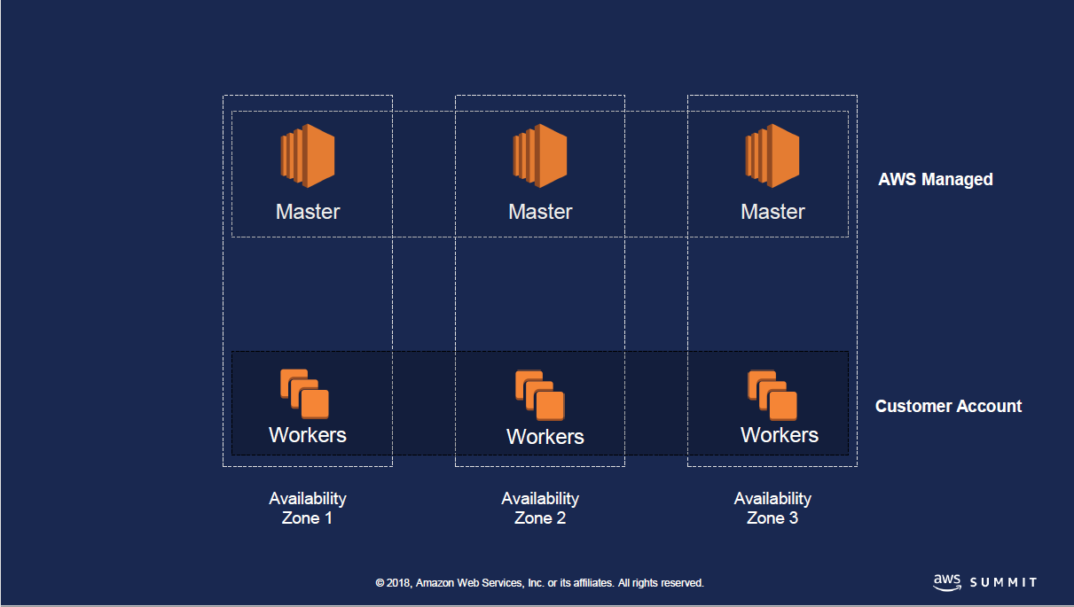

Architecture

Slide 6
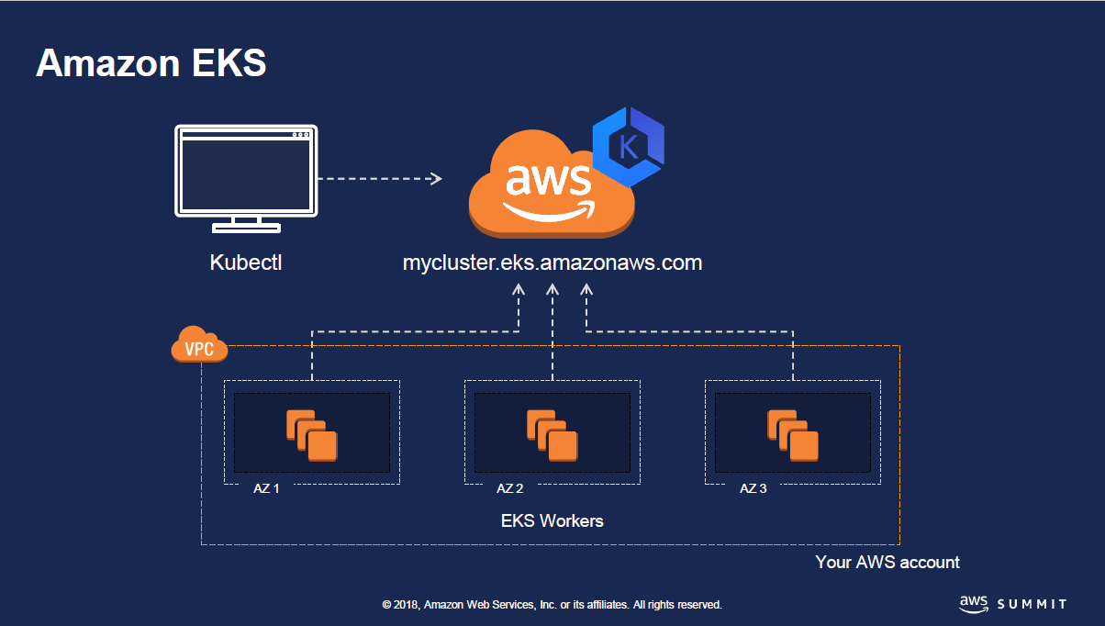
Architecture

Slide 7
Installation Steps
Create your Amazon EKS Service Role (AWS IAM Console)
Add Amazon EC2 Full Access to Service Role (AWS IAM Console)
Create your Amazon EKS Cluster VPC (CloudFormation)
Create your Amazon EKS Cluster (AWS EKS Console)
Launch and Configure Your Amazon EKS Worker Nodes (AWS CloudFormation)
Configure Your AWS EC2 Instance (AWS EC2 Console cloud-init)
Configure kubectl on Your EC2 Instance (AWS EC2 Instance kubectl)
Enable Worker Nodes to Join Your Cluster (AWS EC2 Instance kubectl)
Deploy Web App to Your Cluster (AWS EC2 Instance kubectl)
Notes:
Send a simple text message
Use representative website
Use phone dialer
Use web browser

Slide 8
Quick Demo
To save time AWS EKS Cluster has already been configured using the AWS Web Console, CloudFormation, cloud-init script, and some manual configuration.
We’ll:
Deploy an application using a docker image located in DockerHub at kskalvar/web. This image is nothing more than a simple flask webapp that returns the current ip address of the container it's running in. We'll create a pod, scale the pod, and create an external AWS Load Balancer using kubectl.
Once the running the external load balancer is configured you should see a unique ip address as it is load balanced across containers.
Notes:
Send a simple text message
Use representative website
Use phone dialer
Use web browser

Slide 9
Conclusions
Cons
Unfortunately this is a pretty manual effort right now, not what I would expect for a AWS Managed Service
AWS EKS Fargate still a ways off
AWS Fargate support for Amazon EKS will be available in 2018
Pros
Provision Kubernetes Masters across AWS Availability Zones
kubectl vs. kops
Notes:
Send a simple text message
Use representative website
Use phone dialer
Use web browser

Slide 10
Questions?

Slide 11
References
My AWS EKS QuickStart
https://github.com/kskalvar/aws-eks-cluster-quickstart
AWS Summit Slides for EKS
https://www.slideshare.net/AmazonWebServices/srv318-running-kubernetes-with-amazon-eks
Kubernetes
https://kubernetes.io
AWS EKS Getting Started
https://docs.aws.amazon.com/eks/latest/userguide/getting-started.html

