Slide 1
AWS Elastic Kubernetes Service (EKS) QuickStart
Kirk Kalvar
Senior Software Engineer/Principal
KAL Technology
kirk.kalvar@kal.technology
@kskalvar

Slide 2
So How Did I Get Here?
Used Docker locally but quickly realized I really need a path to Production
Wasted way too much time on other Orchestration Engines
Wanted a Production Grade Development Environment
Something I could scaled as needed
Something easy for developers to instantiate without all the drama, tool fatigue, etc.
Use it and lose it

Slide 3
Introduction
So Kubernetes has fast established itself as the leading platform for managing containerized workloads and services.
Run Anywhere
63% of Kubernetes workloads run on AWS today – Cloud Native Computing Foundation (AWS News Blog by Jeff Barr, 29 November 2017)

Slide 4
Why AWS EKS?
AWS Managed Services enables you to quickly and easily deploy your cloud infrastructure
Amazon EKS is also integrated with many AWS services to provide scalability and security for your applications, including the following
Elastic Load Balancing for load distribution
IAM for authentication
Amazon VPC for isolation
Amazon EKS runs up-to-date versions of the open-source Kubernetes software. Currently 1.12
This means that you can easily migrate any standard Kubernetes application to Amazon EKS without any code modification required
On Demand

Slide 5
Requirements
AWS Account (root)
An EC2 Instance in which to install kubectl, aws-iam-authenticator, and AWS CLI version 1.15.x or greater
Required Cluster Resources
Service Role
VPC
EKS Cluster (installs Master Nodes)
Three EC2 worker nodes (one for each AWS Availability Zone)
Installation time about 15 minutes based on presentation artifacts

Slide 6
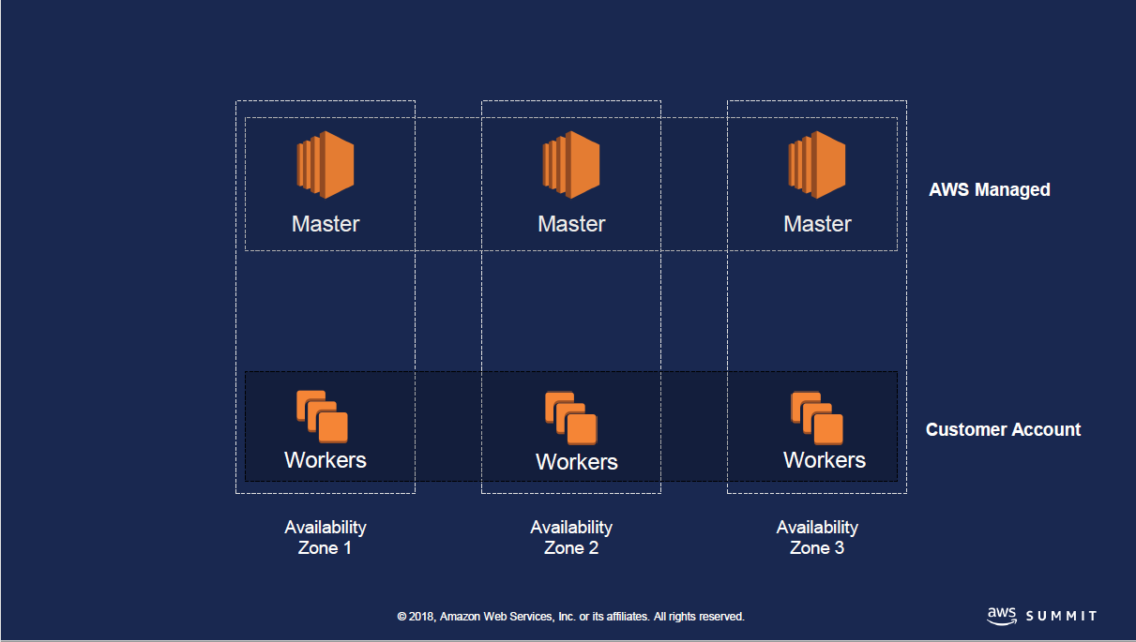

Architecture

Slide 7
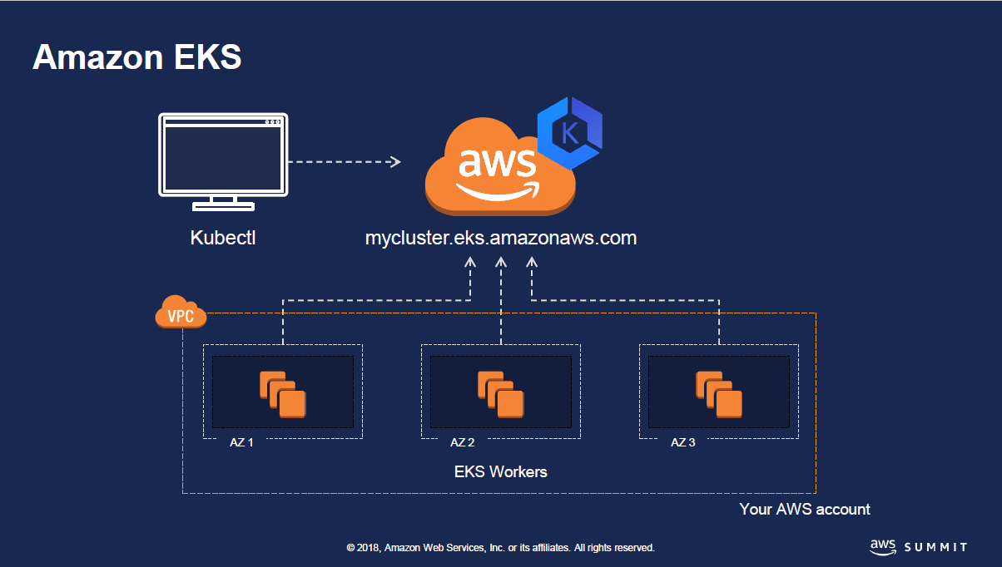
Architecture

Slide 8
Installation Steps
Create AWS EKS Cluster using AWS CloudFormation
Configure Your AWS EC2 Instance
Configure kubectl on Your EC2 Instance
Deploy WebApp to Your Cluster
Configure the Kubernetes Dashboard (Optional)
Remove Your AWS EKS Cluster
Notes:
Send a simple text message
Use representative website
Use phone dialer
Use web browser

Slide 9
Quick Demo
To save time AWS EKS Cluster has already been configured using the AWS CloudFormation scripts, and an EC2 instance created with a cloud-init script.
I’ve already:
Created a docker image located in DockerHub Repo at kskalvar/web. This image is nothing more than a simple flask webapp that returns the current ip address of the container it's running in.
Created a pod
Scaled the pod
Created an external AWS Load Balancer
You should see a unique ip address as it is load balanced across containers.
Notes:
Send a simple text message
Use representative website
Use phone dialer
Use web browser

Slide 10
Conclusions
Cons
Unfortunately this is still a pretty manual effort right now, not what I would expect for a AWS Managed Service
We created a CloudFormation and EC2 cloud-init scripts to speed the process
AWS Fargate support for Amazon EKS was suppose to be available in 2018 (still not released as of this date)
Pros
Provision Kubernetes Masters across AWS Availability Zones
kubectl vs. kops
Notes:
Send a simple text message
Use representative website
Use phone dialer
Use web browser

Slide 11
Questions?

Slide 12
References
AWS EKS QuickStart
https://github.com/kskalvar/aws-eks-cluster-quickstart
AWS Summit Slides for EKS
https://www.slideshare.net/AmazonWebServices/srv318-running-kubernetes-with-amazon-eks
Kubernetes
https://kubernetes.io
AWS EKS Getting Started
https://docs.aws.amazon.com/eks/latest/userguide/getting-started.html

