Slide 1
AWS Elastic Kubernetes Service (EKS) Code Lab QuickStart
Kirk Kalvar
Senior Software Engineer/Principal
KAL Technology
kirk.kalvar@kal.technology
@kskalvar

Slide 2
Introduction
Kubernetes has fast established itself as the leading platform for managing containerized workloads and services.
Run Anywhere
63% of Kubernetes workloads run on AWS today – Cloud Native Computing Foundation

Slide 3
Why AWS EKS?
AWS Managed Services enables you to quickly and easily deploy your cloud infrastructure
Amazon EKS is also integrated with many AWS services to provide scalability and security for your applications, including the following
Elastic Load Balancing for load distribution
IAM for authentication
Amazon VPC for isolation
Amazon EKS runs up-to-date versions of the open-source Kubernetes software. Currently 1.12
This means that you can easily migrate any standard Kubernetes application to Amazon EKS without any code modification required
On Demand

Slide 4
Requirements
AWS Account (root)
An EC2 Instance in which to install kubectl, aws-iam-authenticator, aws cli version 1.15.x or greater
Required Cluster Resources
Service Role
VPC
EKS Cluster (installs Master Nodes)
Three EC2 worker nodes (one for each AWS Availability Zone)
Installation time ~30 minutes using manual process, 15 minutes with CloudFormation

Slide 5
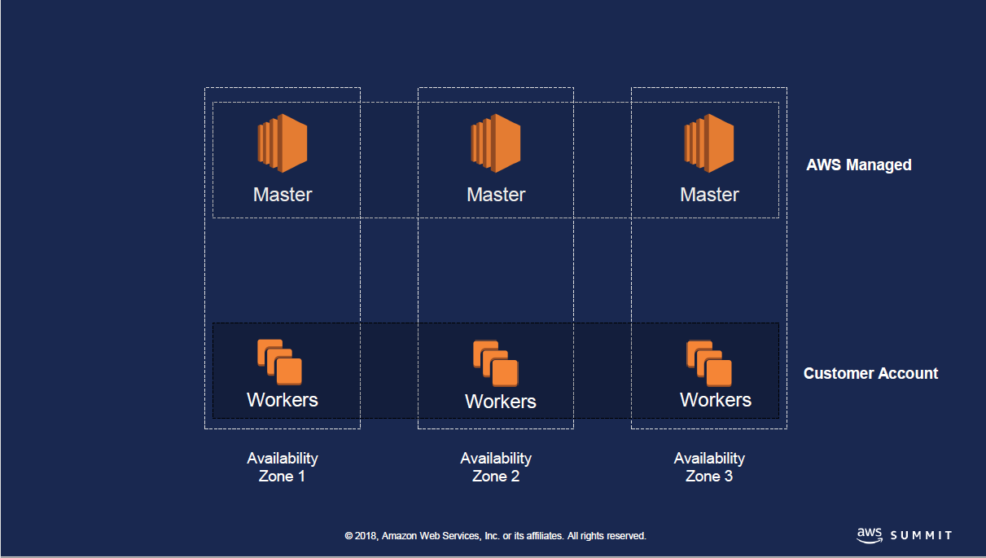

Architecture

Slide 6
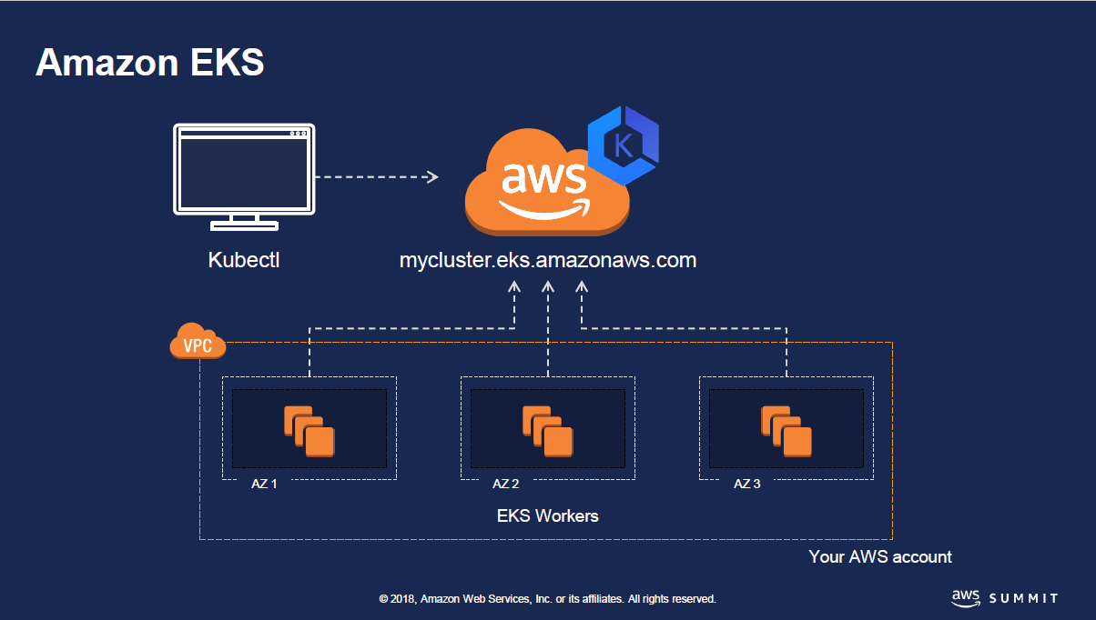
Architecture

Slide 7
Disclaimer
Note: This is the first time this code lab has been done. Artifacts should be publicly available, if not just follow along and you can do this on your own at home. All instructions are captured in GitHub.
Notes:
Send a simple text message
Use representative website
Use phone dialer
Use web browser

Slide 8
Code Lab Requirements
Note: This how-to assumes you are:
Creating the eks cluster in us-east-1,
You have access to your AWS Root Account,
You know how to create an EC2 Instance,
And can login to the instance from your laptop.
Notes:
Send a simple text message
Use representative website
Use phone dialer
Use web browser

Slide 9
Installation Steps
Configure Your AWS EC2 Instance
Create AWS EKS Cluster using AWS CloudFormation
Configure kubectl on Your EC2 Instance
Deploy Web App to Your Cluster
Configure the Kubernetes Dashboard (optional)
Notes:
Send a simple text message
Use representative website
Use phone dialer
Use web browser

Slide 10
References
AWS EKS QuickStart
https://github.com/kskalvar/aws-eks-cluster-quickstart
AWS Summit Slides for EKS
https://www.slideshare.net/AmazonWebServices/srv318-running-kubernetes-with-amazon-eks
Kubernetes
https://kubernetes.io
AWS EKS Getting Started
https://docs.aws.amazon.com/eks/latest/userguide/getting-started.html

