Slide 1
DATA ANALYTICS • POWER BI CASE STUDY
Marketing Campaign
Performance Analysis
A business-led review of campaign spend, revenue,
regional performance and return on investment.
Prepared by: Prasanna Taneeru
Power BI dashboard-based portfolio project

Slide 2
01 • EXECUTIVE SUMMARY
The headline: investment is substantial, but returns need optimisation
The dashboard points to a clear opportunity: shift budget toward the strongest-performing campaign while validating ROI measurement.
TOTAL REVENUE
TOTAL SPEND
AVERAGE ROI
BEST CAMPAIGN
42.54M
25.69M
0.68
Influencer
Reported dashboard KPI
Reported dashboard KPI
Reported dashboard KPI
Best campaign label in dashboard
EXECUTIVE TAKEAWAY
The dashboard reports 42.54M in revenue against 25.69M in spend. Influencer Marketing is identified as the best campaign, and its ROI point is visibly highest in the campaign comparison. Before reallocating budget, confirm the ROI formula, campaign attribution window and the meaning of the 0.68 KPI.
02

Slide 3
02 • BUSINESS CONTEXT
Business challenge: how should marketing budget be allocated?
A multi-channel, multi-region marketing programme needs a consistent way to compare performance.
THE BUSINESS QUESTIONS
ANALYTICS OBJECTIVE
Which campaign types appear to generate stronger returns?
Turn campaign data into practical decisions by comparing spend, revenue, ROI and campaign mix — then identify where deeper investigation can improve marketing efficiency.
Are regional revenue and spend patterns balanced?
Which campaigns deserve more testing or budget?
What should leadership monitor before scaling investment?
03

Slide 4
03 • MEASUREMENT FRAMEWORK
What the dashboard measures — and what needs validation
Use a shared definition of each metric so campaign comparisons are fair.
Revenue
42.54M
Total revenue reported across the dashboard.
Spend
25.69M
Total marketing spend reported across the dashboard.
Average ROI
0.68
Dashboard KPI; confirm whether this is a ratio, decimal or formatted index.
Campaign ROI
Campaign-level comparison
Use the same ROI definition and attribution window for every campaign.
04

Slide 5
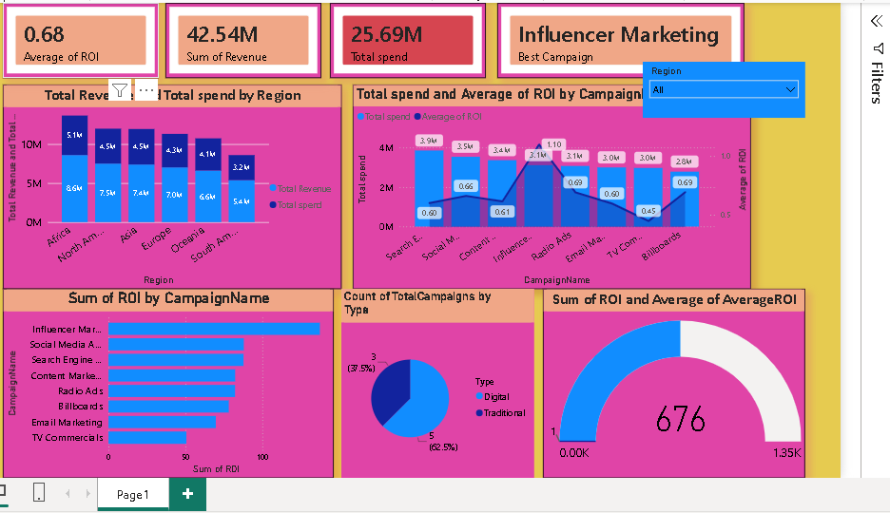
04 • DASHBOARD WALKTHROUGH
One view brings together campaign and regional performance
The supplied Power BI screenshot includes headline KPIs, region comparisons, campaign spend/ROI, campaign ranking and campaign-type mix.
DASHBOARD COMPONENTS
Headline KPI cards
Revenue and spend by region
Spend and ROI by campaign
ROI ranking by campaign
Digital vs traditional mix
05

Slide 6
05 • REGIONAL ANALYSIS
Regional results: revenue and spend move together
Approximate values below are read from the labels in the supplied chart; validate against the source data before external reporting.
REVENUE VS SPEND BY REGION (M)
WHAT IT SUGGESTS
Africa appears highest on both revenue and spend.
South America appears lowest on both measures.
Revenue and spend broadly track together across regions.
Compare regional margin and audience size before shifting budget.
Africa
North
America
Asia
Europe
Oceania
South
America
Blue = revenue • Teal = spend
06

Slide 7
06 • CAMPAIGN ANALYSIS
Influencer Marketing stands out in the campaign comparison
The dashboard labels Influencer Marketing as the best campaign and shows the highest visible ROI point for this campaign.
VISIBLE ROI VALUES BY CAMPAIGN
DECISION SIGNAL
Search
0.60
Prioritise a deeper review of Influencer Marketing.
Social Media
0.65
Content
0.61
Influencer
1.10
Validate campaign scale, audience quality, conversion attribution and incremental lift. A high dashboard ROI is a signal to investigate — not proof that unlimited budget will produce the same return.
Radio Ads
0.69
Email
0.60
TV
0.45
Billboards
0.69
07

Slide 8
07 • CHANNEL MIX
Digital dominates the campaign count
The dashboard's campaign-type pie chart reports five Digital campaigns (62.5%) and three Traditional campaigns (37.5%).
DIGITAL CAMPAIGNS
TRADITIONAL CAMPAIGNS
5
3
FOLLOW-UP ANALYSIS
62.5% of campaign count
37.5% of campaign count
Revenue and ROI by campaign type
Cost per lead / acquisition
Conversion rate and lead quality
Campaign count is not the same as budget share, reach or effectiveness. Compare spend and outcomes by type before concluding that one channel group is better.
Incremental lift versus baseline
08

Slide 9
08 • KEY FINDINGS
What the current dashboard tells us
These are directional findings from the screenshot, not causal conclusions.
01
Revenue & spend
02
Top campaign
The reported totals are 42.54M revenue and 25.69M spend.
Influencer Marketing is highlighted as the best campaign.
03
Regional spread
04
Channel mix
Africa appears strongest by revenue; South America appears lowest.
Digital represents 62.5% of campaign count in this dataset.
09

Slide 10
09 • RECOMMENDATIONS
A practical action plan for marketing leadership
Move from dashboard observation to controlled experiments and measurable budget decisions.
1 Protect the signal
Audit Influencer Marketing tracking, spend and conversions; confirm the ROI calculation.
2 Test before scaling
Run a controlled budget increase and compare incremental conversions and profit.
3 Investigate weaker results
Review TV Commercials and other lower-ROI campaigns for targeting, creative and cost issues.
4 Localise the strategy
Compare region-level ROI and customer value, not just revenue and spend totals.
5 Build a weekly scorecard
Track spend, revenue, ROI, conversions, CPA and campaign pacing consistently.
10

Slide 11
10 • MEASUREMENT & GOVERNANCE
Make the next version decision-ready
A few metric and modelling checks will make the analysis more reliable.
VALIDATION CHECKLIST
NEXT-LEVEL POWER BI ENHANCEMENTS
Confirm ROI formula: (revenue − cost) ÷ cost, or the business-approved definition.
Add a date slicer and month-over-month trends.
Clarify whether the 0.68 KPI is an average, ratio or formatted value.
Show ROI and revenue per campaign type and region.
Check why the gauge shows 676 while the KPI card shows 0.68.
Add conversion, CPA and profit measures.
Use a consistent attribution window and currency unit.
Use dynamic titles and consistent number formatting.
Verify campaign and regional totals against source records.
Add drill-through to campaign detail.
11

Slide 12
11 • CONCLUSION
Turn marketing data into smarter investment decisions.
The dashboard provides a useful starting point for comparing campaign and regional performance. Influencer Marketing is the strongest visible opportunity, while regional and channel-level results need deeper profitability analysis. The next step is to validate the metrics, run controlled tests and scale only where incremental returns are proven.
Thank you
Prasanna Taneeru | Data Analyst Portfolio Project

