Slide 1

What is an OS?
An Operating System (OS) is system software that manages computer hardware, provides basic services for applications, and acts as an interface between the user and the hardware.

Slide 2
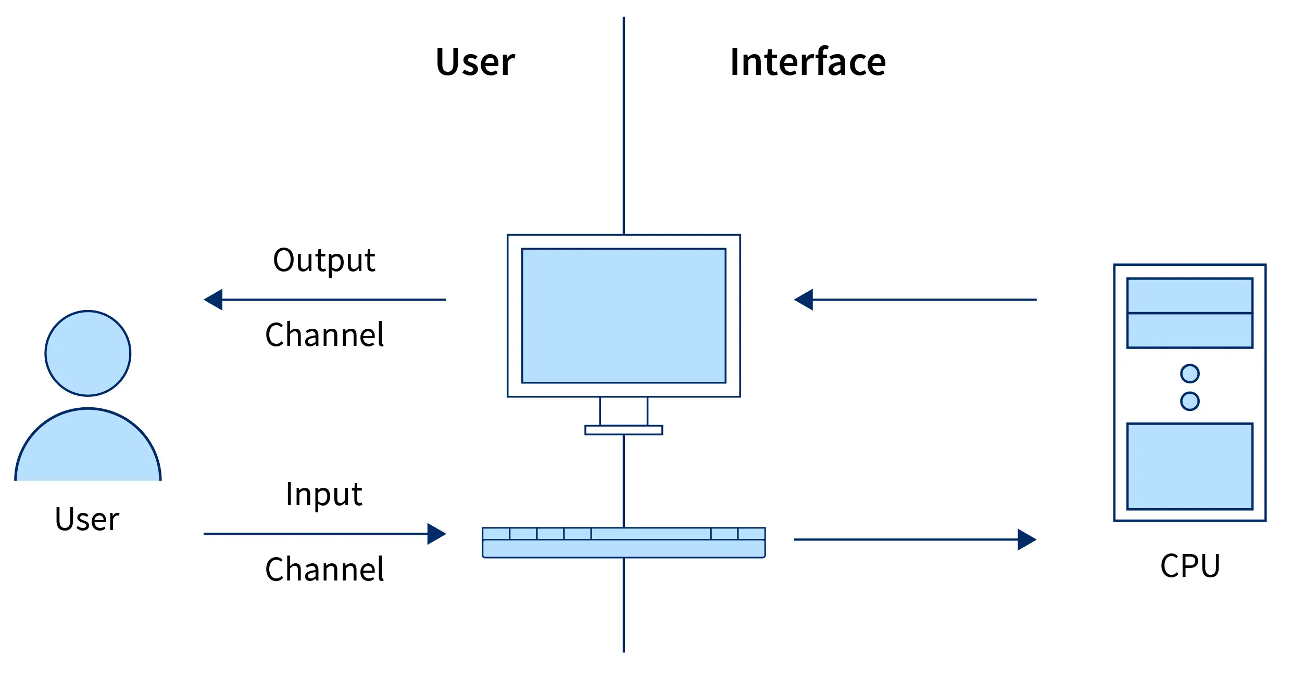
Single-User Machine
Definition: A machine (computer or system) designed for one user at a time. It focuses on providing resources like processing power and memory to a single user.
Ex: PC, Smartphone, Tablet, Gaming Console, etc.

Slide 3
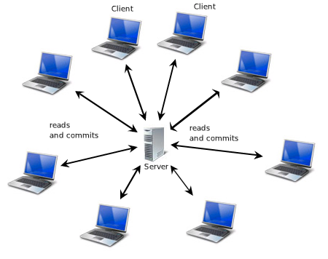
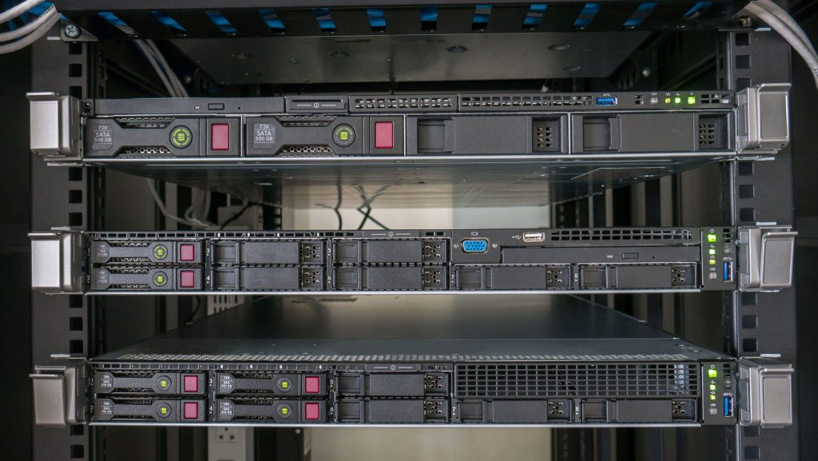
Definition: An OS that allows multiple users to access a computer system simultaneously or at different times.
Ex: Rack Servers, Blade Servers, etc.
Multi-User Machine

Slide 4
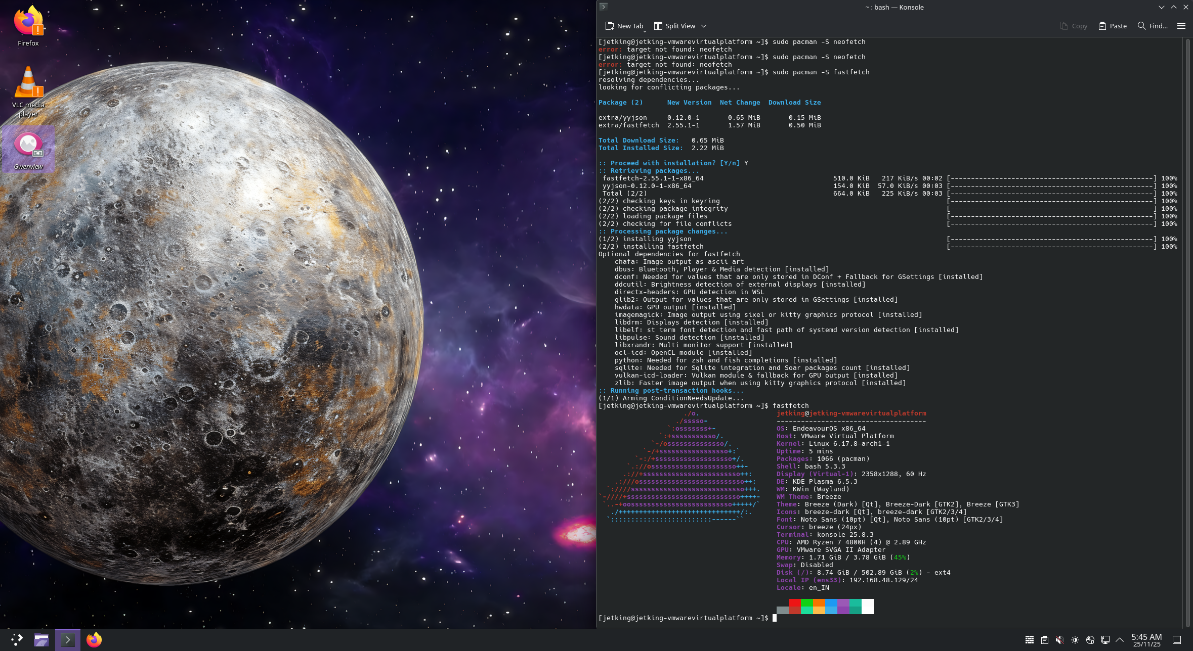
GUI VS CLI

Slide 5
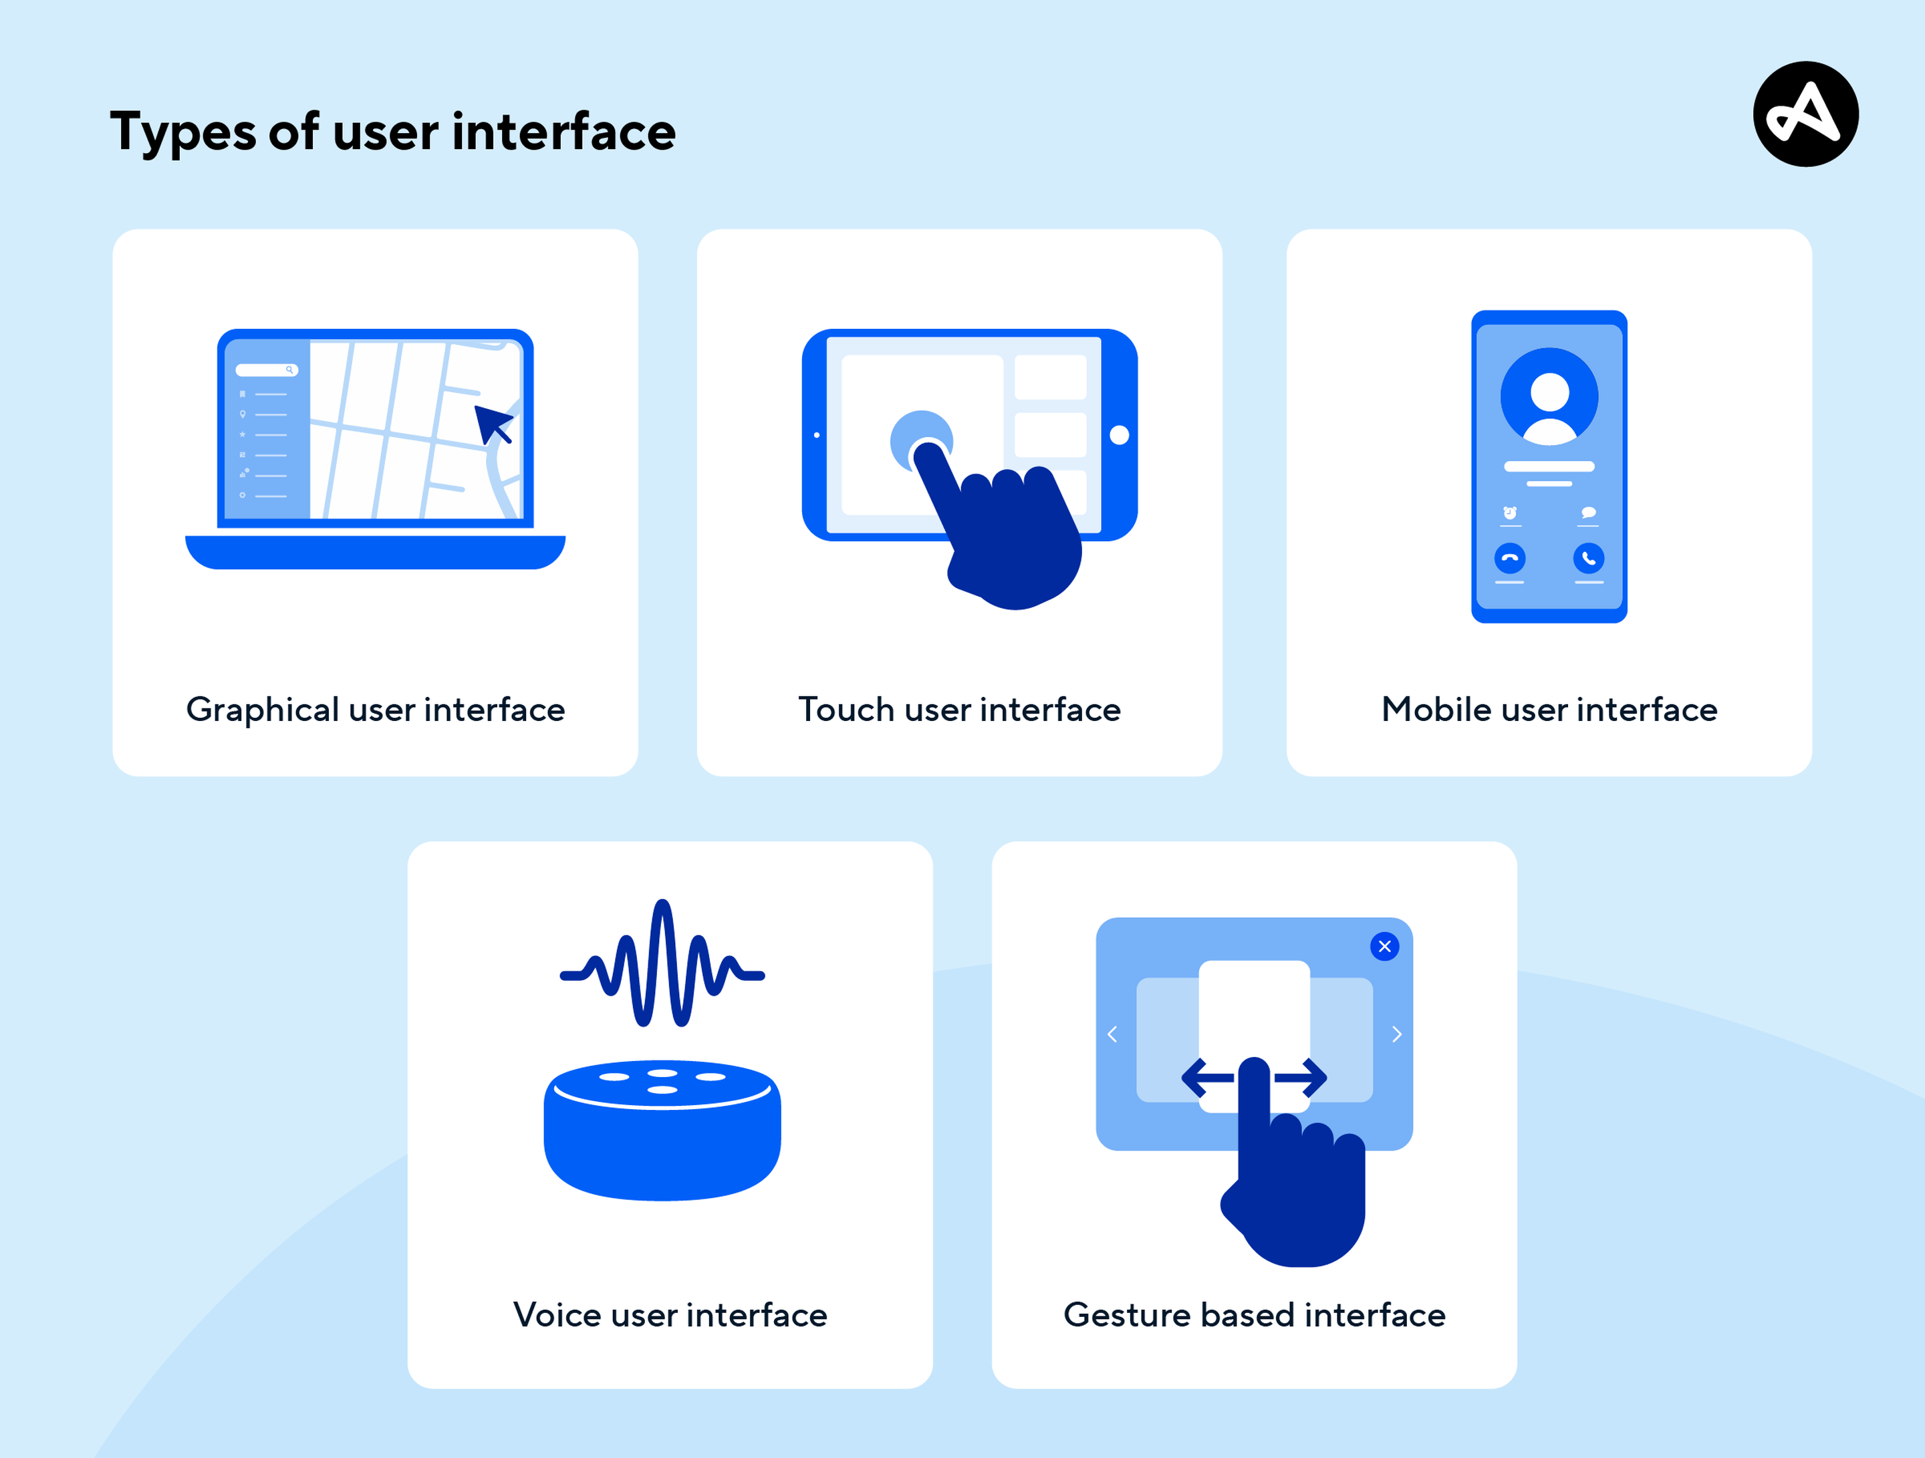

Slide 6


Red Hat Certified System Administrator (RHCSA)
EXAM CODE: EX200
Passing Score: 210 out of 300
https://rol.redhat.com/rol/app/
https://surl.li/hicjmt

Slide 7
Unix is a family of operating systems that originated in the late 1960s at Bell Labs, a research facility affiliated with AT&T. It is a powerful and versatile operating system that has had a significant impact on the development of modern computing. Unix-like operating systems, often referred to as Unix or Unix-like systems, are designed to be highly portable, scalable, and provide a robust set of tools and utilities for various computing tasks.
What is UNIX?

Slide 8


The Birth of
Ken Thompson and Dennis Ritchie were computer scientists who famously co-created the UNIX operating system and the C programming language at Bell Labs.

Slide 9
Key characteristics and features of Unix and Unix-like operating systems include:
Multi-user and Multi-tasking: Unix allows multiple users to simultaneously use the system and run multiple programs or processes concurrently.
Command-Line Interface (CLI): Unix systems are known for their command-line interfaces, where users interact with the system by entering text-based commands.
File Hierarchy: Unix organises files in a hierarchical directory structure, with a root directory (“/”) and subdirectories.
Everything is a File: In Unix, everything, including devices and network resources, is treated as a file, making it a flexible and consistent system for managing resources.
Shell: The Unix shell is a command interpreter that allows users to enter commands and execute them. Common Unix shells include Bash, Zsh, and Csh.

Slide 10
Key characteristics and features of Unix and Unix-like operating systems include:
Pipelines and Redirection: Unix provides powerful mechanisms for connecting commands through pipelines and redirecting input and output streams, enabling complex data processing.
Portability: Unix and Unix-like systems are designed to be highly portable, running on a wide range of hardware platforms with minimal modifications.
Networking Capabilities: Unix has robust networking capabilities, making it suitable for networked environments and the development of network applications.
Security: Unix systems implement various security mechanisms, including user and group permissions, to control access to files and resources.
Extensibility: Unix can be extended through the use of scripts, custom applications, and third-party software packages.

Slide 11

Facts to Agree
Unix has served as the foundation for many other operating systems, including Linux and macOS.
Linux was developed as a Unix-like operating system that is open-source and has gained widespread popularity.
Unix and Unix-like systems are commonly used in server environments, scientific research, software development, and many other fields due to their stability, flexibility, and powerful command-line tools.

Slide 12


The Birth of
Development: Created by Linus Torvalds in 1991.
Source Model: Linux can be free and open-source, and some components or distributions may include proprietary elements.
Unix-Based Kernel: Linux is a Unix-like operating system kernel, following Unix design principles.
Linus Torvalds

Slide 13
What Linux Is:
Linux itself is only the kernel—the core part of the operating system that manages hardware and system processes.
https://www.kernel.org/
Linux Distributions:
The term “Linux” is often used to describe complete operating systems built using the Linux kernel. These complete systems are called Linux distributions (distros), such as Ubuntu, Fedora, Debian, CentOS, and others.

Slide 14
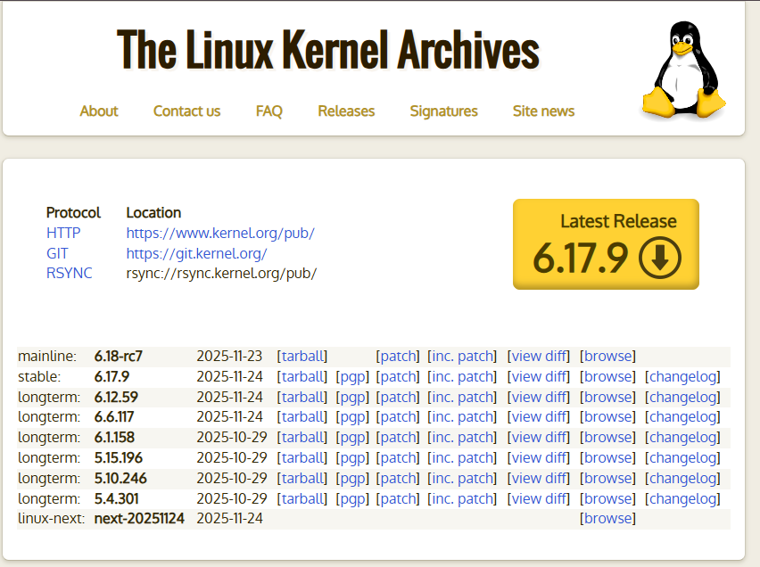
SIZE: 150MB*

Slide 15

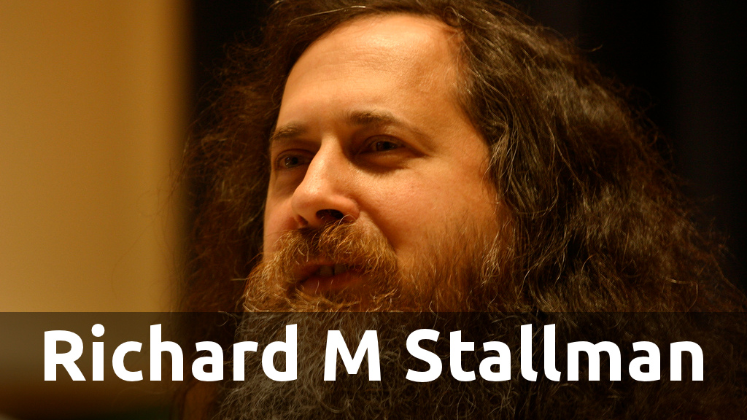
GNU is an operating system that is free software—that is, it respects users’s freedom. The GNU operating system comprises GNU packages (programs specifically developed by the GNU Project) as well as free software released by third parties. The development of GNU made it possible to use a computer without software that would trample your freedom.

Slide 16
Key characteristics of Linux and Linux distributions include:
Open Source: Linux is released under licenses like GPL, allowing anyone to view, modify, and distribute the source code.
Unix-Like: Follows Unix principles—multi-user, multitasking, CLI support, hierarchical filesystem, and strong portability.
Many Distributions: Hundreds of distros exist (Ubuntu, Debian, Fedora, CentOS, Arch), each with unique features and package tools.
Package Management: Tools like APT, DNF/YUM, and Pacman make software installation and updates easy.
GUI Support: Popular desktop environments include GNOME, KDE Plasma, and Xfce, making Linux user-friendly.

Slide 17
Key characteristics of Linux and Linux distributions include:
Server & Desktop Use: Known for stability and security—widely used in servers, cloud, data centers, and also desktops.
Strong Community: Large global community with abundant documentation and support resources.
Security: Robust permissions model and frequent updates; some distros focus heavily on security.
Portable: Runs on hardware ranging from embedded devices to supercomputers.
Customizable: Everything can be customized—from the kernel to the desktop environment.

Slide 18
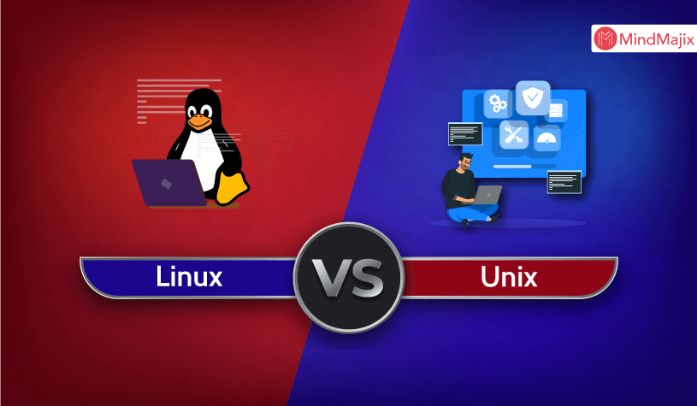

Slide 19
Table Summarizing the Key Differences
Feature | Unix | Linux
Licensing | Proprietary | Open-source
Kernel | Varies | Monolithic Linux kernel
Availability | Servers, workstations, embedded systems | Servers, desktops, laptops, smartphones, etc.
GUIs | Primarily CLI, some GUIs | Various GUI options
Community | Smaller, closed | Large, active, and open

Slide 20
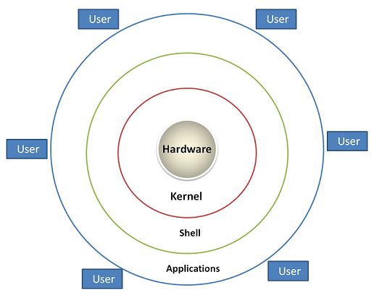
Architecture of Linux

Slide 21
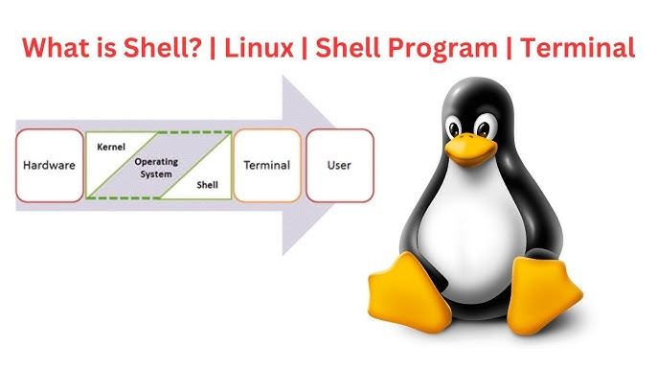
The kernel is the core component of an operating system that sits between the hardware and all other software.
It is responsible for controlling hardware, managing system resources, and enabling applications to run.
Process Management
Memory Management
Device Management
File System Management
System Security & Permissions

Slide 22
Terminal vs Shell
Terminal
A terminal is a program (or emulator) that opens a window and lets you type commands.
Examples: GNOME Terminal, Konsole, xterm, TTY (Ctrl+Alt+F3).
It provides the interface where text input/output happens.
Shell
A shell is the command interpreter that runs inside the terminal.
It processes the commands you type and runs them.
Examples: Bash, Zsh, Fish, Sh.

Slide 23
Major Linux Families
Family | Package Type | Examples | Known For
Debian | .deb | Ubuntu, Kali, Mint | Stability, huge repos
Red Hat (RHEL) | .rpm | RHEL, Fedora, CentOS Stream | Enterprise use
SUSE | .rpm | openSUSE, SLES | Enterprise + YaST tools
Arch | Pacman | Arch, Manjaro | Rolling release, lightweight
Slackware | pkgtool | Slackware, Salix | Simplicity & Unix-like
Gentoo | Portage | Gentoo | Source-based, very customizable
Independent | Mixed | Android, Alpine, NixOS | Designed from scratch

Slide 24
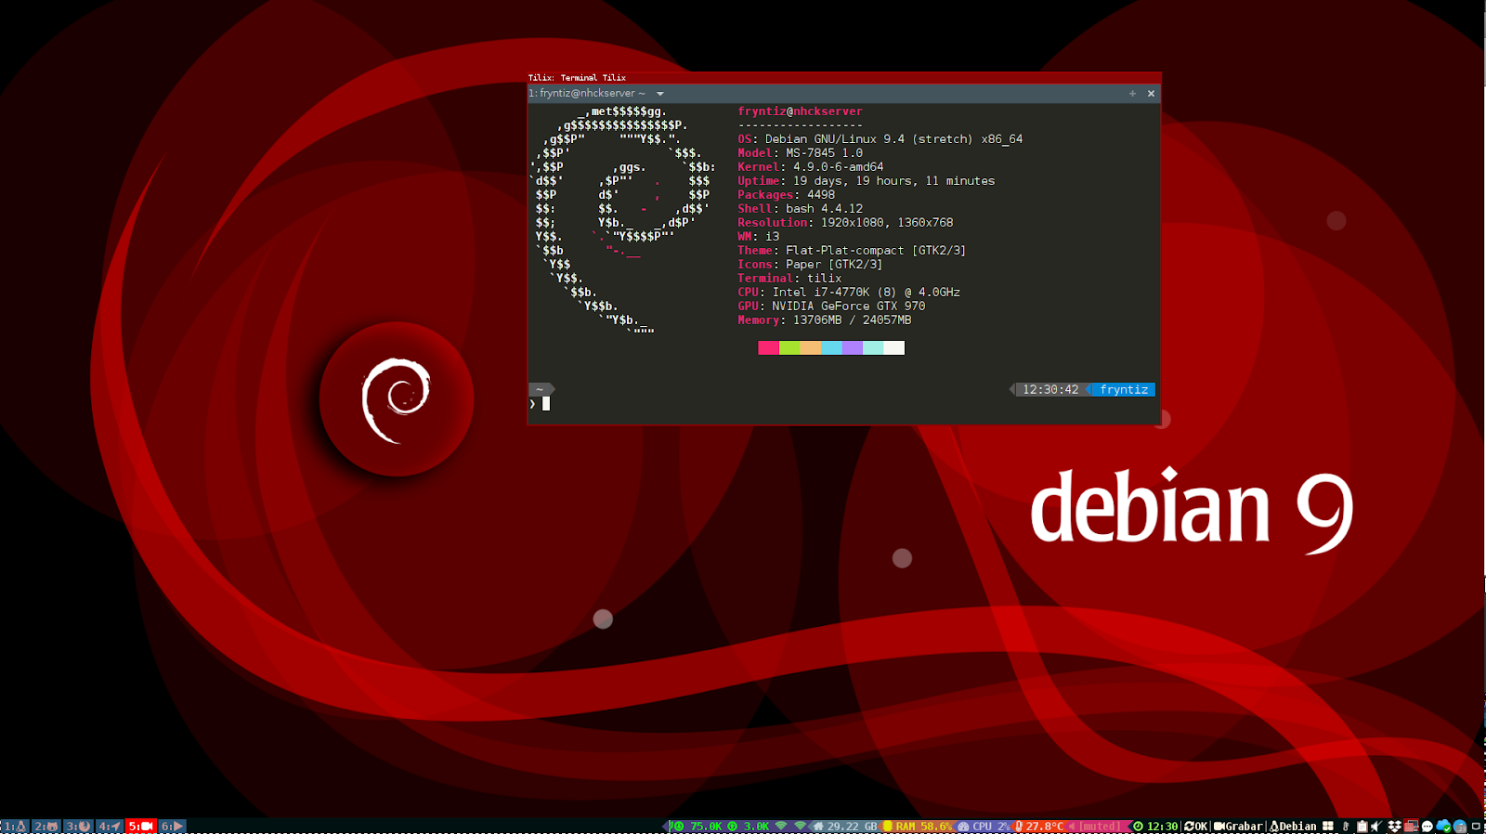
Debian Family - Debian

Slide 25
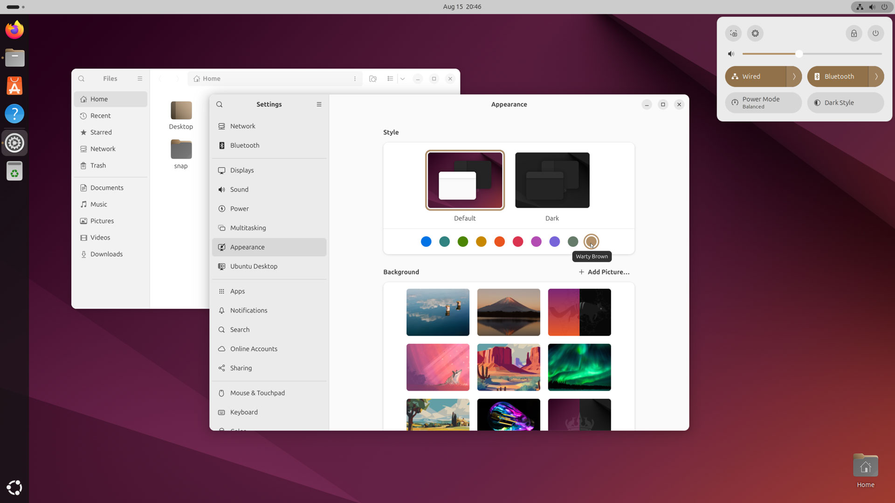
Debian Family - Ubuntu

Slide 26
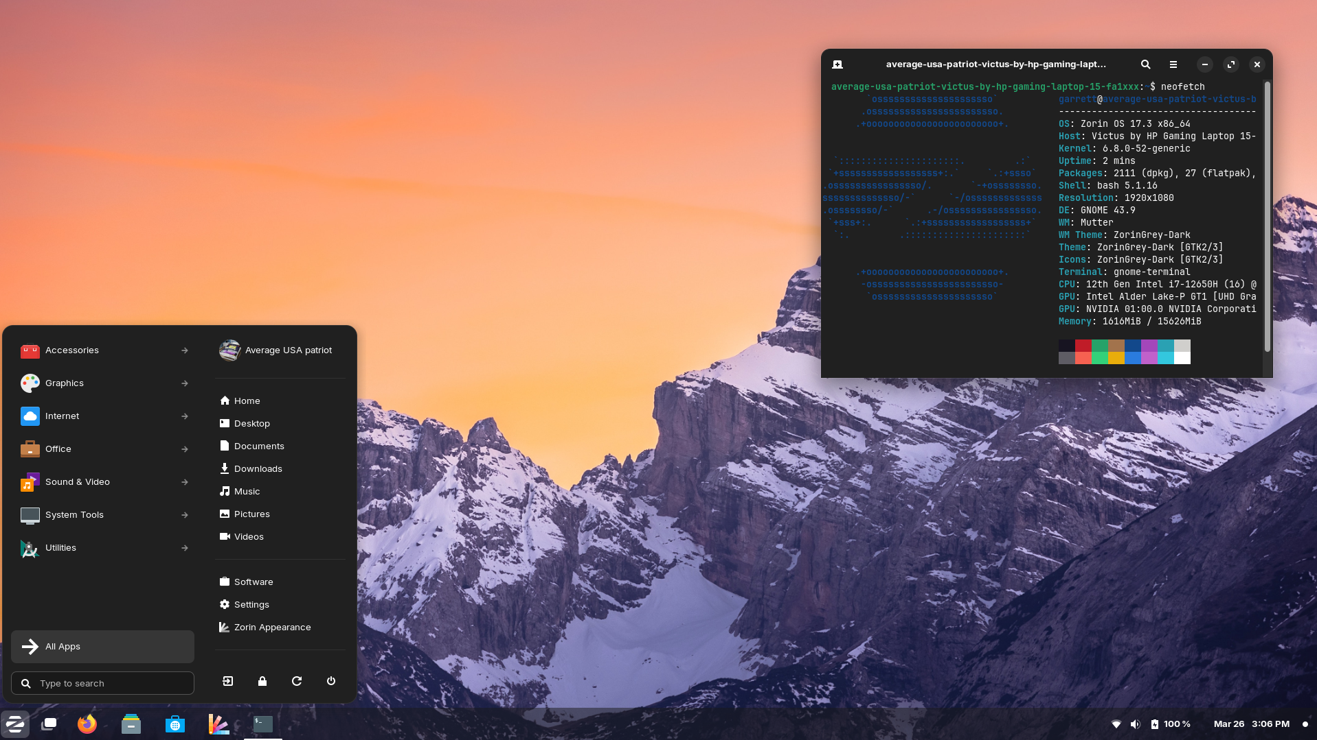
Debian Family – Zorin OS

Slide 27
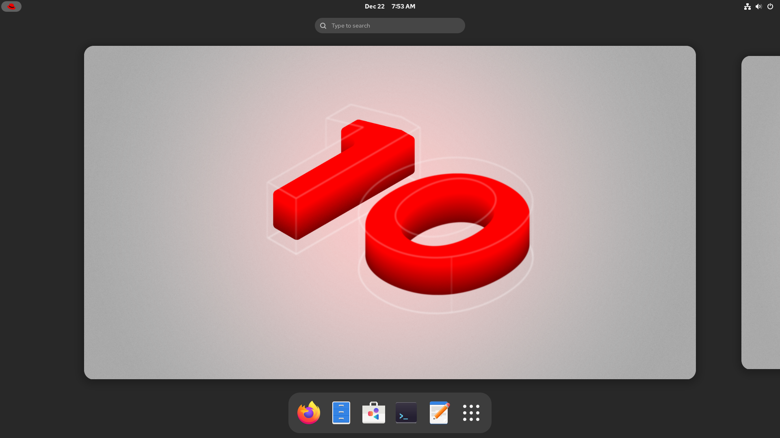
Red Hat Family - RHEL

Slide 28
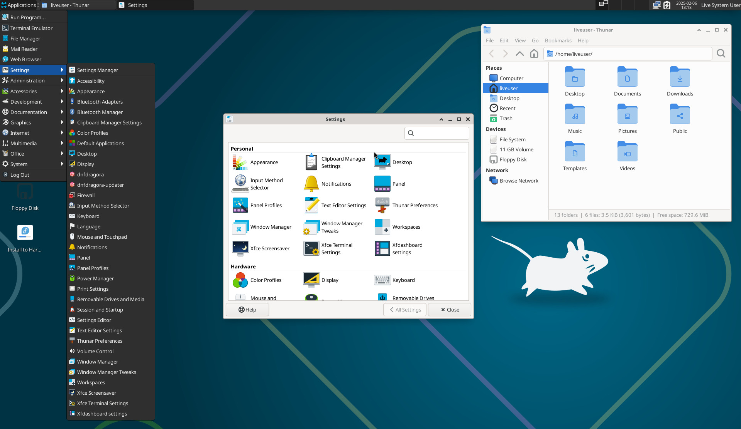
Red Hat Family - Fedora

Slide 29

Red Hat Family – Rocky 10

Slide 30
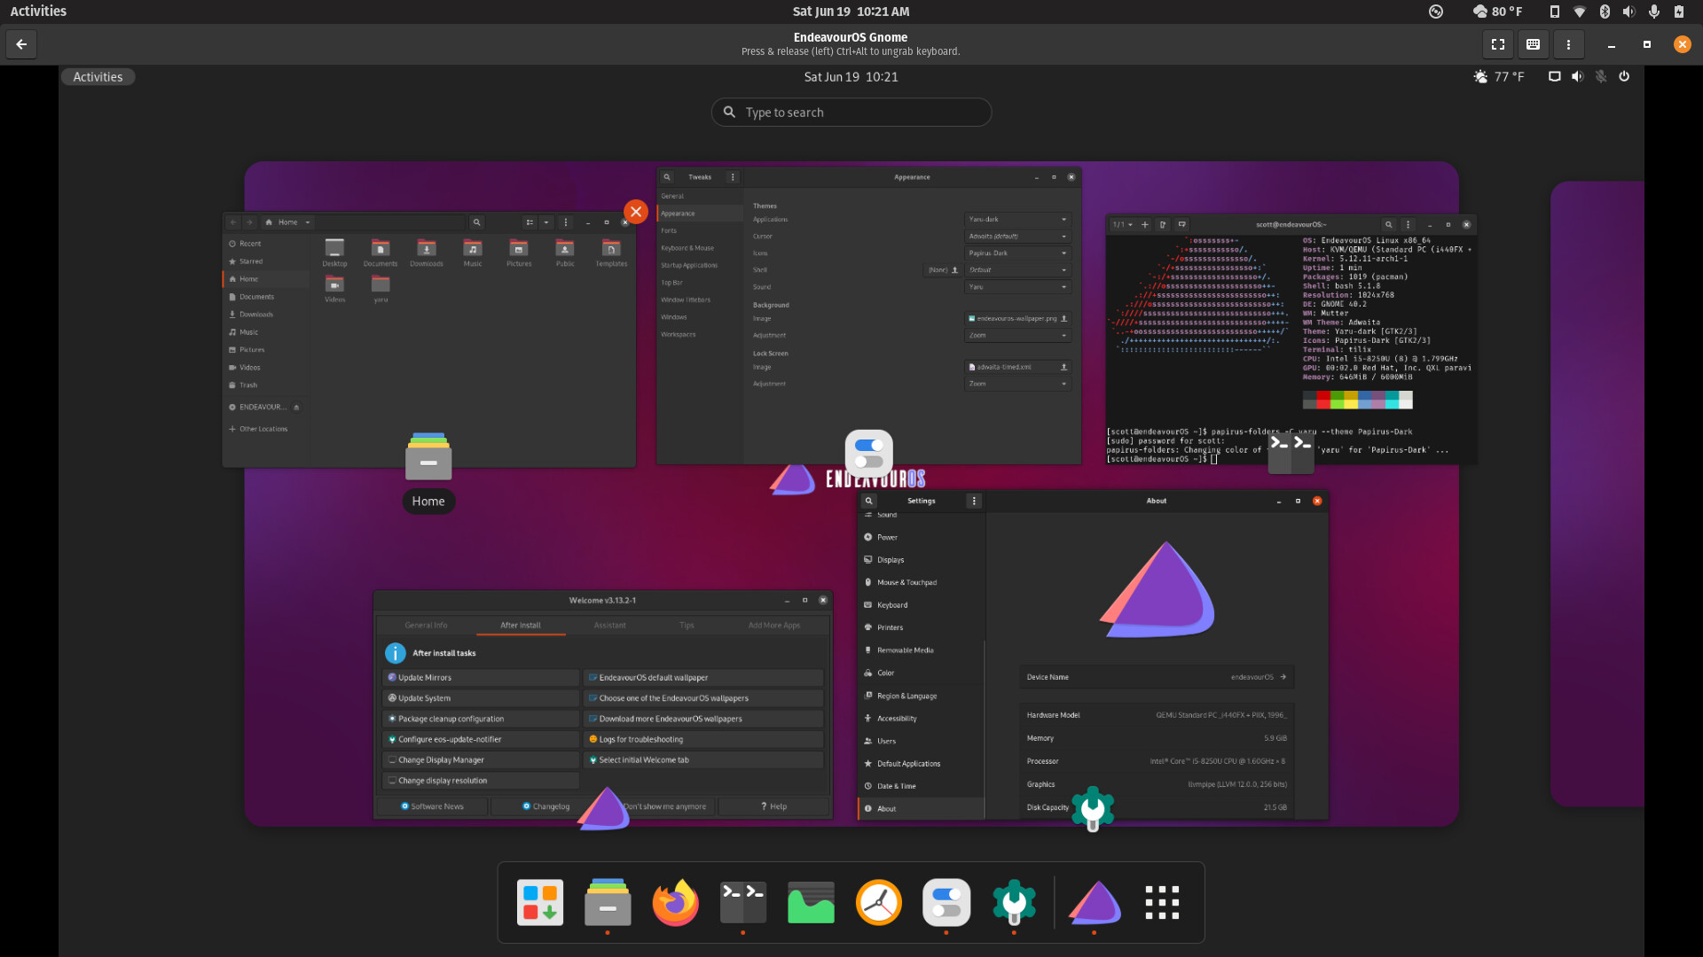
GNOME
And a shout-out to Cinnamon

Slide 31
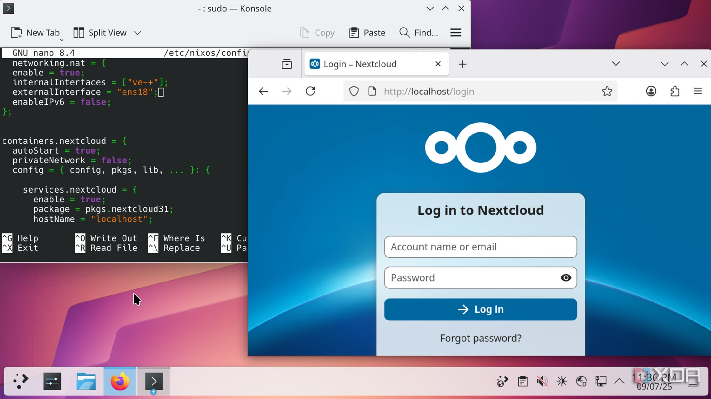
KDE Plasma
Endless Customization

Slide 32
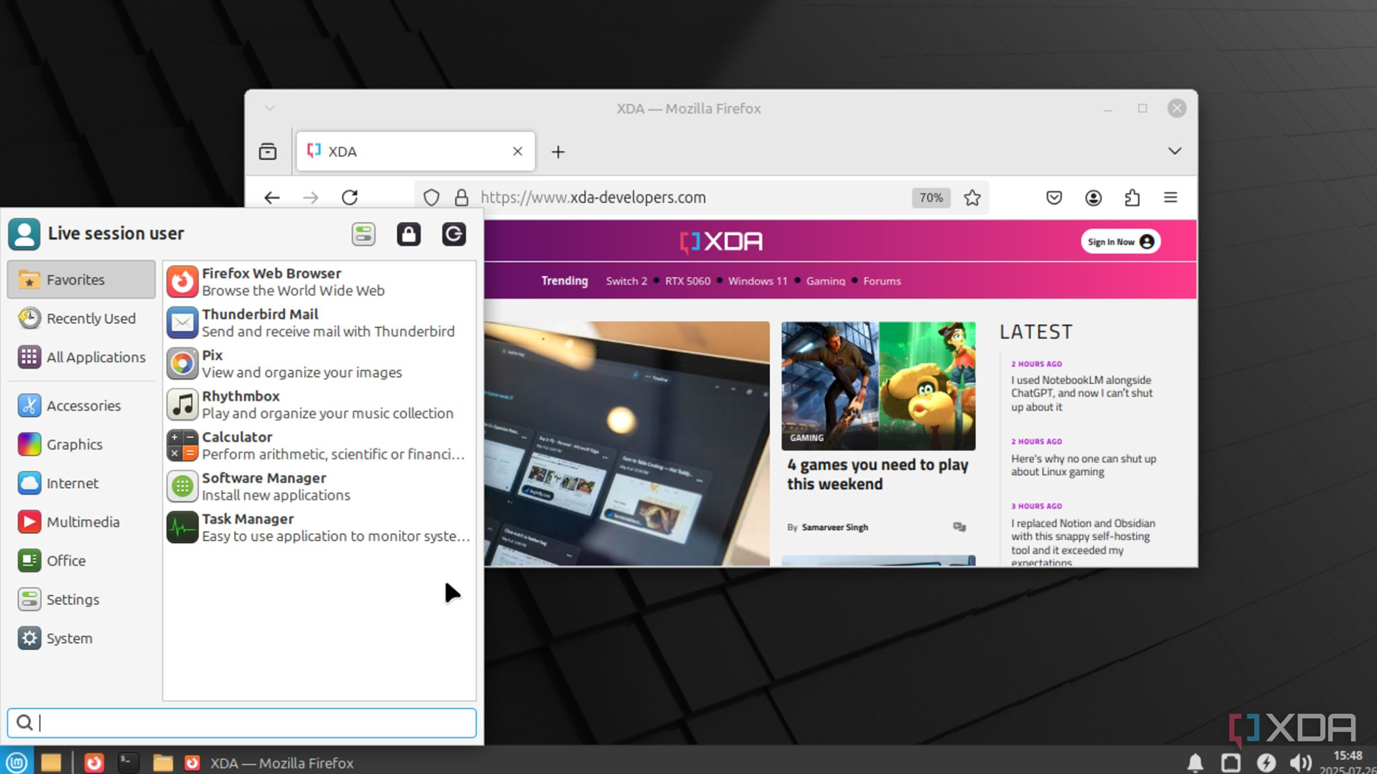
Xfce/Trinity Desktop
Ideal for reviving outdated machines

Slide 33
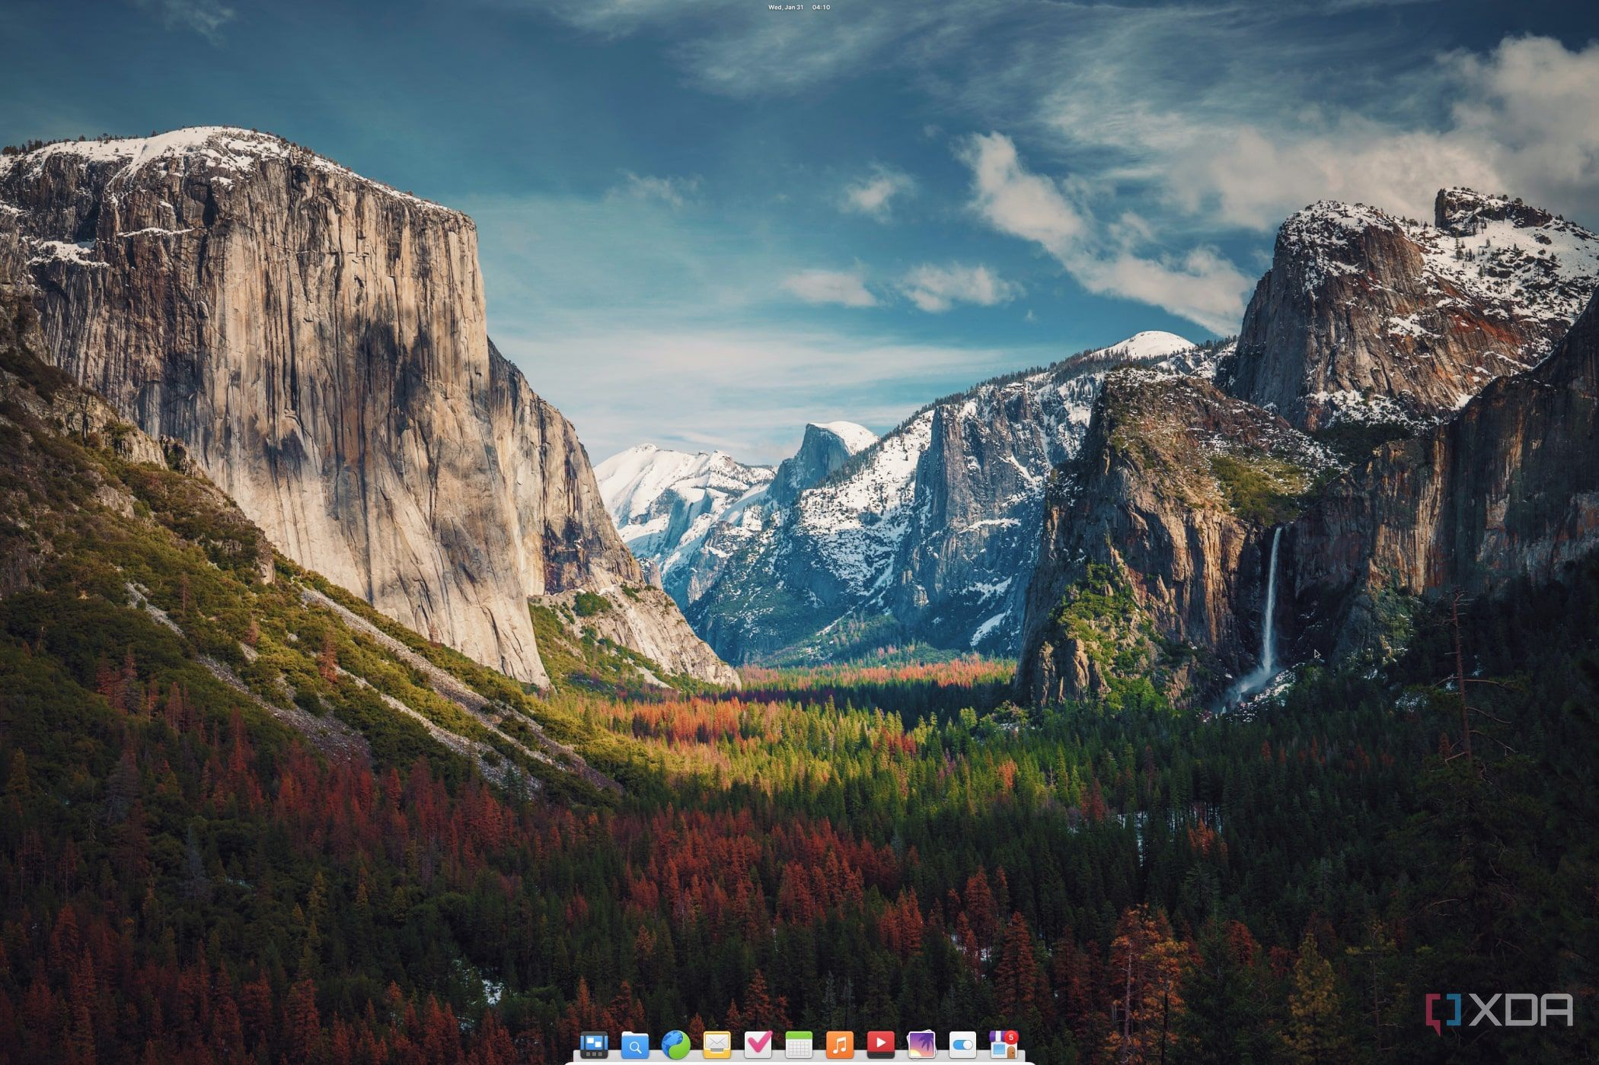
Pantheon
A gorgeous DE for macOS lovers

Slide 34
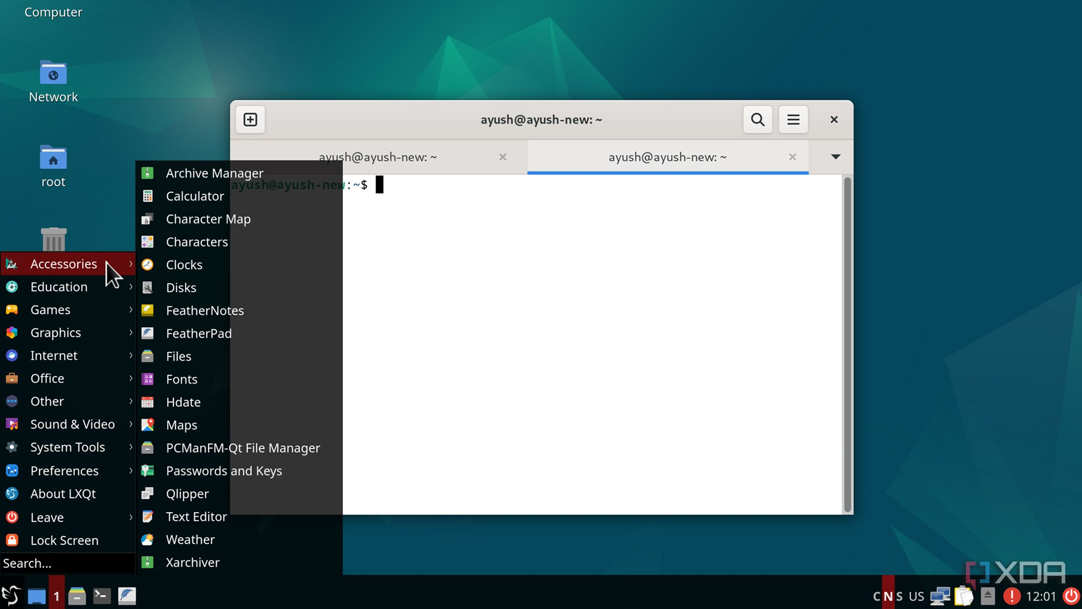
LXQt
Ultra-lightweight with a decent UI

Slide 35
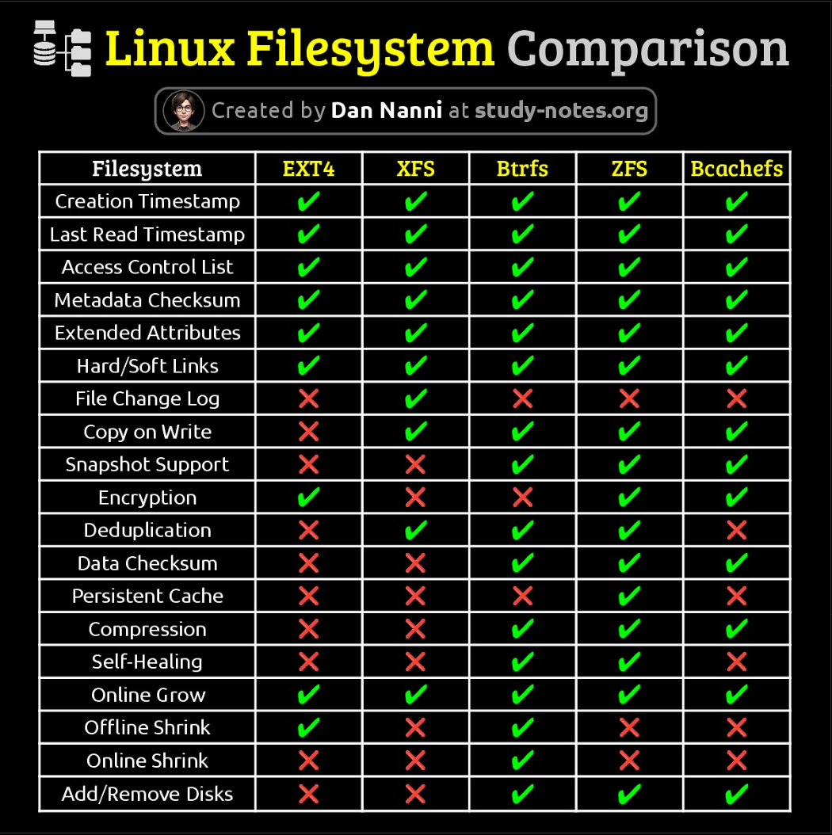

Slide 36
✔ Fully supported
🟡 Partially/optionally supported
⚠️ Experimental/community-supported
❌ Not supported
Supported File System Types
Distro | ext4 | XFS | Btrfs | LVM | ZFS | F2FS
Ubuntu | ✔ | ✔ | 🟡 | ✔ | ⚠️ | 🟡
Debian | ✔ | ✔ | 🟡 | ✔ | ⚠️ | 🟡
RHEL | 🟡 | ✔ (default) | ❌ | ✔ | ❌ | ❌
Fedora | ✔ | ✔ | ✔ (default) | ✔ | ❌ | 🟡
openSUSE | ✔ | ✔ (home) | ✔ (default) | ✔ | ❌ | 🟡
Arch | ✔ | ✔ | ✔ | ✔ | 🟡 | ✔
Manjaro | ✔ (default) | ✔ | ✔ | ✔ | 🟡 | ✔
Gentoo | ✔ | ✔ | ✔ | ✔ | ✔ | ✔
Mint | ✔ (default) | ✔ | 🟡 | ✔ | 🟡 | 🟡
Kali | ✔ | ✔ | 🟡 | ✔ | 🟡 | 🟡

Slide 37
Common Partitioning Setup for Windows/Linux
Windows: Usually requires at least two partitions:
  C: (for OS and applications)
  System Reserved or EFI System Partition (for boot files)
Linux: Typically, has at least three partitions:
  / (root, where the OS is installed)
  /home (stores user files, optional but useful)
Partitioning Options During Installation
Automatic Partitioning – The OS installer sets up the partitions for you.
Manual Partitioning – You create and manage partitions yourself.

Slide 38
HARD DISK DRIVE[HDD]
Windows 10 OS [Client OS]
HDD
Windows 10 OS
User INFO
C Drive
D Drive

Slide 39
File system
A file system is a method or structure used by an operating system (OS) to store, organize, retrieve, and manage data on storage devices like hard drives (HDDs), solid-state drives (SSDs), and USB drives. It determines how data is stored, named, and accessed on these storage devices.

Slide 40
📌 Common Types of File Systems:
FAT (File Allocation Table)
Variants: FAT16, FAT32, exFAT
Common Use: Widely used on USB drives, SD cards, and older operating systems.
Features:
  FAT32 supports a maximum file size of 4GB and partition size up to 8TB.
  exFAT is an improved version of FAT32, designed for larger file sizes (over 4GB) and flash drives.
  Pros: Simple, widely supported by many OS and devices.
  Cons: No support for file permissions, less efficient for large files or modern computing needs.

Slide 41
2. NTFS (New Technology File System)
Common Use: Default file system for Windows operating systems.
Features:
  Supports large file sizes (up to 16TB) and large partitions.
  Supports file permissions, encryption, compression, and disk quotas.
  Pros: Reliable, secure, supports large files and volumes.
  Cons: Not natively supported by macOS or Linux without additional software.

Slide 42
📌 Key Functions of a File System:
Data Organization: It organizes data into files and directories (folders) to make it easy to manage and access.
File Naming: File systems determine the naming conventions, such as allowed characters and file extensions (e.g., .txt, .jpg).
Storage Management: Manages how data is written to and read from the storage device.
Security: Provides mechanisms like access control and permissions to protect data.
Data Integrity: Ensures that data is written to the disk in an organized and recoverable way.

Slide 43
File system in Linux

Slide 44
Linux typically uses a hierarchical file system structure that starts from a single root directory denoted by /.
This structure is based on the Filesystem Hierarchy Standard (FHS).
The Filesystem Hierarchy Standard (FHS) defines the directory structure and contents in Linux and Unix-like operating systems. It is maintained by the Linux Foundation. The FHS dictates how files and directories are organized within the filesystem, ensuring interoperability and uniformity across different distributions and applications.

Slide 45
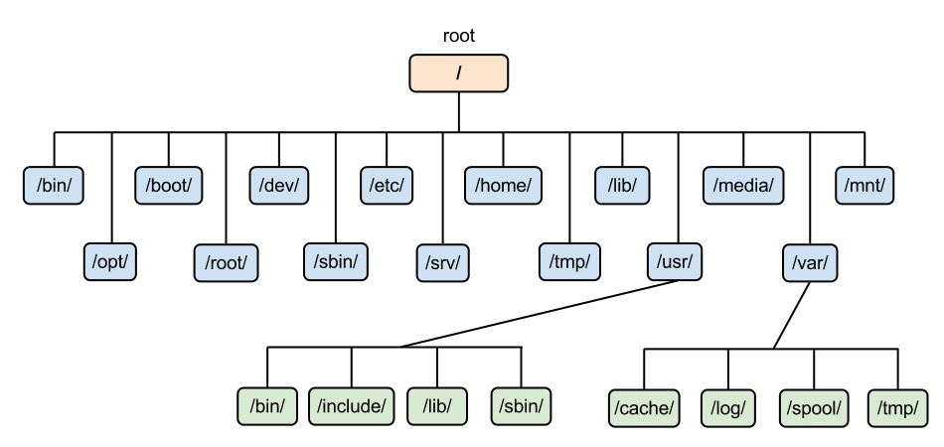

Slide 46
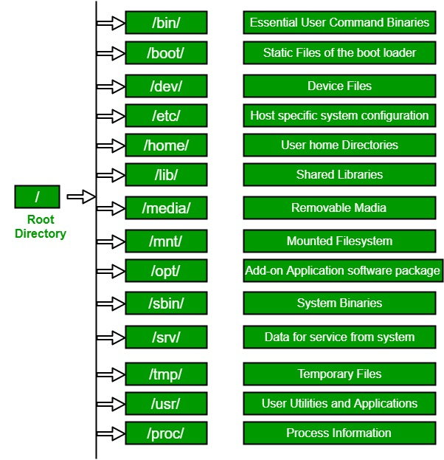

Slide 47
/
The top-level directory is the root filesystem and contains all of the files required to boot the operating system before other filesystems are mounted as well as the files required to boot the other filesystems. After boot, all of the other filesystems are mounted at standard mount points as subdirectories of the root.
/bin
Contains essential command binaries.
/boot
Consists of the static bootloader, kernel executable, and files required to boot the Linux OS.
/dev
Contains device files to facilitate access to every hardware device attached to the system.

Slide 48
/etc
Local system configuration files. Configuration files for installed applications may be saved here as well.
/home
Each user on the system has a subdirectory here for storage.
/lib
Shared library files that are required for system boot.
/media
External removable media devices such as USB drives are mounted here.
/mnt
Temporary mount point for regular filesystems.

Slide 49
/opt
Optional files such as third-party tools can be saved here.
/root
The home directory for the root user.
/sbin
This directory contains executables used for system administration (binary system files).

Slide 50
/tmp
The operating system and many programs use this directory to store temporary files. This directory is generally cleared upon system boot and may be deleted at other times without any warning.
/ usr
Contains executables, libraries, man files, etc.
/var
This directory contains variable data files such as log files, email in-boxes, web application related files, cron files, and more.

Slide 51

Basic Commands

Slide 52
some of the basic commands
Task | Commands
Lock | Super Key + L(Windows Key)
Log out | gnome-session-quit
Reboot | reboot
Shutdown | poweroff

Slide 53
Hostname
hostname
To view the hostname
hostname <test>
To change the hostname temporarily
hostnamectl set-hostname <NEW-HOSTNAME>
To change hostname permanently

Slide 54
Date and Time view as well as management
timedatectl
date
Commands to view date and time
timedatectl set-time <10:15:25>
To change time
timedatectl set-time <‘2025-05-25 10:15:25’>
To set date and time

Slide 55
To set Time zones
timedatectl list-timezones
To list all timezones
timedatectl set-timezone Asia/Kolkata
To change timezone

Slide 56
Calendar
cal
To view Calender

Slide 57
Basic Commands
1. whoami
Displays who you are
2. pwd
Displays the present working directory
3. cd
Change directory
4. ls
List the content [blue-Dir, white-file]

Slide 58
Absolute path vs Relative path
Feature | Absolute Path | Relative Path
Definition | Full path from the root / directory | Path relative to the current working directory
Starting Point | Always starts with / | Does not start with /
Example | /home/user/documents/file.txt | documents/file.txt or ../file.txt
Consistency | Always points to the same location | Depends on where the command is run
Portability | Less portable (hard-coded paths) | More portable within projects

Slide 59
Navigating path and managing files and directory
cd (change directory) command is used to navigate from one location to anotherin terminal
#cd /var/tmp User will be in tmp directory
#cd .. User will move back one level
#cd ../.. User will move back two level
# cd User will move to home directory

Slide 60
managing files and directory
ls (list) command is used to list directory in terminal
# -l Longlist including attribute
# -a All files including hidden files
# ~ List all the user home directory
# –al All files including hidden files with long list. (dot[.] files are hidden files)

Slide 61
managing files and directory
touch command normally update the timestamp without modifying the file and also used for creating empty file.
# touch filename ,Create empty file
# touch file1 file2 file3 ,Create multiple empty file
# touch filename{1..10} ,Create empty 10 file with name file1, file2 and so on
#cat >file1
#cat >>file1
#vim filename
Cat (Concatenate), cat command is used for multiple purpose, for creating, appending, reading, merging file.

Slide 62
managing files and directory
The cp (copy) command copies a file, creating a new file either in the current directory or in specified directory.
It also copy multiples files to a directory.
# cp source_file_name destination_path Copy a file.
# cp file1 file2 destination directory_path Copy multiple file, destination must be directory.

Slide 63
managing files and directory
mv (move) command is used for couple of purpose, for moving and renaming a file or directory.
#mv file 1 file2
File1 will be renamed by file2 if same location.
#mv file1 file2 destination_path
File will move from one location to another.
# mv dir1 dir2
If dir2 is present then it will move, and if dir2 is not available then it will rename.
# mv dir1 dir2 dir3
Dir1 and dir2 will be moved to dir3

Slide 64
rm (remove) command is used for removing file and directories with option. rmdir command is also used for removing empty directory.
managing files and directory
# rm -r directory_name
Remove the directory or file by specifying file name.
# rm -rvf directory_name
Remove the directory or file forcefully.
# rm -rvf dir*
Remove the all directory which is starting with dir.
# rmdir directory name
Remove the empty directory

Slide 65
VIM Editor
Vim (Visual Interface Improved) is a powerful command line-based text editor that has enhanced the functionalities of the old Vi text editor.
It is one the most popular and widely used by programmer.
You can use vimtutor command in terminal to learn more about VIM
It have special color feature when you will edit any configurations file.
#vimtutor

Slide 66
VIM- Command Mode
Key | Description
i | insert the text at current cursor position
I | inserts the text at the beginning of the line
a | appends the text after cursor position
A | appends the text at the end of line
o | inserts a line below current cursor position
O | insert the line above current cursor position

Slide 67
VIM- Command Mode
Key | Description
h | Cursor move left one position
l | Cursor move right one position
j | Cursor move down one position
k | Cursor move up one position
$ | Cursor move to the end of the line
gg | Cursor move to first line of documents

Slide 68
VIM- Command Mode
Key | Description
yy | Copy current line
p | Paste below line from cursor position
dd | Delete current line
2yy | Copy 2 lines below from cursor position
yw | Copy one word
yl | Copy one letter
u | undo
x | Its work like delete button
X | Its work like backspace button

Slide 69
VIM- Command Mode
Key | Description
:w | Write/save working file similar as ctrl+s in windows
:q | Quit from current file
:wq | Save and quit from file
:x | Save and quit from file
:wq! | Save and quit forcefully
:q! | Quite forcefully

Slide 70
VIM- Extended Mode
Key | Description
:se nu | Set line number
:se nonu | Remove line number
:/string | Scarch a word in a file
:%s/string1/string2 | Find and replace
:number | Cursor will jump to given line number

Slide 71
GREP vs FIND Command Notes (Rocky Linux)
GREP Command
Used to search text inside a file.
Example:
grep root /etc/passwd
Explanation: Searches the word 'root' inside the file /etc/passwd.

Slide 72
FIND Command
Used to search files or directories by name, type, or location.
Example:
find / -name student1
Explanation: Searches for a file or directory named 'student1' starting from root (/).
Search only directories:
find / -type d -name testdir
Search only files:
find / -type f -name testfile

Slide 73
3. GREP -r Command
Used to search text inside all files within a directory.
Example:
grep -r root /etc/
Explanation: Searches the word 'root' inside all files under /etc directory.
Quick Exam Summary
grep -> Search text inside a file
find -> Search file or directory by name
grep -r -> Search text inside a directory

Slide 74
What is GREP?
GREP is used to search text inside a file.
It displays matching lines.
Syntax:
grep [options] pattern filename
grep prasad testfile.txt
Searches the word 'prasad' inside file.

Slide 75
grep -i TEST testfile.txt
Ignores uppercase and lowercase differences.
grep -n test testfile.txt
Displays matching lines with line numbers.
grep -r prasad testdir/
Searches inside all files in directory.
grep -n prasad testfile.txt
Displays matching lines with line numbers.

Slide 76
grep prasad testfile.txt testdir/testfile.txt
Searches pattern in multiple files.
grep -c prasad testfile.txt
Counts number of matching lines.
• GREP searches content
• Shows matching lines
• Supports options like -i, -n, -r, -c
• Very important for interviews and exams

Slide 77
Hard Link and Soft Link
Hard Link
Definition:
A hard link is another name (directory entry) for the same inode of a file. Both files share the same data and inode number.
Command to Create Hard Link:
ln original_file hardlink_file
Example:
touch file1
ln file1 file1_hard
Check inode number: ls -li

Slide 78
Important Points:
- Works only for files (not directories)
- Cannot cross filesystems
- Shares same inode number
- If original file is deleted, hard link still works

Slide 79
Soft Link (Symbolic Link)
Definition:
A soft link (symbolic link) is like a shortcut that points to the original file path. It has a different inode number.
Command to Create Soft Link:
ln -s original_file softlink_file
Example:
touch file2
ln -s file2 file2_soft
Check link:
ls -l
Important Points:
- Can link files or directories
- Can cross filesystems
- Has different inode number
- If original file is deleted, soft link becomes broken

Slide 80
  Comparison Table
Hard Link vs Soft Link:
Hard Link:
Same inode, Cannot cross filesystem, Cannot link directories, Works even if original is deleted
Soft Link:
Different inode, Can cross filesystem, Can link directories, Breaks if original is deleted
Simple Explanation
Hard link = Two names for the same file data.
Soft link = Shortcut pointing to another file.

Slide 81
What is Stored in an Inode
An inode contains vital information needed by the operating system to manage files, including:
File type: Specifies if it is a regular file, directory, symbolic link, etc.
Permissions: Read, write, and execute permissions for the owner, group, and others.
Ownership: The User ID (UID) and Group ID (GID) of the file's owner.
Size: The size of the file in bytes.
Timestamps: Time of last access (atime), last modification (mtime), and last status change (ctime).
Link count: The number of hard links (filenames in directories) pointing to this inode.
Data Block Pointers: Pointers to the physical disk blocks where the actual file data is stored.

Slide 82
Pipeline
A pipe is a command which use to run one or more than one command.
Piping is a method though which you send data from one program to another, with the help of operator (|).
A pipe connect the standard output of the first command to the standard input of next command.
Pipes send standard output to or get standard input from another process.
Pipelines allow the output of a process to be manipulated and formatted by other process before it is output to the terminal.

Slide 83
How o use Pipeline and Command integration
#mkdir -p jetking && touch jetking/file{1..7}
#cat /etc/passwd | wc –l(to count the number of user accounts on a Linux system)
#cat /etc/passwd|tr a-z A-Z(converting all lowercase letters to uppercase)
#cat filename |sort(sort those contents alphabetically or numerically)
#cat filename |sort|uniq (used to display the unique lines of a file, sorted alphabetically)

Slide 84
/etc/shadow — Shadow Password File
📂 What it is:
A system file that stores hashed (encrypted) passwords and password aging/security-related information for each user account.
It’s not readable by regular users — only root or privileged processes can read it. That improves password security.
🔐 Why it exists:
Older systems stored passwords directly in /etc/passwd, which is world-readable. This is insecure because someone could copy the password hashes and try to crack them offline.
Linux solves this by moving password hashes and sensitive password data into /etc/shadow, which is protected from all but root or privileged access.
What it contains:
Each line in /etc/shadow corresponds to one user and has fields separated by colons, like:
username:hashed_password:last_changed:min_age:max_age:warn:inactive:expire:reserved

Slide 85
Where:
username — user login name
hashed_password — the encrypted password
last_changed — when password was last changed
min/max age — how often passwords can/must be changed
warn/inactive/expire — aging and expiration rules
reserved — extra field for future use
Examples of values:
!! or ! in the password field usually means account not set up or locked (no login by password).
In short:
/etc/shadow securely stores user passwords and related metadata in a way that ordinary users can’t read, reducing the risk of password cracking.

Slide 86
/etc/skel — Skeleton Directory
🎨 What it is:
A default template directory for new user home directories.
When you create a new user with useradd -m, the system automatically copies everything inside /etc/skel into the new user’s HOME directory.
📁 What it contains:
Usually some default configuration files like:
.bashrc — shell settings
.bash_profile — login shell setup
.bash_logout — logout commands
Anything else you want every new user to start with

Slide 87
Why it exists:
So every new user has a basic environment already set up when they first log in.
You can customize it as per your standard setup — e.g., default directories, configs, aliases.
In short: /etc/skel is the default template for home directories that ensures every new user gets the same starting files/settings.

Slide 88
/var/spool/mail — Mail Spool Directory
📬 What it is:
A directory where the system stores local incoming mail for users — one file per user (e.g., /var/spool/mail/raj).
This is also called the mail spool.
📦 Why it exists:
Traditional mail delivery agents (like Postfix or Sendmail) deposit messages here when local mail arrives.
Files in this directory act as the inbox for local mail clients to read.

Slide 89
📄 How it works:
Mail is delivered by a mail delivery agent or system processes (like cron output) into /var/spool/mail/<username>.
Users can then read their mail using mail clients or by checking those files manually.
If there’s no mail delivered yet, these files will be empty — which is why your user1 file had no content.
In short: /var/spool/mail/ is the traditional location for storing local user email messages waiting to be read.

Slide 90
File/Directory | Purpose | What It Contains
/etc/shadow | Stores secure password info | Hashed passwords, aging & expiration details
/etc/skel | Templates for new users | Default dotfiles copied to new users’ home
/var/spool/mail | Local email storage | Mail spool files for each user

Slide 91
Local Users
  Users can be either people (meaning accounts tied to physical users) or accounts that exist for specific applications to use.
  A user account is used to provide security boundaries between different people and programs that can be run.
  The user associated with a running process determines the files and directories accessible to that process.
  The id command is used to view the current login user. Same command is for other users too, by specifying the username.

Slide 92
commands
id
command is used to view the current login user
id prasad
command is used to view the prasad user

Slide 93
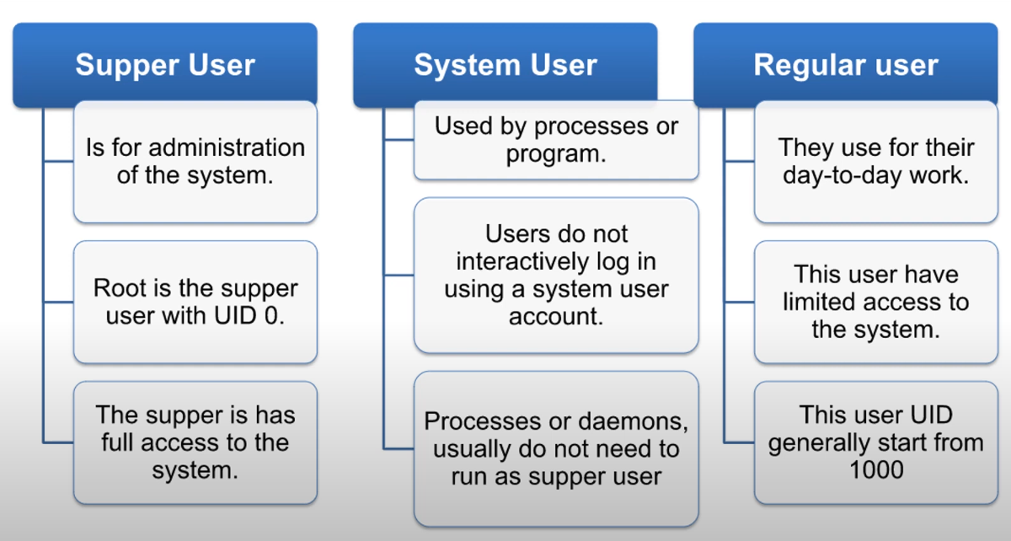
Local user

Slide 94
UID Ranges
UID 0
– is reserved for root user
UID 1–200
– is reserved for system users assigned statically to system processes by Red Hat
UID 201–999
– This ID is normally assigned is reserved for system users, used by system processes that do not own files on the file system dynamically from the available pool when the software is installed.
UID 1000+
– is the range available for regular users.

Slide 95
Local Users
All local users’s information is kept in a "flat file" located at: /etc/passwd.
This file has seven fields, each field contains specific information:
Username
Password
UID (User ID)
GID (Group ID)
Comment (User information)
Home Directory
Shell (Default shell for the user)

Slide 96
Example Entry:
[root@Linux1 ~]# grep prasad /etc/passwd
prasad:x:1002:1002::/home/prasad:/bin/bash
Explanation of Fields:
Ramesh → Username
x → Password (masked, actual password is stored in /etc/shadow)
1002 → UID
1002 → GID
(Empty) → Comment(HR/Admin/IT)
/home/Ramesh → Home Directory
/bin/bash → Default Shell

Slide 97
Managing Local Users
# useradd [option] <username>
Option | Description
-c 'comment' | Create user with a comment
-d | Change default home directory
-M | Create user without a home directory
-N | Create user without a primary group
-u | Create user with a specific user ID

Slide 98
Managing Local Users
• You can manage user in Linux both way Graphical and command
line utilities
• useradd - -help command displays the basic option.
• Range of valid UID numbers and default password aging rules,
are read from /etc/login.defs
• Generally following commands used to manage users along with
options
#useradd
#usermod
#userdel

Slide 99
To create new user
To delete a user
# userdel user1
To delete a user
# cat /etc/passwd
To verify
# useradd user1
To create new user
# cat /etc/passwd
To verify
To create new user with comment
#useradd -c account user2
user2 : x : 1004 : 1004 :account: /home/user2 : /bin/bash
To verify
#cat /etc/passwd

Slide 100
Change default home directory
# useradd -d /opt/user3 user3
To verify
#Is /opt/
Create user without a home directory
# useradd -M user4
To verify
#cat etc/passwd/
#ls /home/

Slide 101
Rename a username
Usermod –l new_username old_username
(-l) Login Name

Slide 102
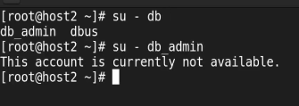
nologin, login can never be done why no login: to no to interact with the other user, it may be a data base stored once.
  Creating a user where we can't login
  #useradd -s /sbin/nologin db_adminl

Slide 103
Create user without a primary group
To view the defaults
# cat /etc/default/useradd
useradd defaults file
ROUP= 1OO
HOME= /home
INACTIVE=1
EXPIRE=
SHELL=/bin/bash
SKEL=/etc/skel
CREATE MAIL SPOOL=yes
#useradd -N user5

Slide 104
Example
  # useradd -u 2056 user7
  To verify
  # cat /etc/pass

Slide 105
To view the group info
# cat /etc/group
Results--
user1:x:1003:
user2:x:1004:
user3:x:1005:

Slide 106
Group
Primary
secondary
To add Group
# groupadd HR
# groupadd ADMIN
# groupadd IT

Slide 107
🔹 Primary Group
Each user is assigned one primary group.
It is defined in the /etc/group file.
When the user creates a file, that file is automatically assigned the primary group as its group owner.
By default, a new user’s primary group is a group with the same name as the username (this is called user-private group model).
Example:
$ id rahul
uid=1001(rahul) gid=1001(rahul) groups=1001(rahul)
Here, gid=1001(rahul) is the primary group of user rahul.

Slide 108
🔸 Secondary Groups
A user can be a member of multiple secondary groups.
These allow users to access resources shared with other groups.
Secondary groups are listed in the /etc/group file.
Example:
$ id rahul uid=1001(rahul) gid=1001(rahul) groups=1001(rahul),27(sudo),1002(devs)
Here, sudo and devs are secondary groups that the user rahul belongs to.

Slide 109
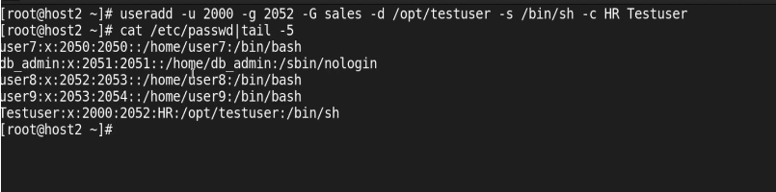
Club all the commands
Creating a user with
UID – 2000
primary Group – 2052
secondary – IT
home dir # opt/testuser
shell /bin/sh
comment -- HR

Slide 110
# usermod [option] <username>
Managing Local Users
Options | Descriptions
-aG | Add a user in multiple group
-L | You can lock the user account
-e | set or change the account expiration date for a user
-u | Change the user id
-m | Move the user home directory must be used with –d option
-s | Create user with specific login shell
-U | Unlock the user account

Slide 111
Add a user in multiple group/Add user to a secondary group
# usermod -aG devs Rahul
  To verify
  # cat /etc/group
  Change a user's primary group
# usermod -g newgroup Rahul
  To verify
  # cat /etc/group

Slide 112
  Change a user’s comment
# usermod -c IT rahul
Set account to expire on 1st June 2025
# usermod -e 2025-06-01 Rahul
Remove account expiration (make it permanent)
# usermod -e " " rahul
🔍 To verify the expiration date:
chage -l rahul
This will show:
Account expires : Jun 01, 2025

Slide 113
To create a group with specific group id
# groupadd -g 3000 account
  To verify
  # cat /etc/group
To change the group id
# groupmod -g 1050 account
  To verify
  # cat /etc/group

Slide 114
To rename a group
# groupmod –n newgroup account
To add/replace from a group
  To verify
  # cat /etc/group
# usermod -G mygroup user1
User will stay in both group
# usermod –aG mygroup user1

Slide 115
To add a user in multiple group
#usermod -a -G HR,mygroup user3
To remove a user from group
#gpasswd -d userl HR
removing user user1 from group HR
#gpasswd -d user1 mygroup
removing user user1 from group mygroup
#gpasswd -d user2 mygroup
removing user user2 from group mygroup
  To verify
  # cat /etc/group

Slide 116
To add multiple user in a single group
# gpasswd -M user2,user3 mygroup
  To verify
  # cat /etc/group

Slide 117
Why Do We Set Password for a Group
Temporary Shared Access Without Permanent Membership
Suppose you have a directory:
/exam_data
This directory is owned by the group: examteam.
Only members of the examteam group can access this folder.
Now assume:
- 3 permanent staff members are already part of the examteam group.
- 1 external examiner visits for only one day.
- You do NOT want to permanently add him to the group using usermod -aG.

Slide 118
Steps to Use Group Password
Step 1: Set a password for the group
Command: gpasswd examteam
Step 2: Share the group password securely with the external examiner.
Step 3: The examiner runs:
Command: newgrp examteam
Step 4: After entering the group password, the examiner temporarily switches to the examteam group and gains access to /exam_data.
After the exam is completed, remove the group password:
Command: gpasswd -r examteam

Slide 119
Why Use Group Password?
- Provides temporary access
- No permanent modification in /etc/group
- Quick access control
- Easy to revoke access
Why Is It Rarely Used Today?
- Sharing passwords is insecure
- No proper auditing
- Hard to track who used the password
- Modern systems prefer usermod, ACLs, and role-based access control

Slide 120
How to kill a process by PID (example PID: 10156)
1. First try a graceful termination: kill 101756
This sends SIGTERM (signal 15) asking the process to exit cleanly.
2. If the process does not stop, force-kill it:
kill -9 101756
# This sends SIGKILL (signal 9), forcing the process to stop immediately.

Slide 121
3. If you get “Operation not permitted” (e.g., process owned by another user), use sudo:
sudo kill -9 101756
Only root (or sudo) can kill other users’ processes.
Notes
By default, `kill <PID>` sends SIGTERM (gentle request to terminate).
`kill -9 <PID>` sends SIGKILL (force kill) and cannot be caught or ignored by the process.
After killing, you can check if the process is gone:
ps -p 101756
If no output, it’s terminated

Slide 122
Gaining Super User Access
Super User
— In RHEL root is the superuser, who has full access to the system.
The root user can run all commands without any restrictions.
— This user managed the complete system administration.
— This user has the power to override normal privileges for the local user to perform some administrative tasks in the system.
— The root user in Linux is almost like the Administrator account in Windows.

Slide 123
• Switching Users
— With the help of "su" command you can switch between the users.
— If it is run by local user it will prompt for the password but if root user
invoke this command no password is required.
— The command su username starts a non-login shell, while the
command su - username starts a login shell

Slide 124
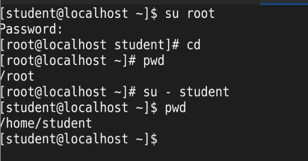
Example:

Slide 125
Sudo
Sudo can give root privileges by configuring etc/sudoers file.
— With sudo you can specified specific rights to the specific users
— Sudo requires to enter their own password not other unlike you do in su command.
— In RHEL9 all members of group wheel able to use sudo to run command.

Slide 126



sudoers
# cat /etc/sudoers

Slide 127
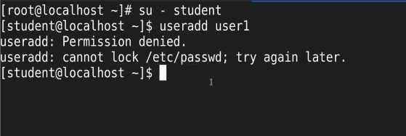
Trying to add new user-account as a local user

Slide 128
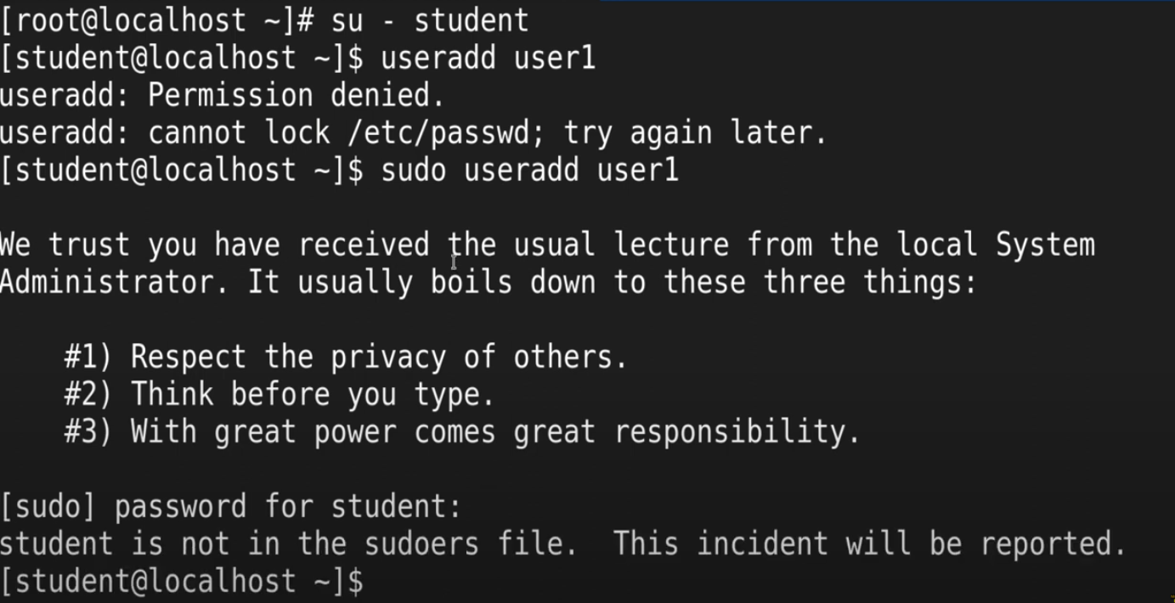

Slide 129
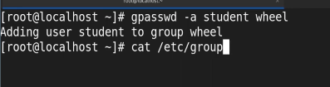

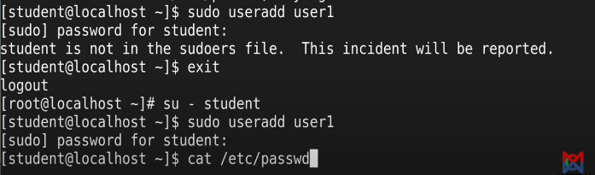

Slide 130
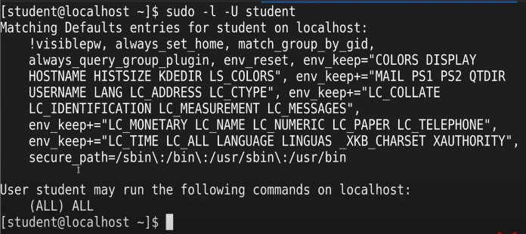

Slide 131

To remove then local user from wheel group

Slide 132
File Permission
• Permission allow a users to access resources in the
organizations.
• With the help of permissions, you can control file and directory
access.
• Red Hat Enterprise Linux permission are simple and flexible, by
which users can easily change or modify the permission of there file and directory.
• Files have three categories to which permission will apply, Users, Groups and Other Users.
• Permission precedence- user permission override group
permission, which override other permission.

Slide 133
Types of Permission
• Content of file can be read
• Content of directory can be listed
Read (r)
• Content of file can be change in file
• File can be created or deleted from the directory
Write (w)
• Files can be executed as command
• Content of the directory can be accessed.
Execute (x)

Slide 134
Viewing File Permission
d rwx r-x r-x . 2 root root 6 Feb 20 10:51 dir1
Directory
Directory Name
Owner Permission
Time Stamp
Group Permission
Group
Other Permission
Owner
No. of content inside

Slide 135
File Permission
Permission Precedence
— If UID match, Owner permission will apply
— If GID match, Group permission will apply
— If neither UID nor GID match, Other permission will apply
Modifying Permission
By default, all file and directory will have default permission, which can
be change with chmod command.
— chmod command function on three parameter who, what and which.
— Permission can be change either symbolic or numeric.

Slide 136
Symbolic Method
Symbolic Method
Permission
Operator
User = u
Read = r
+
Group = g
Write = w
-
Other = o
Exec = x
=

Slide 137
Numeric Method
Numeric Permission value
Numeric Permission value
No Permission = 0
Read = 4
Exc = 1
Read & Exec = 5
Write = 2
Read & Write = 6
Write & Exec = 3
Full Control = 7

Slide 138
Taking Ownership
• In RHEL who create the file or directory that user will become the owner and group owner of the file, but latter you can change ownership with chown command.
• chown can be used to change USER ownership
• chgrp can be used to change group ownership.
• Only root can change the ownership of a file. Group ownership, however, can be set by root or the file's owner.

Slide 139
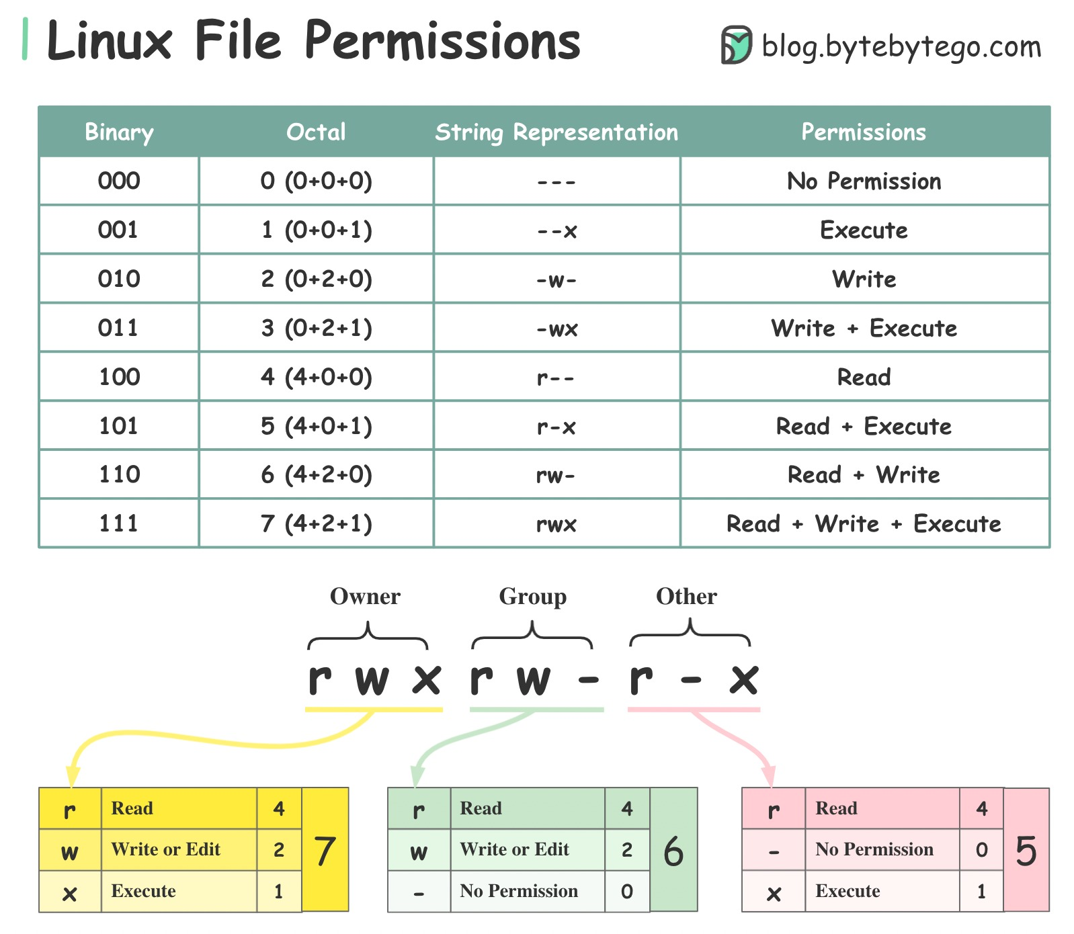

Slide 140
Special Permission
In Linux, apart from the normal permissions (r – read, w – write, x – execute), there are three special permissions that provide additional security and control.
They are:
SUID (Set User ID)
SGID (Set Group ID)
Sticky Bit
These permissions modify the normal behavior of files and directories.

Slide 141
SUID (Set User ID)
📘 Definition
SUID is a special permission applied to executable files.
When a file has SUID enabled, any user executing that file runs it with the file owner's permissions, not their own permissions.
📘 Purpose
It allows normal users to temporarily perform tasks that require higher privileges.
📘 How It Works
Normally:
A program runs with the permissions of the user who executes it.
With SUID:
The program runs with the permissions of the file owner.

Slide 142
📘 Real-Time Example
The Linux passwd command: passwd
When a normal user changes their password:
The system must modify /etc/shadow
/etc/shadow is owned by root
Normal users do not have permission to modify it, Because passwd has SUID set.
It runs with root privileges
So it can update the password securely
📘 Symbol Representation
-rwsr-xr-x
The s in the user execute position indicates SUID.
📘 Numeric Value
SUID = 4

Slide 143
SGID (Set Group ID)
📘 Definition
SGID is a special permission that can be applied to both:
Executable files
Directories
📘 Behavior on Files
When SGID is set on a file:
The file executes with the group permissions of the file, not the user’s group.
📘 Behavior on Directories
When SGID is set on a directory:
All new files created inside inherit the group ownership of the directory
Not the primary group of the user

Slide 144
📘 Why It Is Useful
Very important in:
Shared project directories
Team collaboration environments
Server environments
📘 Symbol Representation
drwxrwsr-x
The s in the group execute position indicates SGID.
📘 Numeric Value
SGID = 2
Example:
IT department shared folder
All users inside should have files under group "IT".

Slide 145
sticky bit
The sticky bit is used only on directories, to ensure that only the owner of a file can delete or rename it, even if others have write permissions on the directory.
Only the owner can delete their files in the directory.
✅ Method 1: Using Symbolic Mode
#chmod +t /path/to/directory

Slide 146
✅ Method 2: Using Numeric Mode
In numeric mode, the sticky bit is represented by 1 as the first digit.
chmod 1777 /shared
Verify Sticky Bit
Use the ls -ld command:
ls -ld /shared
drwxrwxrwt 2 root root 4096 May 26 10:00 /shared
Notice the t at the end — that's the sticky bit.

Slide 147
🔐 Special Permission Binary Logic
Special Permission | Value
SUID | 4
SGID | 2
Sticky | 1
Number | Meaning
1 | Sticky
2 | SGID
3 | SGID + Sticky (2+1)
4 | SUID
5 | SUID + Sticky (4+1)
6 | SUID + SGID (4+2)
7 | SUID + SGID + Sticky (4+2+1)

Slide 148
Umask
What is umask?
umask stands for user file-creation mode mask.
It defines default permissions when a new file or directory is created.
Every process has a umask value; child processes inherit it.
How It Works
Linux assigns a default base permission when a file/directory is created:
  Files: 666 (read/write for user, group, others)
  Directories: 777 (read/write/execute for all)
The umask subtracts (masks out) bits from these defaults.
Effective Permissions = Default Permissions – umask

Slide 149
umask | New File Perms | New Dir Perms | Meaning
000 | 666 – 000 = rw-rw-rw- | 777 – 000 = rwx-rwx-rwx | World-open (insecure)
022 | 666 – 022 = rw-r-r- | 777 – 022 = rwx-r-r- | Common default
027 | 666 – 027 = rw-r-- | 777 – 027 = rwx-r-- | Secure for group
077 | 666 – 077 = rw--- | 777 – 077 = rwx--- | Only user access
002 | 666 – 002 = rw-rw-r- | 777 – 002 = rwx-rwx-r- | Shared write group
umask u=rwx,g=rx,o=

Slide 150
Access control list
Access control list provides an additional more flexible permission mechanism for file systems. ACL allows you to give permission for any user or group to any disc resource

Slide 151
Command to assign and remove ACL permissions
  To add permission for user
  #setfacl –m u:username:rwx /path/to/file
  To add permission for group
  #setfacl –m g:groupname:rwx /path/to/file
  (is used to give a specific group extra permissions (read, write, and execute) on a file or directory, without changing the original owner or group of the file.)
  To allow all files or directories to inherit ACL, entries from the directory it is written
  #setfacl -dm u:john:rwx /project/data

Slide 152
To remove a specific entry
#setfacl –x u:user /path/to /file (for specific users)
To remove all entries
#setfacl –b path/to/file ( for all users)

Slide 153
Mounting a New Volume in Linux
Add the disk in VM-ware
Power off the VM → VMware Settings → Add → Hard Disk → SCSI → Create new virtual disk → 20 GB → Finish. This creates a virtual hard disk for Rocky Linux. Linux will later detect it as a block device.

Slide 154
sudo -i sudo = SuperUser DO; -i = login shell. This opens a root administrator shell so storage commands can be performed without typing sudo every time.
2. Become root
3. Find the new disk
lsblk
lsblk = List Block Devices. Look for the new disk by its size; in our example it is /dev/sdb. Do not assume the name check your own output.

Slide 155
4. Check filesystems lsblk -f
The -f option shows filesystem information such as FSTYPE and UUID. A blank FSTYPE on the new disk normally means it has no filesystem yet.
5. Create a partition
fdisk /dev/sdb
Inside fdisk type: n → p → Enter → Enter → Enter → w. fdisk is a disk-partitioning utility; n creates a new partition and w writes the changes.

Slide 156
6. Verify the partition
lsblk
You should now see /dev/sdb1 below /dev/sdb. /dev/sdb is the whole disk; /dev/sdb1 is its first partition.
7. Create an XFS filesystem
mkfs.xfs /dev/sdb1
mkfs = Make FileSystem; xfs = X File System. This puts a filesystem structure on the partition so Linux can store files.
WARNING: formatting destroys existing data on the target.

Slide 157
8. Verify the filesystem
lsblk -f
Confirm that /dev/sdb1 shows FSTYPE=xfs. XFS is the default filesystem in RHEL 9 and is a common choice for Rocky Linux 9.
9. Create a mount point
mkdir /data
mkdir = Make Directory. /data is the directory that will act as the mount point—the place where you will access the new storage.

Slide 158
10. Mount the volume
mount /dev/sdb1 /data
mount attaches the filesystem to a directory. Here, files stored on /dev/sdb1 become accessible through /data.
11. Verify the mount
df -h
findmnt /data
df = Disk Free; -h = human-readable. findmnt shows where the filesystem is mounted. You should see /dev/sdb1 mounted at /data.

Slide 159
12. Test the storage
echo "Rocky Linux storage test" > /data/test.txt
cat /data/test.txt
The first command creates a test file on the new volume; cat reads it back. If the text appears, the mounted storage is usable.
13. Get the UUID
lsblk -f
UUID = Universally Unique Identifier. Copy the UUID shown for /dev/sdb1; use your own UUID, not an example UUID.

Slide 160
14. Configure permanent mounting
vi /etc/fstab
Add: UUID=YOUR-UUID /data xfs defaults 0 0
/etc/fstab controls persistent mounts. The fields identify the filesystem, mount point, filesystem type, options, backup field, and check-order field.
15. Reload and test fstab
systemctl daemon-reload
mount -a
findmnt /data
systemctl manages systemd; daemon-reload makes systemd reread configuration. mount -a attempts the filesystem mounts listed in /etc/fstab. If there is no error, verify with findmnt.

Slide 161
16. Reboot and verify
reboot
After Rocky Linux starts, run: lsblk, df -h, and findmnt /data. If /data is mounted after reboot, the volume is persistent.
Quick Memory Formula
Find → Partition → Format → Create folder → Mount → Verify → Make permanent
Commands to remember: lsblk → fdisk → mkfs.xfs → mkdir → mount → df -h/findmnt → /etc/fstab

Slide 162
🔧 Basic Network Commands
Task | Command
Show IP address info | ip a / ip addr
Show network interfaces status | nmcli device status
Bring interface up | nmcli device connect eth0
Bring interface down | nmcli device disconnect eth0
Set static IP | nmcli con mod eth0 ipv4.addresses 192.168.1.100/24
Set gateway | nmcli con mod eth0 ipv4.gateway 192.168.1.1
Set DNS | nmcli con mod eth0 ipv4.dns 8.8.8.8
Set DHCP | nmcli con mod eth0 ipv4.method auto

Slide 163
📡 Network Status & Info
Task | Command
Show all connections | nmcli connection show
Show details of a connection | nmcli connection show eth0
Ping a remote host | ping google.com
Delete a connection profile | nmcli connection delete <ens160>
Create a connection profile | nmcli connection add type ethernet ifname <ens160> con-name <ens160> ipv4.method auto ipv6.method ignore

Slide 164
🛠️ Network Manager Service
Task | Command
Restart NetworkManager | systemctl restart NetworkManager
Check status | systemctl status NetworkManager
Enable at boot | systemctl enable NetworkManager

Slide 165
🌐 Firewalld Commands
Task | Command
Check firewall status | firewall-cmd --state
View allowed ports/services | firewall-cmd --list-all
Open a port (e.g. 80/tcp) | firewall-cmd --add-port=80/tcp --permanent
Allow a service (e.g. HTTP) | firewall-cmd --add-service=http --permanent
Apply firewall changes | firewall-cmd --reload

Slide 166
🧠 Useful Tools
Tool | Purpose
nmtui | Text-based UI for network settings
ss -tuln | Show open/listening ports
ethtool eth0 | Get interface hardware info
tcpdump | Capture and analyze network packets

Slide 167
Create a correct DHCP connection using the REAL interface
Step 1
sudo nmcli con add type ethernet ifname ens192 con-name ens192 ipv4.method auto autoconnect yes
Bring the connection up
Step 2
sudo nmcli con up ens192

Slide 168
What Is a Package Management
A package management is a software management system used in Linux to:
Install software
Update software
Remove software
Automatically manage dependencies (other required libraries)
Connect to software repositories (online servers that store packages)
Think of it as the Linux equivalent of a Play Store backend but fully controlled by the operating system and not a third-party service.

Slide 169
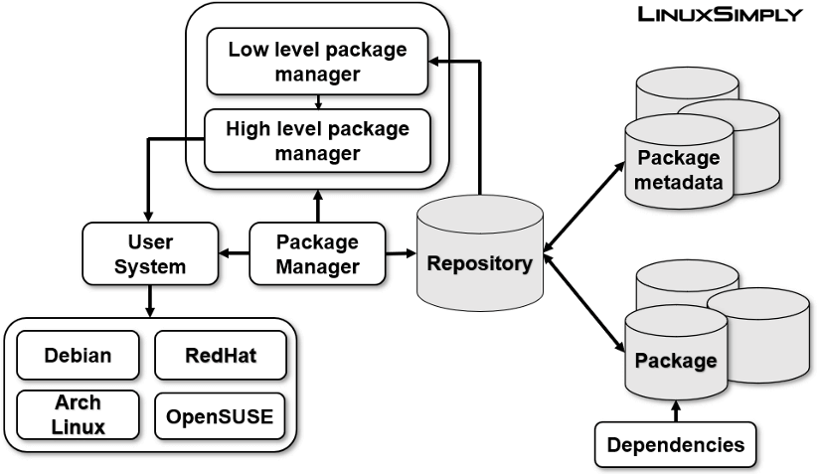

Slide 170
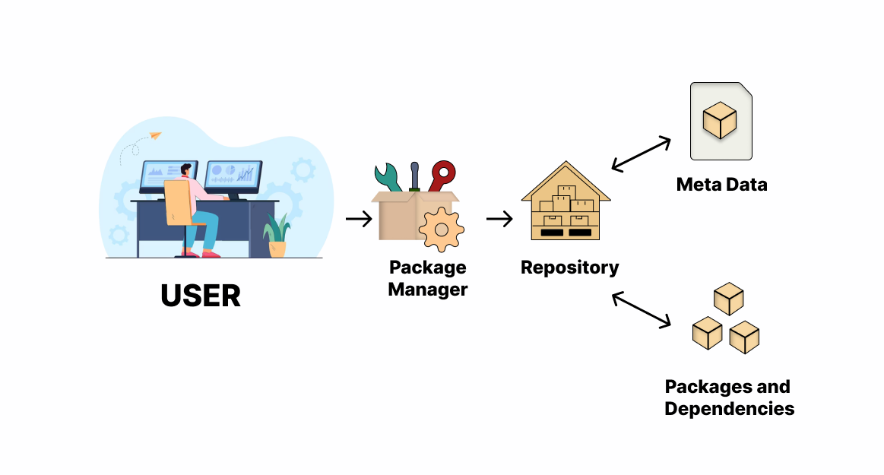

Slide 171
What Is a Repository?
A repository (repo) in Linux is a central server or storage location where software packages are stored, maintained, and distributed.
Key Points
It contains packages, metadata, and update files.
Your package manager (APT, DNF, etc.) connects to it to download apps.
Repositories are usually cryptographically signed for security.
They ensure you get trusted, tested, and verified software.
Examples
Ubuntu repo, Fedora repo, Rocky Linux BaseOS + AppStream repos, Flathub (for Flatpak), Snap Store repo

Slide 172
What Are Dependencies?
A dependency is a software component or library required by another application to work.
Example
VLC requires:
  Audio libraries
  Video codecs
  GUI libraries (Qt)
If any of these are missing, VLC cannot run.
The package manager automatically installs these dependencies for you.

Slide 173
What Is Metadata?
Metadata is data about the package.
It does not contain the software itself but provides information used by the package manager.
Metadata Includes
Package name
Version
Dependencies
Description
Maintainer information
Size
Checksums/signatures
Architecture (x86_64, ARM, etc.)
Metadata helps the package manager:
Resolve dependencies
Verify integrity
Perform upgrades
Search for packages

Slide 174
What Is a Package?
A package is a bundle of files that contains:
The actual software
Supporting configuration files
Metadata
Dependency information
Scripts for installation/uninstallation
Linux Package Formats
.deb (Debian, Ubuntu)
.rpm (Fedora, Rocky, RHEL)
.pkg.tar.zst (Arch)
Flatpak bundle
Snap package
AppImage file (portable)

Slide 175
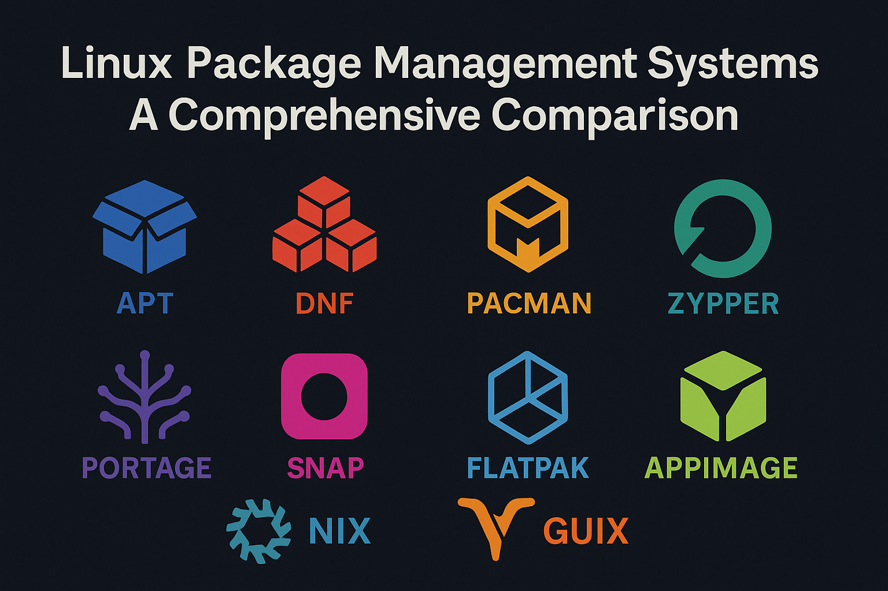

Slide 176
1. Native Package Managers (Default “Stores” for Each Distro)
These are official repositories maintained by each Linux distribution.
Each one acts like a “store” for installing, updating, and removing software.
Linux Distribution | Package Manager | Command Example | GUI Store Available?
Ubuntu / Debian | APT | apt install | Yes: Ubuntu Software Center
Fedora / RHEL / Rocky / Alma | DNF | dnf install | Yes: GNOME Software
CentOS (older) | YUM | yum install | Partially
Arch Linux | Pacman | pacman -S | Yes (Manjaro has Pamac)
openSUSE | Zypper | zypper install | Yes: YaST Software
Gentoo | Portage | emerge pkg | No default GUI
Void Linux | XBPS | xbps-install | No default GUI

Slide 177




2. Universal App Stores (Work Across All Linux Distros)
These are Unofficial repositories maintained by the Linux Community. The best part is that it is Cross-Distro.
Each one acts like a “store” for installing, updating, and removing software.
Snap Store
AppImageHub
Flatpak + Flathub

Slide 178
Snap Store
Created by Canonical (Ubuntu)
Works on all distros
Commands: snap install
GUI: Snap Store App
AppImageHub
Portable apps (no install needed)
Works on all distros
No central command-line installer
Flatpak + Flathub
Most popular universal Linux app store
Works on almost all distros
GUI: GNOME Software / KDE Discover

Slide 179
Package Management
Package which is available in RHEL Family having the package extension .rpm
Package Management can be done by two way
Using rpm --Use to install single package which does not
have dependencies.
Using yum --Using this it install all the required dependencies
automatically
RPM Package Manager
The RPM Package Manager, originally developed by Red Hat, provides a standard way to package software for distribution. Managing software in the form of RPM packages is much simpler than working with software that has simply been extracted into a file system from an archive

Slide 180
yum and dnf
#which yum
Results
/usr/bin/yum
ls –ld /usr/bin/yum
rwxrwxrwx. 1 root root 5 Aug 6 2024 /usr/bin/yum -> dnf-3

Slide 181
1. Dependency Resolution
dnf uses a modern dependency resolver (libsolv) which handles complex dependencies better.
yum can sometimes get stuck or require manual resolution in edge cases.
2. Performance
dnf is more efficient, especially for operations involving many packages.
It uses less memory and CPU compared to yum.
3. Package Management Features
dnf supports delta RPMs, better history and rollback, and automatic cleanup of unused dependencies.
yum lacks several of these features or does them less efficiently.

Slide 182
4. Command Compatibility
  In RHEL 8+, typing yum actually runs dnf under the hood.
  Example: yum install nginx → actually runs dnf install nginx.
5. Extensibility and Maintenance
dnf is more modular and easier to extend.
It's written in Python 3 (yum was Python 2), so it's more maintainable going forward.

Slide 183
✅ Which One Should You Use?
On RHEL 8 and newer: Use dnf. It's the default and modern replacement.
On older RHEL versions (like RHEL 7 or 6): You’ll still use yum, as dnf may not be available or supported.

Slide 184
Difference b/w RPM, YUM, DNF
Tool | Who is it? | Handles Dependencies? | Smart? | Used in?
RPM | Manual Guy | ❌ No | 😐 Average | All Red Hat-based systems
YUM | Old Helper | ✅ Yes | 🙂 Good | RHEL 6/7
DNF | New Helper | ✅ Yes | 😎 Great | RHEL 8/9, Fedora

Slide 185
Basic Package Management Commands
Red Hat Family
sudo dnf update # Updates all packages and dependencies that are already installed
sudo dnf install epel-release # It will install the extra packages that are not available in the official repo
Debian Family
sudo apt update # Updates all packages and dependencies that are already installed

Slide 186
1️⃣ RPM (Red Hat Package Manager)
It's the low-level tool.
Used to install .rpm files manually.
Does not handle dependencies. You must install them one by one.
🛠️ Example:
sudo rpm -ivh package-name.rpm # install
sudo rpm -e package-name # remove
sudo rpm -qa # list all installed packages

Slide 187
sudo yum install <Package> sudo yum update <Package> sudo yum remove <Package>
2️⃣ YUM (Yellowdog Updater Modified)
High-level tool (built on RPM).
Automatically installs required dependencies.
Used in RHEL 6 and 7.
🛠️ Example:

Slide 188
3️⃣ DNF (Dandified YUM) — ⭐ Used in RHEL 8 and 9
Modern replaacement for YUM.
Faster, better dependency solving, and uses less memory.
All new RHEL systems (RHEL 8/9) use DNF instead of YUM.
🛠️ Example:
sudo dnf install <Package>
sudo dnf update <Package>
sudo dnf remove <Package>

Slide 189
Installations of a Few Packages
Red Hat Family
Debian Family
sudo dnf install htop
sudo dnf install fastfetch
sudo dnf install vlc
sudo apt install htop
sudo apt install fastfetch
sudo apt install vlc
sudo dnf update htop
sudo dnf update fastfetch
sudo dnf update vlc
sudo apt update htop
sudo apt update fastfetch
sudo apt update vlc
sudo dnf remove htop
sudo dnf remove fastfetch
sudo dnf remove vlc
sudo apt remove htop
sudo apt remove fastfetch
sudo apt remove vlc

Slide 190
Installations of a Few Packages
Red Hat Family
Debian Family
sudo dnf install htop fastfetch vlc
sudo apt install htop fastfetch vlc
sudo dnf update htop fastfetch vlc
sudo apt update htop fastfetch vlc
sudo dnf remove htop fastfetch vlc
sudo apt remove htop fastfetch vlc

Slide 191
OpenSSH Configuration
OpenSSH is a secure remote login service.
It allows remote access to Linux servers using SSH protocol.
Default Port: 22

Slide 192
Why We Use OpenSSH?
Remote server access — lets you securely log in to and control a server from another machine over a network.
Secure encrypted communication — creates an encrypted channel so all data exchanged between your computer and the server remains private.
Remote command execution — allows you to run commands on a remote server without being physically present.
Secure file transfer (SCP/SFTP) — uses SSH to transfer files securely between systems using SCP or SFTP protocols.
Server administration — enables administrators to manage, configure, and maintain servers remotely through secure shell access.

Slide 193
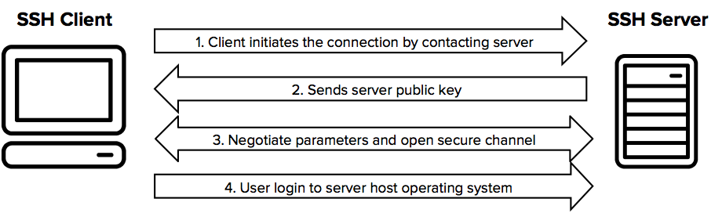

Slide 194
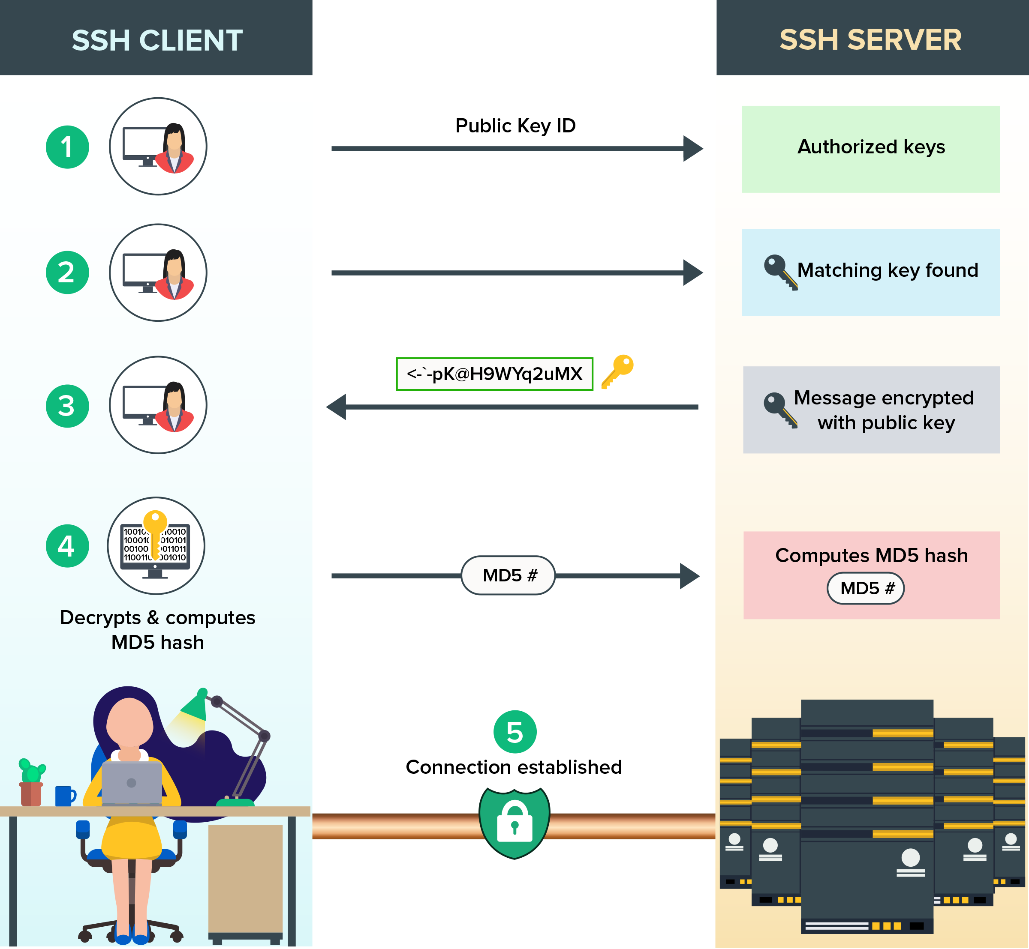

Slide 195
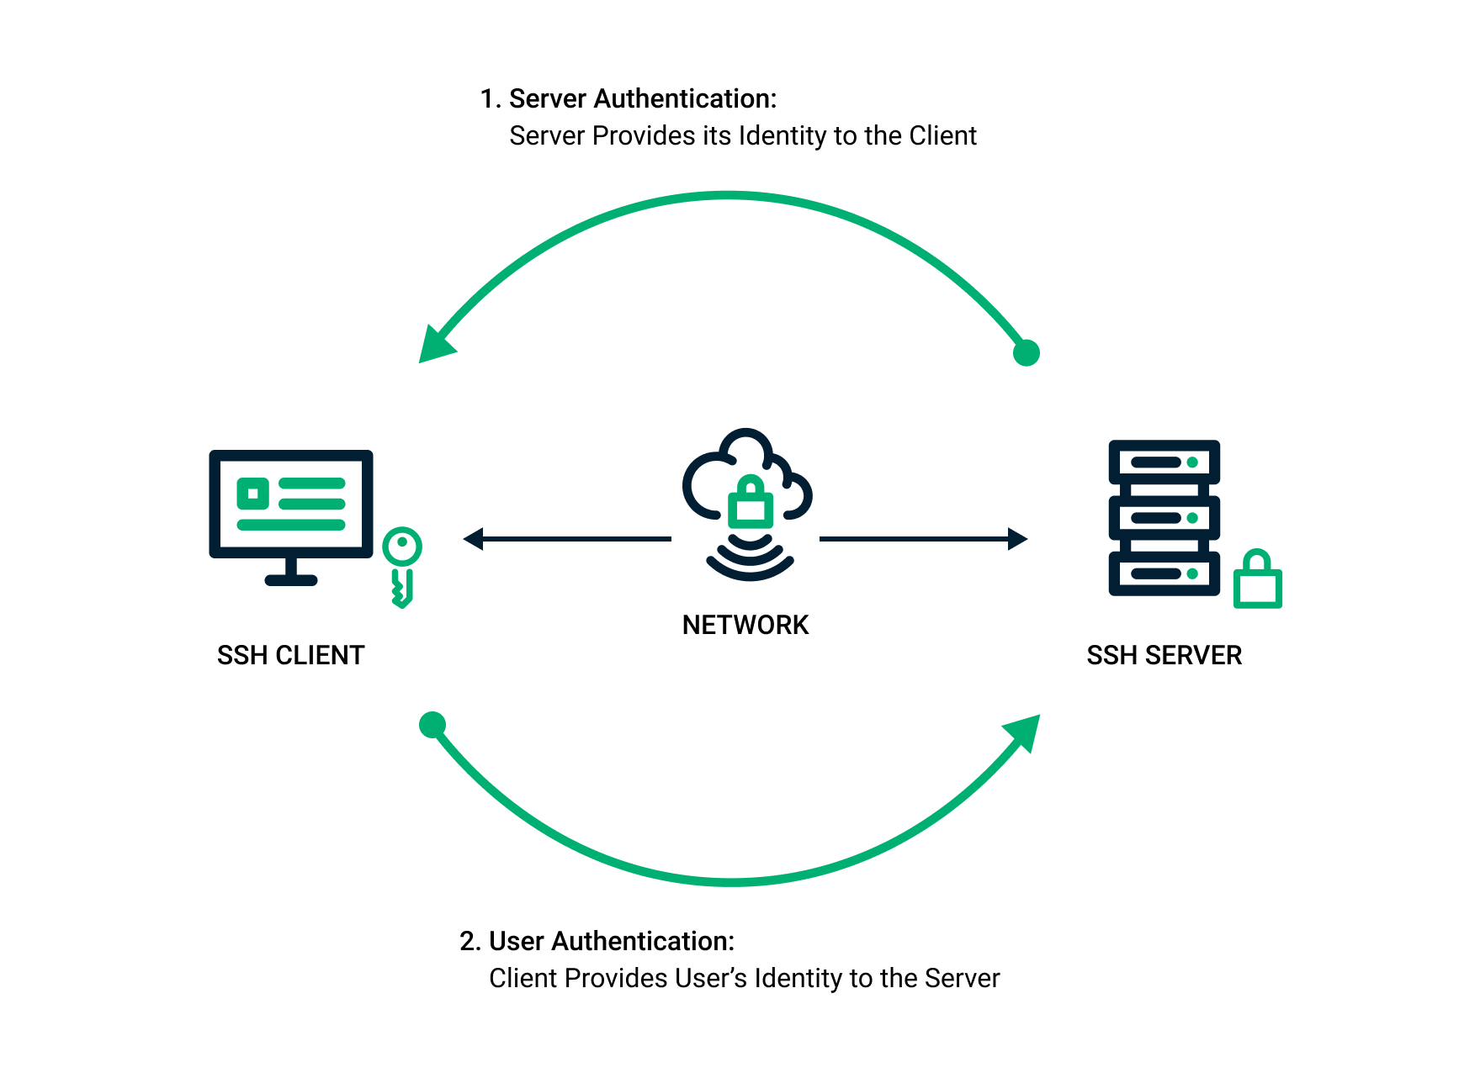

Slide 196
SSH (Secure Shell)
SSH (Secure Shell) is a cryptographic network protocol used to securely connect to remote systems.
It provides:
Encrypted remote login (command-line access)
Secure file transfer
Tunneling and port forwarding
Remote command execution
It replaces older insecure protocols like Telnet, Rsh, and Ftp (in many cases).
SSH uses:
Port 22 by default
Public-key cryptography
Certificates
Strong encryption algorithms (AES, ChaCha20, RSA, Ed25519, etc.)

Slide 197
SSH Server Packages for Linux
OpenSSH (The Default on Linux)
Dropbear SSH
LibreSSH
WolfSSH
Tectia SSH
VShell
SSH Client Packages for Cross-Platform
Native Linux Terminal
Native Mac Terminal
TeraTerm
PuTTY
Secure CRT
MobaXterm

Slide 198
SSH Server Configuration
Install SSH Server
If the SSH server is not already installed, install it using:
sudo dnf install -y openssh-server
Start and Enable SSH Service
Start the SSH daemon and enable it to start on boot:
sudo systemctl start sshd
sudo systemctl enable sshd
Check SSH Service Status
Verify that the SSH service is running:
sudo systemctl status sshd
Test SSH Access in the client
From a client system, connect using:
ssh username@server-ip

Slide 199
Configure Firewall to Allow SSH
If `firewalld` is active, allow SSH traffic:
sudo firewall-cmd --permanent --add-service=ssh
sudo firewall-cmd --reload
ss -tulnp | grep ssh
Confirms SSH is listening on port 22.

Slide 200
Modify SSH Server Configuration (Optional)
Edit the SSH configuration file to customize settings:
sudo vim /etc/ssh/sshd_config
Common changes:
- Change default SSH port:
Port 2222
- Disable root login:
PermitRootLogin no / yes
- Allow only specific users:
AllowUsers username1 username2
After editing, restart SSH service:
sudo systemctl restart sshd

Slide 201
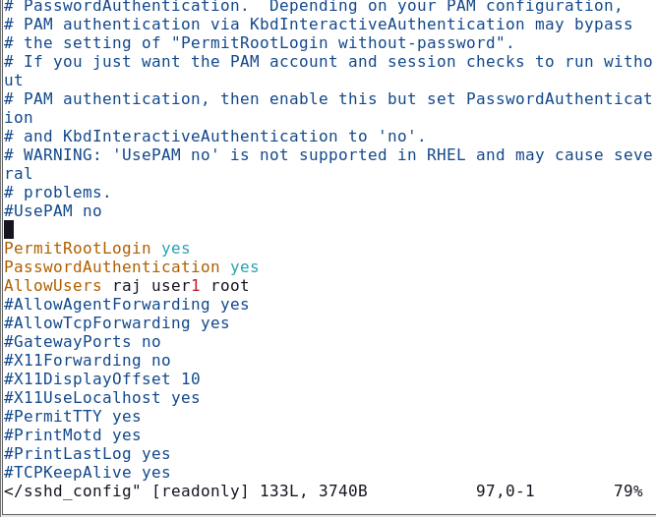

Slide 202
Access from Windows
Command Prompt Method:
ssh student1@192.168.137.128
Login using Linux username & password.
PuTTY Method:
Enter IP, Port 22, Click Open.

Slide 203
SSH Key-Based Authentication
Client Side:
ssh-keygen
Copy Key:
ssh-copy-id student1@192.168.137.128
Login without password using SSH key.

Slide 204
Final Workflow Summary
1. Install OpenSSH
2. Start & Enable service
3. Configure firewall
4. Test SSH connection
5. Secure SSH configuration

Slide 205
Samba Configuration
What is Samba?
Samba is a service that allows file and printer sharing
between Linux and Windows systems using SMB protocol.
Why We Use Samba?
• Share files from Linux to Windows
• Centralized file server
• User-based secure access
• Lab and office file sharing

Slide 206
Step 1: Install Samba
dnf install samba samba-client samba-common -y
Installs Samba server and required packages.
systemctl start smb
systemctl enable smb
Starts Samba now and at boot time.

Slide 207
Step 3: Create Linux User
useradd student1
passwd student1
Creates local Linux user account.
Step 4: Add Samba User
smbpasswd -a student1
smbpasswd -e student1
Adds and enables user in Samba database.

Slide 208
mkdir /sharedfolder chown -R student1:student1 /sharedfolder chmod -R 770 /sharedfolder
Creates folder and sets proper ownership & permissions.
Step 5: Create Shared Folder

Slide 209
Step 6: Edit Samba Configuration
vi /etc/samba/smb.conf
Add at bottom:
[student1]
path = /sharedfolder
valid users = student1
writable = yes
browseable = yes
guest ok = no

Slide 210
Step 7: Check & Restart
testparm
systemctl restart smb
Checks configuration and applies changes.
Step 8: Configure Firewall
firewall-cmd --permanent --add-service=samba
firewall-cmd --reload
Allows Samba through firewall.

Slide 211
SELinux Fix (If Access Denied)
setenforce 0 (Temporary test)
chcon -t samba_share_t /sharedfolder
Sets proper SELinux context.
Access From Windows
Press Win + R
\\192.168.137.128\student1
Login using Samba username & password.

Slide 212
Final Workflow Summary
1. Install Samba
2. Start service
3. Create user
4. Add Samba password
5. Create shared folder
6. Edit smb.conf
7. Restart service
8. Test from Windows

Slide 213

What is Apache Server?
Apache (Apache HTTP Server) is a popular open-source web server used to serve websites and web applications over the internet or a local network.

Slide 214
Why is it used in Linux
1. Host Websites – Serve web pages (HTML, PHP, etc.).
2. Serve Web Apps – Run platforms like WordPress, Laravel, etc.
3. Local Testing – Test websites before deployment.
4. Flexible – Add modules for security, redirects, SSL, etc.
5. Enterprise Use – Stable and supports high traffic.

Slide 215
Step-by-Step Install Apache and Access via IP
1) Install Apache (httpd)
sudo dnf install -y httpd
2) Start and enable the service
sudo systemctl enable httpd
# verify
sudo systemctl status httpd
3) Allow HTTP through the firewall
# Add service permanently and reload
sudo firewall-cmd --permanent --add-service=http
sudo firewall-cmd --reload

Slide 216
4) Create a simple test page
echo "Hello from Apache on RHEL!" | sudo tee /var/www/html/index.html
5) Find the server IP address
Hostname -I
Use the appropriate IP (e.g., 192.168.1.100).
6) Test from a browser or another machine
Open in a browser:

Slide 217
1. DocumentRoot
- Default directory: /var/www/html
- Files inside this directory are served over HTTP.
- Example: raj.html -> http://server_IP/raj.html
2. Index files
- When no filename is provided, Apache serves index.html by default.
- Can be changed with the DirectoryIndex directive.

Slide 218
3. URL mapping
- URL path maps to file under DocumentRoot:
Example: http://server_IP/test.html -> /var/www/html/test.html
4. Configuration file
- Main config: /etc/httpd/conf/httpd.conf
5. Allowing access
- Apache must be running and firewall must allow port 80.
6. Viewing in browser
- http://server_IP/
- http://server_IP/raj.html

Slide 219

COCKPIT
What is Cockpit?
Cockpit is a web-based management interface for Linux servers.
It allows you to manage the server from a browser instead of using only the command line.
Why is it useful?
Easy for beginners
  Good for quick monitoring
  No need to remember many commands
  Works in real time

Slide 220
What can you do with Cockpit?
View system health (CPU, RAM, storage)
Manage users
Manage services
View logs
Configure networking and firewall
Manage virtual machines (KVM)
Update the system
Check running processes
File browser
All through a web dashboard at:
https://server-ip:9090

Slide 221
How to Enable Cockpit
1. Install Cockpit:
sudo dnf install -y cockpit
2. Start and enable the Cockpit service:
sudo systemctl start cockpit
sudo systemctl enable cockpit

Slide 222
How to Enable Cockpit
3. Open firewall port:
sudo firewall-cmd --permanent --add-service=cockpit
sudo firewall-cmd --reload
4. Access Cockpit via browser:
https://<your-server-ip>:9090
Log in using your RHEL system username and password.

Slide 223
Final Workflow Summary
1. Install Cockpit
2. Start service
3. Enable service
4. Configure firewall
5. Access via browser (Port 9090)

Slide 224
Webmin Configuration
What is Webmin?
Webmin is a web-based Linux system administration tool.
It allows managing users, services, packages and firewall via browser.
Default Port: 10000

Slide 225
Why We Use Webmin?
• Web-based server management
• Manage users & groups
• Manage services (Apache, DNS, Samba)
• Package management
• Firewall configuration
• Beginner-friendly administration

Slide 226
Step 1: Install Dependencies
dnf install wget perl –y
Step 2: Download Webmin
wget https://www.webmin.com/download/rpm/webmin-current.rpm
Downloads latest Webmin RPM package.
Installs required packages for Webmin installation.

Slide 227
Step 3: Install Webmin
dnf install webmin-current.rpm -y
Installs Webmin on Rocky Linux
Step 4: Start Service
systemctl start webmin
Starts Webmin service.
.

Slide 228
Step 5: Enable at Boot
systemctl enable webmin
Enables Webmin to start automatically after reboot.
Step 6: Check Status
systemctl status webmin
Verifies Webmin service is running.

Slide 229
Step 7: Configure Firewall
firewall-cmd --permanent --add-port=10000/tcp
firewall-cmd --reload
Allows Webmin port through firewall.

Slide 230
Access from Browser
Step 8: Verify Port
ss -tulnp | grep 10000
Confirms Webmin is listening on port 10000.
Open Browser and type:
https://192.168.137.128:10000
Login using Linux username and password.

Slide 231
SELinux Check (If Needed)
getenforce
setenforce 0 (Temporary test)
Used only if access issues occur.
Final Workflow Summary
1. Install dependencies
2. Download RPM
3. Install Webmin
4. Start & Enable service
5. Configure firewall
6. Access via browser (Port 10000)

Slide 232
Important Linux storage/device names
Name | Meaning | Example | Usually represents
nvme | Non-Volatile Memory Express | /dev/nvme0n1 | NVMe SSD
sd | SCSI disk driver | /dev/sda | HDD/SSD, often SATA/SCSI/USB
sr | SCSI CD-ROM | /dev/sr0 | CD/DVD drive
mmcblk | MMC block device | /dev/mmcblk0 | SD card / eMMC
loop | Loopback device | /dev/loop0 | File treated as a virtual disk
vd | Virtio block device | /dev/vda | Virtual disk, commonly KVM/QEMU
xvd | Xen virtual disk | /dev/xvda | Xen-based virtual machine disk
dm | Device Mapper | /dev/dm-0 | LVM, encryption, etc.

Slide 233
Imagine you add a 20 GB virtual hard disk to Vmware.
VMware
↓
Add 20 GB disk
↓
Rocky detects /dev/sdb
↓
Create partition /dev/sdb1
↓
Create XFS filesystem
↓
Create /data directory
↓
Mount /dev/sdb1 on /data
↓
Make it permanent using /etc/fstab

Slide 234
STEP 1 — Add a new disk in VMware
VM → Settings → Add
↓
Hard Disk
↓
SCSI
↓
Create a new virtual disk
↓
20 GB
↓
Finish

Slide 235
STEP 2 — Become root
sudo -i
You should see something similar to:
[root@rocky ~]#
What does sudo -i mean?
sudo = SuperUser DO → execute something with administrator privileges.
-i = login shell → give you a root user's environment, so you can perform administration tasks.

Slide 236
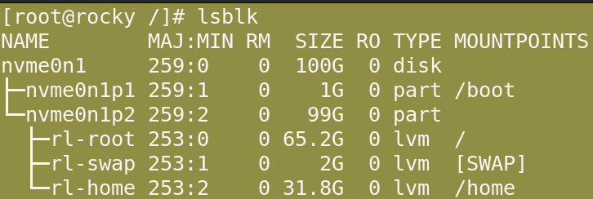
STEP 3 — Find your new disk
lsblk

Slide 237
STEP 3 — Find your new disk
Run:
lsblk
lsblk = List Block Devices.
You might see:
NAME SIZE TYPE MOUNTPOINT
sda 40G disk
├─sda1 1G part /boot
└─sda2 39G part /
sdb 20G disk
Here:
/dev/sda = existing disk
/dev/sdb = NEW 20 GB disk
VERY IMPORTANT
Do not assume your new disk is /dev/sdb.
Check the size and existing mount points with lsblk first. Your system could use a different device name.

Slide 238
STEP 4 — Check the filesystem
Run:
lsblk -f
You might see:
NAME FSTYPE UUID MOUNTPOINT
sda
├─sda1 xfs xxxx-xxxx /boot
└─sda2 xfs xxxx-xxxx /
sdb
Notice:
sdb
has no FSTYPE.
That means the new disk doesn't currently have a filesystem.

Slide 239
STEP 5 — Create a partition
We'll use fdisk.
Run:
fdisk /dev/nvmen0n2
You will get:
Command (m for help):
Now enter these: n
n = New partition
Then:
p
p = Primary partition
For the partition number, press Enter.
For the first sector, press Enter.
For the last sector, press Enter.
This uses the whole disk.
Finally:
w
w = Write → save the partition table to the disk.

Slide 240
What happened?
Before:
/dev/sdb
20 GB
EMPTY
After:
/dev/sdb
│
└── /dev/sdb1
20 GB partition
A partition is a defined section of a disk.
fdisk is a Linux utility used to create and manage disk partitions.

Slide 241
STEP 6 — Verify the partition
Run:
lsblk
You should now see:
nvmen0n2 20G disk
└─ nvmen0n2p1 20G part
The important difference is:
/dev/ nvmen0n2 = entire disk
/dev/ nvmen0n2p1 = first partition For the next steps, we work with:
/dev/ nvmen0n2

Slide 242
STEP 7 — Create a filesystem
A partition by itself isn't ready for normal file storage.
We need a filesystem.
For Rocky Linux 9, we'll use XFS.
Run:
mkfs.xfs /dev/ nvmen0n2p1
What does this mean?
mkfs = Make FileSystem
xfs = X File System

Slide 243
STEP 8 — Verify the filesystem
Run:
lsblk -f
Now you should see something similar to:
NAME FSTYPE UUID MOUNTPOINT
sdb
└─sdb1 xfs 8c2a1234-xxxx-xxxx-xxxx-xxxxxxxx
Now:
FSTYPE = xfs
means your partition has an XFS filesystem.

Slide 244
STEP 9 — Create the mount point
Create a directory:
mkdir /mnt/data
We are creating:
This directory will become our mount point.
Think:
/dev/ nvmen0n2p1
↓
↓ mounted at
/data
A mount point is simply the directory through which you access the filesystem.

Slide 245
STEP 10 — Mount the volume
Now run:
mount /dev/sdb1 /data
The syntax is:
mount [device] [mount point]
So:
mount /dev/sdb1 /data
means:
"Attach the filesystem on /dev/sdb1 to the /data directory."
Red Hat documents this same mount device mount-point syntax.

Slide 246
STEP 11 — Verify the mount
Run: lsblk
You should see:
sdb 20G disk
└─sdb1 20G part /data
You can also use: df -h
df = Disk Free
-h = Human-readable
Example:
Filesystem Size Used Avail Use% Mounted on
/dev/sdb1 20G 24M 20G 1% /data
Another excellent verification command is: findmnt /data
findmnt shows where a filesystem is mounted. Red Hat specifically documents it for checking mounted filesystems.

Slide 247
STEP 12 — Test whether you can use the disk
Run:
echo "Rocky Linux storage test" > /data/test.txt
Then: cat /data/test.txt
You should get:
Rocky Linux storage test
You can also: ls -l /data
You should see: test.txt
Your volume is working.

Slide 248
STEP 13 — Make the mount permanent
There is one problem.
If you reboot now, the manually created mount may not automatically be configured for future boots.
For permanent mounting, Rocky/RHEL uses:
/etc/fstab
Red Hat documents /etc/fstab as the configuration file for persistent filesystem mounts.

Slide 249
STEP 14 — Find the UUID
Run:
lsblk -f
You will see something like:
NAME FSTYPE UUID
sdb
└─sdb1 xfs 8c2a1234-1111-2222-3333-abcdef123456
The UUID is:
8c2a1234-1111-2222-3333-abcdef123456
Your UUID will be different.
UUID = Universally Unique Identifier.
Using UUID is preferable for persistent mounts because the UUID identifies the filesystem independently of the /dev/sdX device name.

Slide 250
STEP 15 — Edit /etc/fstab
Run:
vim /etc/fstab
Go to the bottom and add:
UUID=YOUR-UUID /data xfs defaults 0 0
For example:
UUID=8c2a1234-1111-2222-3333-abcdef123456 /data xfs defaults 0 0
⚠️ Don't copy my UUID.
Use the UUID from your own lsblk -f output.

Slide 251
Understand every part
Look at:
UUID=xxxx /data xfs defaults 0 0
1️⃣ UUID
UUID=xxxx
Tells Linux which storage device/filesystem to use.
2️⃣ /data
/data
Tells Linux where to mount it.
3️⃣ xfs
xfs
Tells Linux the filesystem type.
4️⃣ defaults
defaults
Use the standard/default mount options.
5️⃣ 0
0
The old dump backup field.
6️⃣ 0
0
Filesystem check order.
Red Hat documents these six /etc/fstab fields in this order.

Slide 252
STEP 16
If you're using vi:
Press:
Esc
Then type:
:wq
Press Enter.
w = write/save.
q = quit.
Save /etc/fstab

Slide 253
STEP 17
Test /etc/fstab
This is VERY important. Don't reboot immediately.
Run:
mount -a
-a = all
It tells Linux to mount the filesystems configured in /etc/fstab.
If you get no error, that's a good sign.
Red Hat recommends testing the persistent configuration by mounting the filesystem after adding the /etc/fstab entry.
You can also run:
findmnt /data

Slide 254
STEP 18 — Reload systemd
Run:
systemctl daemon-reload
systemctl = command used to control/manage systemd.
daemon-reload tells systemd:
"Reload the configuration files because something changed."
Red Hat includes systemctl daemon-reload when registering new /etc/fstab configuration.

Slide 255
STEP 19 — Reboot and test
Now:
reboot
After Rocky Linux starts:
lsblk
You should see:
sdb 20G disk
└─sdb1 20G part /data
Then:
df -h
And:
findmnt /data
If /data appears, congratulations.
You have created a persistent mount.

Slide 256
🧑‍🏫 Complete lab — commands only
If you're doing this as a practical, this is the sequence to remember:
# Become root
sudo -i
# Find new disk
lsblk
# Check filesystem
lsblk -f
# Create partition
fdisk /dev/sdb
# Inside fdisk:
n
p
Enter
Enter
Enter
w
# Verify
lsblk
# Create XFS filesystem
mkfs.xfs /dev/sdb1
# Verify
lsblk -f
# Create mount point
mkdir /data
# Mount
mount /dev/sdb1 /data
# Verify
df -h
findmnt /data
# Test storage
echo "Hello Rocky Linux" > /data/test.txt
cat /data/test.txt
# Get UUID
lsblk -f
# Edit persistent mount configuration
vi /etc/fstab
# Add:
UUID=YOUR-UUID /data xfs defaults 0 0
# Reload systemd
systemctl daemon-reload
# Test fstab
mount -a
# Verify
findmnt /data
# Reboot
reboot
⭐ Remember this 7-step formula
For your Linux class, memorize:
1. lsblk
↓
2. fdisk
↓
3. mkfs.xfs
↓
4. mkdir
↓
5. mount
↓
6. df -h / findmnt
↓
7. /etc/fstab
In simple English:
Find → Partition → Format → Create folder → Mount → Verify → Make permanent
That's the complete process for attaching a new VMware virtual disk and mounting it in Rocky Linux.
Official references: Red Hat — Mounting File Systems · Red Hat — Persistent Mounts with /etc/fstab · Red Hat — Creating XFS File Systems

