Slide 1
Capstone Project-3 Mobile Price Range Prediction (Classification) By- Prasad Khedkar (Individual Project)

Slide 2
Points of Discussion :
The Problem Statement
Summary of the Data Set
Data Info and Data Cleaning
EDA
Data Preparation
Data Splitting & Feature Scaling
Different Model Implementations
Final Model Selection
Hyper-parameter tuning
Final conclusion

Slide 3
The Problem Statement
In the competitive phone market, companies want to understand sales data of mobile phones and factors which drive the prices.
The objective is to find out how features of mobile phone(e.g., RAM, Storage etc) are related to its price.
In this classification problem, we are not to predict the actual price of mobile but to classify it price range into 4 categories, namely- 0(Low cost), 1(Moderate cost), 2(High cost), 3(Expensive)

Slide 4
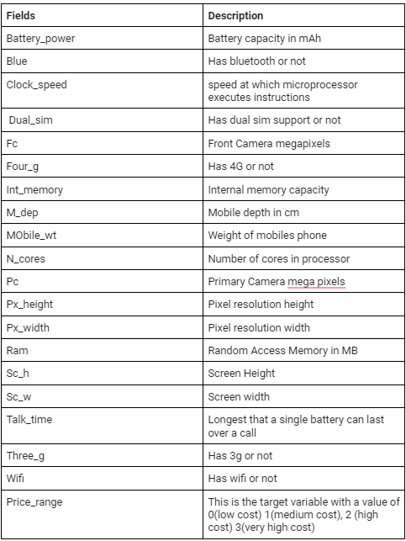

Summary of the Data Set :
Here, we are provided with the data of different mobile features :
We will see how these features are related to mobile price_range, which is our target variable
The original shape of dataset is (2000,21) indicating 2000 rows and 21 columns(features)

Slide 5
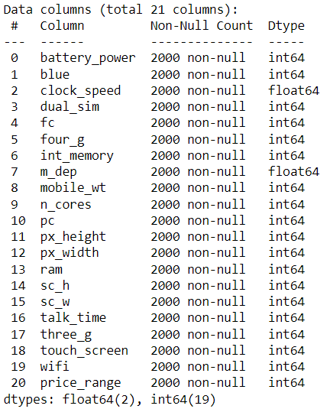
Data Info :
As we can see,
Total 21 features are present in our data set
Among them 19 features have datatype int64 and remaining two having float64

Slide 6
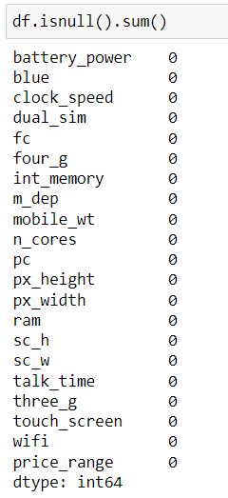
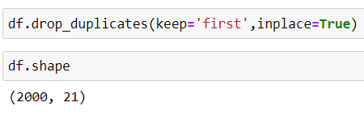
Data Cleaning :
As can be seen,
no null values present in the dataset
And after using drop_duplicates function, the shape didn’t change indicating no duplicate entries present either.

Slide 7
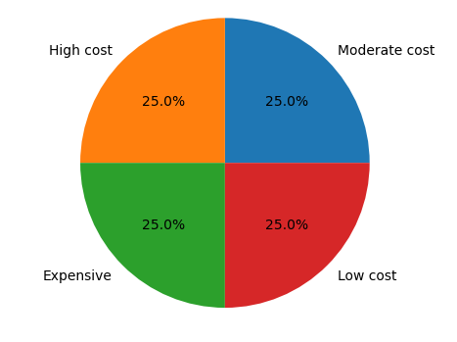
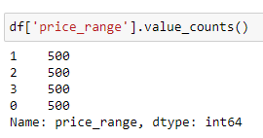
EDA(Exploratory Data Analysis) :
Our target variable ‘price_range’ has equal no. of shares in each categories as shown in pie chart.
0 Low cost
Moderate cost
High Cost
Expensive

Slide 8
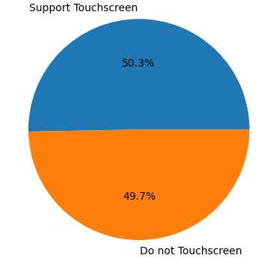
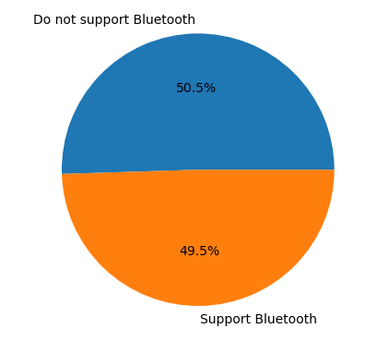
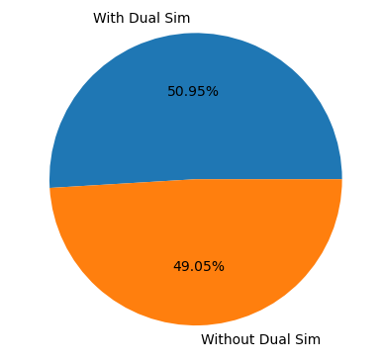
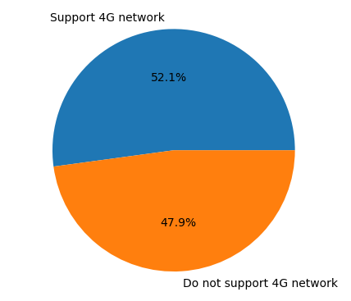
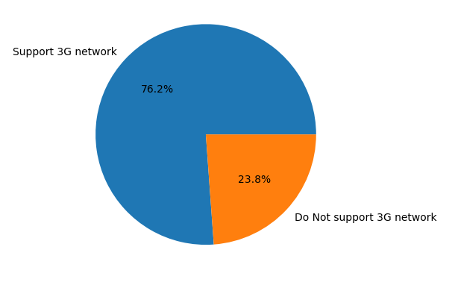
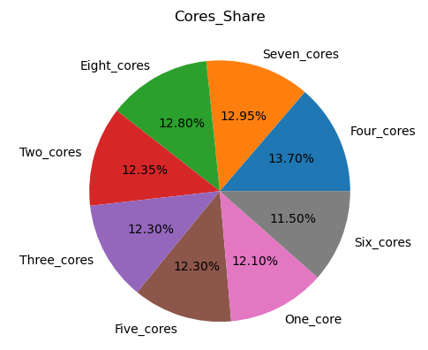
Univariate Analysis(of diff. features):

Slide 9
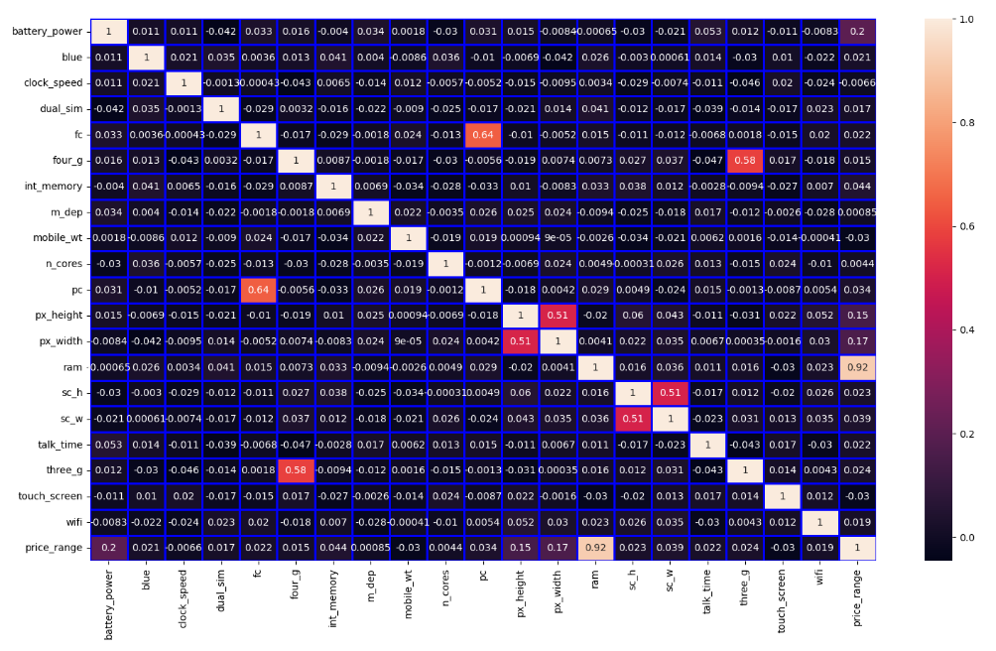
Multivariate/Bivariate Analysis:

Slide 10
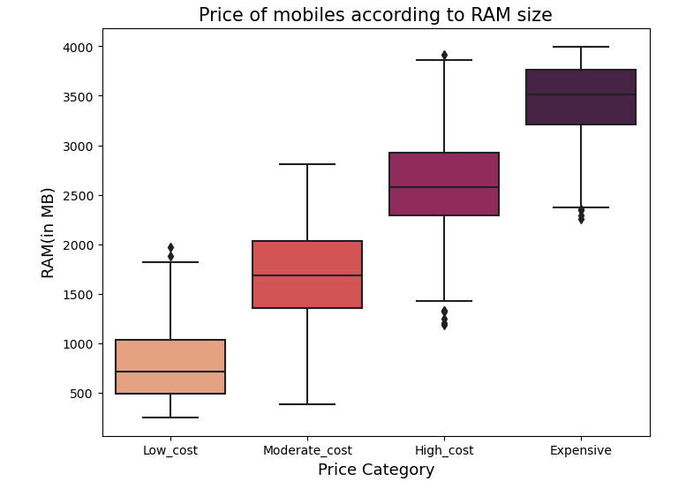
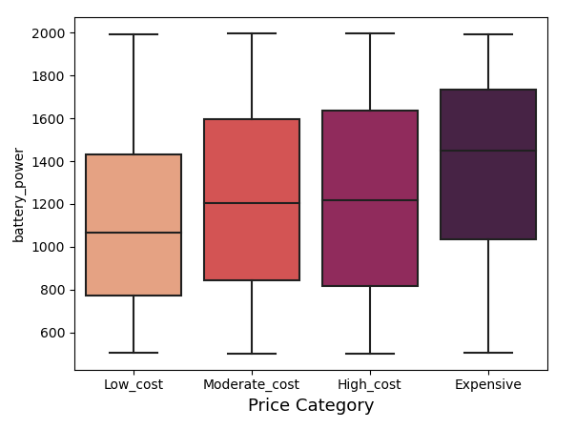
Followings are the box plots of features which affects price_range significantly-

Slide 11
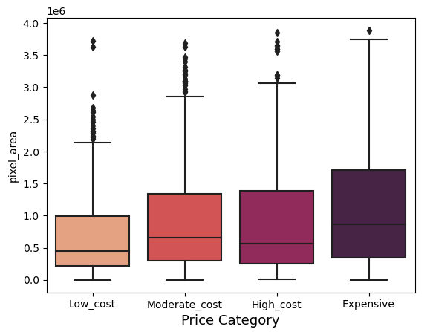
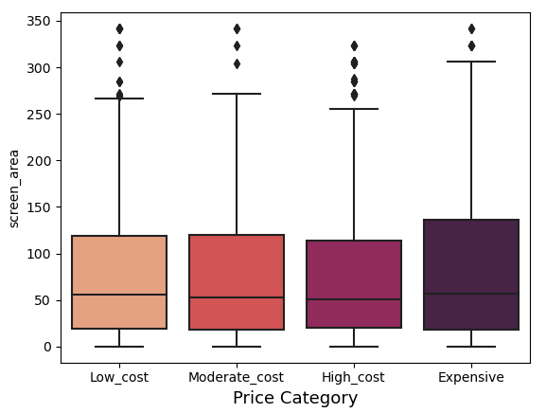
Feature Engineering:
Added new columns –
- pixel_area(Actual display)
- screen(Total display)
And dropping unwanted features like-
-'px_height’,
-'px_width’,
-'sc_h’,
-'sc_w'

Slide 12
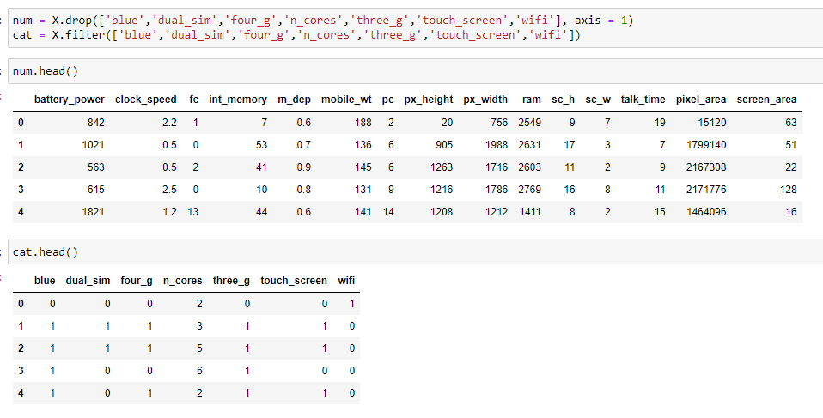
Data Preparation:
After selecting price_range as target variable we divided feature set into numerical and categorical features like-
Numerical features
Categorical features which need encoding

Slide 13
After encoding the categorical features by OneHotEncoder using panda’s get_dummies method, we successfully converted categories into numerical values.
And our data is now ready for training on different models -

Slide 14
Data Splitting and Feature Scaling :
Data is splited into - 70% - Training set
& - 30% - Test set
StandardScaler is used for scaling the data.

Slide 15
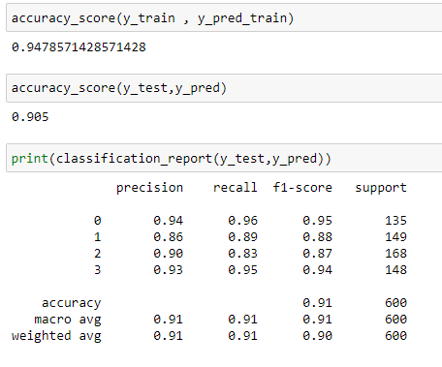
Different Model Implementations:
Different algorithms used for final model implementation:
Logistic Regressor
Random Forest Classifier
K-NN Classifier
Among three, Logistic Regressor performed exceedingly well and will be used for final implementation.

Slide 16
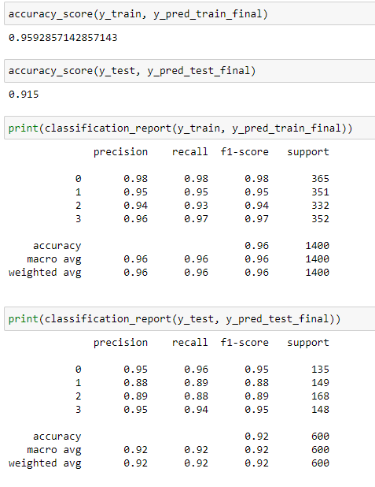
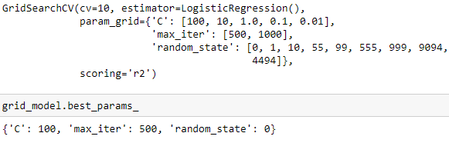
Hyper-Parameter Tuning:
After selecting Logistic Regressor for final model implementation, we did hyper-parameter tuning to further increase the performance of the model,
For that GridSearchCV method is used-

Slide 17
Final Conclusion :
No null values or duplicates present in our dataset.
‘price_range’ was highly correlated to ‘ram’
After going through different algorithms, Logistic Regressor is selected for final model implementation.
The algorithm performed good even without tuning it’s parameters.
Upon tuning, the performance increased from 94% on train score to 95%
& from 90% on test score to 91% .

