Slide 1
Capstone Project-II
TED Talk Views Prediction
By-Prasad Khedkar
(Individual Project)

Slide 2
Points of Discussion :
1. Problem Statement
2. Data Info
3. Data Cleaning
4. Data Processing
5. EDA and Visualization
6. Outlier Treatment
7. Heatmap Co-relation
8. Feature Selection
& Data Preparation
9. Model Implementation
10. Final Model Selection
11. Hyper-Parameter Tuning

Slide 3
Problem Statement :
TED is devoted to spreading powerful ideas on just about any topic. These datasets contain over 4,000 TED talks including transcripts in many languages. Founded in 1984 by Richard Salman as a nonprofit organization that aimed at bringing experts from the fields of Technology, Entertainment, and Design together, TED Conferences have gone on to become the Mecca of ideas from virtually all walks of life. As of 2015, TED and its sister TEDx chapters have published more than 2000 talks for free consumption by the masses and its speaker list boasts of the likes of Al Gore, Jimmy Wales, Shahrukh Khan, and Bill Gates. The main objective is to build a predictive model, which could help in predicting the views of the videos uploaded on the TEDx website.

Slide 4
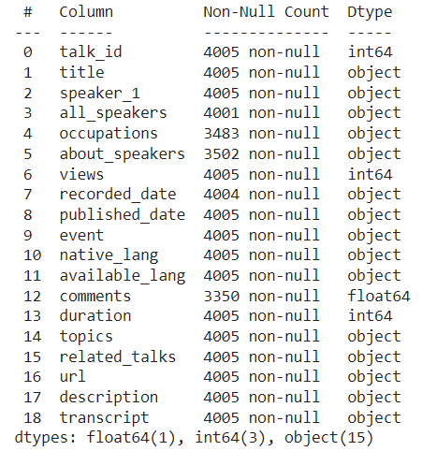
Data Info :
As can be seen from the image, we have total 19 features or columns.
Among them, 4 are numerical columns- 3 (int64) + 1 (float64) and 15 category columns (object)
And shape of our Dataset i.e.,
rows x columns is (4005,19)

Slide 5
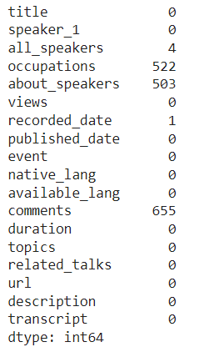
Data Cleaning :
‘isnull()’ method in pandas is used to get total null values in each column.
And by using dropna method all null values are dropped from each column.
Each row is unique and no duplicates found

Slide 6
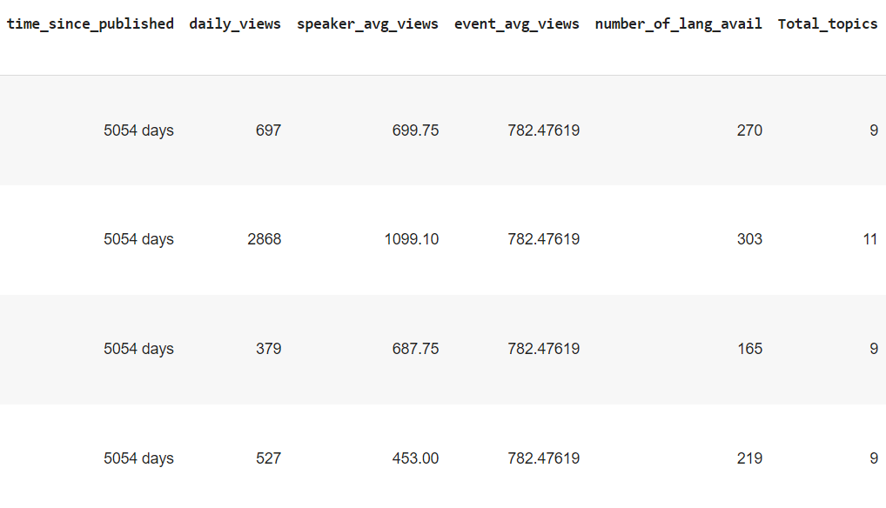
Data Processing :
Added new columns
- daily_views
- time_since_published
- speaker_avg_views
- event_avg_views
- number_of_lang_avail
- Total_topics

Slide 7
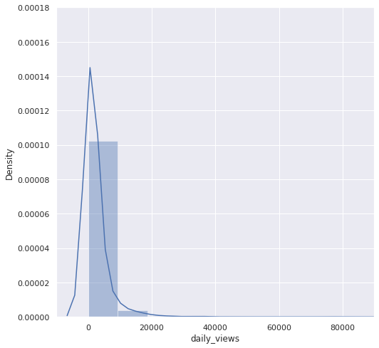
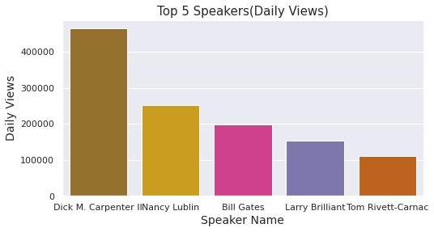
EDA and Visualization :
daily_views distplot (positively skewed)

Slide 8
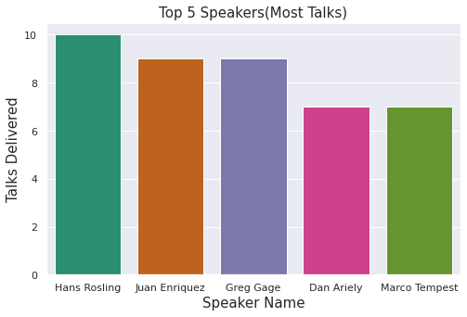
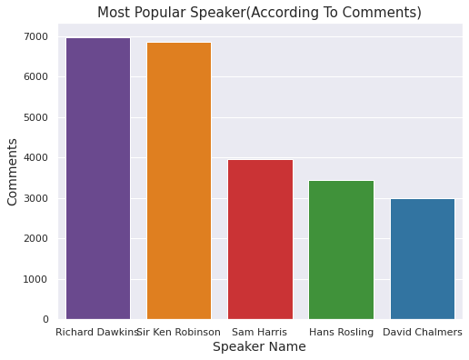
EDA and Visualization :

Slide 9
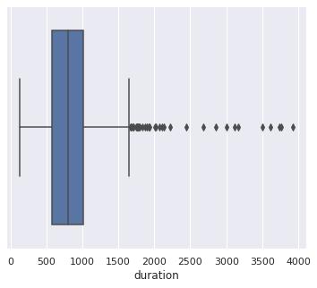
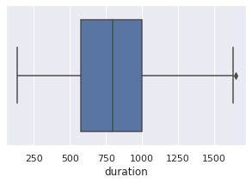
Outlier Treatment :
Removing outliers in ‘duration’ feature

Slide 10
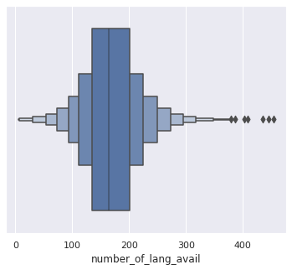
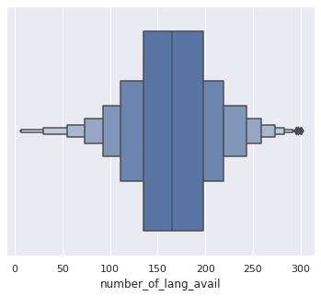
Outlier Treatment :
Removing outliers from ‘number_of_lan_avail’ feature

Slide 11
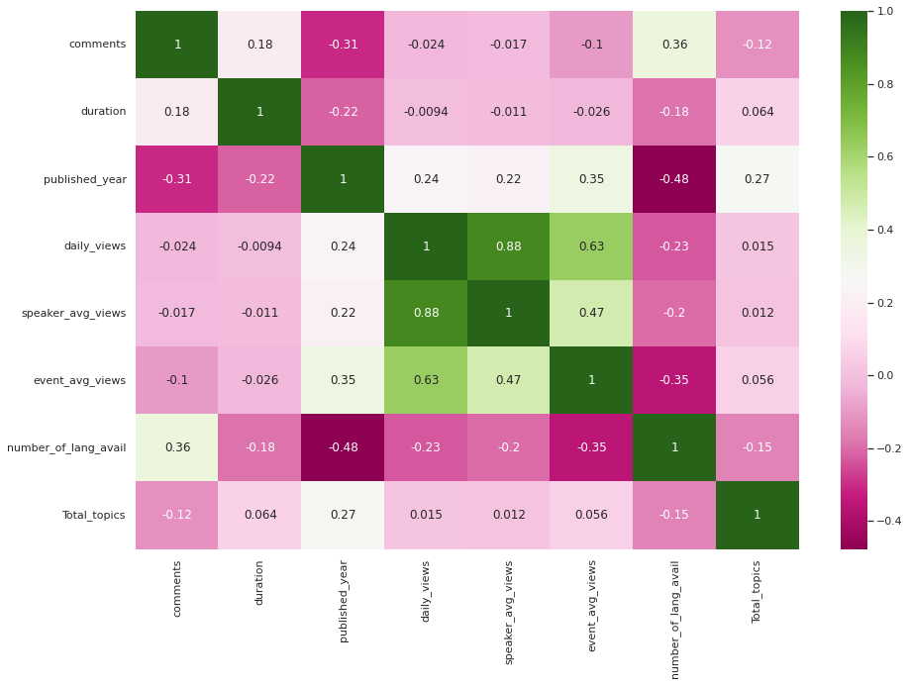
Heatmap Co-relation :
As per the heatmap,
‘daily_views’ is highly co-related to –
1)‘speaker_avg_views’
2)‘event_avg_views’

Slide 12
Feature Selection:
Now, important features have to be selected for training our models based on different algorithms.
Independent features :-
duration, speaker_avg_views, event_avg_views, number_of_lang_avail,
Total_topics, published_year
Dependent feature :-
daily_views

Slide 13
Data Splitting and Feature Scaling :
Data is splited into - 70% - Training set
& - 30% - Test set
StandardScaler is used for scaling the data.

Slide 14
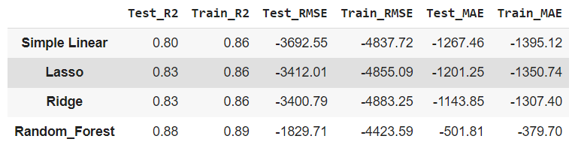
Different Model Implementations :
Different models implemented-
Simple Linear
Lasso
Ridge
Decision Tree
SVR
KNN
Extra Tree Regressor
Gradient Boosting
XGBoost
Random Forest
Out of these only few performed well-
Clearly, Random Forest gave top notch scores

Slide 15
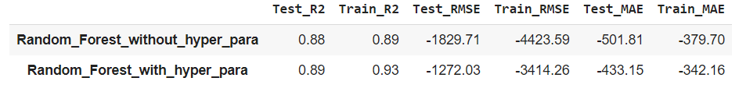
Hyper-Parameter Tuning :
After selecting Random Forest as final algorithm to train our model, hyper-parameter tuning (GridSearchCV) is performed to further influence the overall score.
Tuning influenced the
Train score from 89% to 93% and Test score from 88% to 89%

Slide 16
Final Conclusions :
Random Forest gave the best scores than others and is finalized for model training
It also gave low RMSE and MAE errors
With hyper parameter tuning the score increased further
from 89% to 93% for training dataset &
from 88% to 89% for test dataset

