Slide 1
DairyDome
Name : Prasad Ravindra Patil
Class : MCA II (Technocats)
Roll : 32
Project Guide : Mrs. Swati Kirange
Company Name : Dudh Utpadak Sahkari Sanstha Maryadit Advihir [R.N :- 297]

Slide 2
Existing System
An existing system provides manual paperwork or an excel sheet to track the buying and selling product details.
The customer has to go to the medical shop where the customer can get the required dairy products. Most of the time customer does not get required product which him/her looking the products at different locations. Which results in wasting a lot time in it.
In the existing system, you cannot provide feedback of the service provided to the admin (shopkeeper) directly.

Slide 3
Need of System
The new system is totally Web based application. Nowadays, there is dairy shop management which benefits customers greatly.
A new system provides features like time efficiency to show product details and whatever the customer will give the feedback to the admin(shopkeeper).
This system provides various types of dairy products.
The buying of product is done easily by customer.

Slide 4
Operating Environment-Hardware and Software
Hardware :
Software :
Processor | i5
Hard Disk | 28 GB or More
RAM | 4 GB or More
Operating System | Windows or Any
IDE | VS Code
Python Version | 3.9.13
Django Version | 3.2
Operating System | Any
DataBase | SQlite
Browser | Any

Slide 5
Proposed System
System need to maintain quantity record.
System need to keep the record of Student.
System need to update and delete the record.
System also needs a search area.
It also needs a security system to prevent data.

Slide 6
Objectives:
To manage and maintain data more easily through this web application.
To ensure the system is user-friendly to satisfy the users' needs.
To provide results very quickly.
To allow users to securely store and organize their diary entries.
To enable easy retrieval and editing of past entries.
To offer customizable templates for diary entries to suit different users.
To support multimedia attachments such as photos and audio recordings within entries.
To ensure data privacy and protection with robust security features.
To integrate with calendars and reminders for better diary management.
To provide a search function to quickly find specific entries or topics.
To offer synchronization across multiple devices for convenient access.
To include options for exporting and sharing diary entries.

Slide 7
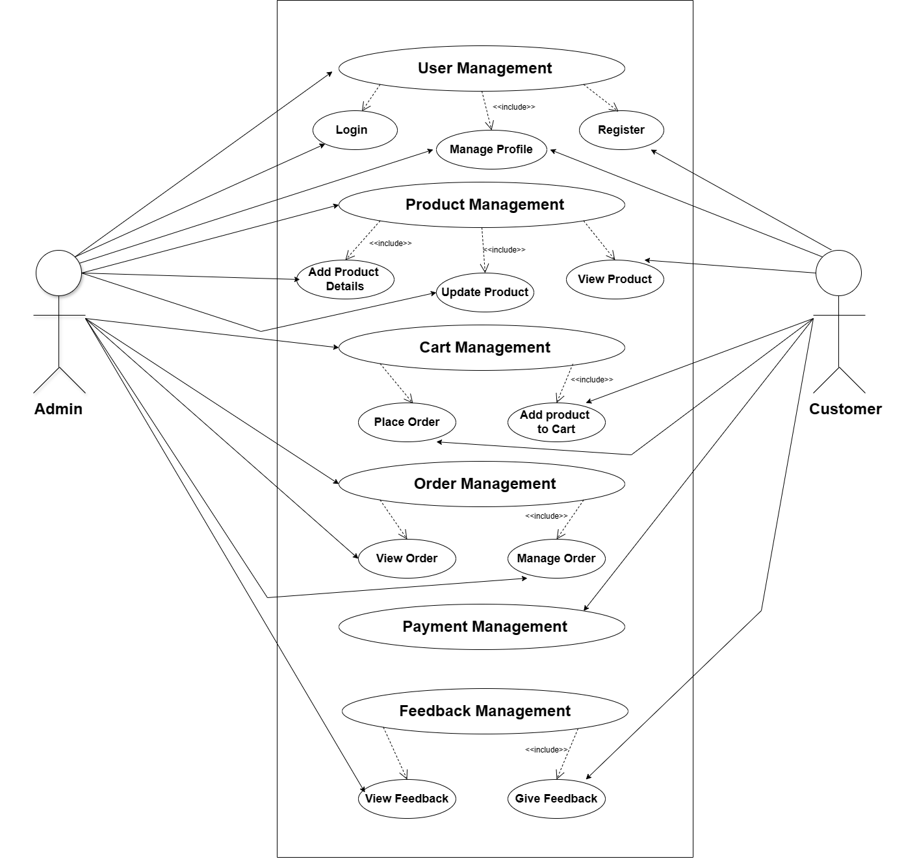
Use Case Diagram
Use case Diagram

Slide 8
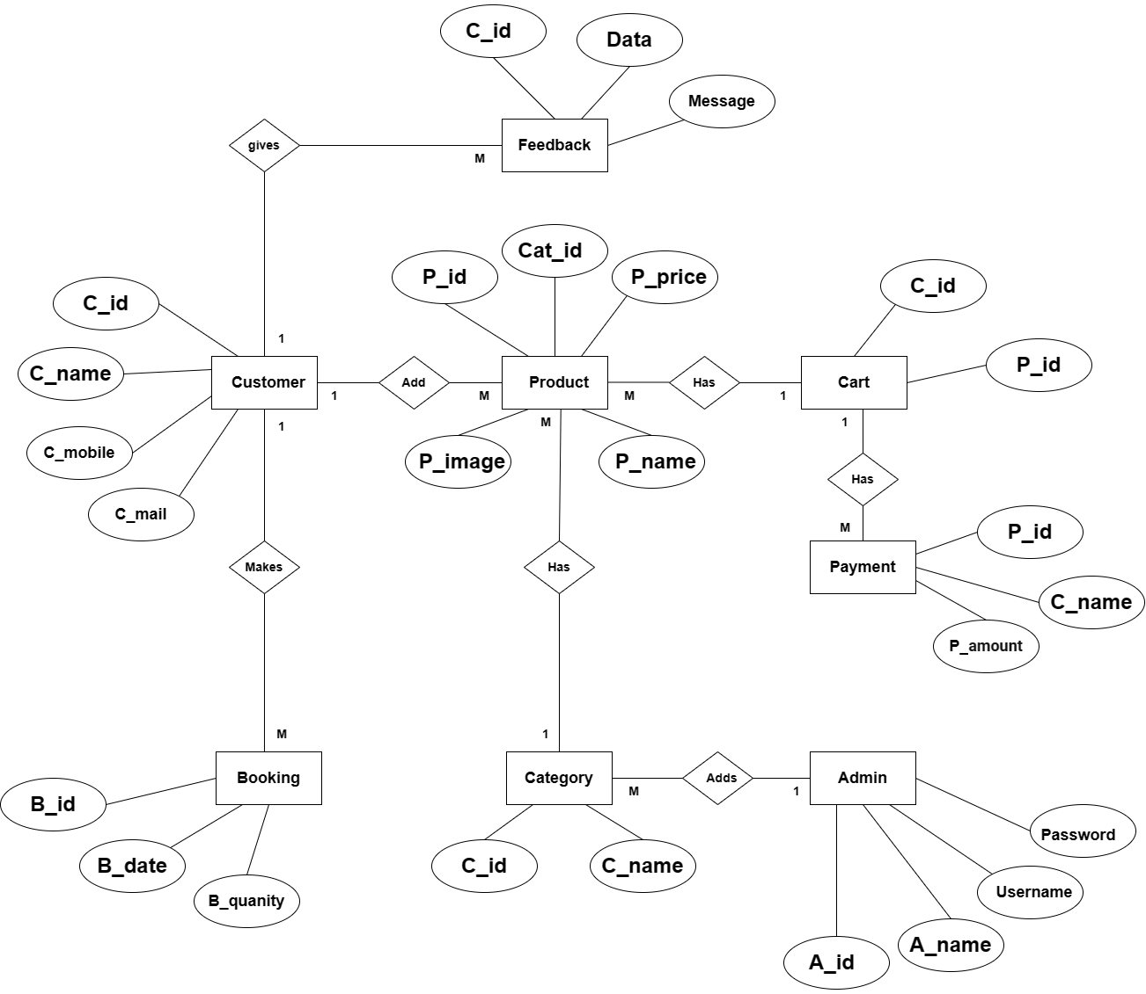
Entity Relationship Diagram

Slide 9
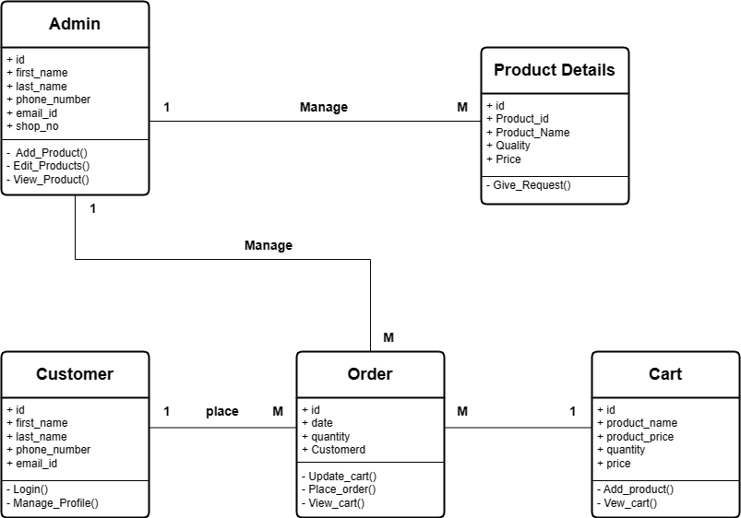
Class Diagram
Class Diagram

Slide 10
Drawback and Limitations
The purpose of this project is to provide Dairy products to directly the consumers more effectively than the existing system.
The limitation with the application can also be looked into and enhancement can be made as per user requirement.

Slide 11
Proposed Enhancement
In future there is a chance change the application according to the requirements.
In future we can add Chatbot for clarifying our doubts.
User will get the receipt of the payment.
Will also add maps to locate stores for nearby areas .

Slide 12
CONCLUSION
The system will be able to serve as web application when it is finally developed, where these small upcoming shops can make use of it to publish different categories of Dairy products in a wide range and also help the shop to manage their service more effectively. On the other hand, it will enable customers to freely buy their required type of product more freely and interactively.

Slide 13
Thank You

